Slide 1
Movie dataset & research
IMDB Movies Top 1000
Rotten Tomato - 2020
Presenter : Cheonsol Lee
Date : 2021.08.06
Notes:
Translation model : 벡터 연산을 통해 지식 완성을 수행

Slide 2
Rotten Tomato - 2020
Notes:
Translation model : 벡터 연산을 통해 지식 완성을 수행

Slide 3
Rotten Tomato
Dataset
Period : ~ 2020.10.31
Link : https://www.kaggle.com/stefanoleone992/rotten-tomatoes-movies-and-critic-reviews-dataset
Data
File name | Dimension | Columns
Movie data | (17713, 22) | 'rotten_tomatoes_link', 'movie_title', 'movie_info', 'critics_consensus', 'content_rating', 'genres', 'directors', 'authors', 'actors', 'original_release_date', 'streaming_release_date', 'runtime', 'production_company', 'tomatometer_status', 'tomatometer_rating', 'tomatometer_count', 'audience_status', 'audience_rating', 'audience_count', 'tomatometer_top_critics_count', 'tomatometer_fresh_critics_count', 'tomatometer_rotten_critics_count'
Review data | (1048576, 8) | rotten_tomatoes_link, critic_name, top_critic, publisher_name, review_type, review_score, review_date, review_content

Slide 4
Rotten Tomato
Rotten Tomato - Movie Dataset
Data
Comparison between IMDb and Rotten Tomato features
IMDb | Rotten Tomato
16 | 22
Common : 8 Features : Title, Actor, Director, Genre, Year, Overview, Certificate, Runtime

Slide 5
Rotten Tomato
Movie Dataset
Comparison between IMDb and Rotten Tomato features
Need Pre-processing
IMDb | Rotten Tomato | Change name
'Series_Title' | 'movie_title' | ‘title’
'Star1', 'Star2’, 'Star3', 'Star4' | 'actors' | ‘actor’
'Director' | 'directors' | ‘director’
'Genre' | 'genres' | ‘genre’
'Released_Year' | 'original_release_date' | ‘year’
'Overview' | 'movie_info' | ‘overview’
'Certificate' | 'content_rating' | ‘certificate’
'Runtime' | 'runtime' | ‘runtime’

Slide 6
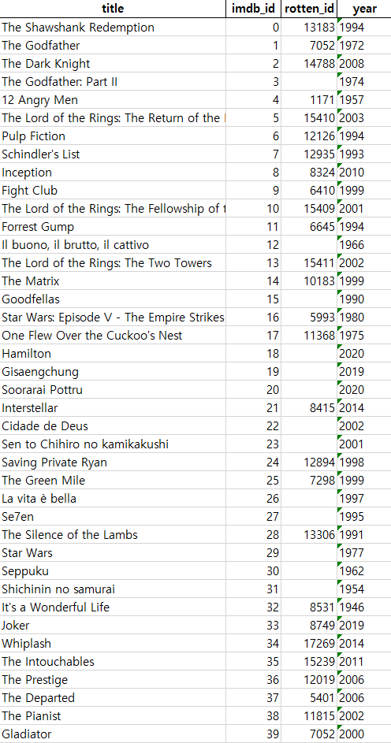
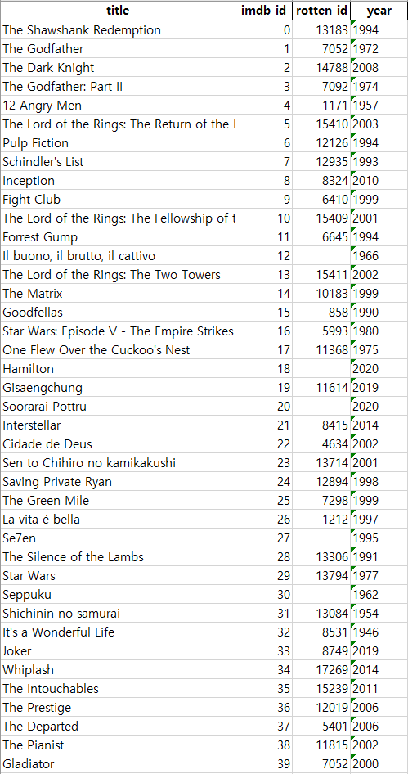
Missing values – Right Answer
- Baseline -
Title Matching
- Answer -
Title Matching
27/40 * 100(%)
= 67.5%
35/40 * 100(%)
= 87.5%

Slide 7
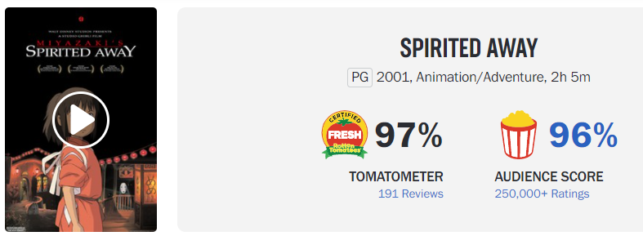
Missing values – Reasons
Separator
: ,
Capital character
Parenthesis
Shichinin no samurai
Different Title - Korean
Important Issue!
Different Title
(IMDb) Sen to Chihiro no kamikakushi
(Rotten Tomato) Spirited Away

Slide 8
Missing movie prediction using common features
Notes:
Translation model : 벡터 연산을 통해 지식 완성을 수행

Slide 9
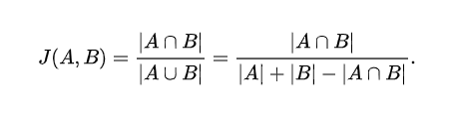
Idea
Similarity Metric
Columns
index | title | overview | certificate | genre | director | actor | runtime | year
* Set() 함수 이용하여 Jaccard similarity
- A : IMDb feature’s value
- B : Rotten Tomato feature’s value
Levenshtein distance
ex) [actor]
A (4명) : Joaquin Phoenix, Robert De Niro, Zazie Beetz, Frances Conroy
B (22명) : Joaquin Phoenix, Robert De Niro, Zazie Beetz, Bill Camp, Frances Conroy, Brett Cullen, Glenn Fleshler, Douglas Hodge, Marc Maron, Josh Pais, Shea Whigham, Bryan Callen, Jolie Chan, Mary Kate Malat, Dante Pereira-Olson, Sharon Washington, Elizabeth Bluhm, David Iacono, Leigh Gill, Chuck Taber, Adrienne Lovette, Tony D. Head
Jaccard(A, B) = 4/22 = 0.181

Slide 10

Idea
Similarity Metric
Columns
index | title | overview | certificate | genre | director | actor | runtime | year
x₁
x₂
x₃
x₄
x₅
x₆
x₇
x₈
w₁x₁ + w₂x₂ + w₃x₃ + w₄x₄ + w₅x₅ + w₆x₆ + w₇x₇ + w₈x₈ = similarity
$${\sum_{i=1}^{n}{w_{i}}=1}$$
(동일) : (0.1)*1 + (0.1)*1 + (0.1)*1 + (0.1)*1 + (0.1)*1 + (0.1)*1 + (0.1)*1 + (0.3)*1 = 1
(완전다름) : (0.1)*0 + (0.1)*0 + (0.1)*0 + (0.1)*0 + (0.1)*0 + (0.1)*0 + (0.1)*0 + (0.3)*0 = 0

Slide 11
Research – recommendation based on review data
Notes:
Translation model : 벡터 연산을 통해 지식 완성을 수행

Slide 12
Rotten Tomato
Dataset
Period : ~ 2020.10.31
Link : https://www.kaggle.com/stefanoleone992/rotten-tomatoes-movies-and-critic-reviews-dataset
Data
File name | Dimension | Columns
Movie data | (17713, 22) | 'rotten_tomatoes_link', 'movie_title', 'movie_info', 'critics_consensus', 'content_rating', 'genres', 'directors', 'authors', 'actors', 'original_release_date', 'streaming_release_date', 'runtime', 'production_company', 'tomatometer_status', 'tomatometer_rating', 'tomatometer_count', 'audience_status', 'audience_rating', 'audience_count', 'tomatometer_top_critics_count', 'tomatometer_fresh_critics_count', 'tomatometer_rotten_critics_count'
Review data | (1048576, 8) | rotten_tomatoes_link, critic_name, top_critic, publisher_name, review_type, review_score, review_date, review_content

Slide 13
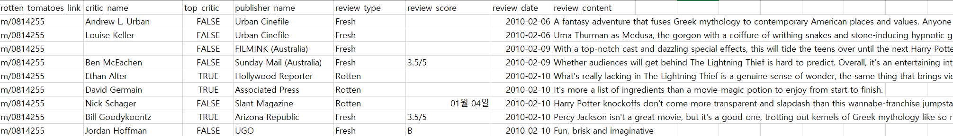
Rotten Tomato Data
Review
MovieID, name, top_critic, publisher_name, review_type, score, date, review
Movie
MovieID, title, summary, content_rating, genres, directors, actors, authors, date, …

Slide 14
Link Prediction
Review Triple
Review Data
Critics (tomatometer)
Regular user
Movie Triple
Data
Meta information
0 : Negative
1 : Positive
Actor
Critic 1
0
Director
1
Critic 2
Authors
Movie 1
0
Movie 1
Genre
1
User 1
Movie 2
0
Production_
company
User 2
…
?
preference
Runtime
Movie N
Content_rating

Slide 15
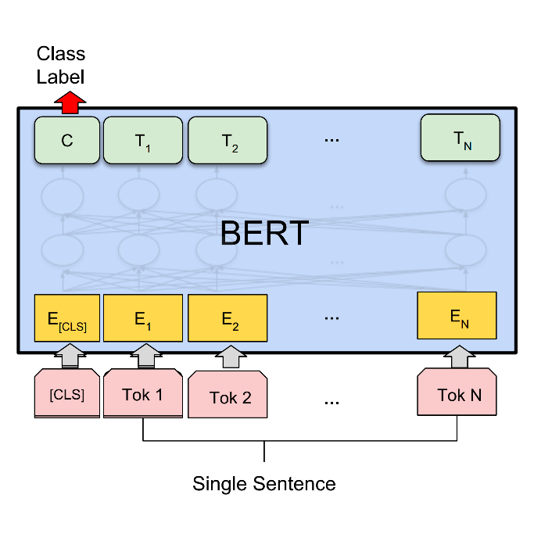
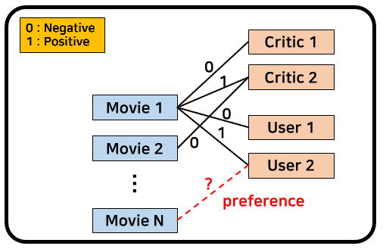
Sentiment Analysis
Labeling
Sentiment analysis using BERT
Review data
Result
Uma Thurman as Medusa, the gorgon with a coiffure of writhing snakes and stone-inducing hypnotic gaze is one of the highlights of this bewitching fantasy
0 / 1
Fill the triple’s edge with sentiment analysis results.

Slide 16
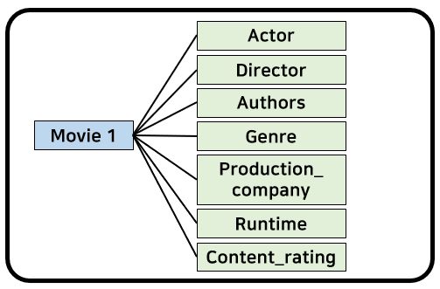
Explainable Recommendation
Explainable Recommendation (XAI)
Movie meta information
Algorithm : GNN
Movie features about positive review
Compare features for ‘Movie N’

Slide 17
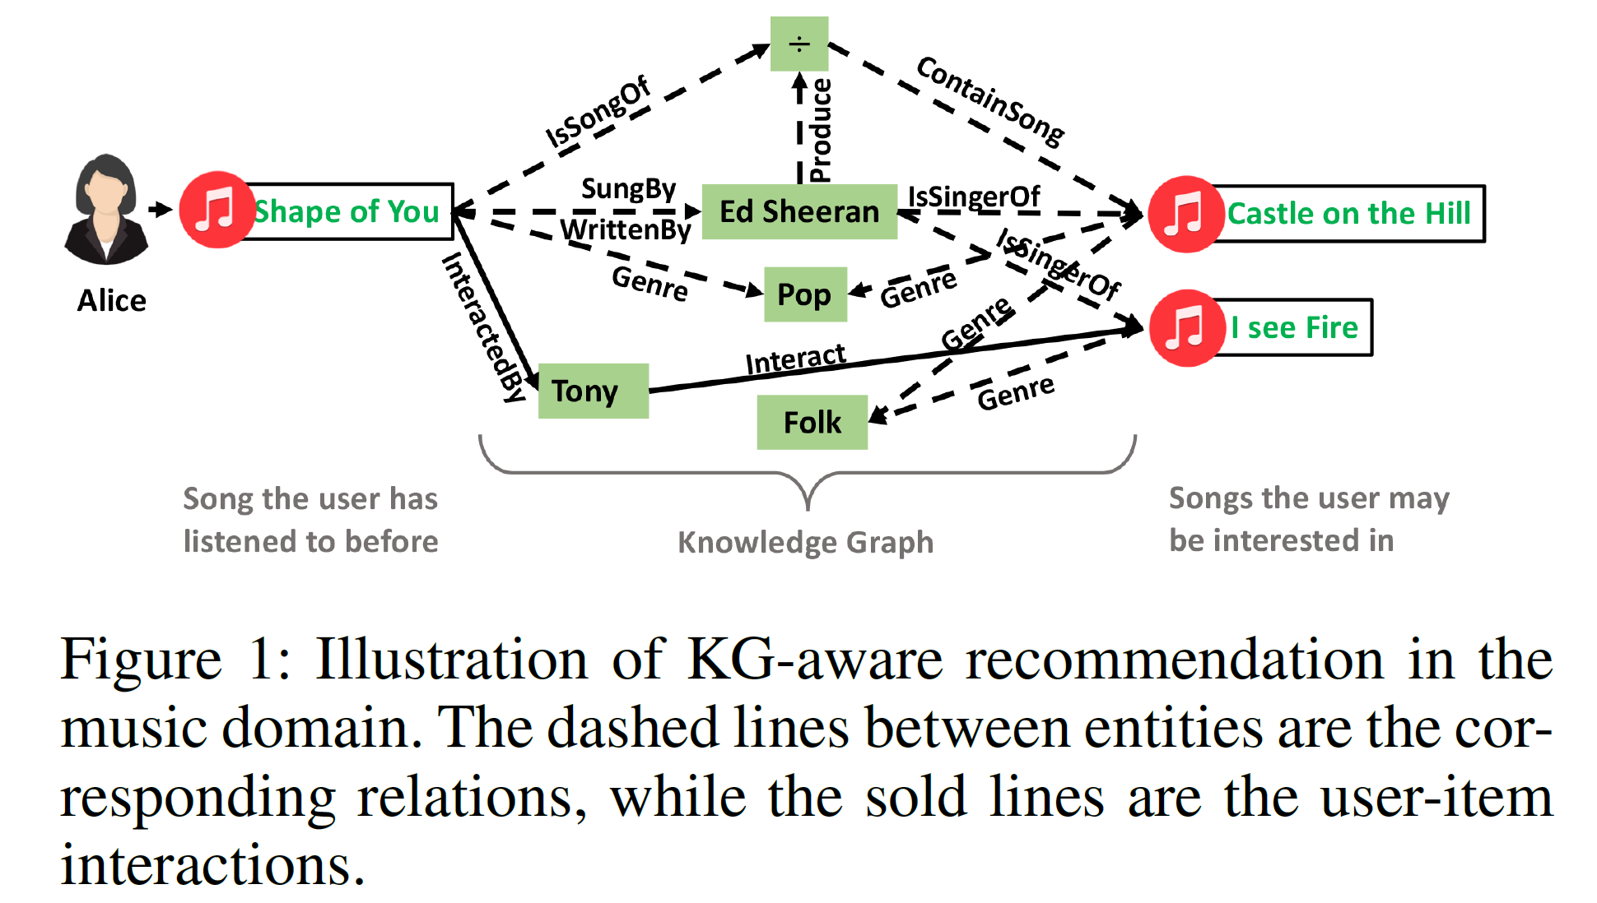
Explainable Recommendation
Explainable Reasoning over Knowledge Graphs for Recommendation (AAAI19)

Slide 18
Thank you

Slide 19
Appendix
Thank you

Slide 20
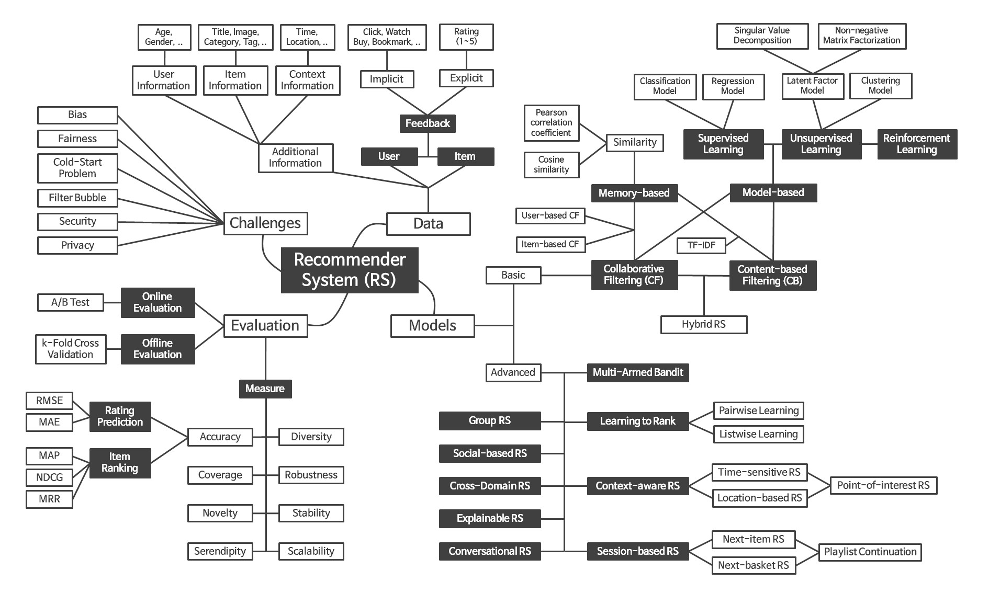
Recommender System Framework

