Slide 1
Related Work
(ECAI `06 workshop) Integrating Collaborative Filtering and Sentiment Analysis : A Rating Inference Approach
(KCI `21) BERT 기반 감성분석을 이용한 추천시스템
Presenter : Cheonsol Lee
Date : 2021.08.11

Slide 2
Integrating Collaborative Filtering and Sentiment Analysis :
A Rating Inference Approach
ECAI 2006 workshop
155 citations

Slide 3
0. Summary
Purpose: Predict a rating using a review
Sentiment analysis of reviews is used with relative-frequency-based method to convert text into numerical data.
Numerical data indicates sentimental orientations(SO) & sentimental strengths.
Sentimental orientations : positive / negative
Sentimental strengths : strong / mild
Framework
Review
Rating
Sentiment Analysis

Slide 4
1. Introduction
Collaborative Filtering(CF) has a problem about data sparseness.
Contribution
Mitigate a problem using review data.
Apply to domains that are difficult to perform numerical evaluation like tourism.
Rating steps
Extract the opinion words in the review. (Adjective words: good, bad, best, great, …)
Identify the opinion word’s sentiment orientation(SO).
Determine the opinion word’s sentiment strength.
Infer the overall rating score using SO & strength of review.

Slide 5
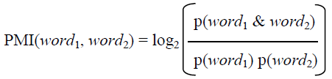

2. Related Work
PMI-IR algorithm : calculate average SO of the phrase.
Word-similarity-based method
WordNet has synonyms, antonyms.
SO of a word is the same in its synonyms.
(exception) ‘terrible’ appeared in negative reviews 75%, whereas ‘frightening’ appeared in negative reviews only 29%.
Similar meanings may not necessarily imply similar sentiments.
Positive-sentence percentage(PSP)
Number of positive sentences / number of total sentences

Slide 6
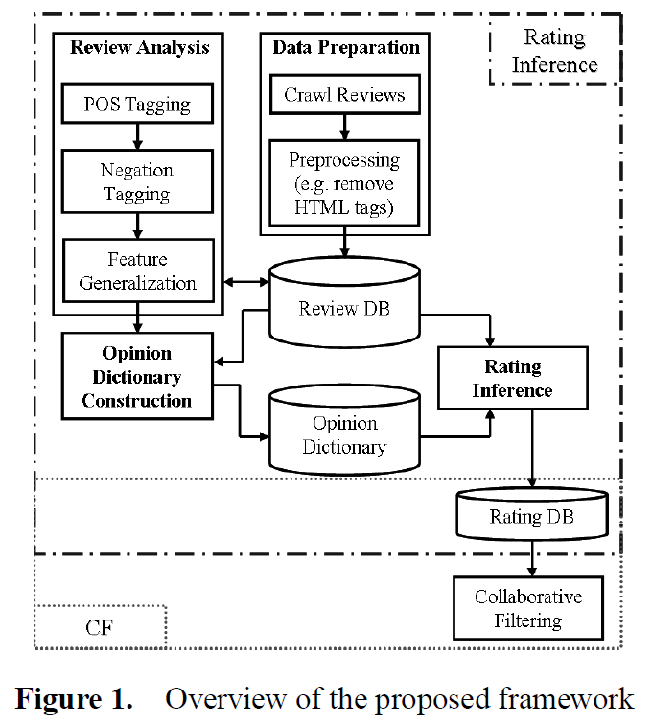
3. The proposed framework
Framework
Data Preparation
Review Analysis
Opinion Dictionary Construction
Rating Inference
2
1
3
4

Slide 7
3. The proposed framework
Review Analysis
POS Tagging
Negation Tagging
Identify the existence of the word ‘not’.
Add the tag ‘NOT_’
Ex) can’t, cant, cannot
Feature Generalization
ex) Toy Story is pleasant and fun.
ex) _MOVIE is pleasant and fun.
2

Slide 8
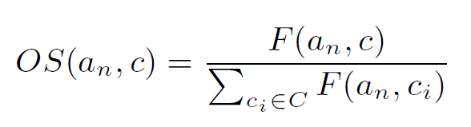
3. The proposed framework
Opinion Dictionary Construction
Compose of opinion words, their estimated SO and the strengths of their SO.
Word-similarity-based method
Assign the SO
Relative-frequency–based method
Calculate the strength
ex) OS('good’, Positive) = 0.33
3

Slide 9
3. The proposed framework
Rating Inference
A review usually contains a mixture of positive and negative opinions.
Assign an overall rating to the review to reflect the dominant sentiment class by aggregating the strengths of the opinion words in review.
4

Slide 10
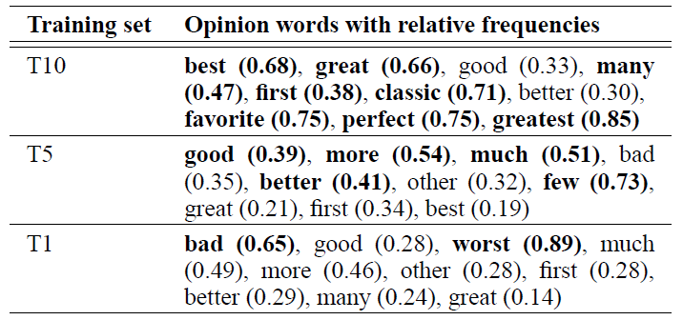
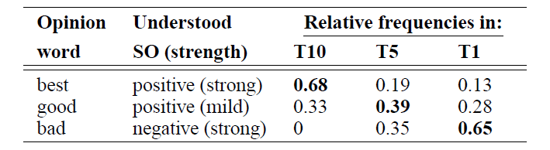
4. Preliminary experiments
Dataset
MovieLens-rating & IMDb-reviews
Analysis
Problem : Reviews have mixture of positive and negative sentence.
Experiment
Rating(T10, T5, T1)
긍정/중립/부정 중에서 나타나는 단어의 빈도수

Slide 11
5. Conclusion
Suggest the inference of rating by integrating sentiment analysis and CF.
Convert the review into the sentiment orientations(SO) and strengths.
Future work
If you have target user's reviews and similar user’s reviews, recommend proper products to target user.

Slide 12
BERT 기반 감성분석을 이용한 추천시스템
KCI 2021

Slide 13
0. Summary
Purpose: Predict a rating using a review
Compare the performance of sentiment analysis between ML & DL algorithms.
Assumption : the higher the rating, the more positive
Framework
Review
Rating
(positive/negative)
Sentiment Analysis

Slide 14
1. Introduction
Limitation of recommendation based on rating
Personalization recommendation
Explainable recommendation
Leverage ratings and reviews to improve recommendation performance.
Suggestion
Recommender system that can reflect the context information of the review using BERT

Slide 15
2. Related Work
Text-based
BoW, TF-IDF, HF-IHU
Sentiment analysis
ML : Naïve-bayes, SVM, LDA
DL : CNN, CBOW, LSTM, GRU

Slide 16
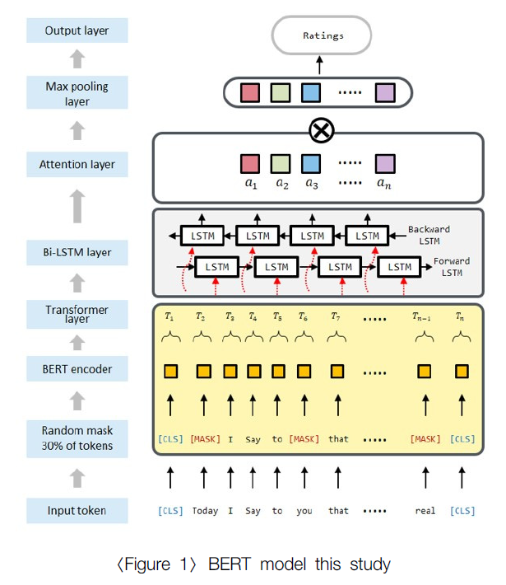
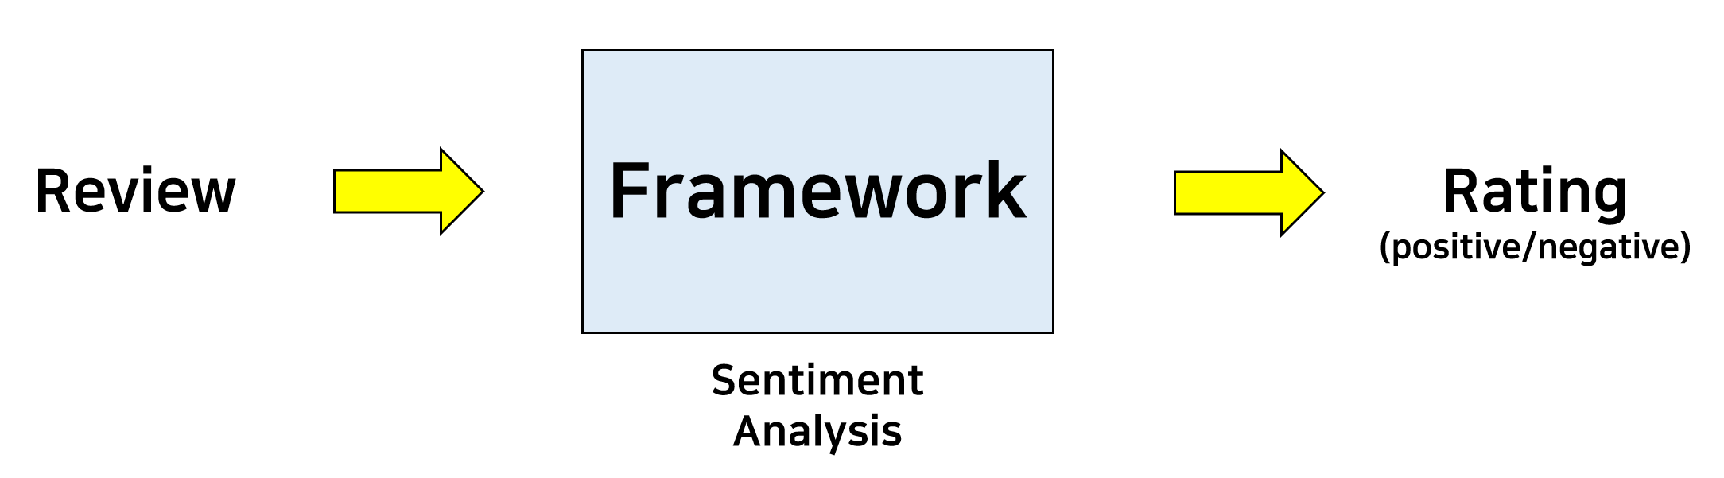
3. Modeling

Slide 17
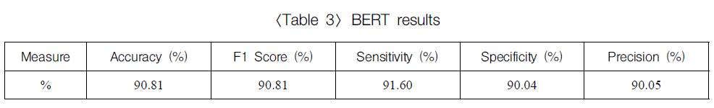
4. Experiment & Analysis
Dataset
Amazon shopping mall dataset’s review
Remove the data of helpfulness 5 points below.
Ex) Perfectly good. But think before you buy. (rating : 1/10)
BERT results

Slide 18
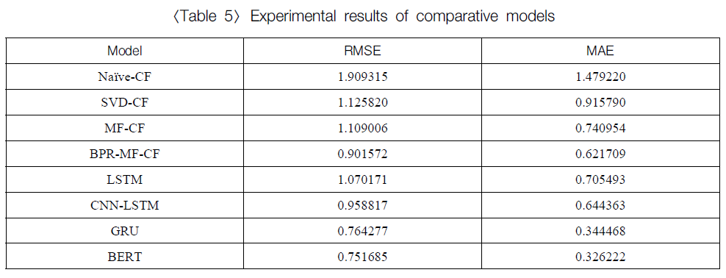
4. Experiment & Analysis

Slide 19
5. Conclusion
Limitations of explanatory power to interpret results due to the nature of deep learning
Cold start problem
Top-N
GPT vs BERT
다른 데이터셋 적용 해보기

Slide 20
Research Discussion

Slide 21
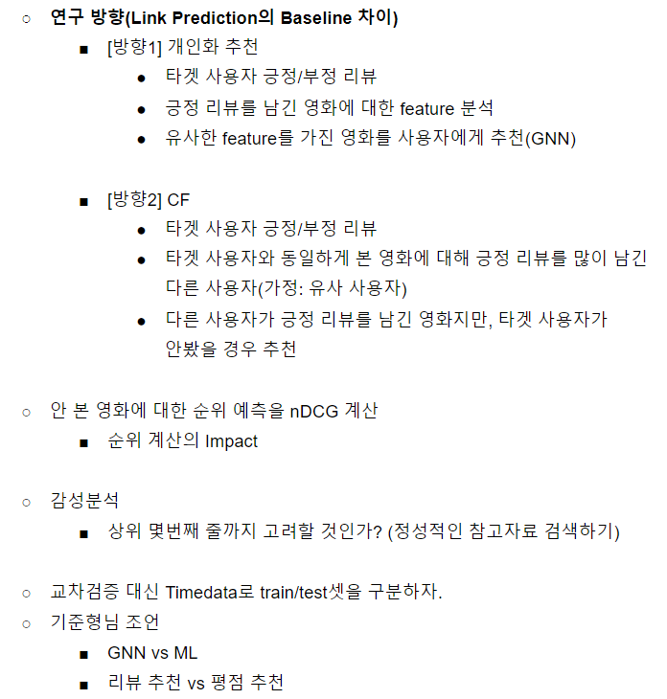
Discussion 1

Slide 22
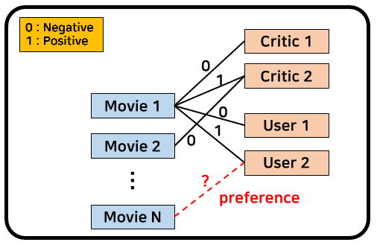
Discussion 2

Slide 23
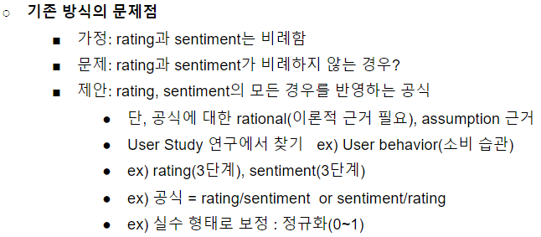
Discussion 3
Novelty : Graph 구성

Slide 24
Last week presentation

Slide 25
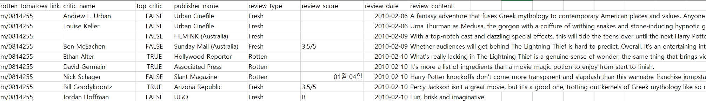
Rotten Tomato Data
Review
MovieID, name, top_critic, publisher_name, review_type, score, date, review
Movie
MovieID, title, summary, content_rating, genres, directors, actors, authors, date, …

Slide 26
Link Prediction
Review Triple
Review Data
Critics (tomatometer)
Regular user
Movie Triple
Data
Meta information
0 : Negative
1 : Positive
Actor
Critic 1
0
Director
1
Critic 2
Authors
Movie 1
0
Movie 1
Genre
1
User 1
Movie 2
0
Production_
company
User 2
…
?
preference
Runtime
Movie N
Content_rating

Slide 27
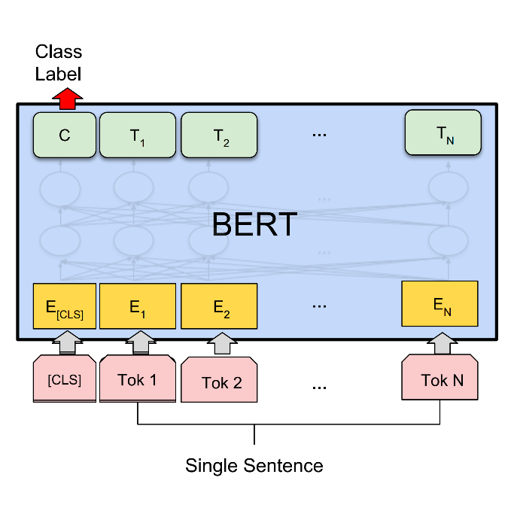
Sentiment Analysis
Labeling
Sentiment analysis using BERT
Review data
Result
Uma Thurman as Medusa, the gorgon with a coiffure of writhing snakes and stone-inducing hypnotic gaze is one of the highlights of this bewitching fantasy
0 / 1
Fill the triple’s edge with sentiment analysis results.

Slide 28
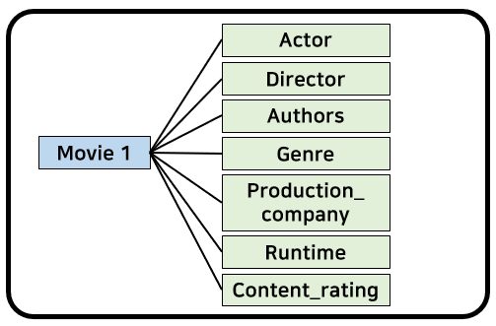
Explainable Recommendation
Explainable Recommendation (XAI)
Movie meta information
Algorithm : GNN
Movie features about positive review
Compare features for ‘Movie N’

Slide 29
Thank you

Slide 30
Appendix
Thank you

Slide 31
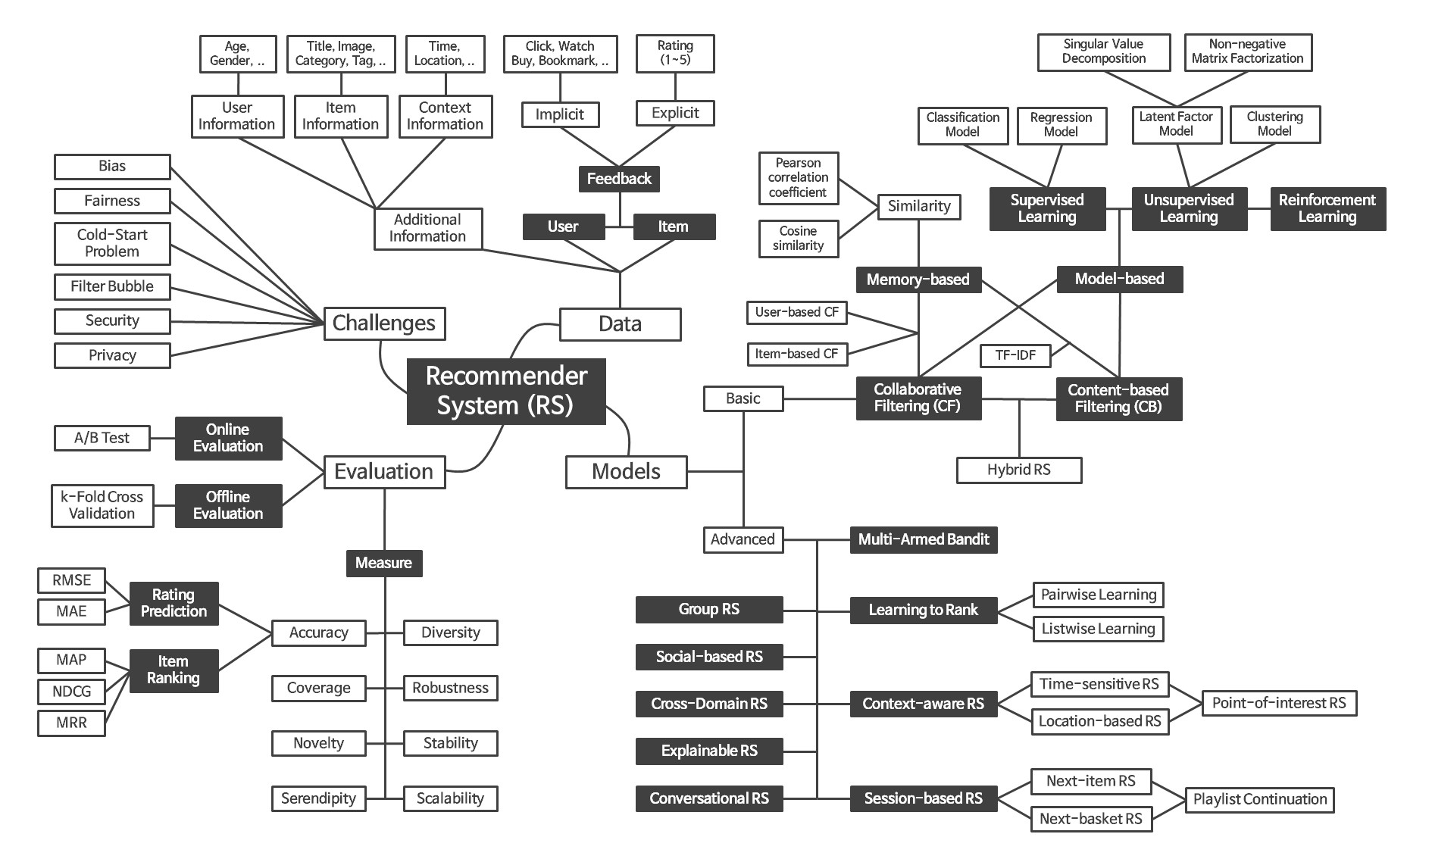
Recommender System Framework

