Slide 1
Graph-based Movie Recommender System
using Sentiment, Emotion Analysis of BERT
Sentiment Graph
Emotion Graph
Graph Neural Network (GNN)
Presenter : Cheonsol Lee
Date : 2021.09.23
Notes:
안녕하세요.
BERT의 감성분석을 활용한 그래프 기반의 영화 추천시스템에 대한 연구를 말씀드리겠습니다.

Slide 2
1. Introduction
Thank you

Slide 3

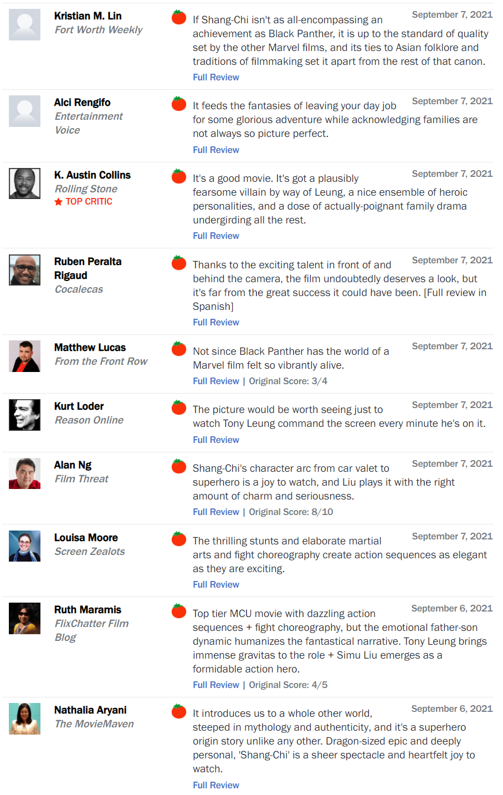
1. Introduction – Problem
Problem
Many missing rating
Ex) Title: Shan-chi (Date: 2021.9.7)
Total: 1,130,017
No rating data is 82% of missing data.
Rating | Review | Amount | Rate
O | O | 758,709 | 67%
X | O | 305,502 | 27%
O | X | 65,372 | 5%
X | X | 434 | 0.03%

Slide 4


1. Introduction - Motivation
Movie Experience (MX)
영화를 시청할 때의 사용자 경험
User’s psychological information -> Sentiment / Emotion
Rational basis
영화에 대한 소비자의 감정이 리뷰 속에 반영
영화 리뷰에 대한 감정과 소비자의 만족도 사이의 상관관계가 있음
확장: 감정 정보가 개인화 정보로서 사용될 수 있음
ex) 특정 유저가 fear 감정을 느꼈을 때, 높은 평점을 자주 남겼다면,
ex) fear 감정일 때, 영화의 메타 정보들 사이의 공통점을 찾고 추천에 반영 가능
출처: The impact of emotions on the helpfulness of movie reviews [JART 2015]

Slide 5
2. Long-tail Graph
Thank you

Slide 6
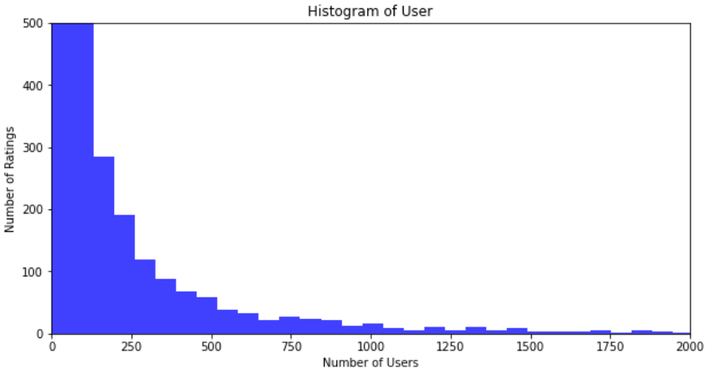
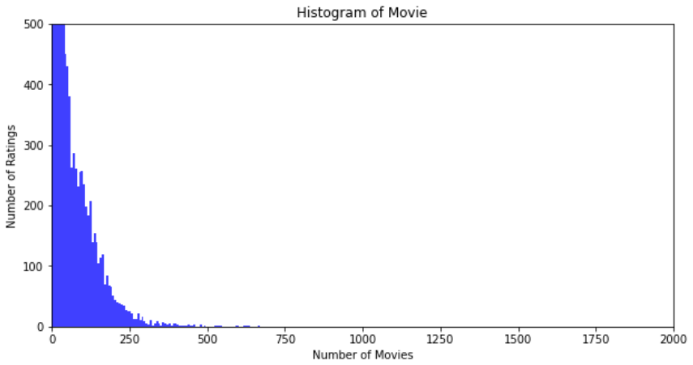
2. Long-tail Graph
Histogram
Group: User, Movie
Range
X-axis : 0 ~ 2,000
Y-axis : 0 ~ 500
Bins : 100
Range | User | Movie
Total | 9,794 | 17,614
< 3 | 3,552 (36%) | 993 (6%)
< 5 | 4,653 (48%) | 2,892 (16%)
> 100 | 1,333 (14%) | 2,453 (14%)
> 500 | 343 (4%) | 13 (0%)
<User>
<Movie>

Slide 7
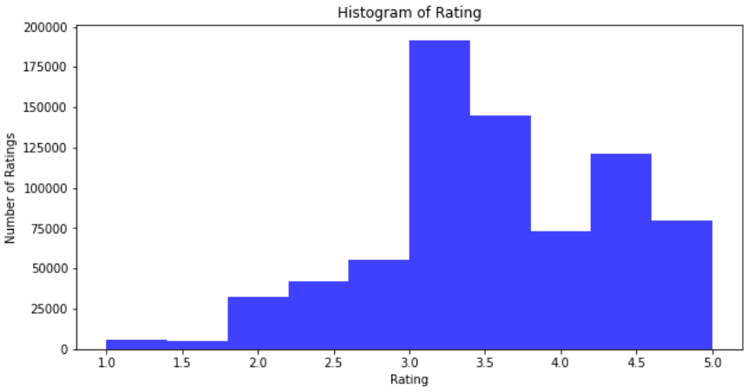
2. Long-tail Graph
Histogram
Group: Rating
Range
X-axis : 1.0 ~ 5.0
Y-axis : 0 ~ 200,000
Bins: 10
Range | Rating
Total | 751,129
1 ~ 2 | 29,336 (4%)
2 ~ 3 | 111,623 (15%)
3 ~ 4 | 337,170 (45%)
4 ~ 5 | 212,717 (28%)
5 | 68,283 (8%)
<Rating>

Slide 8
3. Framework
Thank you

Slide 9
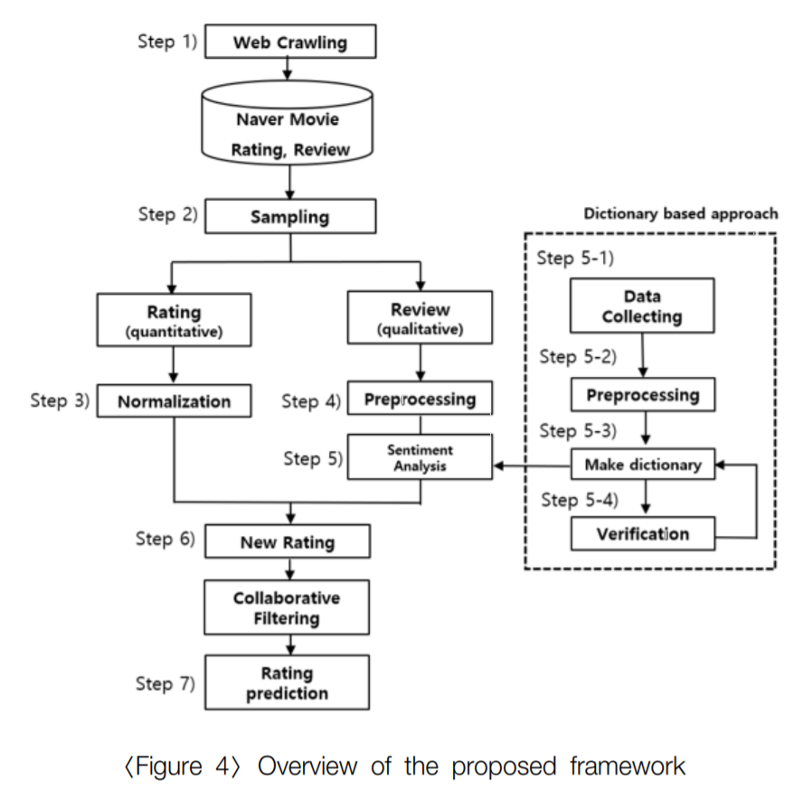
3. Related Work
Sentiment Analysis
[5] How to improve the accuracy of recommendation systems: Combining ratings and review texts sentiment scores. (JIIS 2019)
Emotion Analysis
[6] Tensor-based tag emotion aware recommendation with probabilistic ranking. (KSII 2019)
[7] Item recommendation using tag emotion in social cataloging services. (ScienceDirect 2017)

Slide 10
3. Framework
Web Crawling
Movie Database
Sampling
Review
Rating
Review
BERT
BERT
Normalization
Sentiment / Emotion
Sentiment
Emotion
Multi-layer embedding
Graph Model
Rating Prediction

Slide 11


3. Framework - Methodology
M | R | U
0 | 0.5 | 1
1 | 0.7 | 1
2 | 0.3 | 2
Sum of relation values
Multi-layer Graph
(Rating graph)
M | S | U
0 | 1 | 1
1 | 3 | 1
2 | 2 | 2
Graph
model
(Sentiment graph)
[Predicted Rating]
Metric: RMSE/MAE
[Baseline]
Traditional: CF, SVD, NCF
Graph: NGCF, GCN, GAT, GraphSAGE
M | B | U
0 | 1 | 1
1 | 2 | 1
2 | 5 | 2
Ablation Study
(Emotion graph)
Notes:
그래프를 단순 합으로 결합
Multi-layer로 구성하여 GNN 학습

Slide 12
4. GNN
Thank you

Slide 13
4. GNN
Graph Convolutional Matrix Completion (GCMC) [KDD 2018]
Inductive Matrix Completion Based on Graph Neural Networks (ICGC) [ICLR 2019]
Inductive Matrix Completion Using Graph Autoencoder (IMC-GAE) [CIKM 2021]

Slide 14
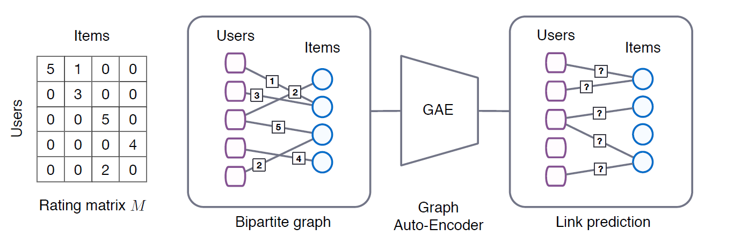
4. GCMC
Graph Convolutional Matrix Completion [KDD 2018]
Rating
Node features
GCN

Slide 15
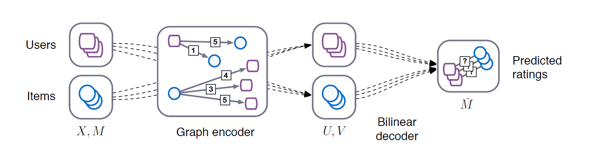
4. GCMC
Graph Convolutional Matrix Completion [KDD 2018]
Rating
Node features

Slide 16
4. Result Table
Thank you

Slide 17
3. Result Table
Result
Graph type : Rating, Sentiment, Emotion
Data : 60%(rating, review)
Ideal result
Type | Method | F1-score | Data
Baselines | CF MF: SVD, SVD++ FM NCF | Low | Rating
Graph (in general) | GCN (GCMC) ICMC IMC-GAE Graphormer | Middle | Rating
Graph (our model) | GNN + “novelty” | High | Rating
 |  |  | Rating + Sentiment
 |  |  | Rating + Emotion
 |  |  | Rating + Sentiment + Emotion

Slide 18
Thank you

Slide 19
Appendix
Thank you

Slide 20
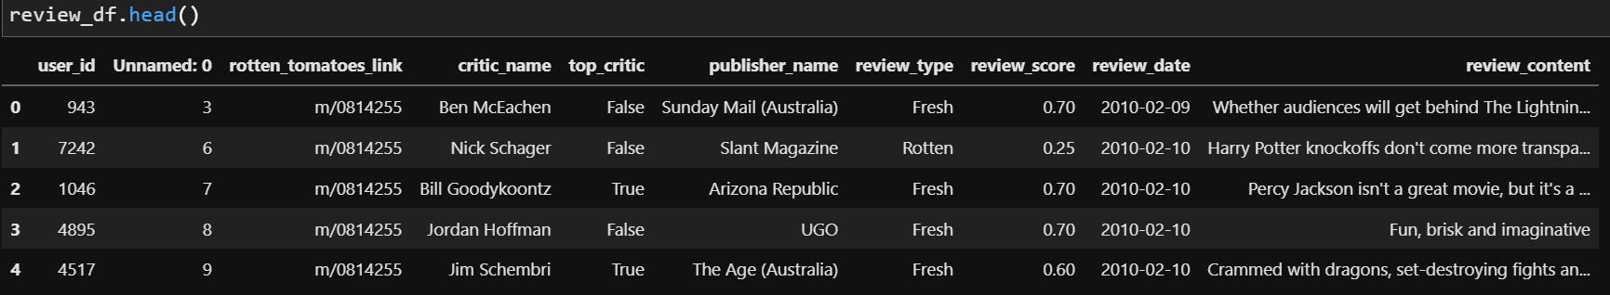
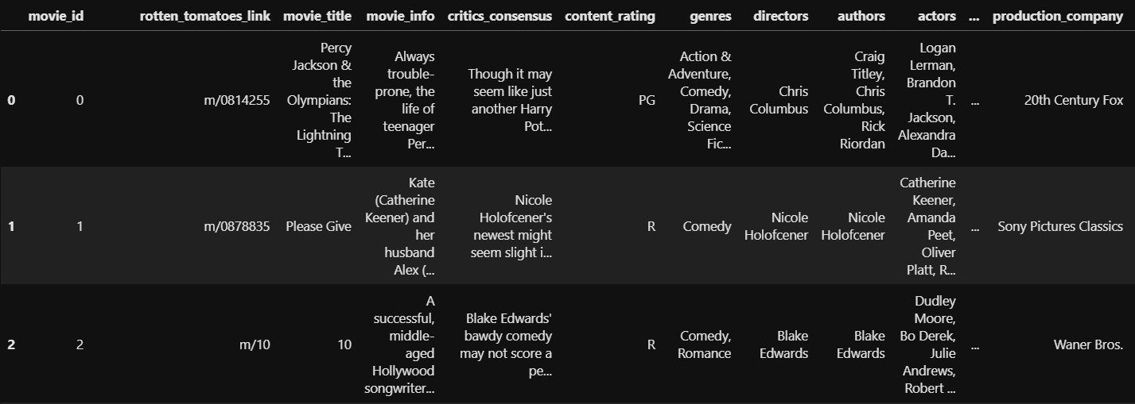
3. Pre-processing
Dataset
Rating matrix
Group : critic_name, top_critic, publisher_name
The number of users : 9,821
Movie matrix
The number of movies: 17,712

Slide 21
3. CF, MF
Thank you

Slide 22
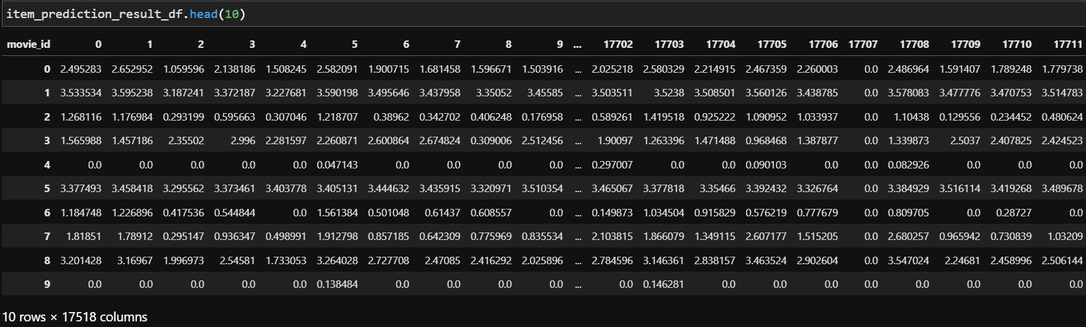
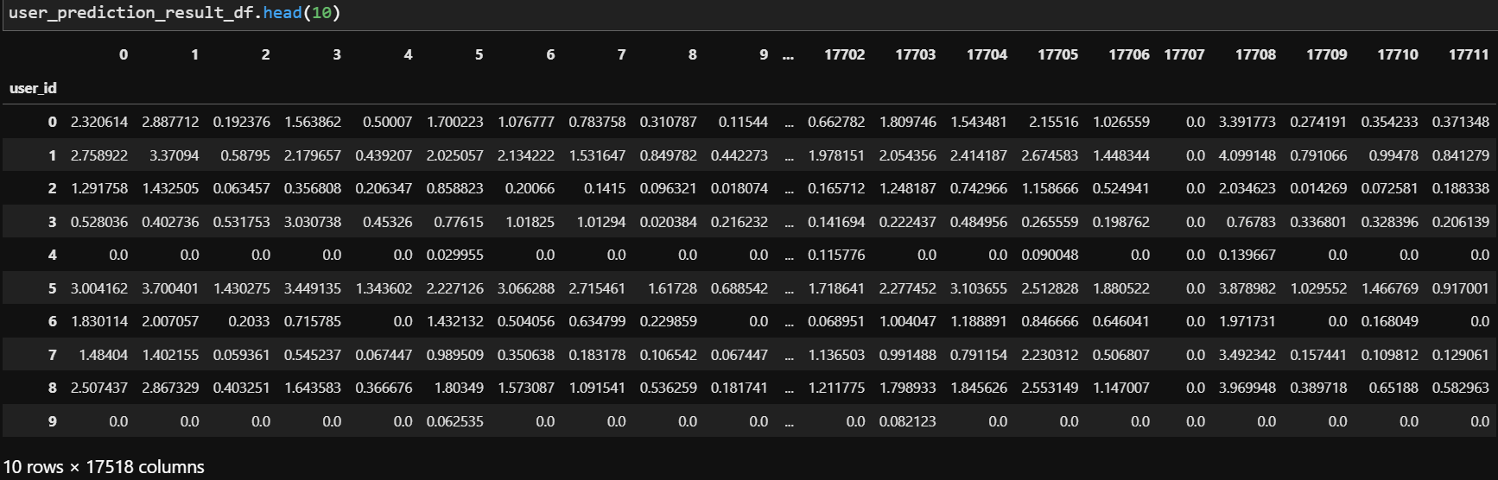
3. CF
Collaborative Filtering (CF)
Item-based
User-based
 | Item-based | User-based
RMSE
<Item>
<User>

