Slide 1
Multi-Relational Stacking Ensemble Recommender System Using Cinematic Experience
(Index Terms)
Graph Neural Network (GNN)
Recommender system
Sentiment analysis
BERT
Data Imputation
Presenter : Cheonsol Lee
Date : 2021.11.01
Notes:
안녕하세요.
BERT의 감성분석을 활용한 그래프 기반의 영화 추천시스템에 대한 연구를 말씀드리겠습니다.

Slide 2
Last Research
Thank you

Slide 3
3. Method
Web Crawling
Movie Database
Sampling
Review
Rating
Review
BERT
BERT
Normalization
Sentiment / Emotion
Sentiment
Emotion
Multi-relations graph
generating
Graph Model
Rating Prediction
Figure 1. Overview of the proposed framework

Slide 4
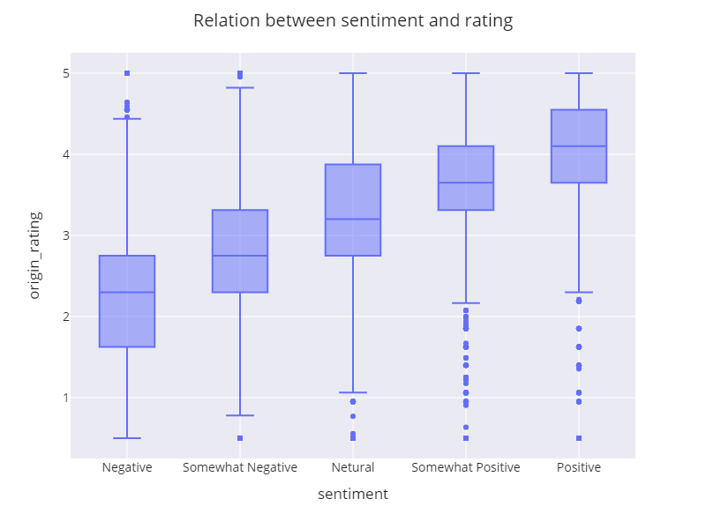
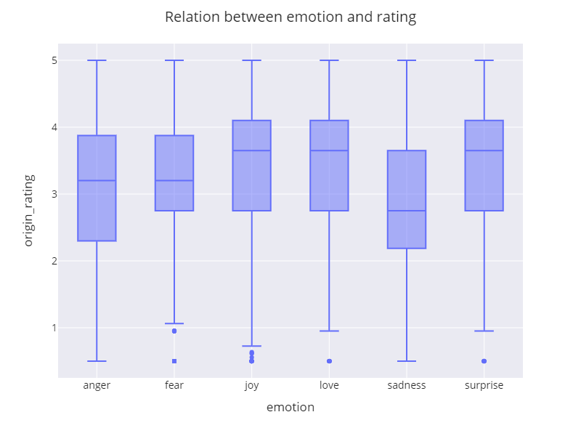
4. Experiment – dataset (sentiment, emotion)
Relation between rating and sentiment/emotion
Figure 7: Relation between sentiment and rating
Figure 8: Relation between emotion and rating

Slide 5
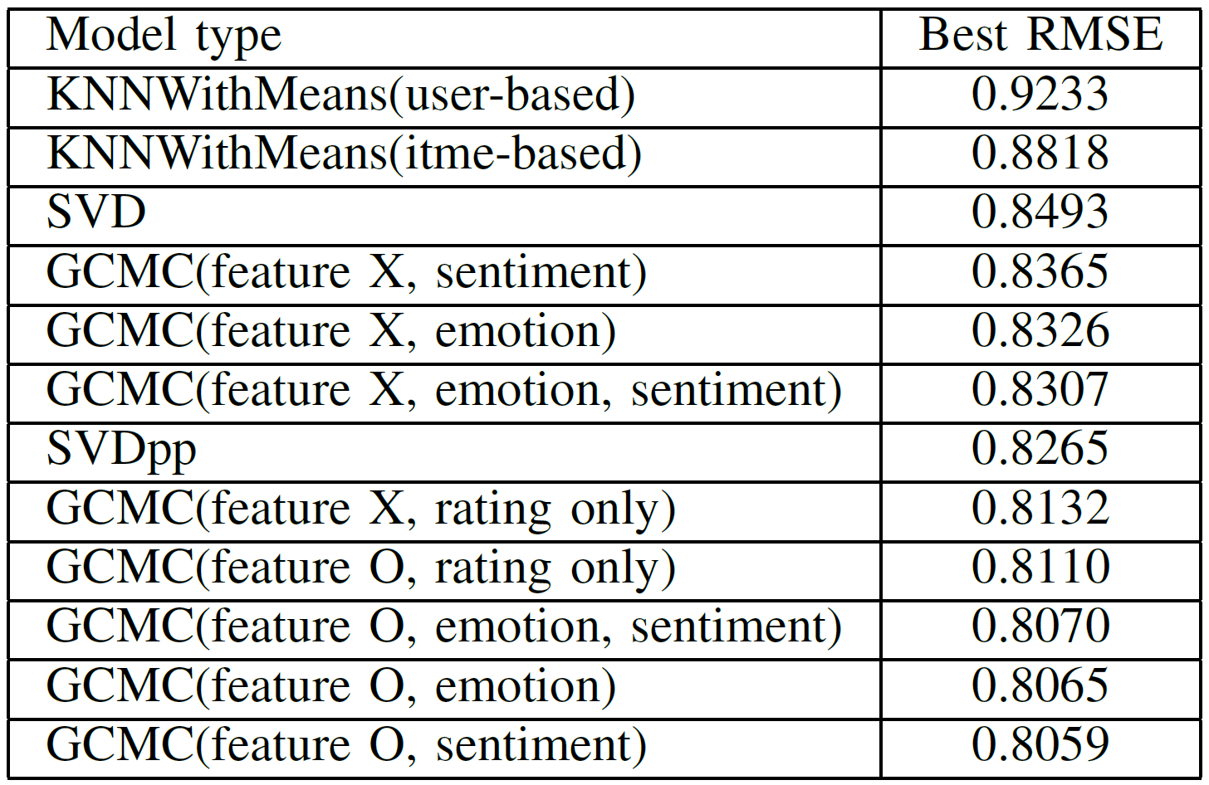
5. Results – Table
Table 1: RMSE results

Slide 6
To do1
Thank you

Slide 7
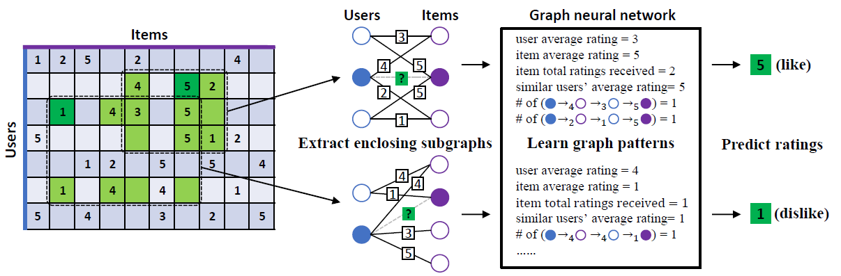
IGMC (Inductive Graph-based Matrix Completion)
IGMC (ICLR 2020)
The model that improved the shortcomings of GCMC
It is the state-of-the-art model among rating inference models using bipartite graphs.
Characteristics
Inductive for generalization
No side-information needed
Efficient because it learns in units of sub-graphs, not in units of total-graphs
Future work: side-information based recommendation
Sub-graph
Notes:
그래프를 단순 합으로 결합
Multi-layer로 구성하여 GNN 학습

Slide 8


Framework1: Aggregated embedding
Subgraph
Embedding
Users
Rating
Items
3
Rating
4
5
?
Target
2
5
1
$$y_{ui}$$
New
Embedding
Users
Sentiment
Items
3
4
5
MLP
Sentiment
?
$${\hat{y}}_{ui}$$
2
5
Prediction
1
Users
Emotion
Items
3
[Aggregation Functions]
Mean
Sum
Avg
Concat
Emotion
4
5
?
2
5
1
Notes:
그래프를 단순 합으로 결합
Multi-layer로 구성하여 GNN 학습

Slide 9


Framework2: CX ratio-based embedding
Subgraph
Embedding
Users
Rating
Items
3
Rating
4
5
?
2
5
Target
1
$$y_{ui}$$
New
Embedding
Users
Sentiment
Items
3
4
5
MLP
Sentiment
?
$$α$$
$${\hat{y}}_{ui}$$
2
5
Prediction
1
Users
Emotion
Items
3
[Aggregation Functions]
Mean
Sum
Avg
Concat
Emotion
4
5
?
$$1−α$$
2
5
1
Notes:
그래프를 단순 합으로 결합
Multi-layer로 구성하여 GNN 학습

Slide 10
Framework3: Attention-based embedding
Subgraph
Embedding
Users
Rating
Items
3
Rating
4
5
?
Attention
2
5
Target
1
$$y_{ui}$$
New
Embedding
Users
Sentiment
Items
3
4
5
MLP
Sentiment
?
Attention
$${\hat{y}}_{ui}$$
2
5
Prediction
1
Users
Emotion
Items
3
[Aggregation Functions]
Mean
Sum
Avg
Concat
Emotion
4
5
?
Attention
2
5
1
Notes:
그래프를 단순 합으로 결합
Multi-layer로 구성하여 GNN 학습

Slide 11
동희 IDEA
Target
Subgraph
Embedding
$$y_{ui}$$
Users
Rating
Items
3
Rating
4
5
?
MLP
2
5
$${\hat{y}}_{ui}$$
1
Prediction
Users
Rating
Edge
Rating
Item
3
3
4
5
BERT
?
Edge
Embedding
2
5
Review
1
[Aggregation Functions]
Mean
Sum
Avg
Concat
(CX 벡터)
Notes:
그래프를 단순 합으로 결합
Multi-layer로 구성하여 GNN 학습

Slide 12
To do2
Thank you

Slide 13
Data Imputation
Expansion of training set
Problem
Exclusion of missing data
Lack of training set
Type | Rating | Review | Rate | Result
1 | O | O | 100 | 1
2 | O | O | 60 | 2
 | X | O | 40
3 | O | O | 60 | 4
 | O | X | 40
4 | O | X | 100 | 3
5 | O | O | 60 | 5
Rating | Review | Amount | Rate
O | O | 758,709 | 67%
X | O | 305,502 | 27%
O | X | 65,372 | 5%
X | X | 434 | 0.03%
Notes:
그래프를 단순 합으로 결합
Multi-layer로 구성하여 GNN 학습

Slide 14
Data Imputation
Expansion of training set
Problem
Exclusion of missing data
Lack of training set
Type | Rating | Review | Rate | Result
2 | O | O | 67 | 2
 | X | O | 27
5 | O | O | 67 | 5
Rating | Review | Amount | Rate
O | O | 758,709 | 67%
X | O | 305,502 | 27%
O | X | 65,372 | 5%
X | X | 434 | 0.03%
Notes:
그래프를 단순 합으로 결합
Multi-layer로 구성하여 GNN 학습

Slide 15
Rating | Review | Amount | Rate
O | O | 758,709 | 67%
O | X | 65,372 | 5%
X | O | 305,502 | 27%
X | X | 434 | 0.03%
Model1: Zero-vectors
Subgraph
Embedding
Users
Rating
Items
3
Rating
4
5
?
Target
2
5
1
$$y_{ui}$$
New
Embedding
Users
Sentiment
Items
3
4
5
MLP
Review
O
?
$${\hat{y}}_{ui}$$
2
5
Prediction
1
[Aggregation Functions]
Mean
Sum
Avg
Concat
Review
X
Zero vectors
Notes:
그래프를 단순 합으로 결합
Multi-layer로 구성하여 GNN 학습

Slide 16
Rating | Review | Amount | Rate
O | O | 758,709 | 67%
O | X | 65,372 | 5%
X | O | 305,502 | 27%
X | X | 434 | 0.03%
Model2: Pseudo-labeling
Subgraph
Embedding
Users
Rating
Items
Target
Data2
Data1
3
$$y_{ui}$$
Rating
X
Rating
O
4
5
New
Embedding
?
2
5
1
MLP
$${\hat{y}}_{ui}$$
Users
Sentiment
Items
Prediction
3
Review
O
Review
O
4
5
?
2
5
1
Notes:
그래프를 단순 합으로 결합
Multi-layer로 구성하여 GNN 학습

Slide 17
Thank you
Thank you

Slide 18
Appendix
Thank you

Slide 19

Framework4: Knowledge Distillation
Subgraph
Embedding
New
Embedding
Users
Rating
Items
3
Prediction
MLP
Rating
4
5
$${\hat{y}}_{ui}$$
?
2
5
A
1
Users
Sentiment
Items
3
$$y_{ui}$$
Sentiment
4
5
Target
?
2
5
B
1
Users
Emotion
Items
3
Train Loss : |A-B| + |A-C| + |Prediction-Target|
Testset : only rating dataset (Cover: rating O, review X)
Emotion
4
5
?
2
5
C
1
Notes:
그래프를 단순 합으로 결합
Multi-layer로 구성하여 GNN 학습

Slide 20
Framework1: Aggregated embedding
Subgraph
Embedding
Users
Rating
Items
Target
3
$$y_{ui}$$
Rating
4
5
New
Embedding
?
2
5
1
MLP
Users
Sentiment
Items
$${\hat{y}}_{ui}$$
3
Prediction
Review
X
4
5
Zero vector
?
2
5
1
Notes:
그래프를 단순 합으로 결합
Multi-layer로 구성하여 GNN 학습

Slide 21
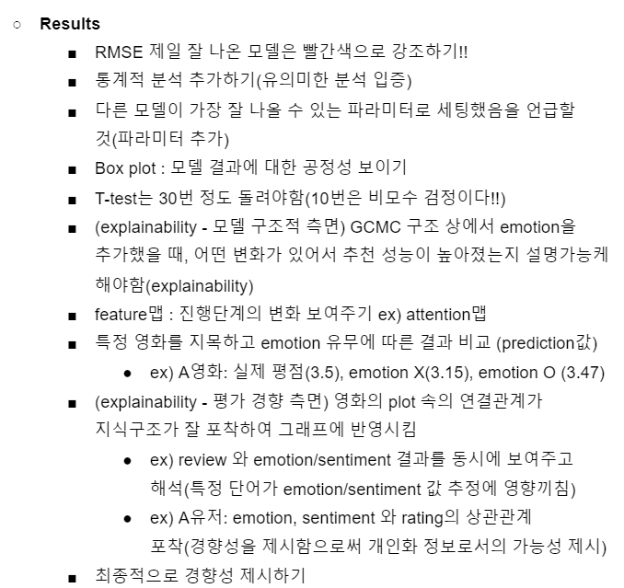
Feedback (이문용 교수님)

