Slide 1
Graph-based Movie Recommender System
using Sentiment Analysis of BERT
Sentimental Graph
Graph Neural Network (GNN)
Presenter : Cheonsol Lee
Date : 2021.09.03
Notes:
안녕하세요.
BERT의 감성분석을 활용한 그래프 기반의 영화 추천시스템에 대한 연구를 말씀드리겠습니다.

Slide 2
1. Have done
Thank you

Slide 3
1. Introduction
Problem
There are a lot of data with reviews but without rating in Rotten tomato.
Missing rating(27%), Missing review(6%)
Suggestion
Recommendation reflecting sentiment analysis/metadata is improved compared to only using rating data.
Graph
Graph Type | Contents
Rating | Movie – Rating – User
Sentiment | Movie – Sentiment – User
Metadata | Movie – Binary – metadata

Slide 4


1. Framework
Framework
M | R | U
0 | 0.5 | 1
1 | 0.7 | 1
2 | 0.3 | 2
(Rating graph)
Traditional
M | S | U
0 | 1 | 1
1 | 3 | 1
2 | 2 | 2
Graph
(Sentiment graph)
Compare RMSE/MAE
M | B | M
0 | 1 | Action
1 | 1 | Comedy
2 | 1 | Drama
[Baseline]
Traditional: CF, MF
Graph: NGCF, LightGCN
Ablation Study
(Metadata graph)

Slide 5
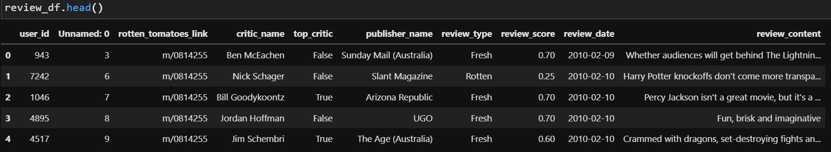
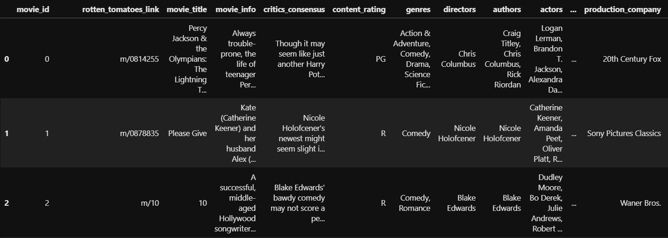
1. Pre-processing
Have done
Rating matrix
Group : critic_name, top_critic, publisher_name
The number of users : 9,821
Movie matrix
The number of movies: 17,712

Slide 6
2. Discussion
Thank you

Slide 7
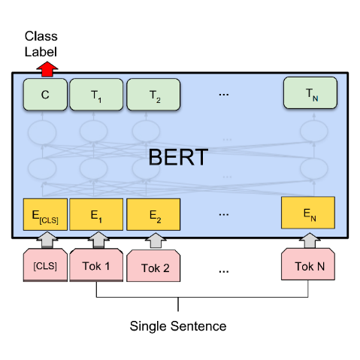
2. Discussion – Purpose of BERT
Sentiment Analysis
BERT
Scaled rating (Not sentiment value)
Training : Input(Review), Output(Rating)
Range
0(negative): 0 ~ 0.3
1(neutral) : 0.3 ~ 0.7
2(positive) : 0.7 ~ 1.0
Review
Rating
Review data
Result
M | S | U
0 | 1 | 1
1 | 3 | 1
2 | 2 | 2
Uma Thurman as Medusa, the gorgon with a coiffure of writhing snakes and stone-inducing hypnotic gaze is one of the highlights of this bewitching fantasy
Sentiment value(?)
(Sentiment graph)

Slide 8
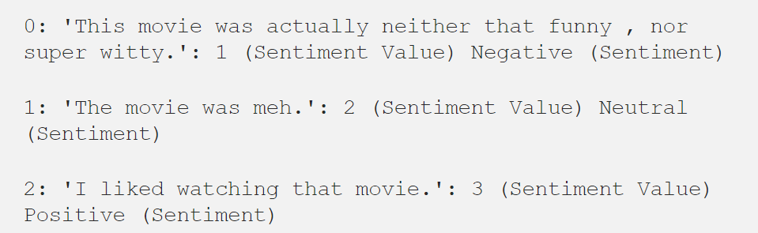

2. Discussion – CoreNLP
Sentiment Analysis
Stanford - Core NLP
The Scale for sentiment values : 0 ~ 3
Standard Sentiment Analysis
Framework
Review data
Result
M | S | U
0 | 1 | 1
1 | 3 | 1
2 | 2 | 2
Uma Thurman as Medusa, the gorgon with a coiffure of writhing snakes and stone-inducing hypnotic gaze is one of the highlights of this bewitching fantasy
Sentiment value
(Sentiment graph)

Slide 9
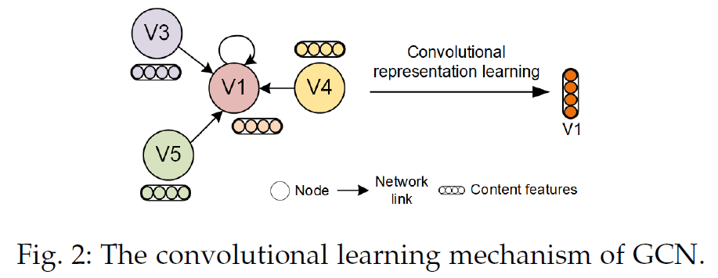
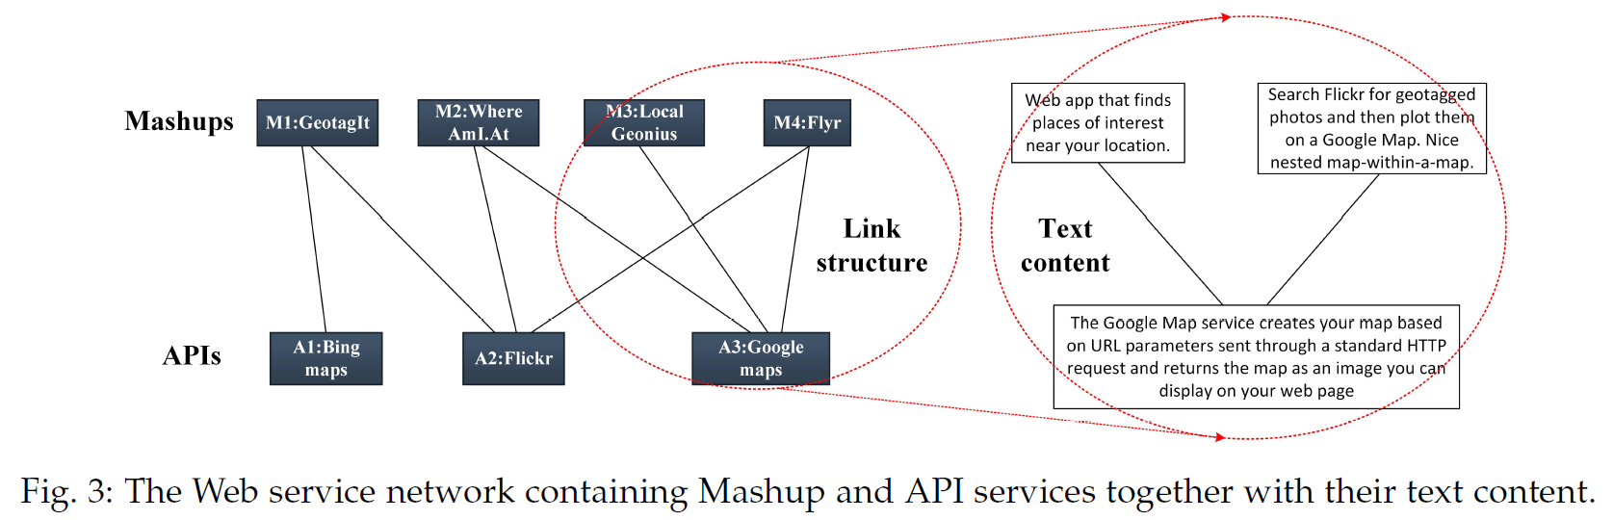
2. Discussion
Contribution
Improve accuracy of link prediction
Baseline: Graph (Rating data) & Model
Solution: Graph(Rating + Review + Meta data) & Model
Reference
Web Service Network Embedding based on Link Prediction and Convolutional Learning
IEEE Transactions on Services Computing 2020
Data: Node features + text content

Slide 10
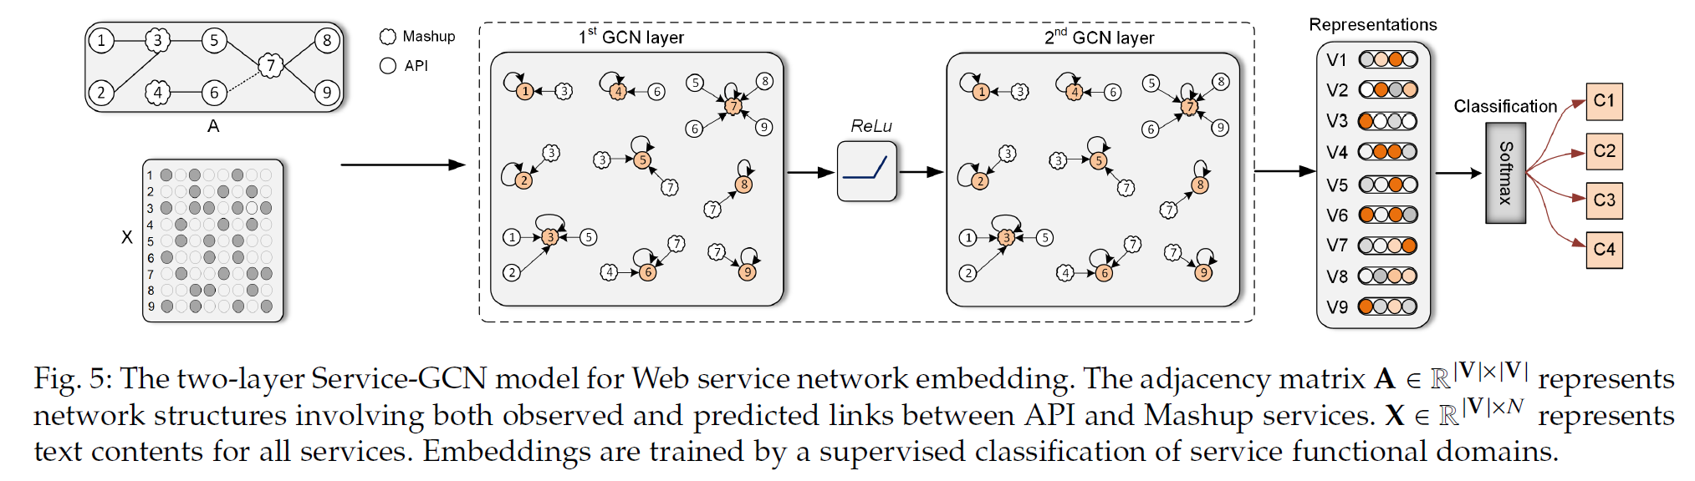
2. Discussion
Contribution
Conclusion
1) 네트워크가 sparse할 때, contents 내용을 참고하는게 도움이 됨
2) 예측된 link를 포함시킨 네트워크 구조를 이용할 때, node 임베딩 성능이 향상됨 (원래 있어야할 link가 포함된 경우로 보임)
3) GCN이 node 간의 관계 파악에 도움
4) WSNE모델(제안 모델명)은 클러스터링에서 구별가능한 경계를 생성하는 방법으로 제일 좋은 결과를 냄.
Difference

Slide 11
Thank you

Slide 12
3. To do
To do
Sentiment graph 완성
Stanford – CoreNLP 이용
Baseline 모델 구축 및 성능 비교 : CF, MF, NGCF, LightGCN
Meta graph 생성 (예정)

Slide 13
3. Feedback
피드백
문제점: label이 안된 implicit score 활용 못함
솔루션: 평점 정보가 없더라도 영화 정보, 리뷰가 있다면 평점을 예측이 가능!

