Slide 1
Employee Data Analysis using Excel
STUDENT NAME: KEERTHIKA B
REGISTER NO: 2213391036296 { NAAN MUDHALVAN ID:9941342628}
DEPARTMENT: B.com {general}
COLLEGE: QUEEN MARY'S COLLEGE

Slide 2
PROJECT TITLE
Employee Performance Analysis using Excel

Slide 3


AGENDA
Problem Statement
Project Overview
End Users
Our Solution and Proposition
Dataset Description
Modelling Approach
Results and Discussion
Conclusion
3/21/2024 Annual Review

Slide 4

PROBLEM STATEMENT
We have lots of employee data but don’t use it well. This makes it hard to understand why employees leave and how to improve their satisfaction and performance. We need to analyze this data to find ways to keep employees happy and productive.

Slide 5

PROJECT OVERVIEW
To analyze employee data to uncover patterns that impact employee satisfaction, performance, and retention.

Slide 6

WHO ARE THE END USERS?
Human Resources (HR) Team
Management and Executives
Team Leaders and Supervisors
Data Analysts

Slide 7

OUR SOLUTION AND ITS VALUE PROPOSITION
CONDITIONAL FORMATTING – MISSING
FILTER – REMOVE
FORMULA – PERFORMANCE
PIVOT - SUMMARY
GRAPH – DATA VISUALIZATION

Slide 8
Dataset Description
EMPLOYEE DATA SET = EDU NET
26 – FEATURES
9 – FEATURES
EMP ID – NUM
NAME – TEXT
EMP TYPE
PERFORMANCE LEVEL
GENDER – MALE AND FEMALE
EMPLOYEE RATING – NUM

Slide 9

THE "WOW" IN OUR SOLUTION
PERFORMANCE LEVEL =IFS(Z2>=5,"VERY HIGH",Z2>=4,"HIGH",Z2>=3,"MED",TRUE,"LOW")
3/21/2024 Annual Review
9

Slide 10
MODELLING
DATA COLLECTION
EDUNET DOWNLOAD
IDENTIFIED FEATURES
FEATURE COLLECTION
DATA SET OF EMPLOYEES
CONDITIONAL FOPRMATTING
MISSING VALUES IDENTIFY
FILTER OUT MISSINNG VALUE
PERFORMANCE LEVEL
PIVOT TABLE
SUMMARY
GRAPH VISUALIZATION
10

Slide 11
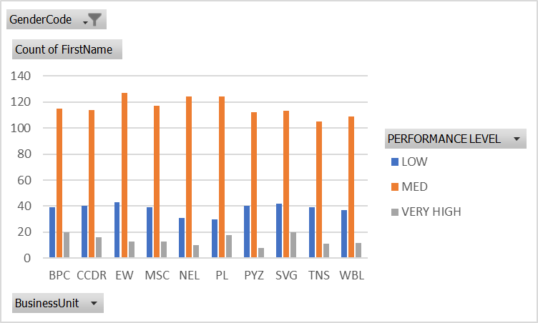
RESULTS
11

Slide 12
conclusion
The analysis reveals that employee performance levels are lower than desired, as shown in the performance chart. To address this, we need to implement targeted strategies to motivate employees, such as personalized development programs, regular feedback, and recognition initiatives, to enhance overall performance and engagement.

