Slide 1

Estimating the relationship between drug use and major depressive disorder among youth
Keele J. Thomas, BS & Samantha J. Bauer, PhD
Department of Family Medicine & Public Health Sciences Research Day
April 16, 2026

Slide 2
Agenda
Background & specific aims
Methods
Results
Discussion
Conclusions
Questions
Acknowledgements
DFMPHS Research Day Committee
Masters of Public Health program
Applied Practice Experience Fall 2025, Michael McLeod & SD
Department of Family Medicine and Public Health Sciences faculty & staff
About Me
Keele J. Thomas, BS
MPH Public Health Practice Student
Bachelor of Science in Biology, Gonzaga University
Environmental Health Sanitarian, Washtenaw County Health Dept.

Slide 3
Background & Specific Aims

Slide 4
Background
Substance use is a risk factor for depression and associated with the leading causes of death in adolescents.¹
90% of Americans with clinical addiction started using before the age of 18.²
In 2023:
4.5 million (18.1%) of adolescents aged 12-17 reported having a Major Depressive Episode (MDE).³
70.5 million people 12-20 years old reported having used illicit drugs in the past month.³
Adolescents with a past year MDE more likely to have used illicit drugs in the past year than those without (28.4% vs. 11.6%).⁴

Slide 5
Specific Aims
1. To estimate the association between incident drug use and lifetime major depressive episode among youth ages 12-17 years old.
2. To evaluate whether the hypothesized association between incident drug use and lifetime major depressive episode varies by drug type (i.e., “hard” vs. “soft” drugs) among youth ages 12-17 years old.
Major Depressive Episode
Incident Drug Use
Major Depressive Episode
Incident use of
“soft drugs”
Major Depressive Episode
Incident Use of
”hard” drugs

Slide 6
Note to think about...
How we could have answered aim 2....
Test for effect modification
Tells us whether there are significant differences in the exposure-outcome relationship
Doesn't tell us the magnitude of association (need stratified models for that)
Stratified models [what we did]
Tells us the strength of association between exposure-outcome across levels
Doesn't tell us if differences are significant

Slide 7
Methods

Slide 8
Nationally Representative Survey Data
National Survey on Drug Use and Health, 2023
Substance Abuse and Mental Health Services Administration
Target Population:
Non-institutionalized US civilians, age ≥12 years
Includes households, group quarters, & homeless shelters
Analytic Sample:
Youth age 12-17 years with complete data
Multistage complex sampling
Based on geography, age, biological sex, and race/ethnicity
Variance estimation based on Taylor series linearization approach

Slide 9
Exposure: Incident Drug Use
Audio computer-assisted. Self-interviews in-person or via web
Survey Question: “Have you ever, even once, used…?” Or “Have you ever smoked part or all of…?”
Whole portions specified
Defined as binary yes/no variable for having ever tried at least one drug listed
“Soft” Drugs
Alcohol, nicotine (e.g., cigarettes, cigars, vape, smokeless tobacco), marijuana, CBD/hemp
“Hard” Drugs
Cocaine, crack, methamphetamine, heroin, hallucinogenics, inhalants, non-medical use of prescription drugs

Slide 10
Outcome: Major Depressive Episode (MDE)
DSM-5 Criteria [MDE: 5/9 items, must include “depressed mood/loss of interest”]
1. Depressed mood most of the day
2. Markedly diminished loss of interest or pleasure in all or almost all activities most of the day
3. Significant weight loss, weight gain, or decrease in appetite
4. Insomnia or hypersomnia
5. Psychomotor agitation or retardation at a level observable by others
6. Fatigue or loss of energy
7. Feelings of worthlessness, excessive or inappropriate guilt
8. Diminished ability to think, concentrate, or indecisiveness
9. Recurrent thoughts of death or suicidality (recurrent suicidal ideation without a specific plan, making a specific plan, or making an attempt)
Lifetime history
Self reported; asked questions pertaining to 9 DSM-5 criteria
Defined as binary yes/no variable for lifetime history of MDE

Slide 11
Statistical Analysis
Cross-sectional, secondary data analysis
Survey-weighted logistic regression
Odds ratios (OR) and 95% confidence intervals (CI)
Candidate confounders based on literature review; confirmed by statistically significant chi-square tests between variable with exposure and outcome.
Model selection: time-oriented epochs
Fit statistics ← the only thing we have to go back to do
Biological
Age group
Biological sex
Social
Race/ethnicity
Current grade level
Behavioral
Arguments with parents
Confirmed confounders

Slide 12
Results

Slide 13
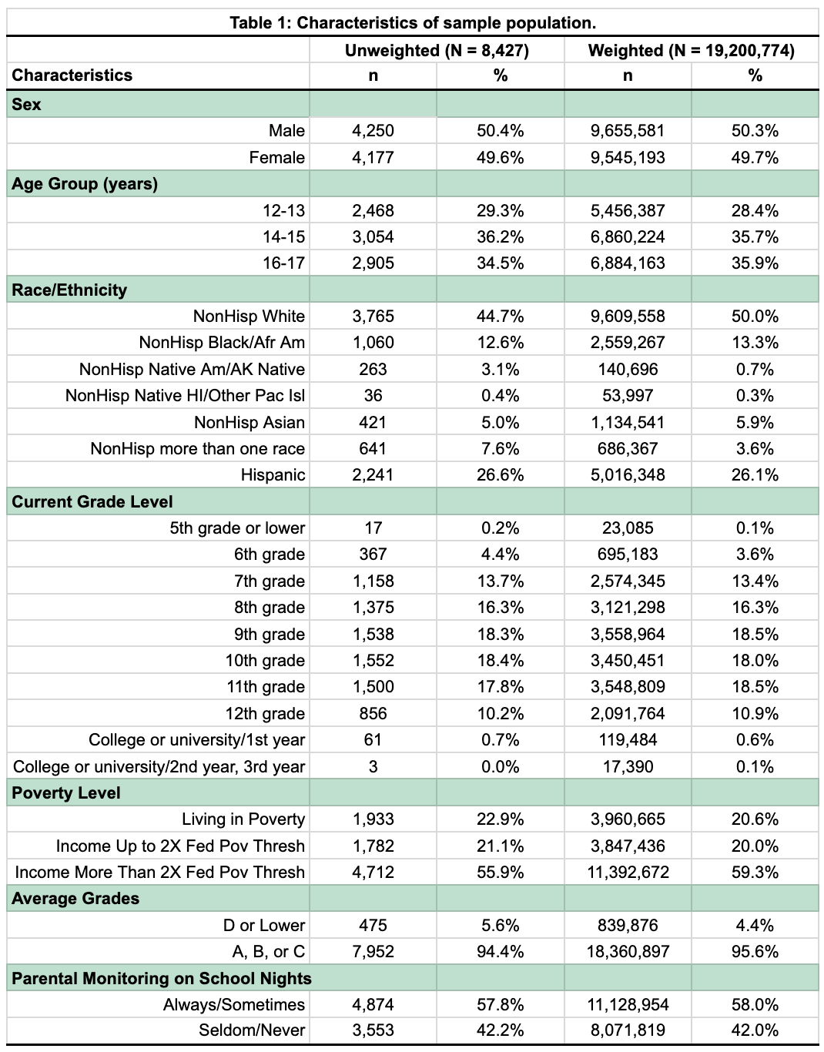
Sample Characteristics
Table 1: Characteristics of sample population
Characteristics | Weighted (N=19,200,774) n | Weighted (N=19,200,774) % | 95% Confidence Interval
Sex Male Female | 9,655,581 9,545,193 | 50.3% 49.7% | (48.6, 52.0) (48.0, 51.5)
Age 12-13 14-15 16-17 | 5,456,387 6,860,224 6,884,163 | 28.4% 35.7% 35.9% | (27.0, 29.9) (33.9, 37.6) (34.1, 37.6)
Race/Ethnicity NonHisp White NonHisp Black/Afr Am NonHisp Native Am/AK Native NonHisp Native HI/Other Pac Isl NonHisp Asian NonHisp more than one race Hispanic | 9,609,558 2,559,267 140,696 53,997 1,134,541 686,367 5,016,348 | 50.0% 13.3% 0.7% 0.3% 5.9% 3.6% 26.1% | (48.1, 52.0) (12.1, 14.6) (0.5, 1.0) (0.1, 0.5) (5.0, 6.8) (3.0, 4.1) (23.7, 28.5)
Poverty Level Living in Poverty Income Up to 2X Fed Pov Thresh Income More Than 2X Fed Pov Thresh | 3,960,665 3,847,436 11,392,672 | 20.6% 20.0% 59.3% | (19.1, 22.2) (18.4, 21.6) (57.3, 61.4)
Ethnically Non-Hispanic White and Hispanic: accounting for over 75% of sample.
Economically Stable: almost 60% in households with incomes >2x federal poverty threshold.
High Academic Achievement: 96% with grades of A, B, or C.

Slide 14
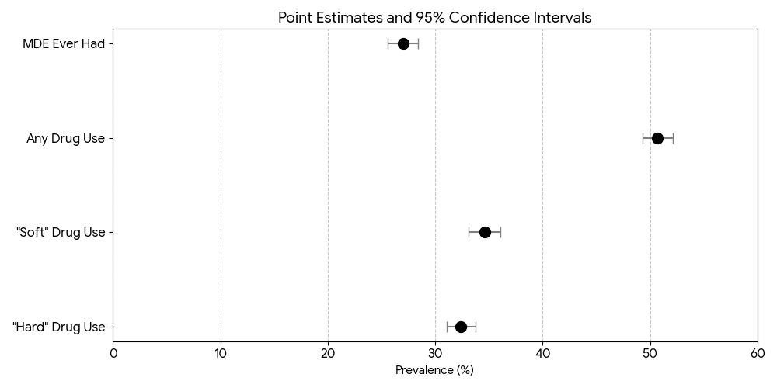
Descriptives
Maybe we’ll do a visual on this slide instead of table

Slide 15
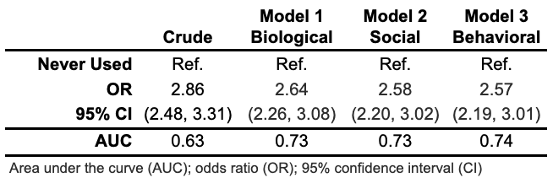
Aim 1 - Any Drugs Ever Used
Logistic regression model adjustments:
1 - age group, sex
2 - race, current grade level
3 - arguments with parents
Crude indicates drug use is associated with almost 3x odds of a MDE. After adjustment, association attenuates but remains robust and statistically significant at almost 2.6x odds.
Suggests any drug use is a strong predictor of MDE in adolescents.
Biological factors provide considerable increase to model’s predictive power.

Slide 16
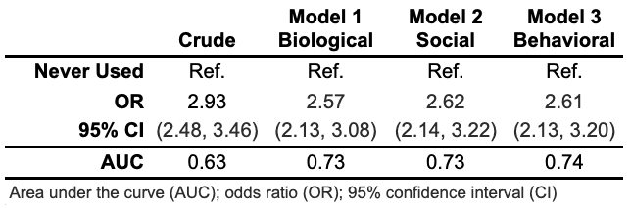
Aim 2a Model - “Soft” Drugs Ever Used
Logistic regression model adjustments:
1 - age group, sex
2 - race, current grade level
3 - arguments with parents
Crude indicates drug use is associated with almost 3x odds of a MDE. After adjustment for covariates, association attenuates but remains robust and statistically significant at 2.6x odds.
Suggests “soft” drug use is an independent predictor of MDE in adolescents.
Biological factors provide considerable increase to model’s predictive power.

Slide 17
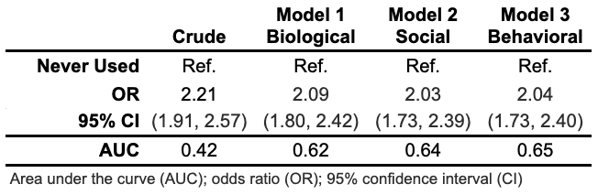
Aim 2b Model - “Hard” Drugs Ever Used
Logistic regression model adjustments:
1 - age group
2 - race, current grade level
3 - arguments with parents
Crude indicates drug use is associated with >2x odds of a MDE. After adjustment for covariates, association attenuates slightly but remains significant.
Suggesting “hard” drug use is a predictor of MDE in adolescents.
Biological factors provide considerable increase to model’s predictive power.
Sex not a significant confounder.

Slide 18
Discussion

Slide 19
Across all three categories, a history of substance use is a strong, independent predictor of experiencing a MDE in adolescents.
Persistent association seen even after adjustments for biological, social, and behavioral factors.
Misconception of “soft” vs “hard” - strongest association with “soft” drug use.
Models are better at identifying at risk youth once adjusted, especially for biological factors.

Slide 20
Strengths
Limitations
Use of NSDUH data provides national representation as a large-scale dataset.
Statistical weights allows survey to capture a broad population of youth.
Cross-sectional design of the NSDUH limits inference of causality.
Survey relies on self-reported data, which introduces biases.
Absence of some topics in dataset.
Operational definitions of “soft” and “hard” drugs.

Slide 21
Conclusions

Slide 22
Substance use, regardless of the type of drug, is a resilient and independent marker for adolescent depression.
While biological factors are the strongest contributors to the model’s overall predictive accuracy, the consistent 2-3x risk across all drug categories highlights a critical need for integrated mental health and substance use screening in adolescent populations.

Slide 23
Implications
Future Work
Universal vs Targeted Screening
Integrated Treatment Models
Biological Vulnerability
Directional and Longitudinal Analysis
Mediation and Moderation Analysis
Substance Specificity
Policy Impacts and Advocacy

Slide 24
Thank you!

Slide 25
References
Simon, K. M., Levy, S. J., & Bukstein, O. G. (2022, May 24). Adolescent Substance Use Disorders - PMC. National Library of Medicine. Retrieved November 30, 2025, from https://pmc.ncbi.nlm.nih.gov/articles/PMC11003516/#R6
The Partnership. (2011, May). Adolescent Substance Use: America’s #1 Public Health Problem. Partnership to End Addiction. https://drugfree.org/reports/adolescent-substance-use-americas-1-public-health-problem
Substance Abuse and Mental Health Services Administration. (2024, July). Key Substance Use and Mental Health Indicators in the United States: Results from the 2023 National Survey on Drug Use and Health. SAMHSA. Retrieved November 30, 2025, from https://www.samhsa.gov/data/sites/default/files/reports/rpt47095/National%20Report/National%20Report/2023-nsduh-annual-national.pdf
Substance Abuse and Mental Health Services Administration. Highlights for the 2023 National Survey on Drug Use and Health. SAMHSA; 2024. https://www.samhsa.gov/data/sites/default/files/NSDUH%202023%20Annual%20Release/2023-nsduh-main-highlights.pdf

Slide 26
Supplemental Slides

Slide 27
Keele Prep – what might you be asked
What is multistage complex sampling?
How were confounding variables and models selected?
Candidate confounders – literature
Confounders – chi square stats check
Model selection: You will need to be able to explain the time-oriented epoch strategy.
Why hard vs soft drugs?
Public health implications

