Slide 1
Laser Speaker Dude
Keelin Becker-Wheeler
Oliver Kisielius

Slide 2
Motivation
Motivation
Lasers are cool
Poor man's fiber-optic cable

Slide 3
Design Specifications
Take input from microphone and stereo audio cable
Mix them
Amplify to 3-5V range
Use a laser to transmit the resulting wave
Restore the laser to a voltage wave (c. 1V)
Play it with a speaker
Profit

Slide 4
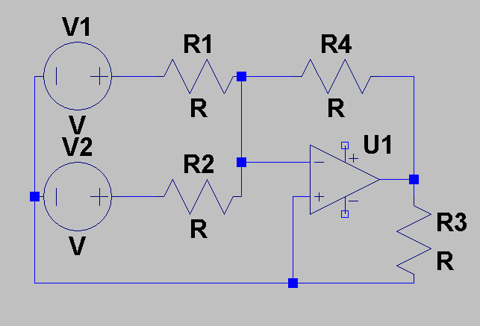
Transmitter
Summing circuit
Vout = -R4(V1/R1 + V2/R2)

Slide 5
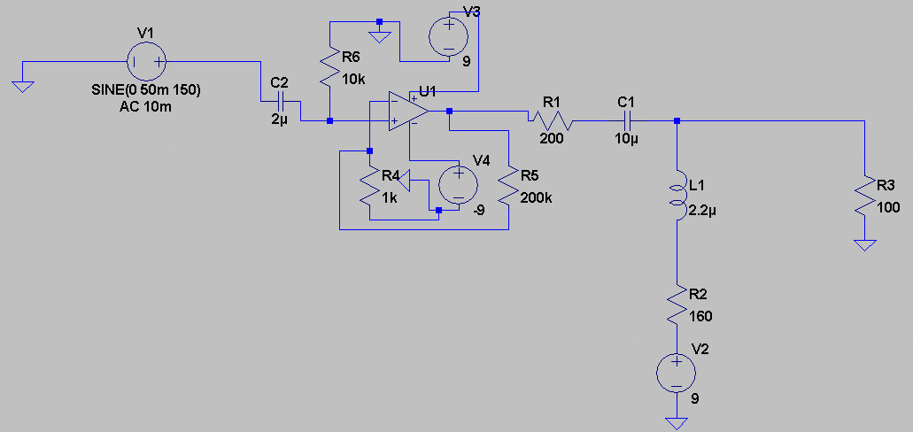
Transmitter
V1 is the output of the summing circuit
R3 is to be in series with the laser

Slide 6
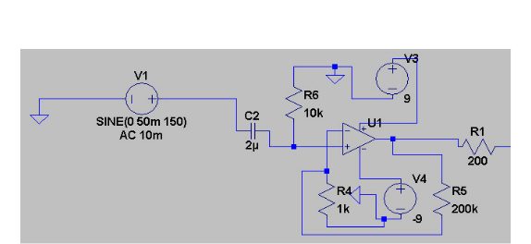
Receiver
V1 is the photodiode
R1 should be 8ohm (the speaker)
(This is exactly the amplifier from the transmitter)

