Slide 1
Smart Gesture-Based Communication System for Non-Verbal Patient Assistance

Slide 2
CONTENTS
ABSTRACT
OBJECTIVE
EXISTING METHOD
PROPOSED METHOD
BLOCK DIAGRAM
WORK FLOW
DESCRIPTION
LIBRARIES/FRAMEWORKS
HARDWARE TOOLS
SOFTWARE TOOLS
ADVANTAGES

Slide 3
ABSTRACT
The Smart Gesture-Based Communication System enables non-verbal and bedridden patients to communicate their needs using AI-driven hand gesture recognition, ensuring timely caregiver assistance.
Traditional communication methods for non-verbal patients are often ineffective, leading to misinterpretation, delays, and discomfort.
The system utilizes an ESP32 camera to detect hand gestures, where each finger represents a specific request like water, food, or emergency.
Detected gestures are processed in real-time, transmitted via Firebase, and displayed through a buzzer, LCD, and colored lights, providing immediate and accurate feedback to caregivers.

Slide 4
OBJECTIVE
Enhance communication for non-verbal patients using AI-driven hand gesture recognition.
Utilize an ESP32 camera to detect hand gestures, mapping finger counts (1 to 5) to specific patient needs like water, food, or emergency.
Process gestures in real-time and transmit data via Firebase for instant caregiver response.
Provide a user-friendly interface with an LCD display, buzzer alerts, and colored lights for clear visual and auditory feedback.

Slide 5
EXISTING METHOD
Traditional communication methods for bedridden and non-verbal patients rely on physical gestures, manual signaling, or verbal interpretation by caregivers. These methods can be inefficient, prone to miscommunication, and require constant caregiver presence. In some cases, assistive devices like call buttons or communication boards are used, but they often lack adaptability for patients with limited mobility. Additionally, delays in recognizing patient needs can lead to discomfort, distress, or medical complications. The absence of a real-time, intuitive, and automated communication system highlights the need for a more efficient and responsive solution.

Slide 6
PROPOSED METHOD
The Smart Gesture-Based Communication System uses AI-driven hand gesture recognition to help non-verbal, bedridden patients communicate efficiently. An ESP32 camera captures finger count-based gestures (1 to 5), processed using MediaPipe, and mapped to predefined requests (water, food, medicine, emergency, happy). Recognized gestures are sent to Firebase, triggering visual alerts (bulbs), a buzzer, and an LCD update for real-time caregiver response. This automated, intuitive system ensures faster assistance, improved patient comfort, and better healthcare support.

Slide 7
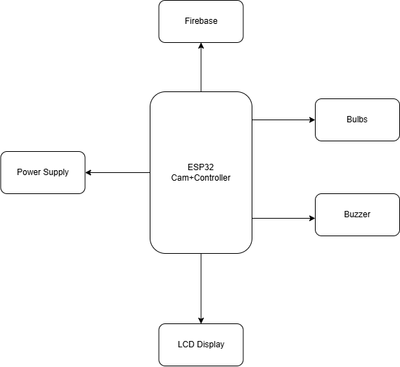
BLOCK DIAGRAM

Slide 8
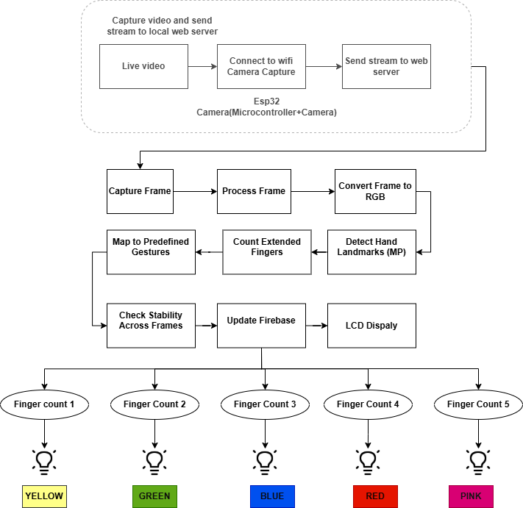
WORK FLOW

Slide 9
WORK FLOW

Slide 10
DESCRIPTION
Video Capture and Streaming
Capture & Send Stream: Continuously capture video from the ESP32 camera and send it to a local web server for display.
Live Video: Stream the captured video in real-time.
Wi-Fi Connection: The ESP32 camera connects to Wi-Fi to transmit the video stream.
ESP32 Camera: Utilizes an ESP32 microcontroller with a camera module for video capture and streaming.

Slide 11
DESCRIPTION
Frame Processing and Gesture Recognition
Capture & Process Frame: Divide the video into individual frames and process them for hand gestures.
Convert to RGB: Convert frames to RGB format for easier processing.
Map Gestures: Detect hand gestures (e.g., 1 finger = water, 2 fingers = food).
Count Fingers: Identify the number of extended fingers.
Detect Hand Landmarks (MP): Use MediaPipe to detect hand landmarks and interpret gestures.
Check Stability: Ensure consistency of detected gestures across multiple frames.
Update Firebase & LCD: Log gestures to Firebase and display them on an LCD screen.

Slide 12
DESCRIPTION
Finger Count Output and Visualization
Finger Counts 1–5: Each finger count represents a different request.
Colored Light Bulbs: Different light colors correspond to each gesture:
1 finger = Yellow (Water)
2 fingers = Green (Food)
3 fingers = Blue (Medicine)
4 fingers = Red (Emergency)
5 fingers = Pink (Happy)

Slide 13
Libraries/Frameworks
opencv-python
mediapipe
firebase-admin

Slide 14
HARDWARE TOOLS
Source of Supply: USB cable
ESP32 Camera
Esp32 Microcontroller
Lcd Display
Buzzer
Bulbs(Red,Green,Yellow,Blue,Pink)

Slide 15
SOFTWARE TOOLS
Software Tools: Visual Studio, ArduinoIDE
Programming Language: Python, Arduino language

Slide 16
ADVANTAGES
Enhanced Caregiver Interaction:
The system gives caregivers real-time insights, enabling quicker, more effective responses to non-verbal patients.
Personalized Assistance:
It tailors communication to each patient, ensuring their unique needs are met.
Promotes Independent Living:
Gesture-based communication empowers non-verbal patients to interact freely, fostering independence.

Slide 17
THANK YOU

