Slide 1

Predicting Relapse of Myocardial Infarctions
By Keely Grice and Lou Lindsley

Slide 2
Process
Data Cleaning and Background Research
LASSO Model
Logistic Modeling
Reflection

Slide 3
Research Questions
Building a predictive model for relapse of Myocardial Infarction (MI)
Comparing imputation techniques
  Median
  K-Nearest Neighbor

Slide 4
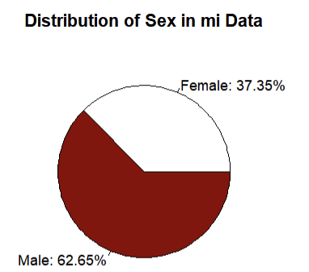
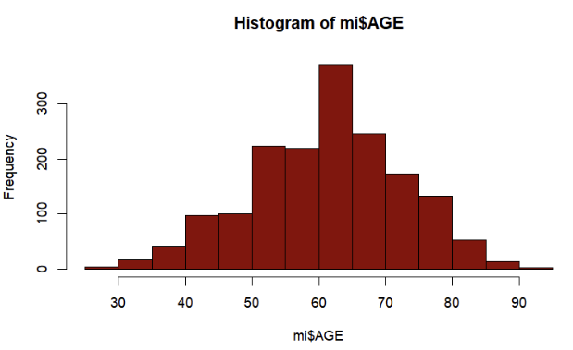
Demographics

Slide 5
Missing
Total Missing data (7.6%)
It
It
Missing ≥ 30%
It
Missing ≤ 12%
12% ≤ Missing < 30%
Binary Cutoff?
Dropped*
Kept
Dropped*
Kept
*3.75% total missing after dropping

Slide 6
Missing
Total Missing data (7.6%)
It
It
Missing ≤ 12%
12% ≤ Missing < 30%
Binary Cutoff?
Kept
Kept
Imputed with median or k-NN

Slide 7

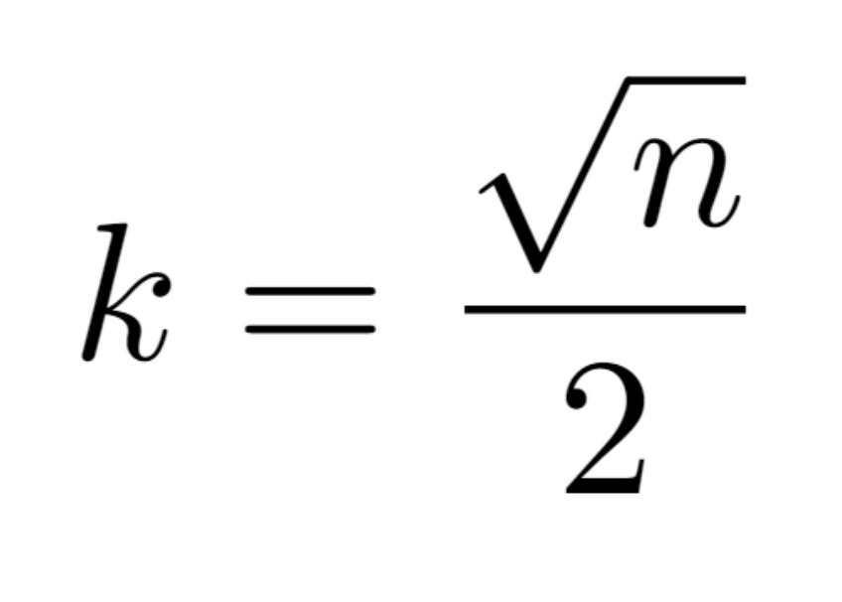
Data Cleaning: k-NN
What is Nearest Neighbors?
Maintains original distribution, unlike median imputation
Decrease variance as compared to other imputation methods
Risk of bias
k=21 using standard formula:

Slide 8
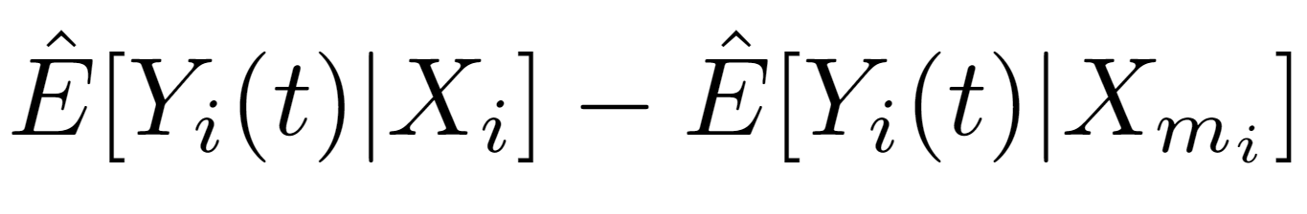
k-NN Bias Calculations
Across several variables found low bias
Further research to estimate bias across all variables
More difficult to estimate across non-binary variables, but binary variables were of greater concern

Slide 9

Covariate Research
Age
  Likelihood of MI and relapse of MI increases^{1,2}
  Changes risk/benefit assessment for certain therapies³
Prior First-Degree Atrioventricular (AV) blockage
  ECG cutoff value associated with poor electrical conduction through the atrioventricular (AV) node⁴
  Leads to problems with pumping blood through atria & ventricles⁴
  Not normally an issue unless older⁴
Use of opioid drugs in the ICU
  Increased odds of high platelet reactivity⁵
  Interaction with antiplatelet therapies⁵

Slide 10

Covariate Research
Age
  Likelihood of MI and relapse of MI increases^{1,2}
  Changes risk/benefit assessment for certain therapies³
Prior First-Degree Atrioventricular (AV) blockage
  ECG cutoff value associated with poor electrical conduction through the atrioventricular (AV) node⁴
  Leads to problems with pumping blood through atria & ventricles⁴
  Not normally an issue unless older⁴
Use of opioid drugs in the ICU
  Increased odds of high platelet reactivity⁵
  Interaction with antiplatelet therapies⁵

Slide 11

Covariate Research
Age
  Likelihood of MI and relapse of MI increases^{1,2}
  Changes risk/benefit assessment for certain therapies³
Prior First-Degree Atrioventricular (AV) blockage
  ECG cutoff value associated with poor electrical conduction through the atrioventricular (AV) node⁴
  Leads to problems with pumping blood through atria & ventricles⁴
  Not normally an issue unless older⁴
Use of opioid drugs in the ICU
  Increased odds of high platelet reactivity⁵
  Interaction with antiplatelet therapies⁵

Slide 12
Process
Data Cleaning and Background Research
LASSO Model
Logistic Modeling
Reflection

Slide 13
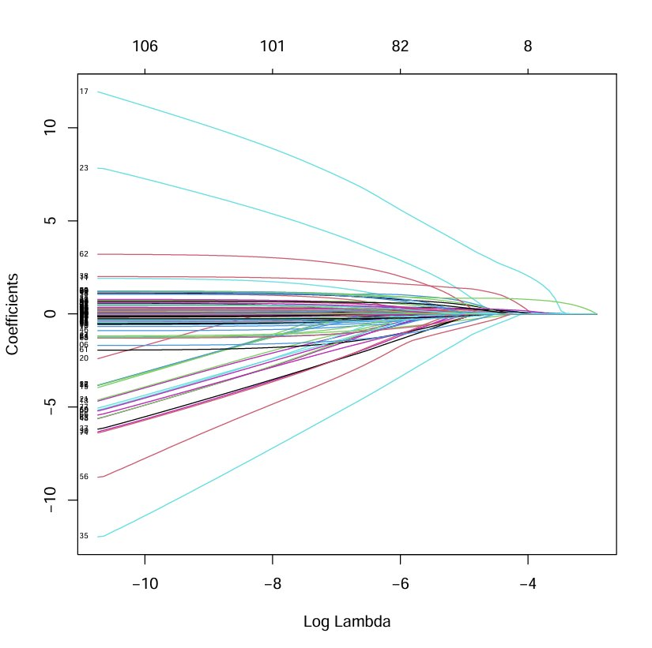
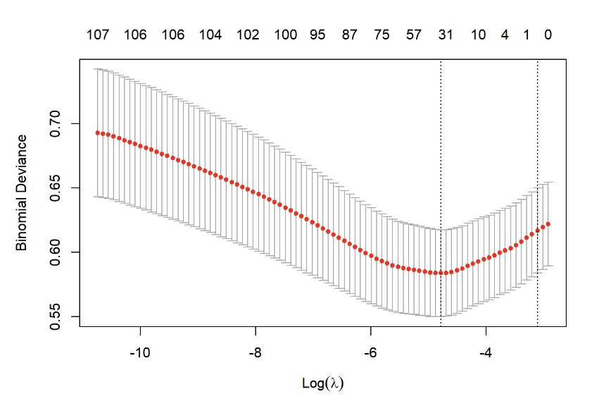
LASSO
Chose over Ridge because interested in a simpler model
Resulting model contained 32 variables; not feasible in clinical practice
Found more implementable models from logistic models

Slide 14
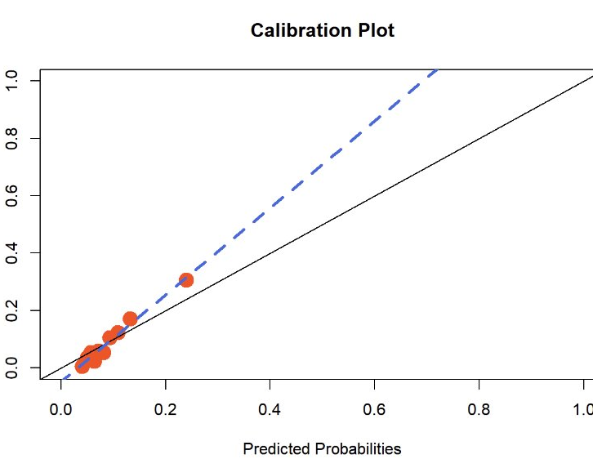
Calibration
Slope: (1.31, 1.73)

Slide 15
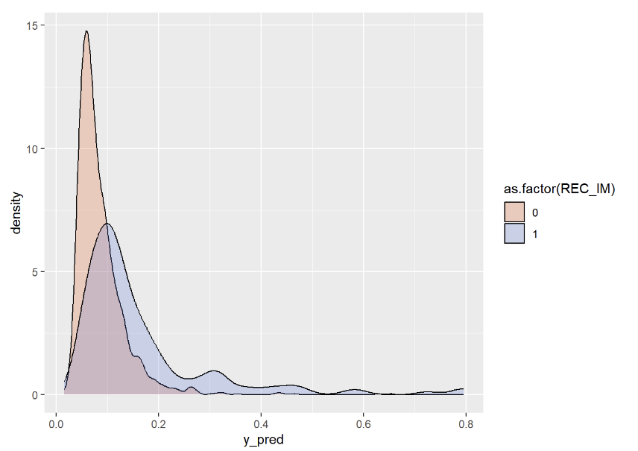
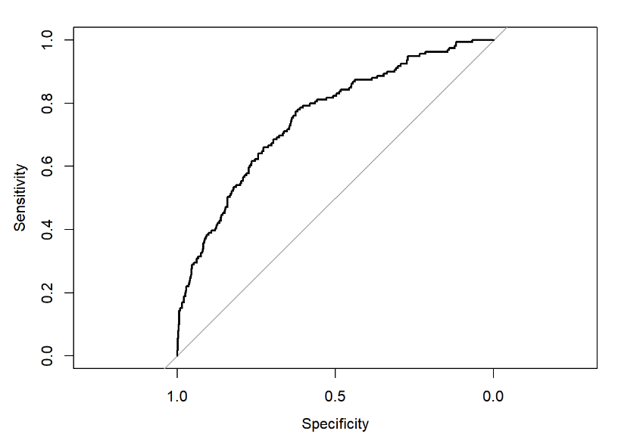
Discrimination
Area under ROC curve = 0.7545

Slide 16
Process
Data Cleaning and Background Research
LASSO Model
Logistic Modeling
Reflection

Slide 17
Regression Analysis
Stepwise (Median, k-NN)
All high calibration, low discrimination
No interaction terms were significant
Majority interaction values were zero
1
2
3
4
Best Subset (k-NN)
1
1
2
1
2
3

Slide 18
Covariates
Stepwise (kNN)
Use of Anticoagulants
Tachycardia at admission
More feasible for a clinician to measure
Age and use of opioid drugs were always highly correlated (p<0.001)
AV block was in every model, but consistently had a high p-value
Best Subset (kNN)
Age
Opioids
AV Block
Stepwise (Median)
Chronic Bronchitis

Slide 19
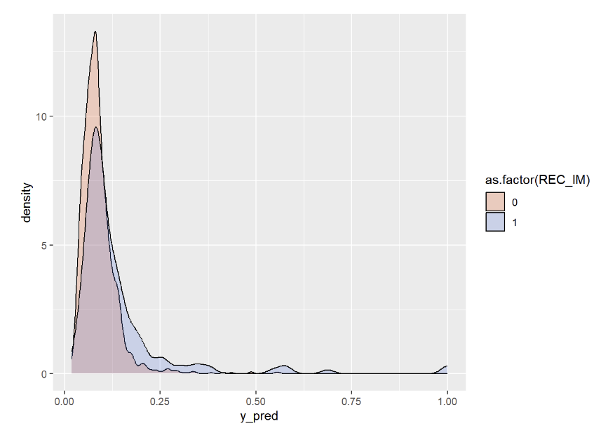
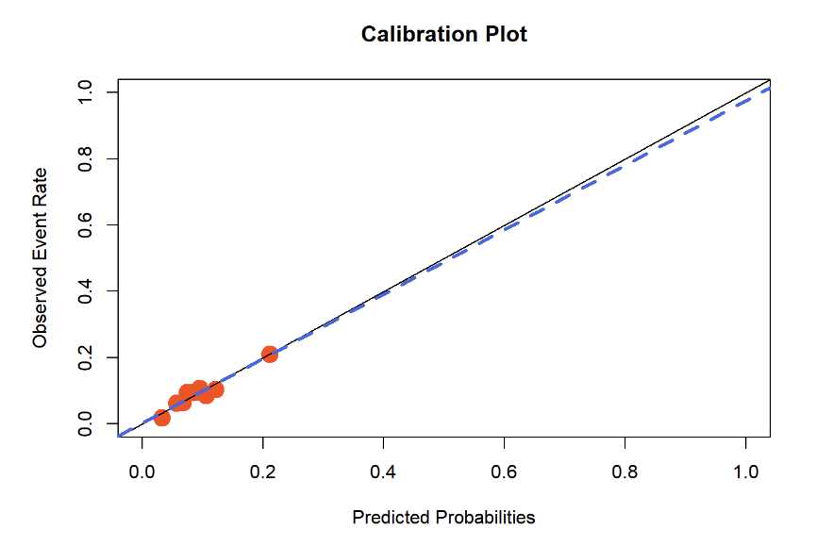
Calibration and Discrimination
From Median Imputation
From k-NN Logistic Regression
Slope: (0.74, 1.21)

Slide 20
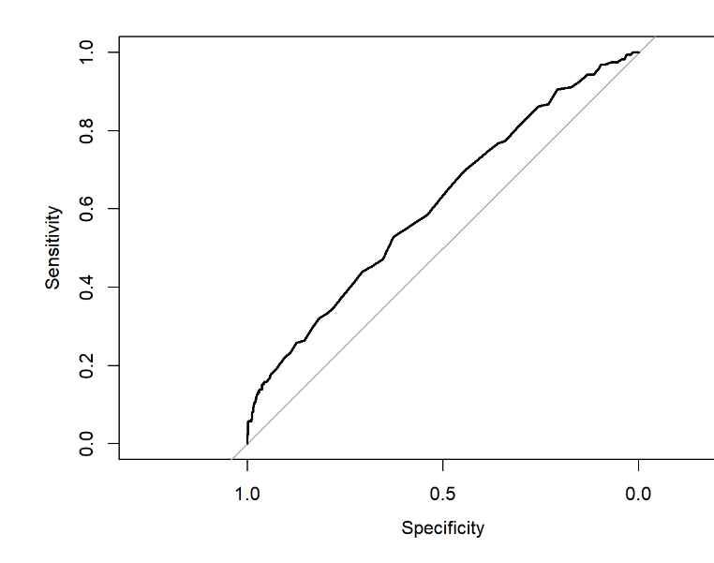
ROC Curve:
Best Subset
Area under the curve ranges from 0.6126 to 0.6456, across all logistic models

Slide 21
Process
Data Cleaning and Background Research
LASSO Model
Logistic Modeling
Reflection

Slide 22
Reflection
Narrow covariates from background research
More modeling with interactions (best subset or LASSO)
Use ML to determine most effective k value for k-NN

Slide 23
References
McMechan SR, Adgey AAJ. Age related outcome in acute myocardial infarction. BMJ. 1998;317(7169):1334-1335. doi:10.1136/bmj.317.7169.1334
Gharacholou SM, Lopes RD, Alexander KP, et al. Age and outcomes in ST-segment elevation myocardial infarction treated with primary percutaneous coronary intervention: findings from the APEX-AMI trial. Arch Intern Med. 2011;171(6). doi:10.1001/archinternmed.2011.36
Brewster GS. Heparin should be administered to every patient admitted to the hospital with possible unstable angina. West J Medicine. 2000;173(2):138-140. doi:10.1136/ewjm.173.2.138
Oldroyd SH, Quintanilla Rodriguez BS, Makaryus AN. First-degree heart block. In: StatPearls. StatPearls Publishing; 2024. Accessed July 17, 2024. http://www.ncbi.nlm.nih.gov/books/NBK448164/
Chen H, Wang H, Li B, Hong L, Kuang M, Yang L. Analgesic drug use in patients with STEMI: Current perspectives and challenges. Front Med. 2023;10:1148581. doi:10.3389/fmed.2023.1148581

Slide 24
Q&A

