Slide 1
ShiftSwap
A shift schedule and substitute management system for small part-time workplaces
Team 7 · Software Engineering, Fall 2026 · SeoulTech
Hyewon Kim · Hyoungdo Kim · Minkyung Kim
Notes:
[Hyoungdo Kim · about 0.5 min]
Good afternoon. We are Team 7. Our project is ShiftSwap, a system that manages part-time shift schedules and substitute requests in small stores. Hyewon will present the problem and the requirements, I will present the design and how we built it with vibe coding, and Minkyung will show the system, the tests and our results.

Slide 2
One exam, five phone calls
Wednesday 18:00–23:00 — Seoyeon has a midterm exam.
The owner calls co-workers one by one until someone says yes.
Then edits the spreadsheet, and later re-checks two workers' weekly hours for holiday allowance.
2 / 16 · Hyewon Kim
Notes:
[Hyewon Kim · about 0.8 min]
This is a real situation from the café where I work. When a worker cannot come, the owner phones the other workers one at a time. In our store that is usually three to five contacts per request. After someone agrees, the owner edits the spreadsheet, and at month end has to check again whether each of the two workers still qualifies for the weekly holiday allowance.

Slide 3
Three problems
P1
P2
P3
Finding a substitute
Keeping records right
Applying pay law
Repeated one-to-one contacts for every request (3–5 in the reference store).
Every swap changes the schedule and weekly hours of two workers; all recalculation is manual.
Minimum wage, 15-hour holiday-allowance threshold, 5-employee premium rule and probation are applied from memory.
3 / 16 · Hyewon Kim
Notes:
[Hyewon Kim · about 0.9 min]
We grouped the difficulties into three problems. P1 is the cost of finding a substitute. P2 is that every swap changes two workers' schedules and weekly hours, and nothing recalculates them. P3 is that labour-law pay rules are applied from memory, so mistakes are found only on payday, if at all.

Slide 4
Requirements in numbers
3
13
23
actors
use cases
functional req.
Worker, Owner, System Clock
UC-14 added, UC-02 retired
FR-01 … FR-24, FR-03 retired
16
15
11
non-functional req.
business rules
tables
Product · Organisational · External
BR-01 … BR-15, each tested
same schema in SQLite and PostgreSQL
4 / 16 · Hyewon Kim
Notes:
[Hyewon Kim · about 0.9 min]
From interviews and the legal sources we wrote twenty-three functional requirements and sixteen non-functional requirements, classified as product, organisational and external requirements as in Chapter 8. The core logic is captured in fifteen business rules, and the data in eleven tables, which exist both in the browser database and in the shared database. This is well above the course minimum of five use cases and four tables.

Slide 5
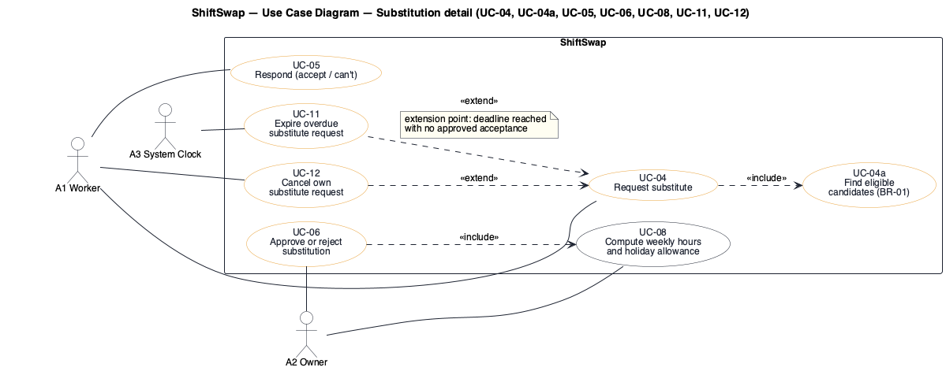
Use cases
Substitution use cases with «include» / «extend» (overview of all 12 in the report)
5 / 16 · Hyewon Kim
Notes:
[Hyewon Kim · about 1.0 min]
This diagram shows the substitution part of the use-case model. A worker requests a substitute; the request includes finding eligible candidates. A candidate responds, and the owner approves, which includes recomputing the weekly hours. Cancellation by the worker and expiry by the system clock extend the request use case.

Slide 6
Pay law as testable rules
BR-06 | Holiday allowance only with ≥ 15 contract hours a week and no absence | Labor Standards Act Art. 18 ③, 55
BR-07 | Holiday hours = min(hours, 40) ÷ 40 × 8 | Enforcement Decree Art. 30
BR-08 | 50 % premiums only with 5 or more regular employees | Art. 11, 56
BR-08/15 | Part-time: hours beyond contract earn 50 %; warn above 12 h a week | Fixed-term and Part-time Employees Act Art. 6
BR-09/10 | Warn below KRW 10,320; 90 % only in qualifying probation | Minimum Wage Act Art. 5 ②
6 / 16 · Hyewon Kim
Notes:
[Hyewon Kim · about 1.0 min]
The legal rules became business rules that can be tested. For example, the holiday allowance exists only when the contract has at least fifteen hours a week and the worker was not absent; the hours are capped at forty. In workplaces with five or more regular employees, a part-time worker's hours beyond the contract earn the premium, and the approval card warns when a swap would exceed the legal limit of twelve such hours a week. Because handing a shift over is legally unclear, the attendance effect of a swap is a setting the owner chooses.

Slide 7
A requirement we changed
Found
Decided
Result
A dead end
Ask everyone, allow 'can't'
A clear ending
When nobody's availability matched, the owner was only told 'no candidate' and could do nothing.
Availability is no longer collected. Every co-worker not already working is asked; the first to accept takes it.
If everyone answers 'can't', the requester is told to call the owner and the owner gets one card to acknowledge.
7 / 16 · Hyewon Kim
Notes:
[Hyewon Kim · about 0.8 min]
Using the running system showed us a dead end: when nobody's registered availability matched, the owner was told there was no candidate but had nothing to do, and workers had to keep their availability up to date. We changed the requirement. Availability is gone; every co-worker who is not already working is asked, and anyone can answer 'can't'. If all of them do, the request ends clearly: the requester is asked to call the owner, and the owner gets one card to acknowledge. We retired UC-02 and FR-03 instead of reusing their numbers, so traceability stays intact. I now hand over to Hyoungdo.

Slide 8
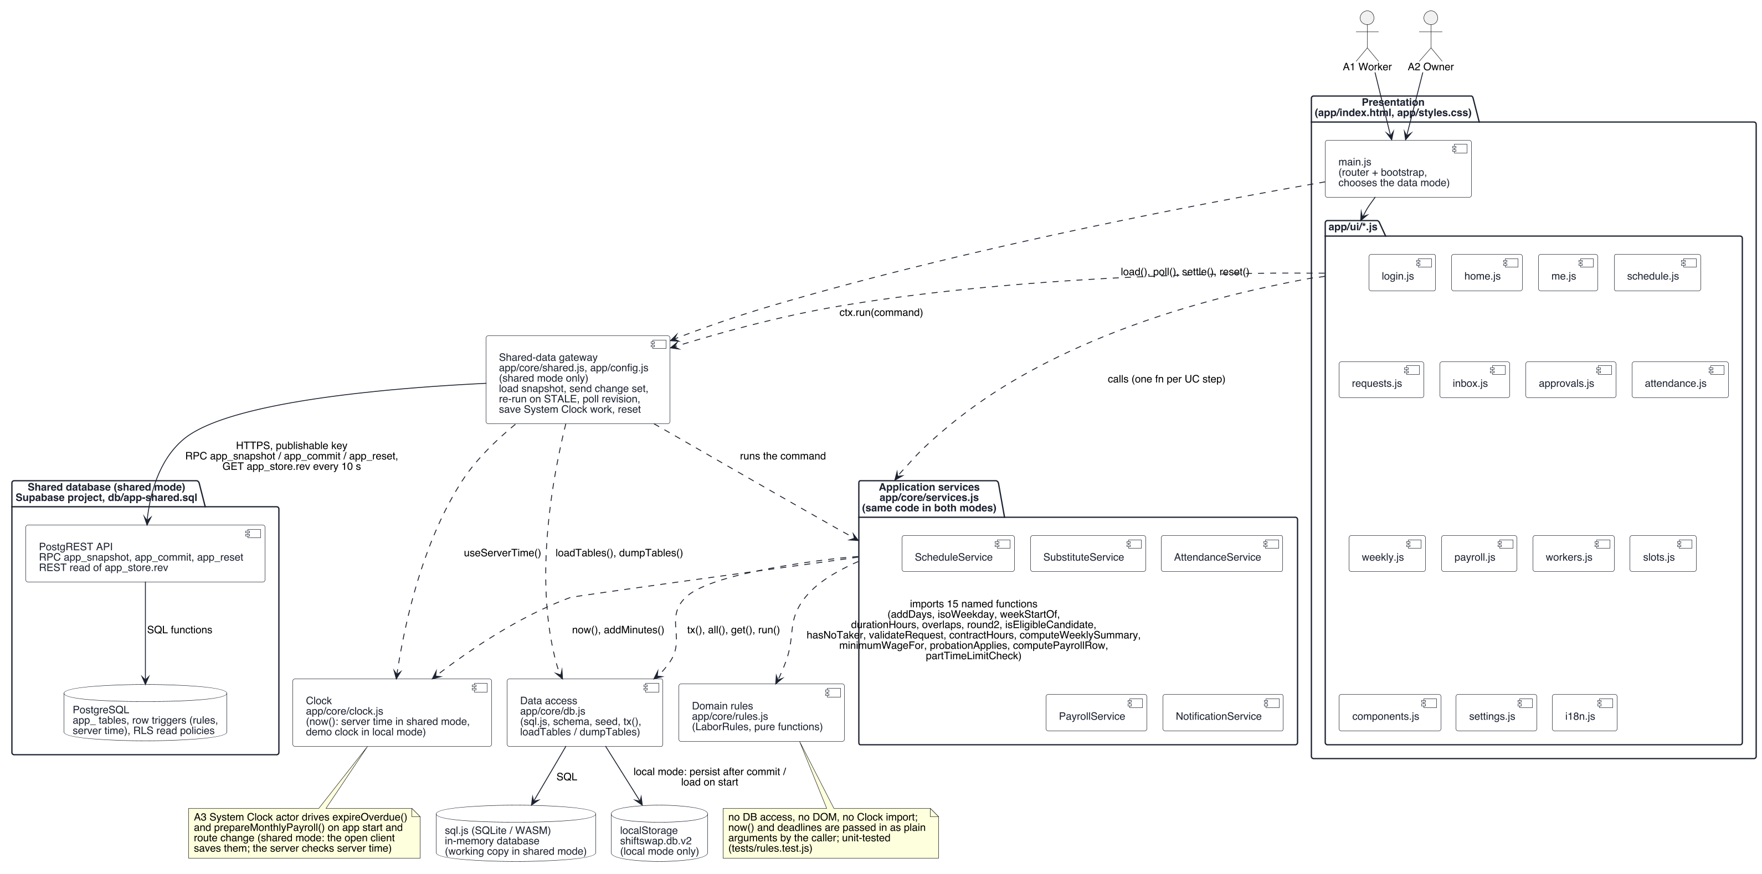
Architecture: a static web app and a shared database
Presentation → application services → pure rules → SQLite working copy (sql.js) → shared database (three RPC functions) or localStorage
8 / 16 · Hyoungdo Kim
Notes:
[Hyoungdo Kim · about 0.9 min]
The application is a static web app on GitHub Pages; it has no application server of its own. The user interface calls application services, one per use-case step. The services call pure rule functions that contain no database code, which is why every rule can be unit-tested. The services work on a SQLite working copy compiled to WebAssembly. In the default shared mode the working copy is loaded from a hosted PostgreSQL database, and every change is sent back as one change set through a single database function that checks the revision and the state rules, so everyone sees the same café. The local demonstration mode keeps the data in the browser, as before.

Slide 9
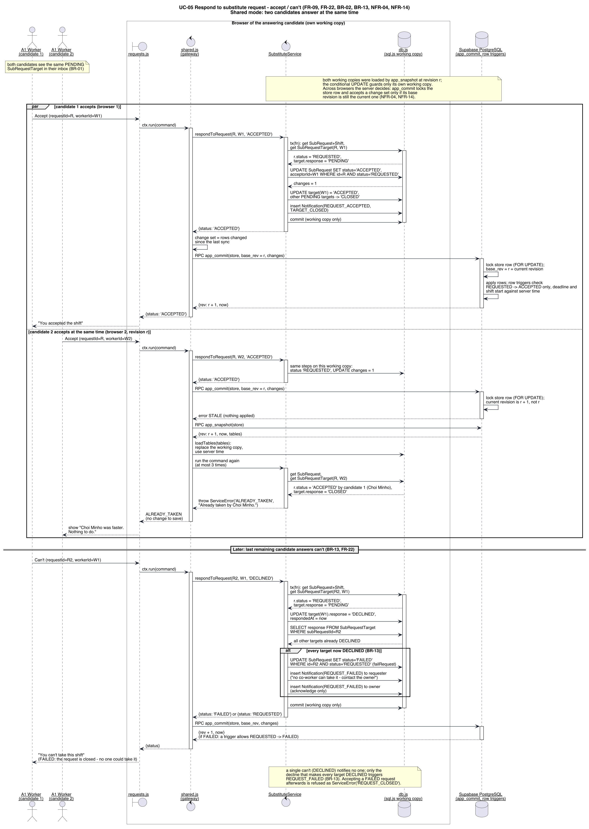
First acceptance wins
Sequence SD-2: the second acceptance re-checks the state inside its transaction and is refused
9 / 16 · Hyoungdo Kim
Notes:
[Hyoungdo Kim · about 1.0 min]
The most delicate interaction is two candidates accepting at almost the same time. Each acceptance runs in one transaction that first re-reads the request state. Only the first finds it REQUESTED; the second sees ACCEPTED, rolls back, and the worker is told who already took the shift. With the shared database the same holds across two phones: the database accepts only a change set based on the latest revision, so the slower phone reloads, re-runs the acceptance and gets the same message.

Slide 10
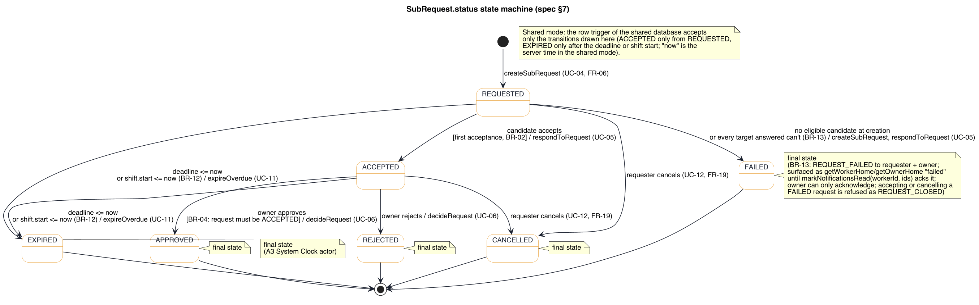
Life of a substitute request
State diagram: REQUESTED → ACCEPTED → APPROVED / REJECTED, with EXPIRED and CANCELLED
10 / 16 · Hyoungdo Kim
Notes:
[Hyoungdo Kim · about 0.9 min]
This state diagram is the contract between screens, services and tests: every transition has a triggering function and at least one test. For example, a request that reaches its deadline or its shift start without approval expires automatically.

Slide 11
Vibe coding: eight prompt versions
v1 | Specification + technology, screens, design, done criteria | App built; 21 ambiguities logged by the build
v2 | Ambiguities and document-review gaps resolved in the spec | Acknowledgement column, notification recipients, S7 walkthrough
v3 | UI review of the running app | Time-grid board, page purposes, overview strip, empty states
v4 | UX redesign review: task-first, one primary action | Role Home screens, 3-step request flow, consequences shown before commit
v5 | Rebuild in an empty folder + independent code review | Tests become input; 7 defects fixed
v6 | Requirements change after using the app | Availability removed; 'can't' answer; FAILED ending
v7 | Owner request: history and automatic payroll | Contract history seeded; last month's draft on the 1st
v8 | Proposal revision: shared data, part-time law | Shared database with local fallback; part-time overtime and 12 h warning
11 / 16 · Hyoungdo Kim
Notes:
[Hyoungdo Kim · about 1.4 min]
We did not write code by hand. We wrote one prompt that treats the specification as a contract, and let the AI coding assistant build the system. Every ambiguity the build found went into a prompt log and back into the specification. Eight versions were needed; the last one followed the revised proposal: a shared database, so that everyone who opens the demo sees the same data, and the part-time overtime rule. The last one came from re-running the prompt in an empty folder: the rebuilt system worked, but its function signatures differed from ours, so version five supplies our test files as the contract. I hand over to Minkyung.

Slide 12
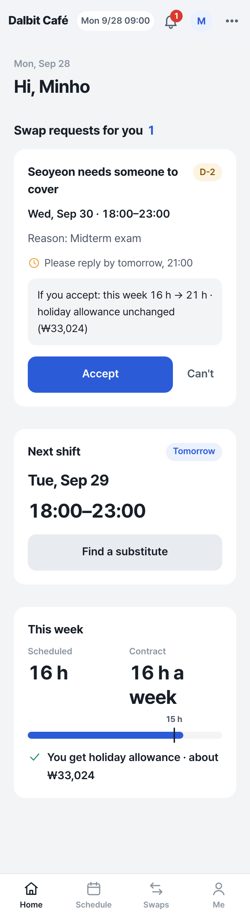
Demo: the request comes to you
Minho's Home: the request card shows the effect on his week before he taps Accept (one tap, NFR-01)
12 / 16 · Minkyung Kim
Notes:
[Minkyung Kim · about 1.2 min]
Here is the system with our demo café. Seoyeon requested a substitute for Wednesday. The system asked the three co-workers who are free at that time, all at once. Minho does not have to look for it: his Home screen shows the request first, together with what accepting means for him — sixteen to twenty-one hours this week, holiday allowance unchanged. One tap accepts. When Doyun tries a moment later, he is told Minho was faster.

Slide 13
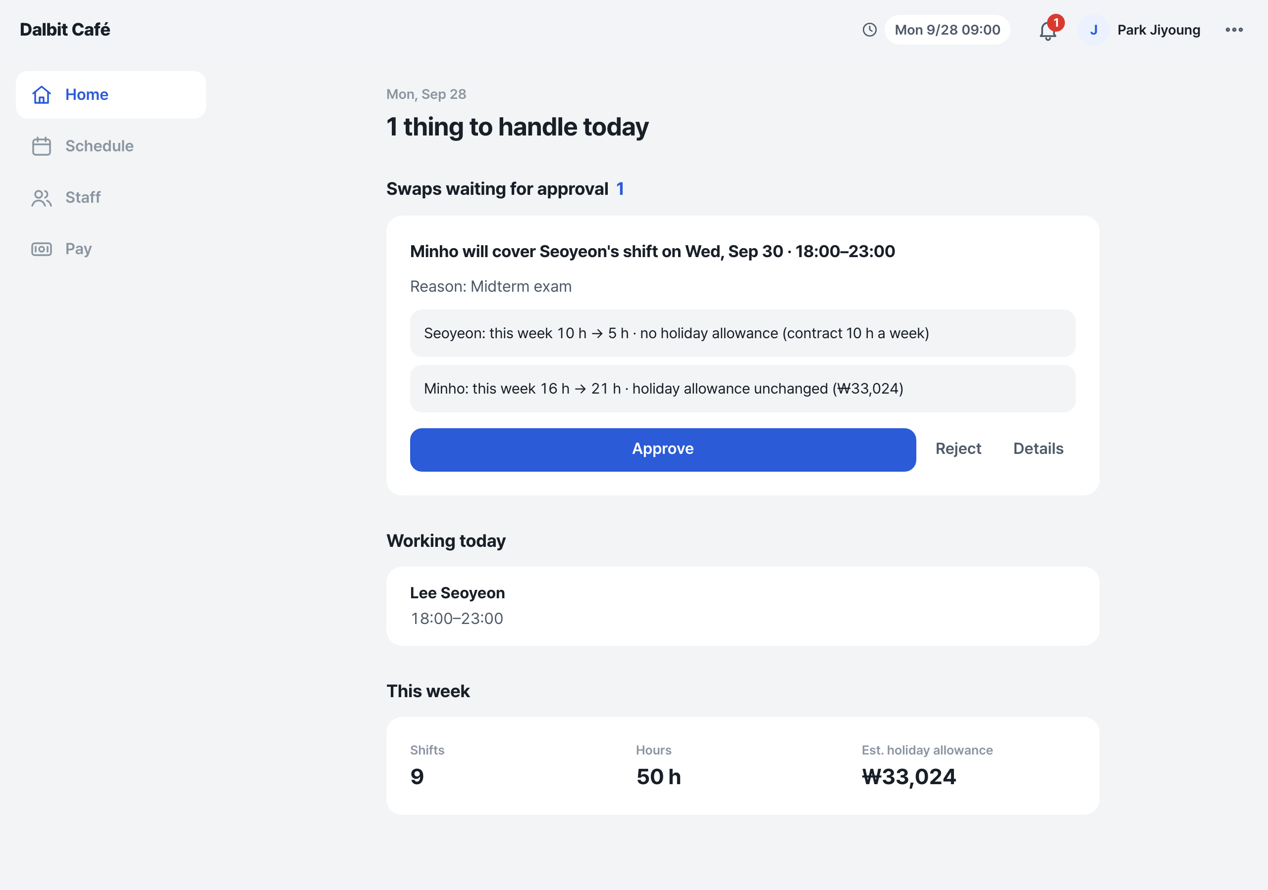
The owner decides on one card
Owner Home: '1 thing to handle today' — the swap, its effect on both workers, and one Approve button
13 / 16 · Minkyung Kim
Notes:
[Minkyung Kim · about 1.2 min]
The owner opens the app and sees one thing to handle today. The card states the effect on both workers. Minho's scheduled hours rise from sixteen to twenty-one, but his contract hours stay sixteen, so he keeps the holiday allowance of three point two hours, which is 33,024 won. After approval the board shows the handover in amber.

Slide 14
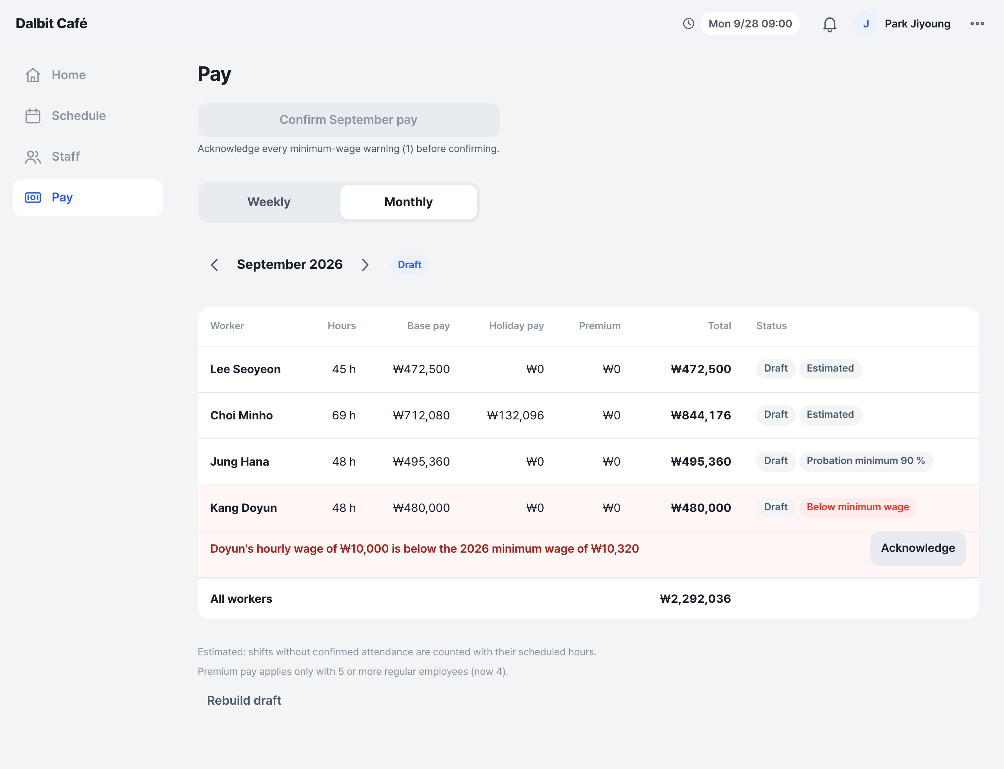
Month end: payroll prepares itself
Doyun's wage is below the 2026 minimum: 'Confirm September pay' stays disabled, with the reason, until acknowledged
14 / 16 · Minkyung Kim
Notes:
[Minkyung Kim · about 0.9 min]
On the first day of each month the system prepares last month's payroll as a draft and tells the owner. March to August are already confirmed from the employees' contracts. Doyun's hourly wage is below the 2026 minimum wage, so the row is flagged and the month cannot be confirmed until the owner acknowledges the warning.

Slide 15
Testing
125/125
15/15
113/113
tests pass
business rules tested
tests pass in a clean rebuild
npm test, Node test runner
every BR has ≥ 1 test
final prompt v8 re-run in an empty folder
23/23
2
FRs traced
browsers at once
FR → UC → screen → function → test
shared database: one acceptance wins (12/12 checks)
15 / 16 · Minkyung Kim
Notes:
[Minkyung Kim · about 1.0 min]
All 125 automated tests pass. They include boundary values such as fourteen point nine nine versus fifteen hours, the forty-hour cap, both attendance policies, the part-time limit, and the concurrent acceptance — also between two browsers on the shared database. The traceability matrix in the report links every functional requirement to its use case, screen, function and tests.

Slide 16
Results and limits
Achieved | 0 owner contacts per request · 2-click accept · automatic recomputation for both workers · legal checks before payday
Size | 13 use cases · 11 tables · 6,298 lines of application code · 1,788 lines of tests
Limits | Demo accounts without passwords, so identity is not enforced · no messaging outside the app
Next | Login with row-level ownership · KakaoTalk notifications · field test in the reference store
16 / 16 · Minkyung Kim
Notes:
[Minkyung Kim · about 1.0 min]
To sum up: the owner no longer contacts workers one by one, candidates answer in two clicks, and every swap updates both workers' hours and pay eligibility. Everyone who opens the demo now works on the same shared data. The main limit is that there is no real login: anyone can act as any demo account. The next steps would be login with ownership of each row and a field test in the café. Thank you. We are happy to take questions.

