Slide 1
Sarcasm Detection in Tweets
CS 725 : Introduction to Machine Learning
Kalpesh Patil - 130040019 Navjot Singh - 130110071
Ashwin Bhat - 13D070006 Yash Bhalgat - 13D070014

Slide 2
Introduction
Sarcasm is defined as a cutting, often ironic remark intended to express contempt or ridicule.
Sarcasm detection is the task of correctly labeling the text as 'sarcastic' or 'non-sarcastic'.
Challenging because :-
Lack of intonation
Lack of facial expressions

Slide 3
Data
Querying the Streaming API using keywords #sarcasm and other sentiment tweets, filtering out non-English tweets and re-tweets
Stream data using Twitter
https://github.com/guyz/twitter-sentiment-dataset
Sentiment dataset for Sarcasm detection
https://github.com/dmitryvinn/twitter-sarcasm-measurement

Slide 4
Feature Engineering
Lexical Features
Pragmatic Features
Explicit Incongruity

Slide 5
Lexical Features
Unigrams are used to extract lexical features from the text

Slide 6
Pragmatic Features
Number of capitalizations
Number of emoticons
Number of slang laughter words like “lol”
Number of punctuation marks

Slide 7
Explicit Incongruity
Linguistic theory - positive sentiment contrasted with negative situation
Number of sentiment incongruities
Number of words with positive or negative polarities
Largest positive/negative polarity word sequence
Overall lexical polarity of the input

Slide 8
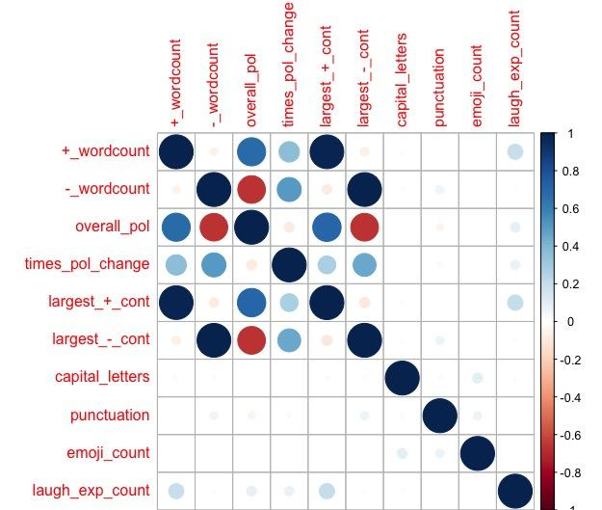
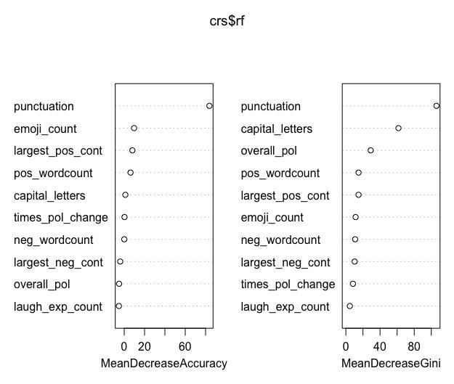
Feature Analysis

Slide 9
Evaluation
Random Forest
Neural Network
SVM
Classifier Models tried →

Slide 10
Random Forest
Accuracy - 0.67
Precision - 0.62
Recall - 0.53
F-score - 0.59
Predicted
0 1
0.44 | 0.13
0.20 | 0.23
Actual
0 1

Slide 11
Neural Network
Accuracy - 0.72
Precision - 0.73
Recall - 0.85
F-score - 0.78
Predicted
0 1
0.20 | 0.19
0.09 | 0.52
Actual
0 1

Slide 12
SVM
Accuracy - 0.73
Precision - 0.71
Recall - 0.93
F-score - 0.81
Predicted
0 1
0.15 | 0.23
0.04 | 0.58
Actual
0 1

Slide 13
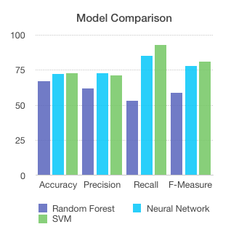
Comparison of Models

Slide 14
Conclusion
LibSVM could handle high dimensionality of features as compared to Neural Networks
Features like punctuation and capitalization are important since they reduce the impurity function
SVM model performs the best!

Slide 15
References
LibSVM : A Library for Support Vector machines
Rattle : A GUI for Data Mining using R
Senti-Strength Tool : automatic sentiment analysis of word corpus.
Keras: Deep Learning library for Theano and TensorFlow

Slide 16
References
Cliche, M. The sarcasm detector, 2014.
Bharti, Santosh Kumar, Korra Sathya Babu, and Sanjay Kumar Jena. "Parsing-based sarcasm sentiment recognition in Twitter data."
Joshi, Aditya, Vinita Sharma, and Pushpak Bhattacharyya. "Harnessing context incongruity for sarcasm detection."

Slide 17
Thank You

