Slide 1


City/County of Broomfield
Investing Basics
Gary Helm
VP West
February 2003

Slide 2
Agenda
Retirement Planning Overview
  Steps to Retirement Investing
  Building a Successful Plan
II. Roadblocks to Financial Success
Understanding Retirement Plans
Investment Basics
Investment Concepts
Resources (Periodicals)
Reading List

Slide 3




Achieving a comfortable retirement in the new millenium requires a focused approach to retirement investing.

Slide 4
457 Plan Contribution Limits
Plan limits
  From $8,500 to $11,000 in 2002
    incrementally to $15,000 by 2006
  25% salary cap increased to 100% of includible compensation
Catch-Up limits
  Plan limit is twice the contribution limit
    for three years preceding normal retirement age
  New “Age 50 Catch-Up”
    Additional $1,000 annually in 2002
      increasing incrementally to $5,000 by 2006
    Beginning in year age 50 reached through employment termination
    Cannot be used in same years as 457 Catch-Up

Slide 5
New Limits
New New Combined
Year 457 Limit Age 50 Limit
(Over 50)
2002 $11,000 $1,000 $12,000
2003 $12,000 $2,000 $14,000
2004 $13,000 $3,000 $16,000
2005 $14,000 $4,000 $18,000
2006 $15,000 $5,000 $20,000
Note: Three (3) year 457 Catch-Up provision not shown

Slide 6
IRA Contribution Limits
More ways to save and invest
From current $2,000 to $3,000 in 2002
  $4,000 in 2005
  $5,000 in 2008
New “Age 50 Catch-Up”
  Additional $500 annually in 2002
    increasing to $1,000 in 2006
  Beginning in year age 50 is reached
IRA

Slide 7
The Catch-Up Provision
The Opportunity to “Catch Up”
Allows participants to catch-up for any year(s) they were eligible to contribute, but did not contribute the maximum amount allowed under the Internal Revenue Code
Use the three-year period prior to your normal declared retirement age
Contribute up to double the normal contribution limit for the year

Slide 8
457 Enhanced Withdrawal Provisions
More control for you at retirement
Eliminates the “60-day rule”
457 similar to 401 in 2002
Allows stopping, starting & changing of disbursements
  Appears also to apply to those in disbursement
Continued flexibility of withdrawal at retirement age, regardless of age
Exception of 10% penalty tax for withdrawals prior to age 59½ continues

Slide 9
Plan Portability
More freedom, choices & decisions
Effective upon separation from service
Can consolidate retirement assets in 2002
Transferable across plan types
  Between 457, 401 & 403 plans at current employer or from prior employer’s plans
  From retirement plans to Traditional IRAs after separation
Plans must permit assets to roll out
Portability designed for our mobile society

Slide 10
457- IRA Rollover Considerations
It all depends upon what you want
Plan to plan roll-over take on the characteristics of the new plan
  Do you want to avoid the 10% penalty?
  Exception: Assets rolled into 457 plan still subject to 10% penalty
Plan to “IRA rollover” take on characteristics of IRA
Tax reform law will make retirement plans (457, 401, 403(b) and IRAs) similar

Slide 11
Additional 457 Withdrawal Provisions
Certain distributions subject to 20% withholding
Surviving spouses may roll-over distributions
Minimum distribution rules for those over 70½ simplified
Qualified plan rules for QDROs (Qualified Domestic Relations Orders) applied to 457 plans
  Recipient of distribution taxed
  Non-employee can withdraw immediately

Slide 12

Steps to Retirement Investing
The key to self-reliance and security…..
a well-constructed financial plan
Assess your current financial picture
Develop a strategy to help you reach your goals
Create a long-term investment program

Slide 13

Building a Successful Plan
Understand the roadblocks
Learn how to manage your cash
Estimate your expenses and manage your spending
Learn about the basics of investing

Slide 14

Roadblocks to Financial Success
Lack of goals
Lack of knowledge
Debt
Inflation
Taxes
Procrastination

Slide 15

Roadblocks to Financial Success
Being goal-oriented keeps you focused and on track to financial independence.
Set goals by considering...
  When?
  Where?
  What will you do?
  What about life expectancy?
  What about the the economy?

Slide 16

Roadblocks to Financial Success
Credit Card \kred’-et kard\ n.:
A means for buying something you don’t need, at a price you can’t afford, with money you don’t have.

Slide 17


Roadblocks to Financial Success
If your money is not working for you, then it is probably losing ground due to inflation.
An estimated inflation rate of 3.5% reduces the value of your dollar by half in just 20 years!

Slide 18
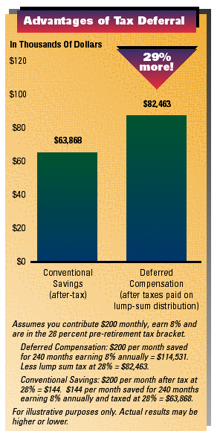
Roadblocks To Financial Success
Tax-Deferred Investing
Generally, one of the best ways to defer taxes is to take advantage
of any tax-deferred or tax-deductible retirement programs available to you, such as employer-sponsored retirement plans or Individual Retirement Accounts (IRA).

Slide 19
Roadblocks To Financial Success
Procrastination
Some people never quite get around to planning for the future. As a result, they fail to reach their financial goals.
“Procrastination is my sin;
It brings me constant sorrow
I really shouldn’t practice it
perhaps I’ll stop tomorrow.”
Source Unknown

Slide 20

Understanding Retirement Plans
Funding Retirement

Slide 21

Understanding Retirement Plans
How will you fund your retirement?
Defined Contribution Plans and Personal Savings
Defined Benefit
Social Security

Slide 22

Understanding Retirement Plans
Social Security Basics
Eligibility?
How much?
For general information on Social Security and to request your “Personal Earnings and Benefits Estimate Statement”,
call 1-800-772-1213 or visit www.ssa.gov

Slide 23
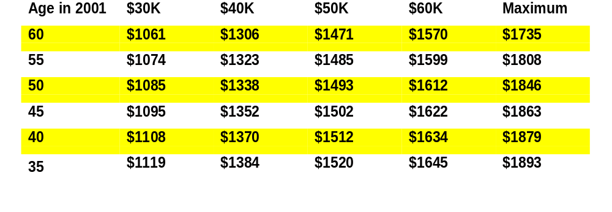
Understanding Retirement Plans
Estimated MONTHLY SOCIAL SECURITY BENEFIT
at Normal Social Security Retirement Age
(in year 2001 Dollars)
AVERAGE ANNUAL EARNINGS (IN YEAR 2001 DOLLARS) FOR 30 YEARS
This benefit estimate may differ significantly from the estimate received from Social Security, which is based on your actual work record.
If you get your benefits from Social Security earlier than your Social Security normal retirement age, your benefit may be reduced by as much as 28.5%.
If you will earn retirement benefits in a job not covered by Social Security your benefit will be figured with a different formula. See Social Security publication 05-10045, A Pension from Work Not covered by Social Security.
A spouse (and sometimes former spouses) may be eligible for an additional benefit equaling the greater of the amount calculated on his or her own work record or 50% of the higher earning spouse’s benefit, adjusted for beginning age. Benefits for which you may be eligible, based on your spouse’s work record, may be substantially reduced if you receive a pension from work not covered. See Government Pension Offset Social Security publication 05-10007.

Slide 24
Understanding Retirement Plans
“Full” Social Security
Birth Year Retirement Age
1937 65
1938 65 and 2 months
1939 65 and 4 months
1940 65 and 6 months
1941 65 and 8 months
1942 65 and 10 months
1943 - 1954 66
1955 66 and 2 months
1956 66 and 4 months
1957 66 and 6 months
1958 66 and 8 months
1959 66 and 10 months
1960 and later 67

Slide 25

Understanding Retirement Plans
Two Types Of Pension Plans
Defined Benefit
  Benefits based on known formula
Defined Contribution
  Benefits based on your personal account and investment choices

Slide 26


Understanding Retirement Plans
Defined Contribution Plans
You make investment decisions
You make disbursement decisions
You may make contributions
Your pension depends on You

Slide 27

Investment Basics
Learning The Fundamentals

Slide 28

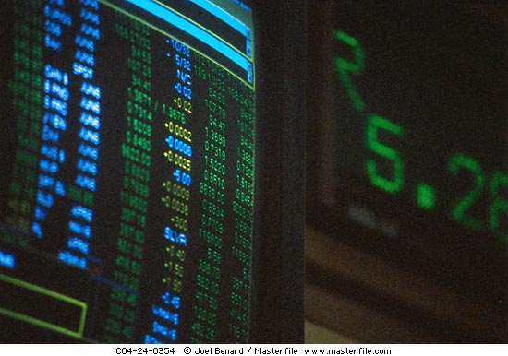
Investment Basics
Saving requires discipline
Investing requires knowledge and patience
Invest wisely - your retirement depends on it!

Slide 29

Investment Basics
Wall Street
Bull Market
Prolonged rise in the prices of stocks, bonds, or commodities. Usually lasts at least a few months and is characterized by high trading volume.
Bear Market
Prolonged period of falling prices. Usually brought on by the anticipation of declining economic activity and interest rate changes.

Slide 30
Investment Basics
Wall Street
Stocks
  Part ownership, also known as “equity”
    No guarantees, unlimited potential for gain and loss
    Gains come from dividends (income) and/or share price increase
Bonds
  Lending money, also known as “debt”
  Usually pay a fixed rate of interest income to bondholders with principal coming due at maturity
Money Market Instruments
  Short term money market investments

Slide 31
Investment Basics
Common Investment Terms
Asset Classes - Principal classes are stocks, bonds and cash
Asset Allocation - Dividing investments among the different asset classes to obtain the best risk/return trade-off
Portfolio - A grouping of all your investments
Dividends - The portion of a company’s profits paid to shareholders
Total Return - The amount of interest or dividends your investment earns plus any increase or decrease in principle
Volatility - How much and how often its price changes
Earnings - The profit a company makes after all expenses are deducted from revenues

Slide 32
Investment Basics
“Asset Classes”: What exactly does that mean?
Cash - Lower risk such as money market and stable value
Bonds - Low to moderate risk such as government, agency, and corporate. Risk based on credit rating
Domestic Equity - Moderate to high risk stocks of US companies
International Equity - Higher risk such as stocks of companies headquartered outside of the US
Global Equity – Higher risk such as stocks of companies both foreign and domestic.

Slide 33

Investment Basics
Types of Risk
Inflation Risk
  If your investment earns less than inflation, your money buys less
Market Risk
  Price swings that are caused by factors beyond the control of the company’s management, such as political developments and investment fads
Credit Risk
  The ability of bond issuers to repay principal and interest to the bondholder
  The greater the risk of default, the higher the yield
  U.S. government has highest credit safety

Slide 34
Investment Basics
Types of Risk
Interest Rate Risk
  Interest rate changes affect the value of interest-sensitive investments, such as bonds, high-dividend stocks, etc.
Currency Risk
  International currency fluctuations
Security-Specific Risk
  Securities of a particular company are affected by factors unique to the company

Slide 35
Investment Basics
Risk Management
Diversify your portfolio - own different types of investments
Invest within your comfort level
Dollar Cost Average*
  Following a disciplined schedule of investing regardless of the markets ups and downs which over time lowers the average price paid (cost) per share
Have a plan and stick with it
Be patient - don’t react to short term trends… it’s time in the market not timing the market
* Periodic Investment Plans do not assure profit, nor protect against loss in a declining market. Since the Plan involves a continuous investment, regardless of fluctuating prices, investors must consider the financial ability to continue to invest during low prices.

Slide 36
Investment Basics
Start Saving Early: The Time Value of Money!
For illustrative purposes only based on $50 biweekly contributions at 8% compound annual return.
$335,473
Begin contributing at age
25
35
45
55
$145,968
$64,250
$17,533
0
10
20
30
40
Years

Slide 37
Investment Basics
Can you afford not to contribute?
Non out-of-pocket savings increase exponentially over time
For illustrative purposes only based on $2000 annual contributions at 8% compound annual return.
$300,000
Earnings on Earnings
$200,000
78%
Earnings on Contributions
73%
$100,000
65%
Out-of-Pocket Contributions
$-
30 Years

Slide 38
Investment Basics
Rule Of 72
A simple formula to determine how long it will take your money to double
Divide 72 by your rate of return. The result is an estimate of how long it takes to double your money
Rate Years
  12% 6 years
  10% 7.2 years
  8% 9 years
  6% 12 years
  4% 18 years

Slide 39
Investment Basics
Diversification
Spreading assets among different securities and asset classes to reduce the potential for loss
Time Horizon
Match your time horizon with your investments
While volatility is a concern, time reduces its impact
Accepting greater risk and holding the investment over a long period of time may result in meeting your retirement goals

Slide 40
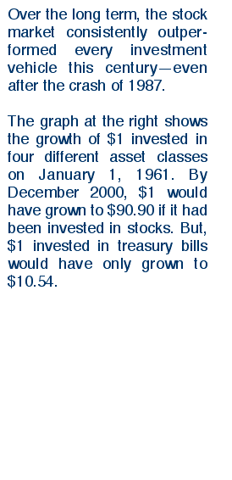
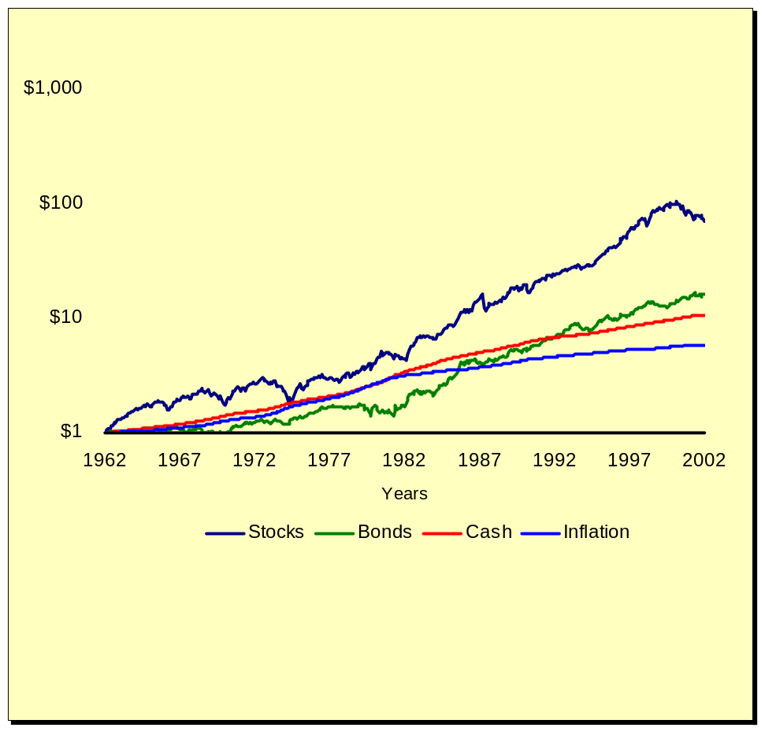
Investment Basics
Match your financial goals with the level of risk you’re willing to accept over various periods of time.
Stocks, Bonds, Cash, and Inflation
40 Years Ending June, 2002

Slide 41
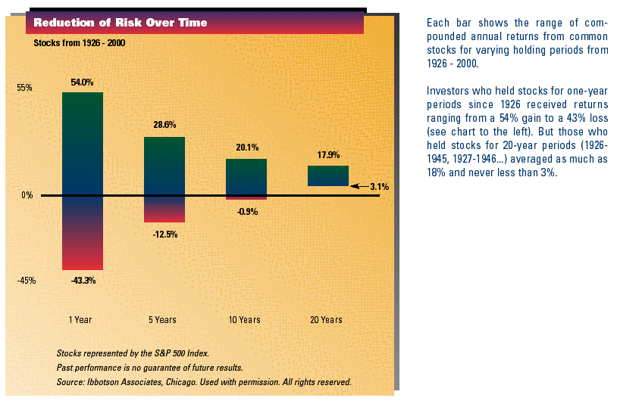
Investment Basics
Consider Your Time Horizon When Investing

Slide 42
Investment Basics
Risk Vs. Reward: It’s a Trade-Off
Investors who are willing to take on additional risk may expect to be rewarded with higher returns
18%
Investors who are willing to take on additional risk may expect to be rewarded with higher returns.
16%
Domestic Stocks
14%
12%
International Stocks
Reward
10%
Bonds
8%
6%
Cash
4%
2%
0%
5%
10%
15%
20%
25%
Risk
Risk
Data: Ibbotson Associates. 30 Day T-bill, Lehman Brothers Aggregate Bond Index, and MSCI EAFE Index 20 year annualized return/standard deviation for period ending June 30, 2002
Data: Ibbotson Associates. 30 Day T-bill, Lehman Brothers Aggregate Bond Index, S&P 500 Index, and MSCI EAFE Index 20 year annualized return/standard deviation for period ending ending June 30, 2002.
Lehman Brothers Bond Aggregate Index represents securities that are US domestic, taxable, and dollar denominated. The index covers the US investment grade fixed rate bond market, with index components for government and corporate securities, mortgage pass-through securities, and asset-backed securities. S&P 500 is an Index of 500 Stocks, a widely recognized, unmanaged index of common stock prices. MSCI EAFE/Morgan Stanley East Asia Far East Index is composed of stocks screened for liquidity, cross-ownership, and industry representation and acts as a benchmark for managers of international stock portfolios. Indices are not available for direct investment; therefore their performance does reflect the expenses associated with the active management of an actual open-ended investment company portfolio.

Slide 43
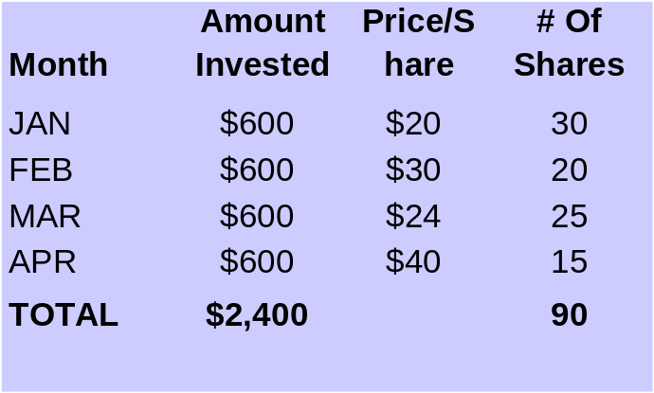
Investment Basics
Dollar Cost Averaging*
Steady Investing
Patience is the best way to see a return on your investment
Dollar Cost Averaging
Consistently investing the same amount of money on a regular basis regardless of market fluctuations
Average Share Price = $28.50
Average Cost Per Share Price = $26.67
Savings: $1.83 Per Share
*Dollar cost averaging plan does not assure profit. Plan does not protect against loss in a declining market. Since the plan involves continuous investment, regardless of fluctuating prices, investor must consider financial ability to invest during low price levels.

Slide 44
Investment Basics
Bond Prices and Interest Rates
Bond prices rise and fall inversely to interest rates
Bond
Prices
Interest
Rates
Interest
Rates
Bond
Prices

Slide 45
Investment Basics
Mutual Funds
Your money is pooled with other investors
The fund manager then invests this pool of money in a variety of stocks and/or bonds
Provide diversification with limited capital
Dividends can be reinvested

Slide 46

Investment Basics
Mutual Funds
Mutual funds pool the money of many people and invest it in a portfolio of stocks, bonds, and/or money market instruments to meet a specific investment objective
Mutual funds are managed by full-time, professional money managers

Slide 47
Investment Basics
Mutual Funds
Mutual funds pool the money of many people and invest it in a portfolio of stocks, bonds, and/or money market instruments to meet a specific investment objective.
Are a professionally managed portfolio of diversified securities.
Provide diversification with limited capital.
Dividends and/or Capital Gains may be reinvested
A graphic depiction of a mutual fund
Co. E
Co. A
Co. D
Co. B
Co. C

Slide 48
Investment Basics
Types of Mutual Funds
Stock Funds
  Certain funds concentrate on specific factors
    Growth funds - strong earnings growth
    Equity Income funds - strong dividend history
    International funds - overseas companies
Bond Funds
  Bond funds diversify among different maturities and types of bonds, so prices may fluctuate less when interest rates change

Slide 49
Investment Basics
Types of Mutual Funds
Short-Term Bond Funds
  Invest in debt that matures within 2 to 3 years
  Investors use these funds when they believe they will need the assets soon
Index Funds and Specialty Funds
  Seeks to provide similar if not identical risk and return characteristics to a passively managed index, such as the S&P 500 Index*
* S&P 500 is a registered trademark of the Standard & Poors Corporation. The Index is a market value-weighted index showing the change in the aggregate market value of 500 stocks. You cannot invest directly in this index.

Slide 50
Investment Basics
Types of Mutual Funds
Balanced/Asset Allocation Funds
  Invest in a mixture of stocks, bonds and cash instruments
  Goal: Balance volatility and return by blending capital appreciation from stocks with steady income from bonds and cash
  Asset mix remains relatively unchanged over time
Asset Allocation Funds
  Same investment mix and goal as balanced funds
  In contrast to balanced funds, asset allocation funds regularly alters blend of stock, bonds and short-term cash investments

Slide 51
Investment Basics
Types of Mutual Funds
Stable Value Funds
  Provides maximum current income consistent with preserving capital
  Do not have a market value and do not fluctuate in price

Slide 52
Investment Basics
Growth Vs. Value
Investors, whether they invest in growth stocks or value stocks, expect their investments to go up. The difference between the two is why they expect the value of those investments to rise:
Growth
Value
Earnings growth faster than the economy
Rapidly growing industry
Higher than market volatility
High P/E ratio
Low price relative to intrinsic value
Industry which is temporarily out of favor
“Contrarian” investing
Low P/E ratio

Slide 53
Investment Basics
Small- Vs. Mid- Vs. Large-Cap
Market capitalization is calculated by multiplying the price of a stock by the number of shares outstanding.
Small-cap
  Up to $1 billion
  Usually small or newly established companies
Mid-cap
  $1-10 billion
  Usually medium sized companies (as measured by revenue, number of years in business, etc.)
Large-cap
  Over $10 billion
  Often large, established companies

Slide 54
Investment Basics
Benchmark
The performance of a predetermined set of securities, for comparison purposes
Fund performance is compared to the performance of the benchmark
  Goal is to outperform the benchmark
Well-known Benchmark or “Market Indices”
  Dow-Jones Industrial Average
  Standard & Poor’s 500
  Wilshire 5000
  Wilshire 4500
  EAFE Index: Europe, Australia, Far East

Slide 55

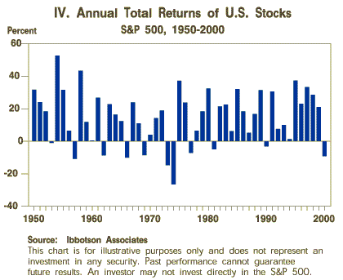
Stock Market Return History
It is important to assess your investment goals in view of the level of risk you are willing to assume
  The basic rule of investing is, the higher the potential return, the greater the risk
Stocks generated substantial returns over the years, with many peaks and valleys along the way
Stocks had 40 up years and 11 down years from 1950 through 2000 but generated an annualized return 13% during that period
  To benefit, you had to be willing to ride out some steep declines

Slide 56

Investment Concepts
Things To Remember

Slide 57
Investment Basics
ICMA-RC’s Multi-Management Investment Approach
Multi-manager strategy seeks:
  To improve the possible consistency of return
  To continue historical competitive performance by eliminating reliance on the results of a single subadviser
Different assets have different:
  Sensitivities to market factors affecting all assets
  Issue-specific risks
Results in different patterns of return among assets
Diversification in the selection of assets with lower correlations (i.e. they do not perform in lockstep) may reduce overall portfolio volatility

Slide 58
Greater Consistency
Single Manager Can Beat Index, But With Inconsistency
Manager A
Index
Manager B
Multi-Management Can Beat Index, And With Greater Consistency
α
Manager A
Index
Fund

Slide 59
Investment
Value
Blend
Growth
Balanced
Vantagepoint Equity Income
Lord Abbett Affiliated*
Fidelity Magellan ® *
Vantagepoint Growth & Income
Fidelity Contrafund *
American Centrury Ultra*
MFS Mass Investors Growth
Putnam Voyager
Fidelity Puritan ® Fund*
Large-Cap
>$10 .5 B
Asset Allocation
American Century Value*
Calvert Social Inv Fd Eq Port*
Gabelli Value*
Vantagepoint Aggressive Opportunity
Vantagepoint Asset Allocation
Mid-Cap
$1.7B - $10.5 B
Fixed Income
PIMCO Total Return Bond*
PIMCO High Yield Bond*
Vantagepoint US Govt Sec
Vantagepoint Money Market
Small-Cap
<$1.7B
T. Rowe Price Sm Cap Value
T. Rowe Price Sm Cap Stock*
Invesco Small Co Growth
Stable Value
International
Model Portfolios
Index
Vantagepoint International
Putnam International*
Janus Adviser Worldwide*
Vantagepoint Overseas Eq. Index
Vantagepoint Broad Market Index
Vantagepoint 500 Stock Index
Vantagepoint Mid/Small Co. Index
Vantagepoint Core Bond Index
VantageTrust PLUS Fund
Vantagepoint All Equity Growth
Vantagepoint Long-Term Growth
Vantagepoint Traditional Growth
Vantagepoint Conservative Growth
Vantagepoint Savings Oriented
* Available through funds of the VantageTrust Mutual Fund Series that invests solely in fund listed. Please read the Prospectus carefully prior to investing. Fund shown in red are new additions, effective 7/02; funds shown in blue will no longer be available through the Mutual Fund Series, effective 9/026

Slide 60
Investment Concepts
3 Rules for Retirement Investing…
Diversify, Diversify, Diversify
Diversity among asset classes
  Cash, bonds and stocks
Within stocks, diversify among styles
  Growth and value
Within stocks, diversify among market capitalizations
  Small-cap, mid-cap, and large-cap

Slide 61
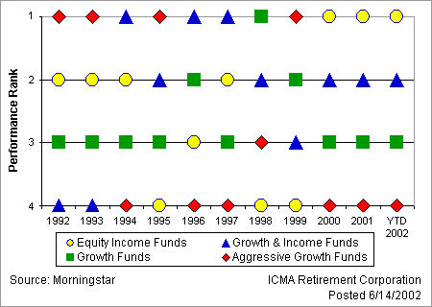
Investment Concepts
No single investment objective consistently beats others
  The top line shows the best-performing objective for each year while the bottom line shows the worst-performing objective for the same period
    Aggressive growth funds were the top performing funds in 1992, 1993, 1995, and 1999, but were the worst-performing funds in 1996, 1997, 2000,2001, and so far in 2002
The information and analysis contained herein is presumed to be accurate and is provided "as is", without warranty of any kind, either expressed or implied. RC presents this material for educational purposes only and it is not to be construed as investment advice. RC shall not have any liability for any loss sustained by anyone who has relied on the information contained in this illustration. Past performance is not indicative of future returns.

Slide 62
Investment Basics
Benefit of Uncorrelated Assets
Investment Returns
Asset Class A
Asset Class B
Total Portfolio
Time

Slide 63
Investment Concepts
Diversification: The key to long-term retirement investing
Select a Vantagepoint Model Portfolio Fund that meets your needs:
  Savings Oriented Fund
  Conservative Growth Fund
  Traditional Growth Fund
  Long-Term Growth Fund
  All-Equity Growth Fund
Less risk, lower
return opportunity
More risk, higher
return opportunity
Or, select a mix of Vantagepoint Funds:
  Include more than one asset class Choose from actively managed, passively managed, and “outside” funds
* Please consult the current prospectus and MAKING SOUND INVESTMENT DECISIONS: A Retirement Investment Guide prior to investing any money. Vantagepoint securities are distributed by ICMA RC Services LLC, the controlled broker dealer affiliate of ICMA RC, member NASD/SIPC. 1-800-669-7400.

Slide 64
Investment Concepts
5 Simple Steps:
Set your retirement savings goals
  How much $ do I want at retirement?
Determine your time horizon & risk tolerance
  When will I retire?
  How much “up & down” can I stomach?
Determine appropriate asset allocation
  What % in stocks, % in bonds, etc.
Select funds to achieve that asset allocation
Monitor and rebalance your portfolio

Slide 65
Investment Concepts
Personal Investing Principles
Use a payroll deduction plan to “pay yourself first”
Understand your tolerance for taking investment risk
Invest in what you understand
Invest a regular dollar amount each month
Diversify
Invest for the long haul
Maximize your tax-deferred savings
Use the power of time

Slide 66
Things to Remember
Take Action!!!
Do your personal budget analysis today!
Maximize your contributions to your employer’s retirement plan
Start planning, saving, and investing now
Don’t put it off!

Slide 67
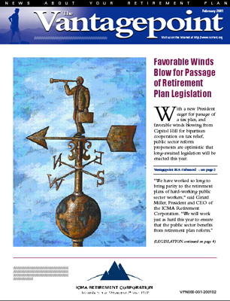


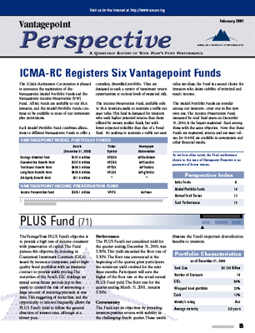
Resources
Periodicals
  Newspapers
  Financial Magazines
  ICMA - RC Newsletter
  Vantagepoint Perspectives
Classes
  Employee Training & Development Catalog

Slide 68


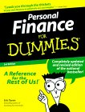
Reading List
Making the Most of Your Money
by Jane Bryant Quinn
The New Working Women’s Guide to Retirement
by Martha Priddy Patterson
Personal Finance for Dummies
by Eric Tyson
Public Employees Guide to Retirement Planning
by the Government Finance Officers Association (GFOA)*
* May be ordered through the GFOA’s website for $12.00, which may be accessed through ICMA-RC’s website: www.icmarc.org.

Slide 69
ICMA Retirement Corporation
This presentation is intended as educational advice and is not to be construed as investment advice or the solicitation for a specific product or service. ICMA Retirement Corporation does not render specific legal or tax advice. Please read the current prospectus and Retirement Investment Guide carefully prior to investing any money. Vantagepoint securities are distributed by ICMA RC Services, LLC, a controlled broker dealer affiliate of ICMA RC, member NASD/SIPC. ICMA Retirement Corporation, 777 North Capitol Street, N.E., Washington, DC 20002-4240. 1-800-669-7400.

