Slide 1
Meme-ify Global Warming
Submission By: Team Planet Protectors
Team Members: Liam Dodd, Steven Finkelstein, Eduardo Laiter, Aylar Roshan Nahad, and Arzav Jain

Slide 2
Problem
Global warming is an important risk to our society that is not prioritized enough by the public or by people in leadership positions
Explaining the “science” will not further the cause

Slide 3
Objectives
To generate grass roots enthusiasm that puts global warming risks at the top of the public’s mind
This will put pressure on global leaders
To take advantage of network effects of spreading ideas online
To make global warming a top priority for the world
To make global warming a “cool” issue to talk about

Slide 4
Solution
Develop a meme engine that automates the process of creating images with captions to spread “messages” to the public that global warming is important
Environmentally Conscious Organizations/Influencers
Sell the use of the meme engine to organizations which are environmentally conscious at a discounted rate
Non-Environmentally Conscious Organizations/Influencers
Sell the use of the meme engine to non-environmentally conscious organizations/influencers at the full rate

Slide 5
How Does this Work?
The meme engine utilizes GPT-3 and Dalle through a series of prompts and responses to create a global warming-related image accompanied by a funny caption
The code maximizes variance to encourage creative memes
Write a funny caption from this image description
Generate Climate Change Concept
Describe a funny image representing this climate change concept
Combine the image and caption into a meme
Generate an image from this image description
GPT-3
Dalle
Python

Slide 6
Demo Time!

Slide 7
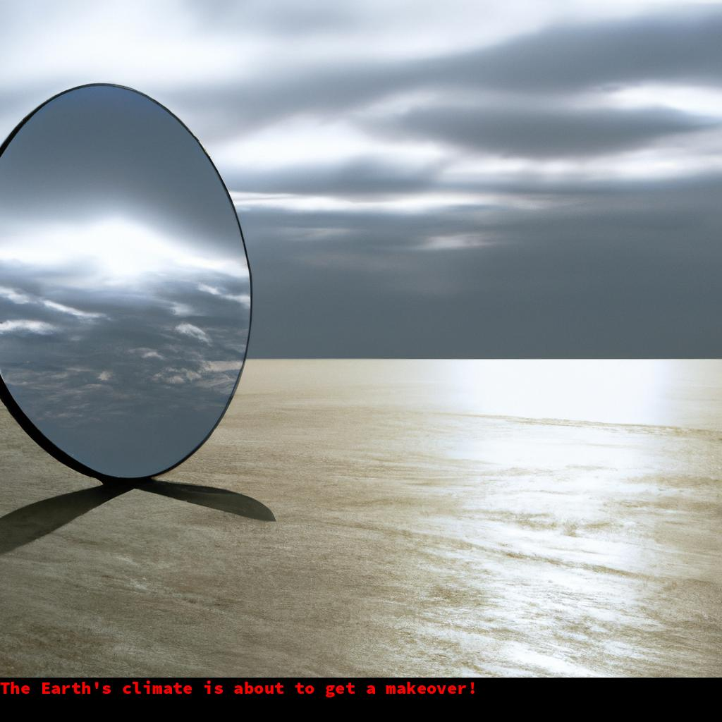
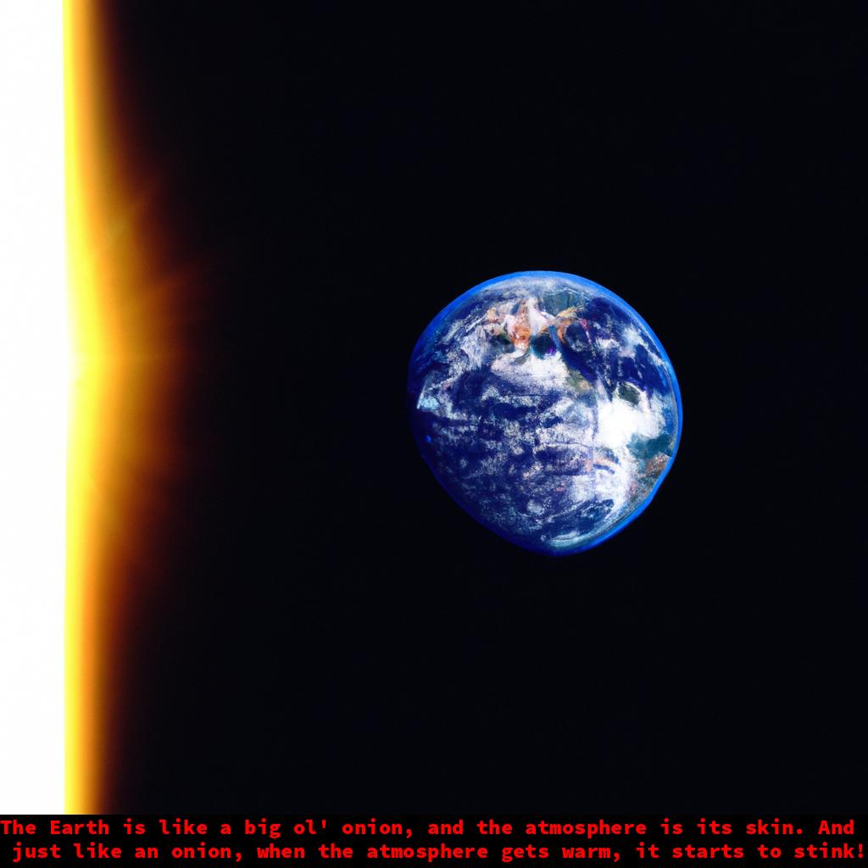
Demo Time!

Slide 8
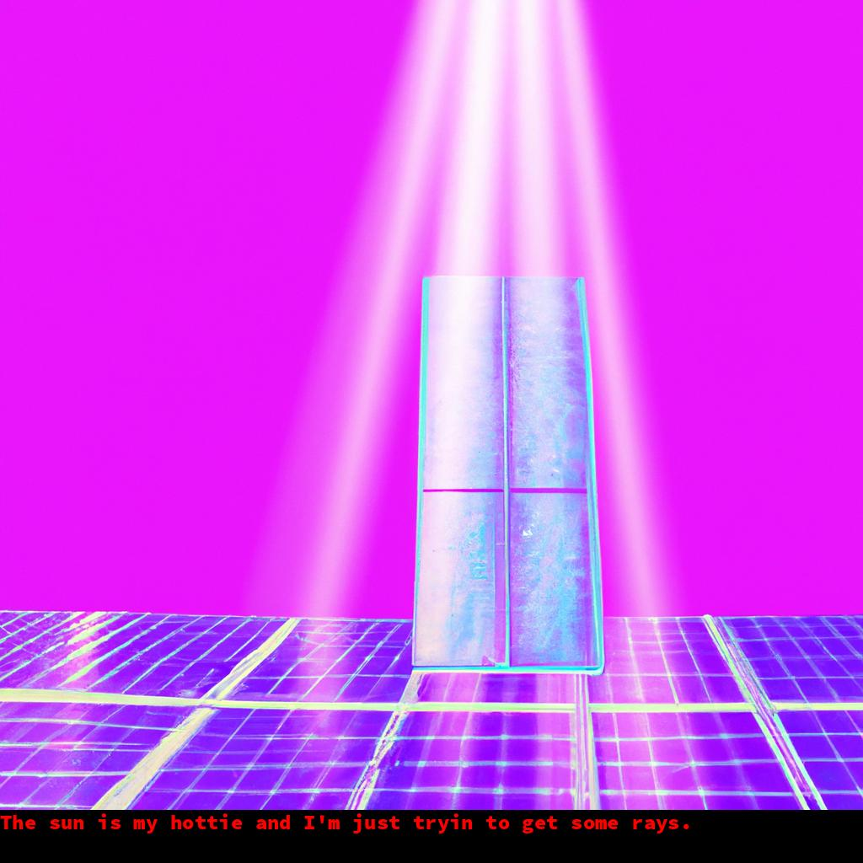
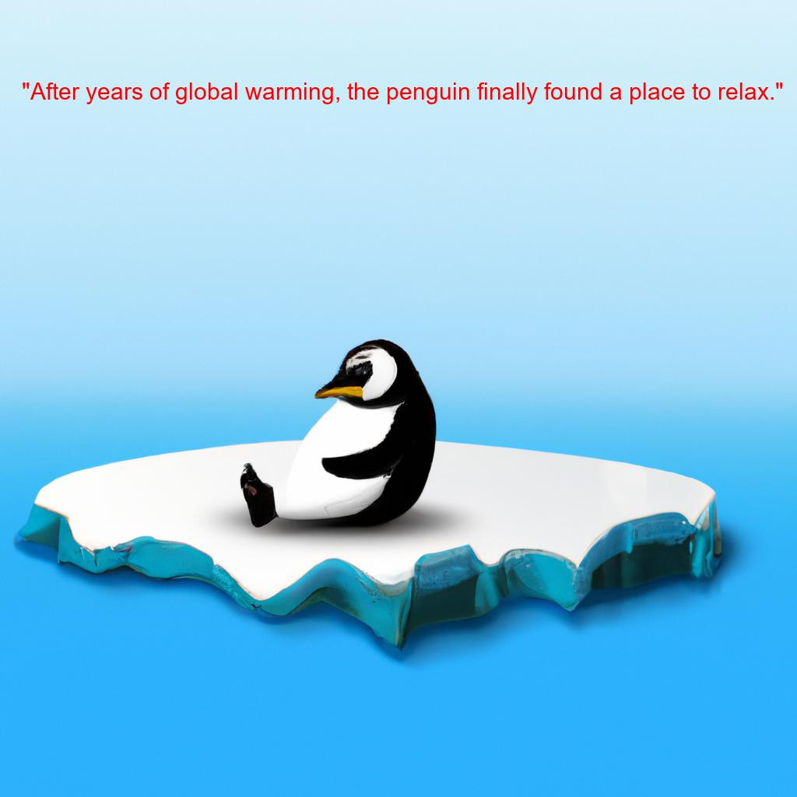
Output Example #2

Slide 9
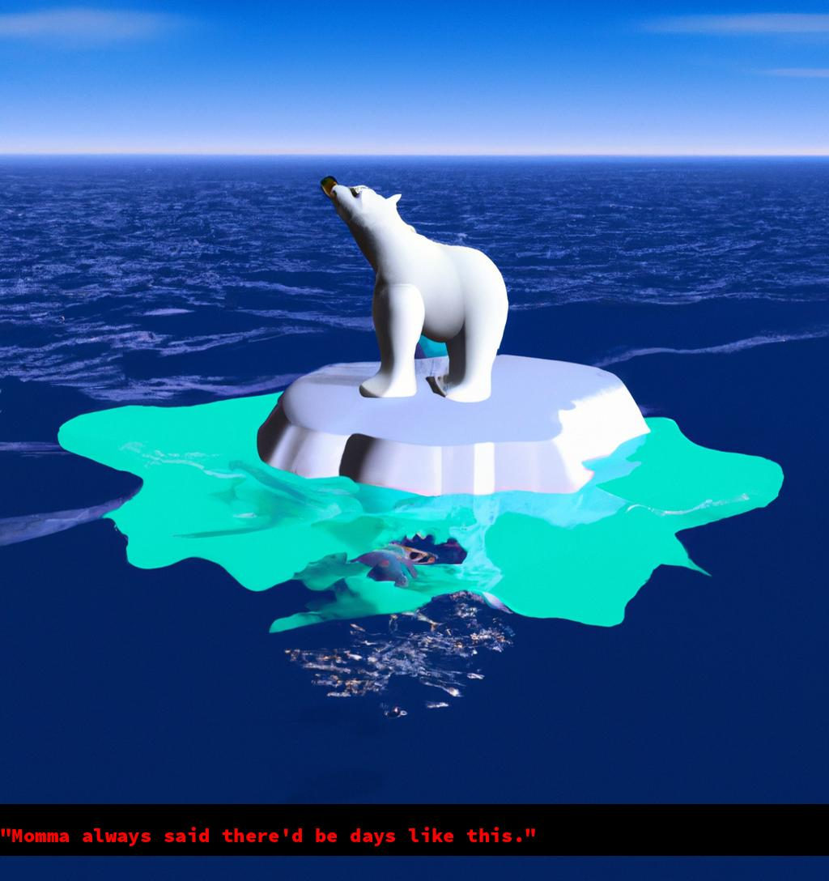
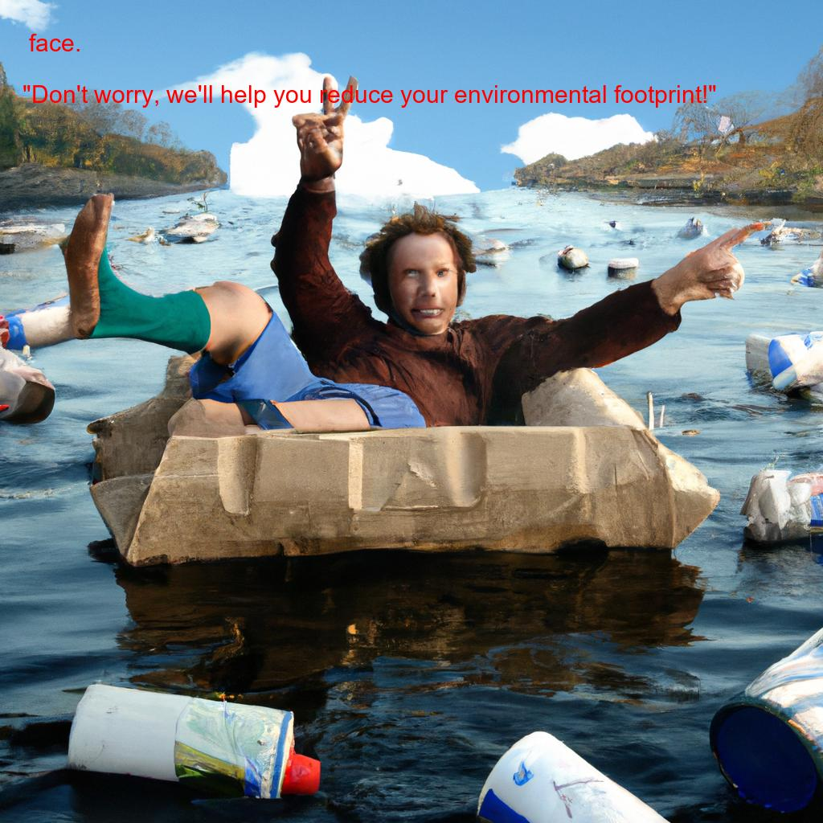
Output Example #3

Slide 10
Predicted Impact
The meme engine will arm ALL kinds of organizations and influencers with the tools to create powerful memes – both the good and bad
This is no different than today
Need to be cautious about who gets access to this tool
Our belief is that the most powerful images will “win” in the hearts and minds of the public
Winning means that they are more likely to spread online
The “internet audience” is skewed younger so this should skew towards an audience that is concerned about Global Warming

