Slide 1

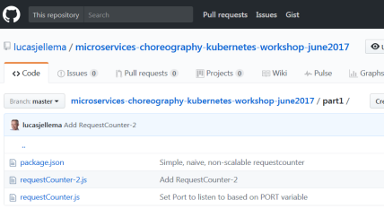
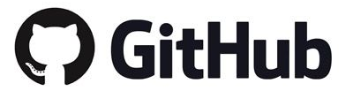
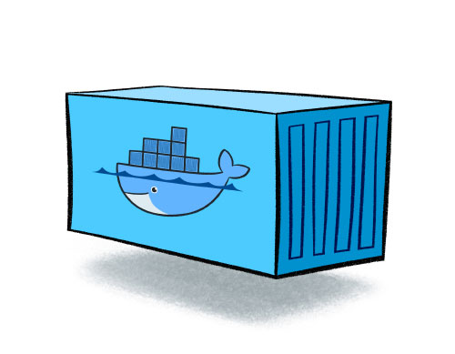

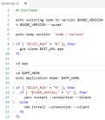
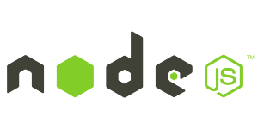
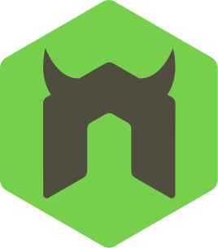
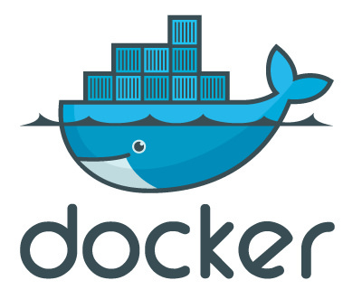


Run an Oracle JET application from Github using generic container image
Node 10
npm
git client
Oracle JET cli
nodemon
node reload app
3. clone Oracle JET app from GitHub
8. pull Oracle JET App from GitHub
2. docker run:
port mapping
volume
4. npm install // install application dependencies
run container
5. Build Oracle JET application and run with Nodemon //to run and monitor
1. pull image from Docker Hub registry
Specify:
- GITHUB_URL
- Other environment variables
9. Reinstall npm dependencies Rebuild Oracle JET application & restart
6. access application
7. curl /reload //refresh app from GitHub
10. access upgraded JET application

Slide 2
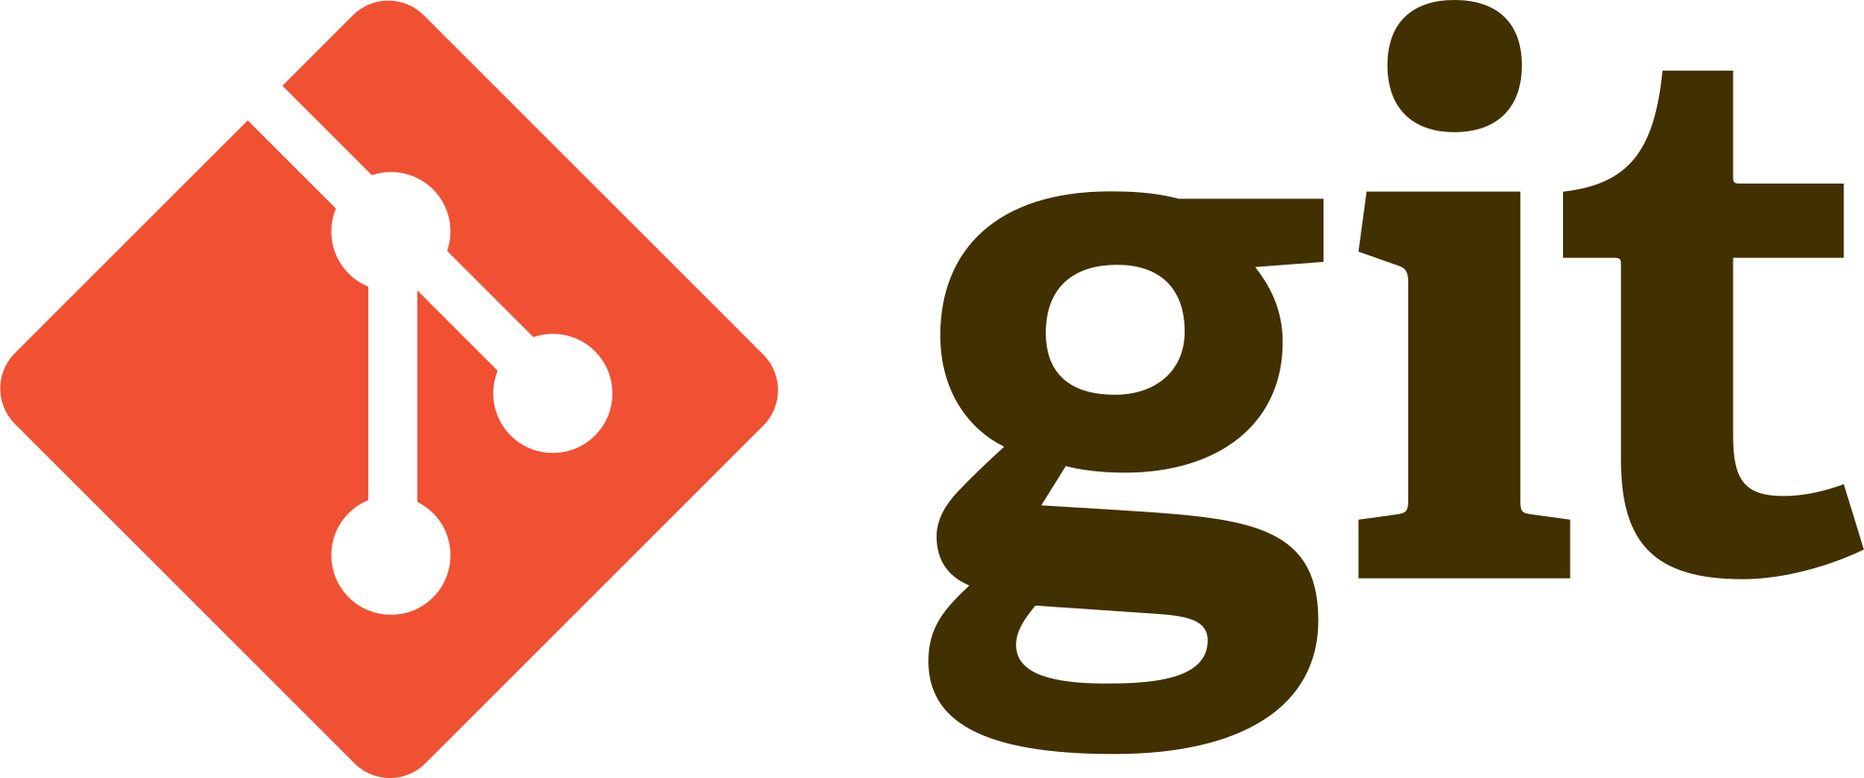
Run an Oracle JET application from Github using generic container image
Node 10
npm
git client
Oracle JET cli
nodemon
node reload app
Reload trigger
GitHubReload Node application
Oracle JET application

