Slide 1
From 125,855 Steam listings to 95,787 analysable games
DATA CLEANING & PROCESSING
Challenge: a shifted header
The header has 39 column names, but every row has 40 values. A plain read_csv shows no error, yet it puts the wrong labels on columns. Example game, Supipara:
Column label | Naive load | Fixed
"Price" | 65 | $5.24
"Required age" | 5.24 | 0
Fix: split "DiscountDLC count" into two columns, then check automatically that every column holds the right kind of data.
Also verified: 0 duplicate games, 0 unreadable release dates
Notes:
TIME: about 1 minute.
Before we could analyse anything, we had to make the raw file trustworthy.
[Point to the right card] The biggest challenge was hidden. The CSV header has 39 column names, but each row has 40 values, because one header cell, "DiscountDLC count", should be two columns. Loading it normally gives no error, but it puts the wrong labels on columns. For example, the column called "Price" holds the 65% discount, and "Required age" holds the $5.24 price. We fixed the header and added automatic checks so it can't slip back in.
[Point to the chart] Then we kept only rows that can answer our question:
- 24,579 listings had no sales data at all: playtests, unreleased or delisted games. We can't call those a success or a failure.
- 1,099 were software, like audio or video tools, not games.
- 4,390 were released within 6 months of the data snapshot (March 2026), so they hadn't had time to sell.
That leaves 95,787 games, 76% of the original.

Slide 2
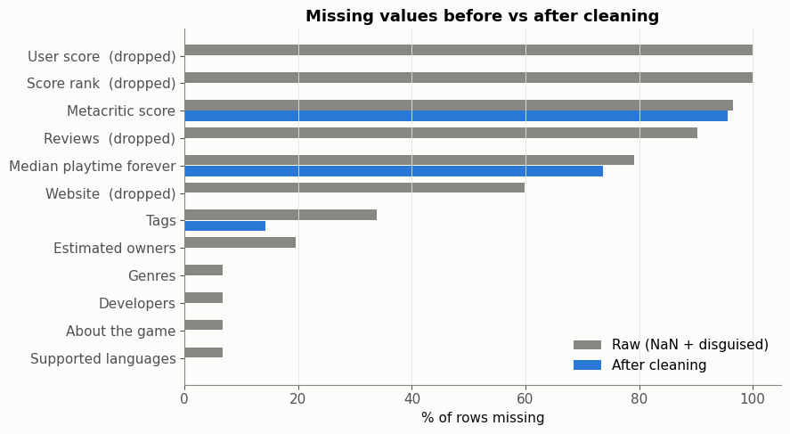
Missing values, outliers and transformations
DATA CLEANING & PROCESSING
172
games priced over $100 (up to $999.98) were capped and flagged, not deleted
156 → 0.8
skewness of review counts after a log(1 + x) transform
72
pre-release features, kept apart from post-release outcomes to avoid leakage
14.6%
Disguised missing values: placeholders like 0 or [ ] counted as missing. A Metacritic score of 0 means "never reviewed", so it becomes blank, not zero.
of games reach ≥ 50K owners: an imbalanced target for ML
Notes:
TIME: about 1 minute.
[Chart, left] Missing values came in two forms: real blanks, and "disguised" ones, placeholders like 0 or an empty list that look like data. For example, a Metacritic score of 0 means "never reviewed", not "scored zero". Counting both, three columns were essentially empty (User score, Score rank, press quotes), so we dropped them or turned them into yes/no flags. Metacritic stays about 96% missing on purpose: most games are simply never reviewed by critics, and inventing scores would distort the analysis.
[Cards, right]
- Outliers: we did not delete blockbusters, because they are exactly the games we want to learn from. Extreme values were capped and flagged instead: 172 games priced over $100 (normal new releases cost up to about $70) and achievement counts in the thousands. Capping limits their pull on averages, and the flag keeps them traceable.
- Review counts are extremely skewed (skewness 156), so we use a log transform, which brings it down to 0.8.
- We parsed dates, turned owner ranges into numbers, and turned genre and category lists into yes/no columns. That gives 72 features known before release, kept separate from post-release numbers like reviews and playtime, so the model can't cheat.
- Only 14.6% of games reach 50,000 owners, so our target is imbalanced. [Hand over] Rachel's EDA builds on this clean dataset.

