Slide 1
Progress Report
Keerat Singh

Slide 2
Problem: Cervical cancer has become a problem for most of third world countries because of their inability to treat it. Certain treatments don’t work for everyone, and can even worsen the condition. Doctors don’t have the skills or resources to discern the appropriate treatment.
Goal: The goal is to create an image classifier that will be able to determine the type of a woman’s cervix, and therefore the appropriate treatment.

Slide 3
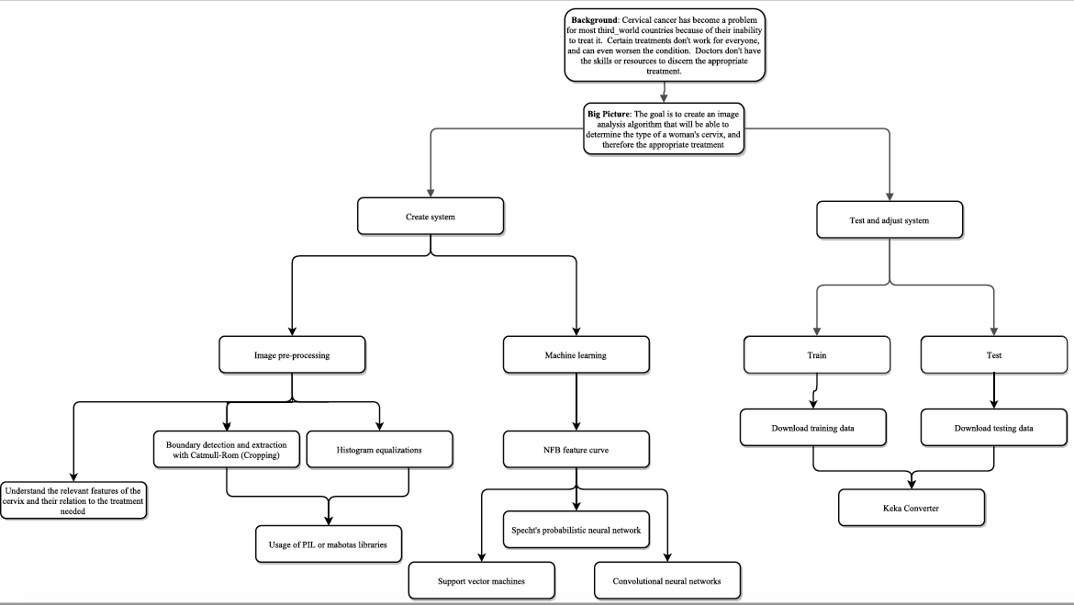

Slide 4
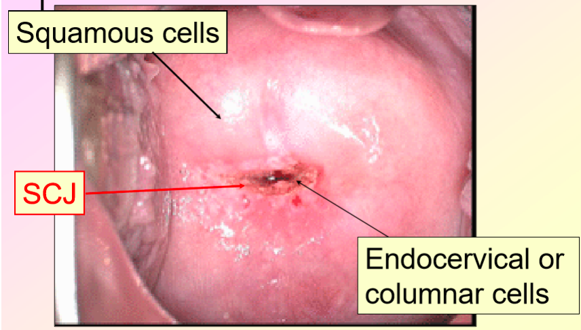
Data

Slide 5
My time so far…
Learning the basics of ML through introductory Kaggle projects
Reading articles about current algorithms being used for image classification

Slide 6
What have I learned so far…
Understanding the steps to the ML process
Steps to both clean and transform data
Learning steps I could take in preprocessing
Boundary detection and extraction
Histogram equalizations
Learning new algorithms that I could implement
Specht’s probablistic neural networks

Slide 7
My next local steps
Doing the Facebook Kaggle Competition
Starting the preprocessing using techniques learned from research articles and OpenCV tutorials

