Slide 1
Progress Report
Keerat Singh

Slide 2
Problem: Cervical cancer has become a problem for most of third world countries because of their inability to treat it. Certain treatments don’t work for everyone, and can even worsen the condition. Doctors don’t have the skills or resources to discern the appropriate treatment.
Goal: The goal is to create an image classifier that will be able to determine the type of a woman’s cervix, and therefore the appropriate treatment.

Slide 3
Learn
Do

Slide 4
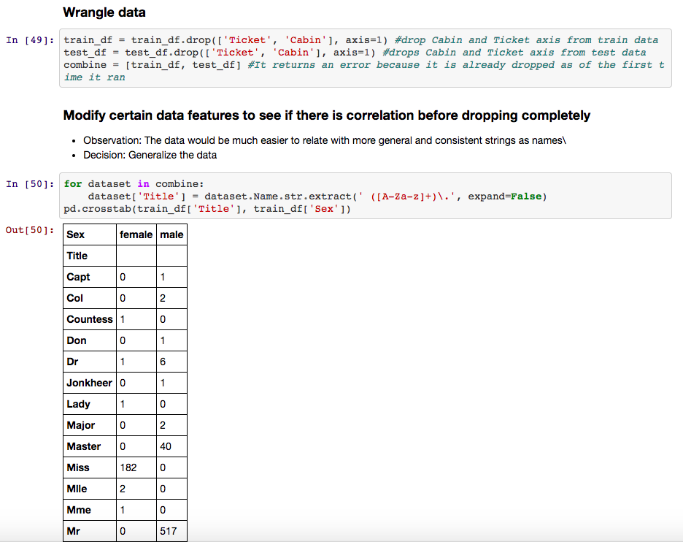
1. Learn

Slide 5
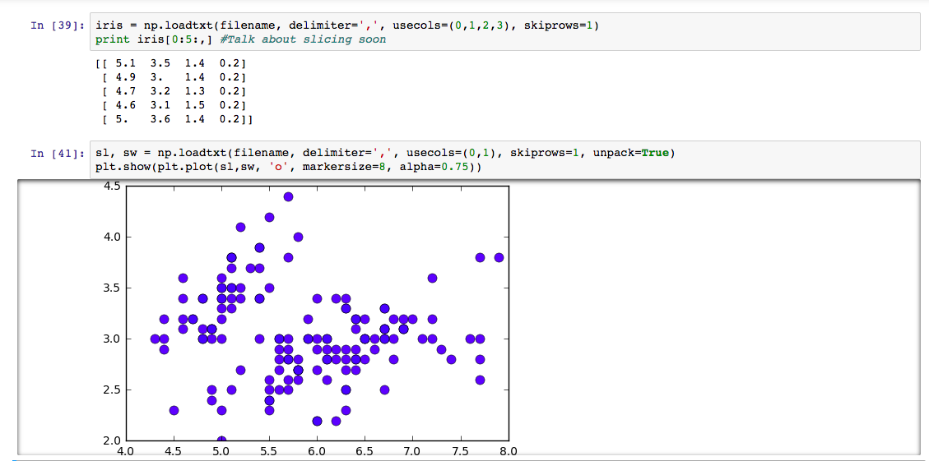
1. Learn

Slide 6
Problem with progress so far: Lost the relationship between my work and the goal of the project
Solution: Jump in, starting with the preprocessing

Slide 7
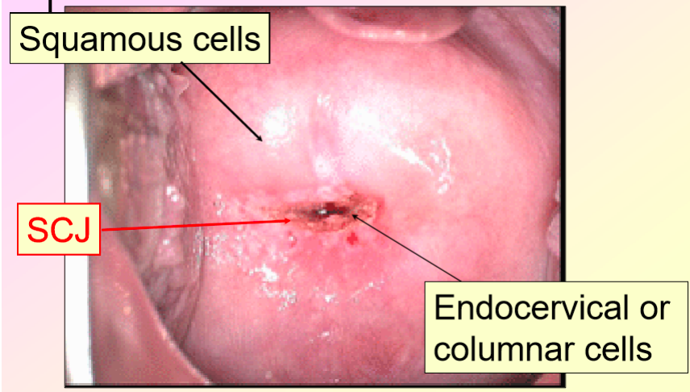
Data

Slide 8
Information gained from other research
Learning steps I could take in preprocessing
Boundary detection and extraction
Histogram equalizations
Learning new algorithms that I could implement
Specht’s probablistic neural networks

Slide 9
Preprocessing
Boundary detection and extraction
NFB feature curve
Histogram equalizations
Adjusts image intensities

Slide 10
Specht’s probablistic neural network (PNN)
Map any input pattern to a number of classifications
Feedforward network:
Input layer
Pattern layer
Summation layer
Output layer

Slide 11
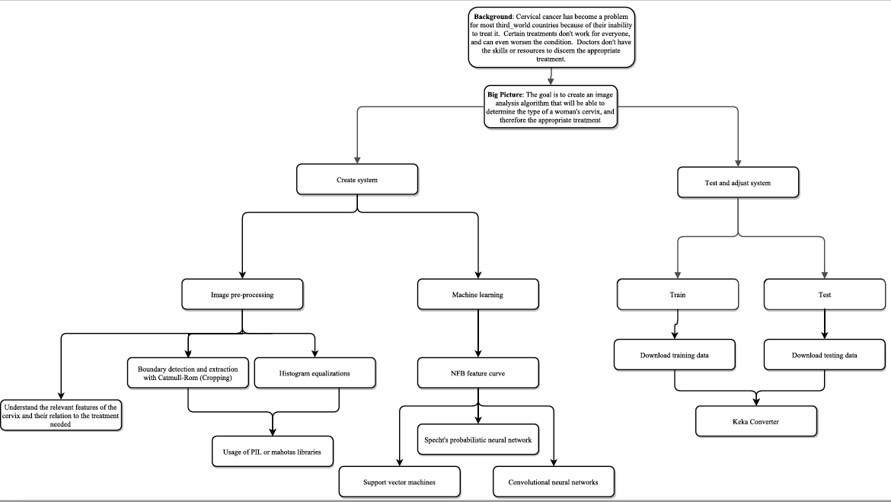

Slide 12
References
Chen, E., Chung, P., Chen, C., Tsai, H., & Chang, C. (1998). An automatic diagnostic system for CT liver image classification. IEEE Transactions on Biomedical Engineering, 45(6), 783-794. doi:10.1109/10.678613
Lawrence, S., Giles, C., Tsoi, A. C., & Back, A. (1997). Face recognition: a convolutional neural-network approach. IEEE Transactions on Neural Networks, 8(1), 98-113. doi:10.1109/72.554195
Saeed, K., & Werdoni, M. (2014). A New Approach for Hand-Palm Recognition. Enhanced Methods in Computer Security, Biometric and Artificial Intelligence Systems, 185-194. doi:10.1007/0-387-23484-5_18

