Slide 1
Progress Report
Keerat Singh

Slide 2
Problem
Cervical cancer has become a problem for most of third world countries because of their inability to treat it. Certain treatments don’t work for everyone, and can even worsen the condition. Doctors don’t have the skills or resources to discern the appropriate treatment.

Slide 3
Goal
The goal is to create an image classifier that will be able to determine the type of a woman’s cervix, and therefore the appropriate treatment.

Slide 4
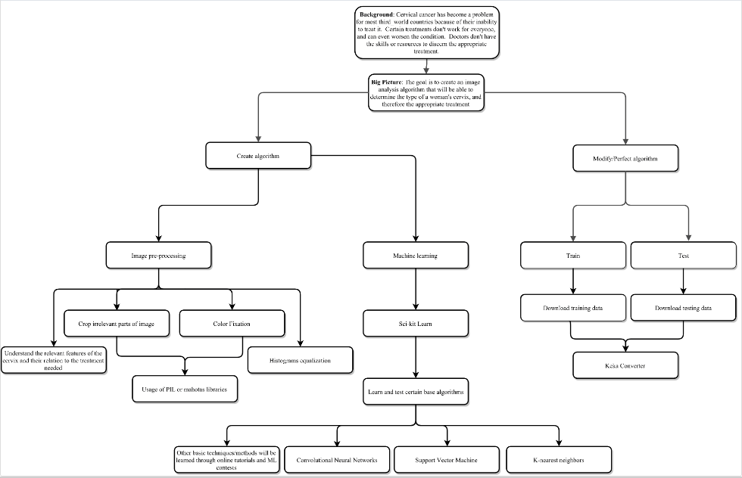

Slide 5
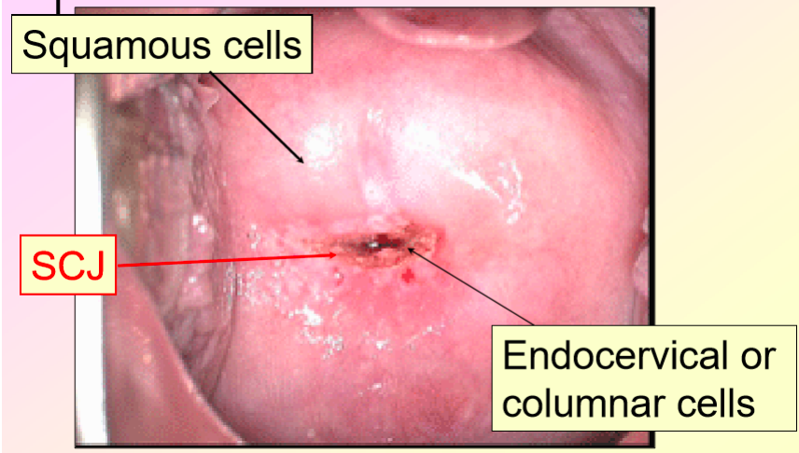
Data

Slide 6
My time so far…
Titanic Machine Learning Disaster
Reading articles about current algorithms being used for image classification

Slide 7
What have I learned so far…
Understanding the steps to the ML process
Steps to both clean and transform data
Learning steps I could take in preprocessing
Learning new algorithms that I could implement

Slide 8
My next steps
Doing the Facebook Kaggle Competition
Starting the preprocessing using techniques learned from research articles

