Slide 1
Missing Values and Treatment

Slide 2
4 Detecting Missing values
4.1 Detecting missing values numerically
4.2 Detecting missing data visually using Missingno library
4.2.1 Visualizing the locations of the missing data
5 Reasons for Missing Values
5.1 Finding reason for missing data using matrix plot
5.2 Finding reason for missing data using a Heatmap
5.3 Finding reason for missing data using Dendrogram
6 Treating Missing values
6.1 Deletions
6.1.1 Pairwise Deletion
6.1.2 Listwise Deletion/ Dropping rows
6.1.3 Dropping complete columns
6.2 Imputations Techniques for non Time Series Problems
6.3 Imputations Techniques for Time Series Problems
6.3.1 Time Series dataset
6.3.2 Imputing using ffill
6.3.3 Imputation using bfill
6.3.4 Imputation using Linear Interpolation method
6.4 Advanced Imputation Techniques
6.4.1 K-Nearest Neighbor Imputation
6.4.2 Multivariate feature imputation - Multivariate imputation by chained equations (MICE)
7 Algorithms which handle missing values

Slide 3
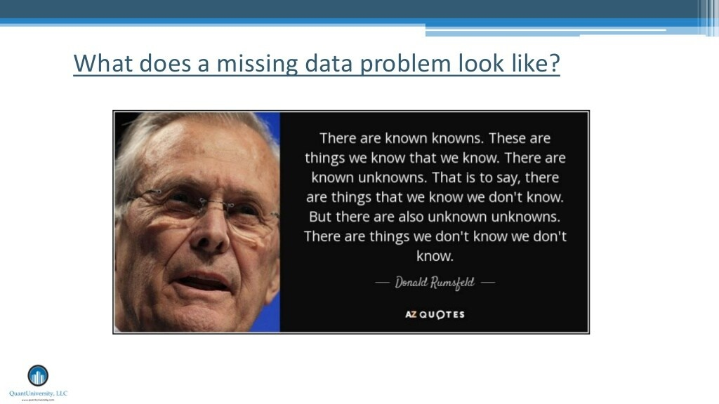

Slide 4
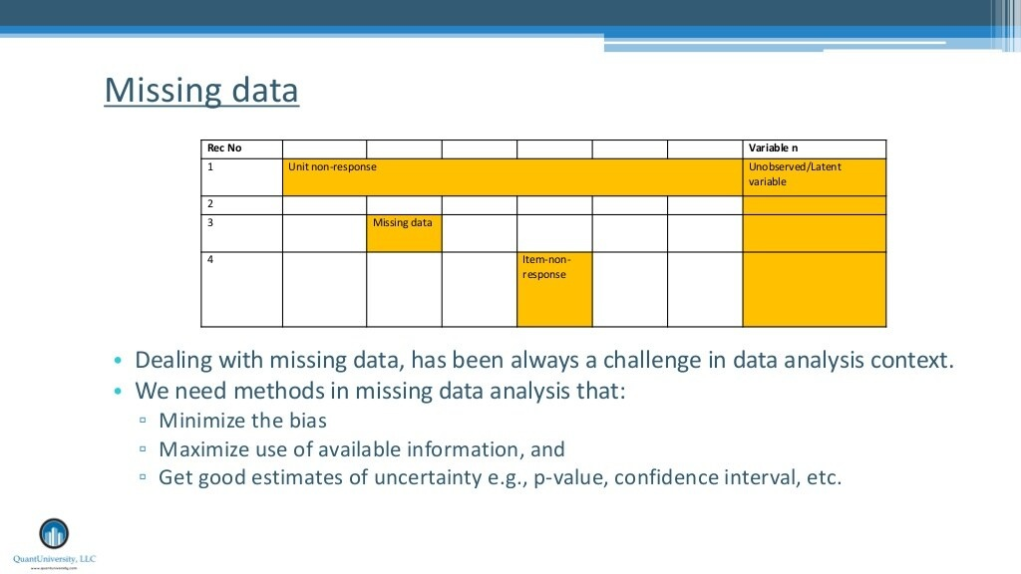

Slide 5
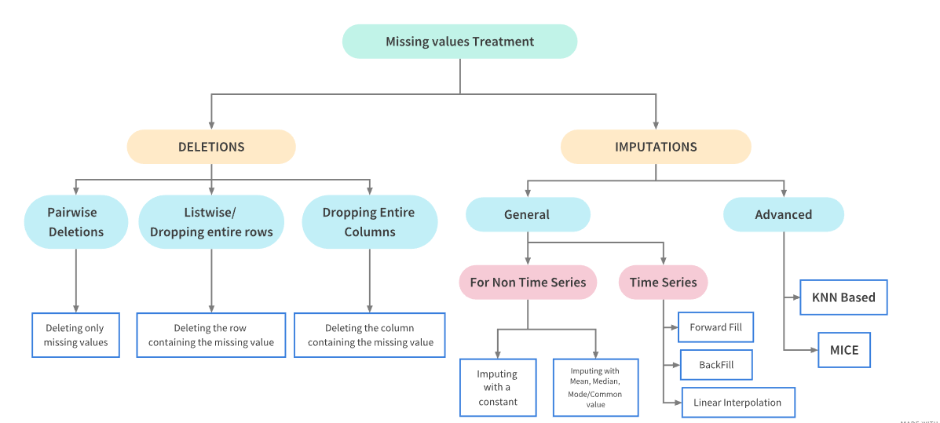

Slide 6
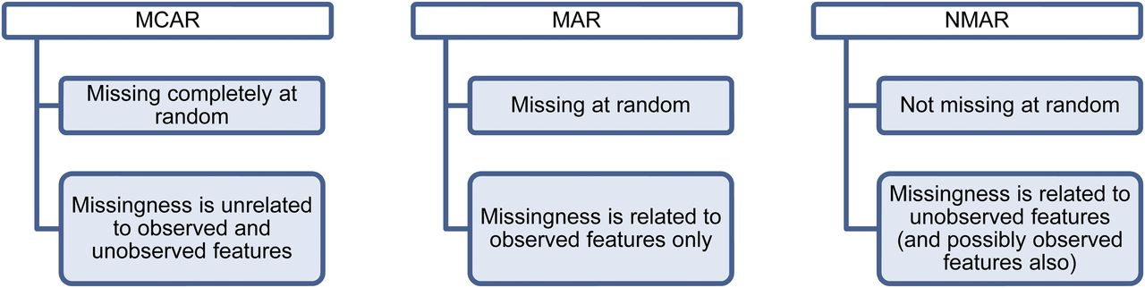

Slide 7
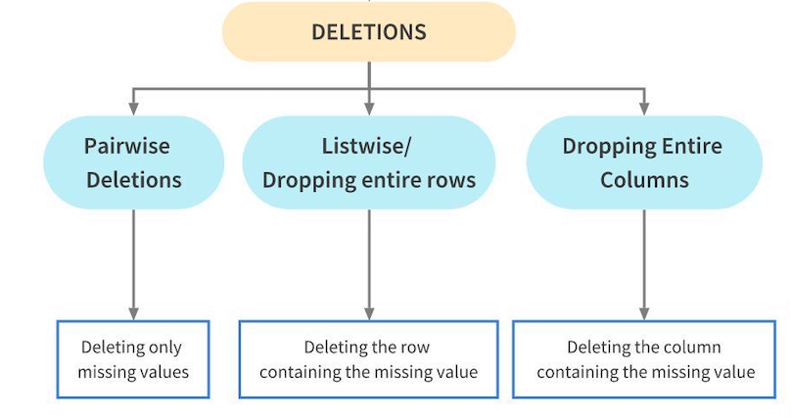

Slide 8
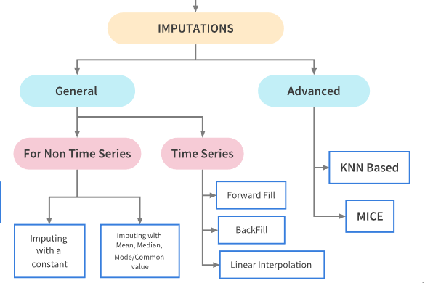

Slide 9
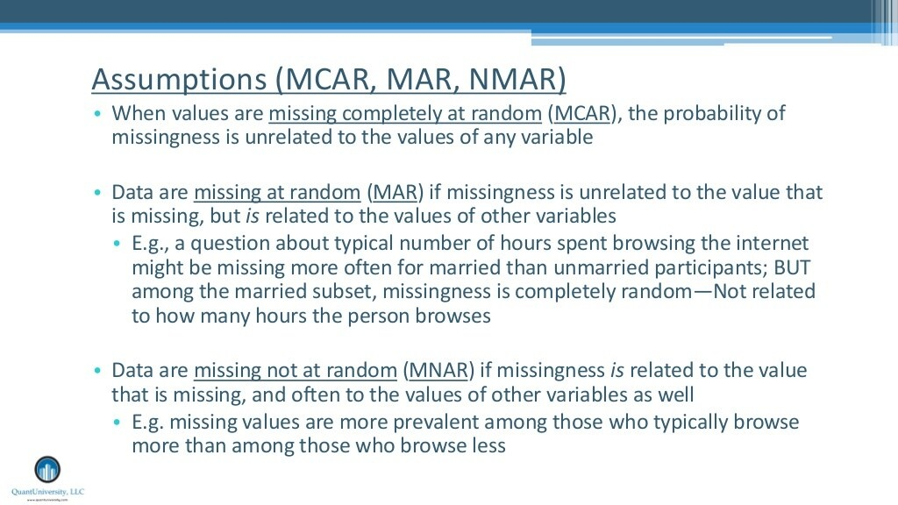

Slide 10


Slide 11
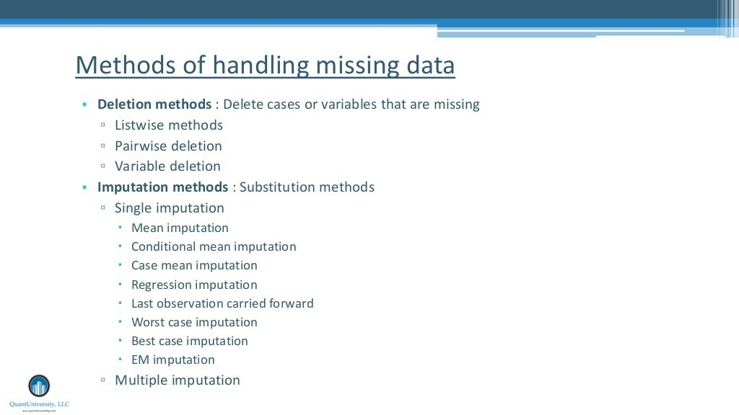

Slide 12
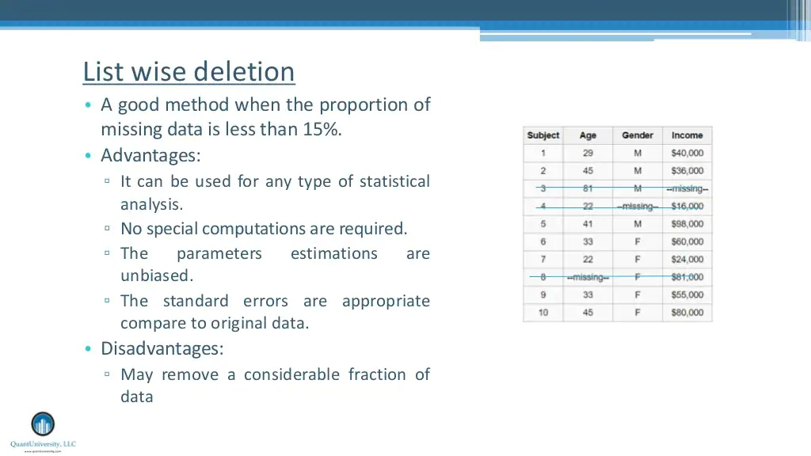

Slide 13
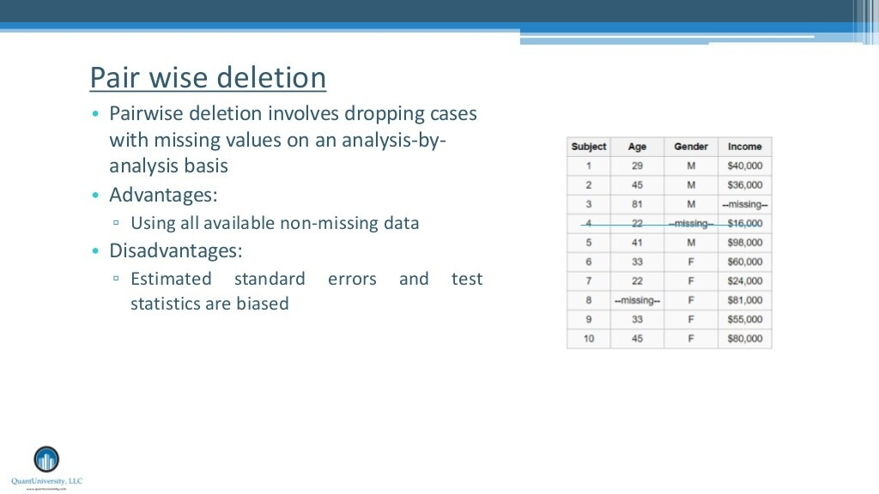

Slide 14
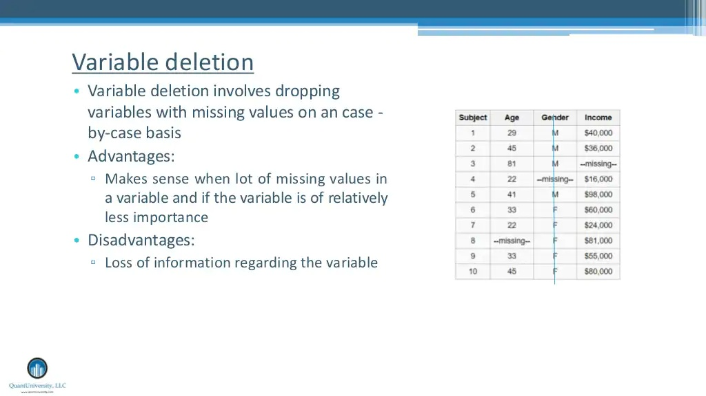

Slide 15
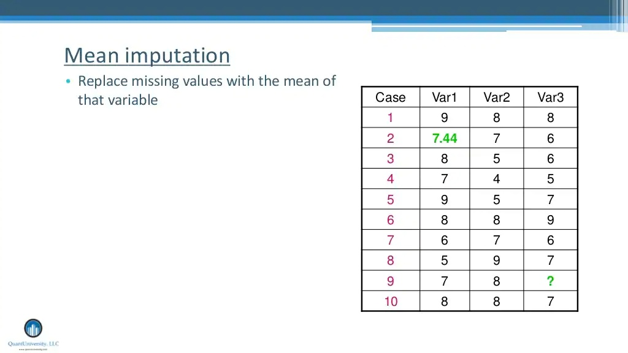

Slide 16
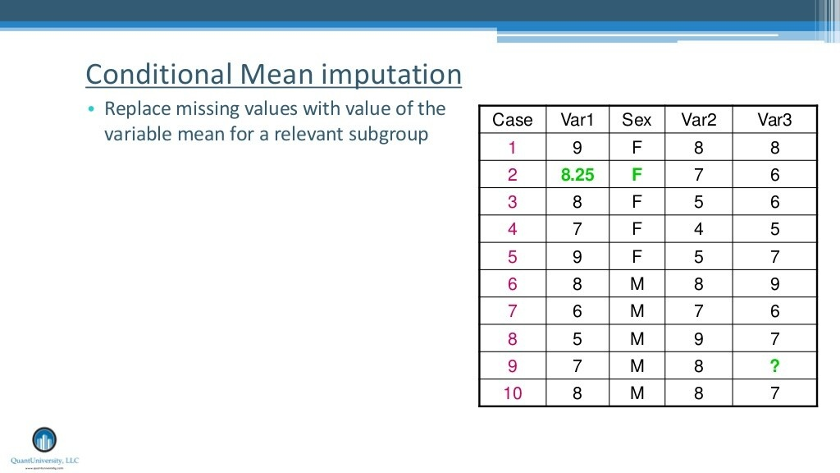

Slide 17
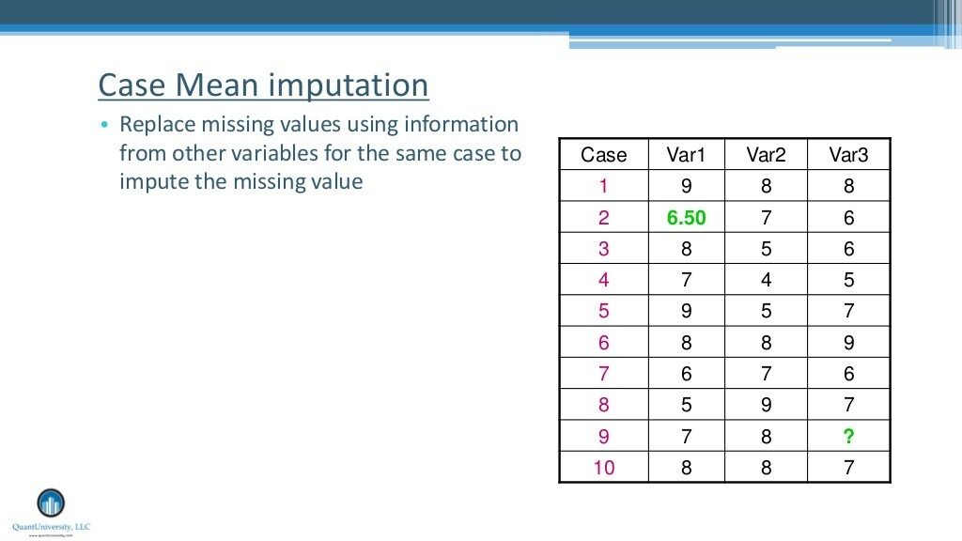

Slide 18
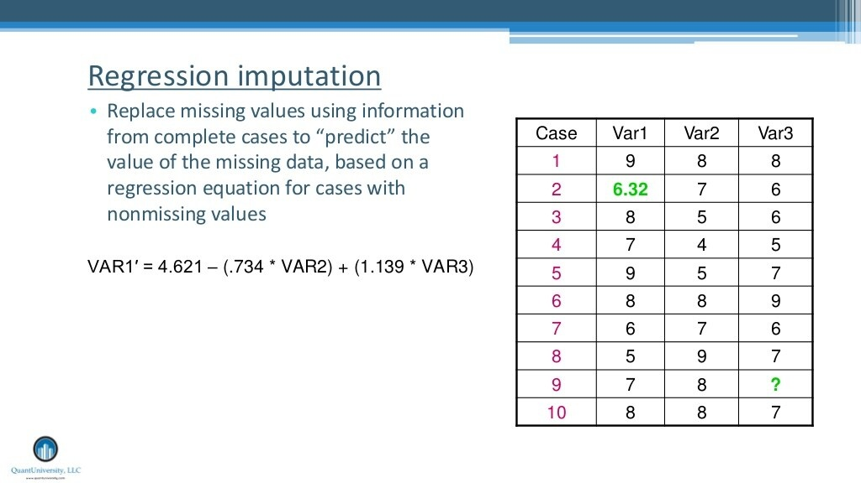

Slide 19
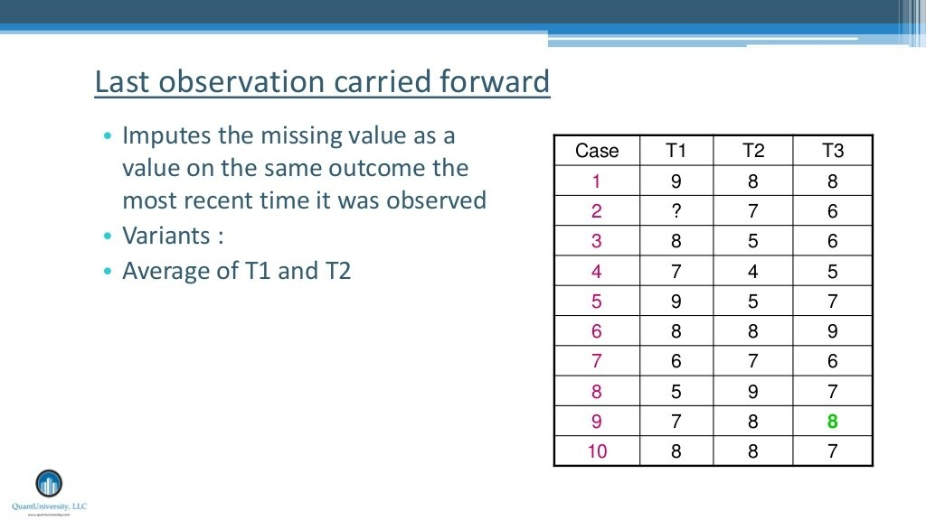

Slide 20
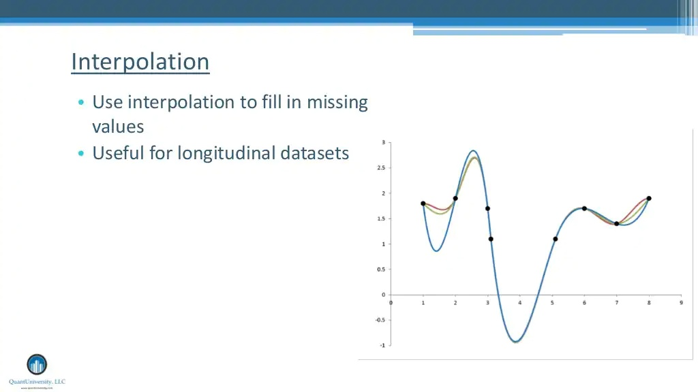

Slide 21
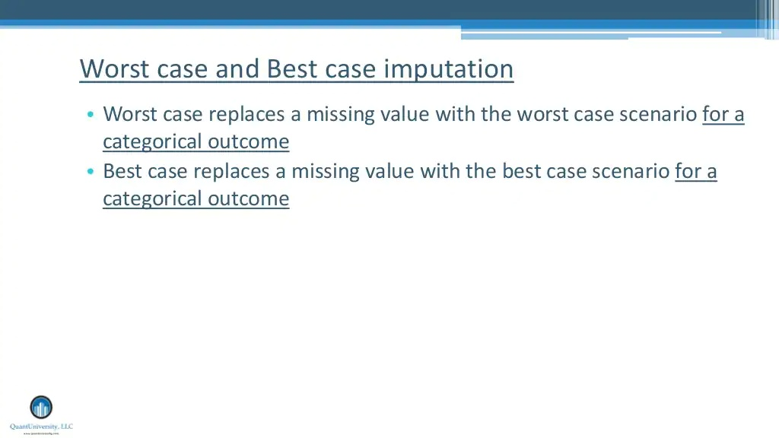

Slide 22
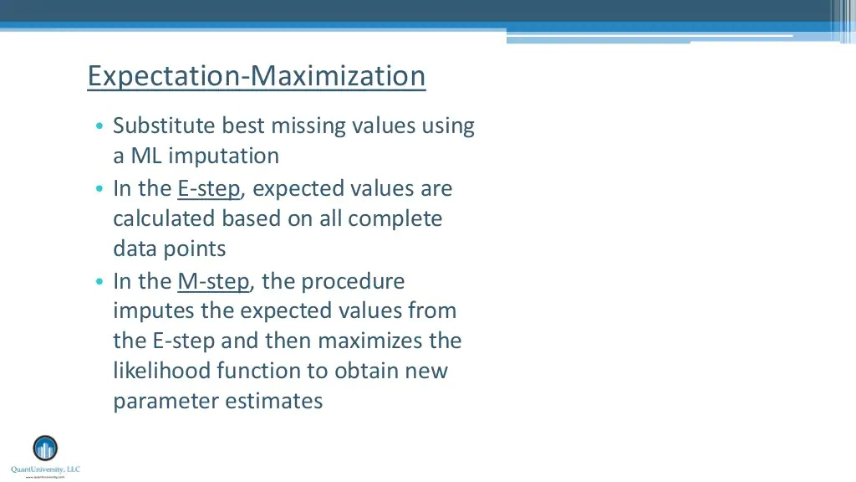

Slide 23
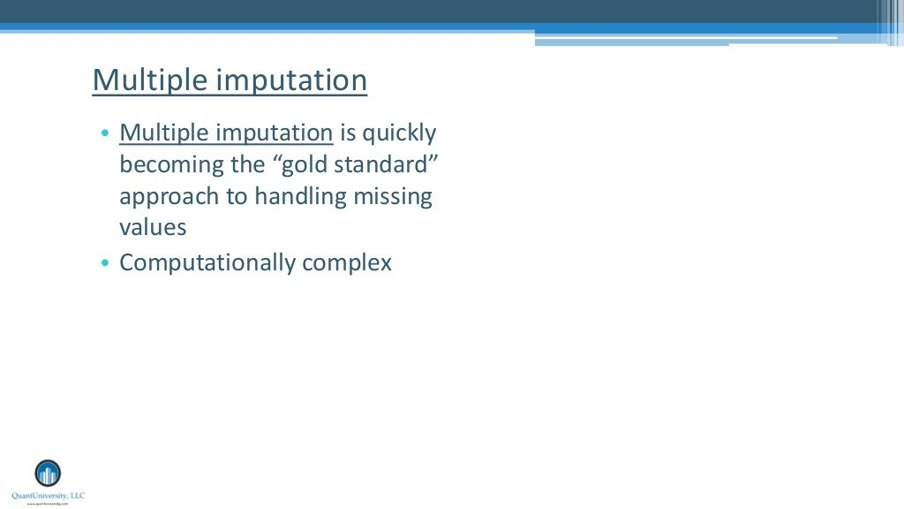

Slide 24
Encoding the Data
What is Categorical Data?
Label Encoding or Ordinal Encoding
One hot Encoding
Dummy Encoding
Effect Encoding
Binary Encoding
BaseN Encoding
Hash Encoding
Target Encoding

Slide 25
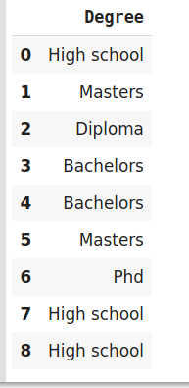
Label Encoding

Slide 26
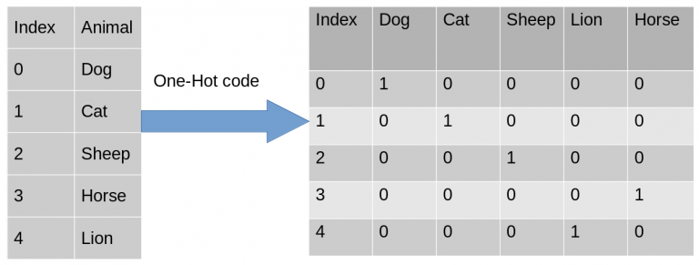
One Hot Encoding

Slide 27
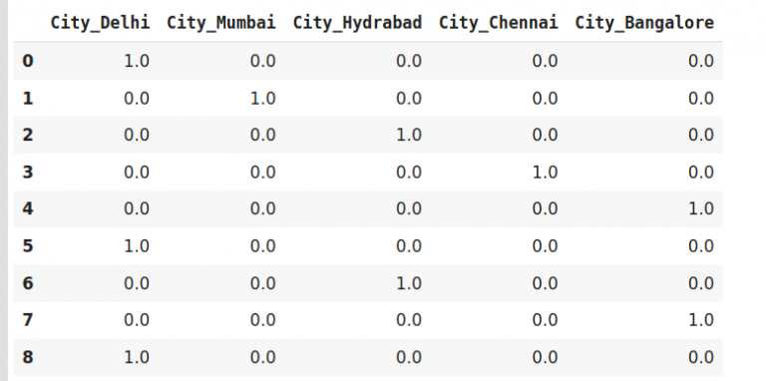

Slide 28
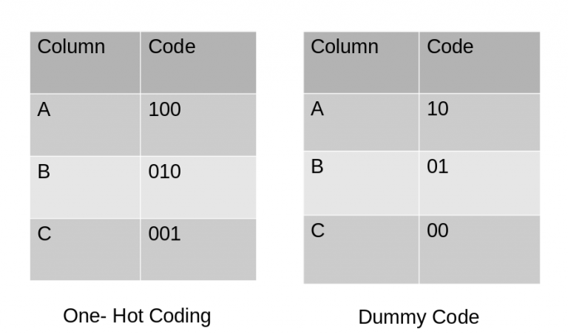
Dummy Encoding

