Slide 1
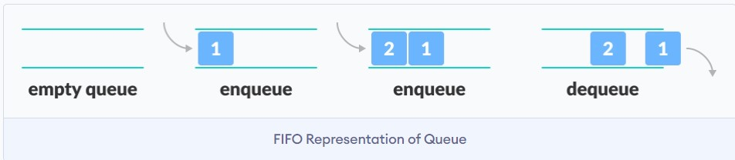
Queue
A queue is a useful data structure in programming. It is similar to the ticket queue outside a cinema hall, where the first person entering the queue is the first person who gets the ticket.
Queue follows the First In First Out (FIFO) rule - the item that goes in first is the item that comes out first.
In the shown image, since 1 was kept in the queue before 2, it is the first to be removed from the queue as well. It follows the FIFO rule.
In programming terms, putting items in the queue is called enqueue, and removing items from the queue is called dequeue.

Slide 2
Basic Operations of Queue
A queue is an object (an abstract data structure - ADT) that allows the following operations:
Enqueue: Add an element to the end of the queue
Dequeue: Remove an element from the front of the queue
IsEmpty: Check if the queue is empty
IsFull: Check if the queue is full
Peek: Get the value of the front of the queue without removing it.

Slide 3
Working of Queue
Queue operations work as follows:
two pointers FRONT and REAR
FRONT track the first element of the queue
REAR track the last element of the queue
initially, set value of FRONT and REAR to -1
Enqueue Operation
check if the queue is full
for the first element, set the value of FRONT to 0
increase the REAR index by 1
add the new element in the position pointed to by REAR

Slide 4
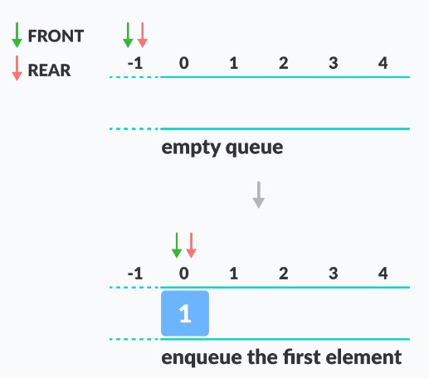
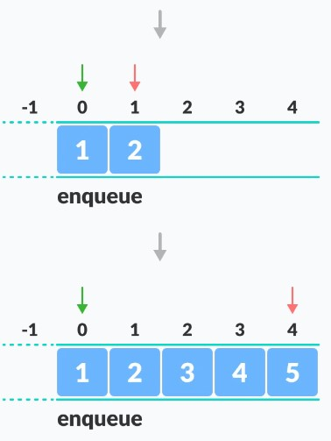
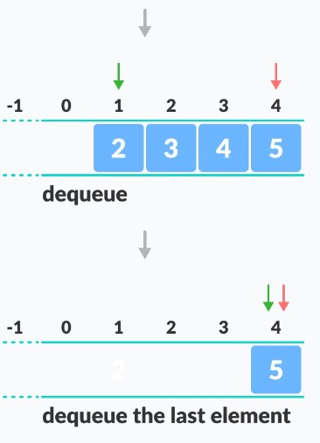
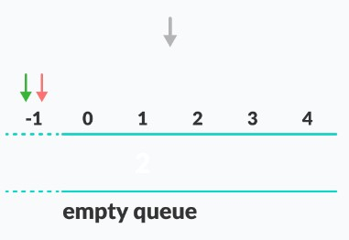
Dequeue Operation
check if the queue is empty
return the value pointed by FRONT
increase the FRONT index by 1
for the last element, reset the values of FRONT and REAR to -1

Slide 5
Applications of Queue
CPU scheduling, Disk Scheduling
When data is transferred asynchronously between two processes. The queue is used for synchronization. For example: IO Buffers, pipes, file IO, etc..
Handling of interrupts in real-time systems.
Call Center phone systems use Queues to hold people calling them in order.

