Slide 1
Internship: Computational Pathology
Keerthan Ugrani
Heidelberg University

Slide 2
Internship Computational Pathology
End Goal: Image Classification on Pathology (Histology) images
For classification “FewShotLearning” is used which allows to classify with very little amount of data per class
Data sets are highly unbalanced

Slide 3
First Working Task
Objective: Creating a general data structure for classification of datasets.
Solution: The DatasetManager class for handling and streamline data management for DICOM medical images.
Recursive loading of DICOM files from specified directories.
Organized storage of data based on class labels derived from directory structure.
Automatic computation of class distributions and data statistics.
Extraction of essential metadata for analysis and reporting.
Supports standardization and normalization techniques.
Flexible methods to accommodate various preprocessing needs.
Easy partitioning into training and testing sets with customizable ratios.
Maintains class balance across splits.
Efficient storage of processed data in HDF5 format for quick access.

Slide 4
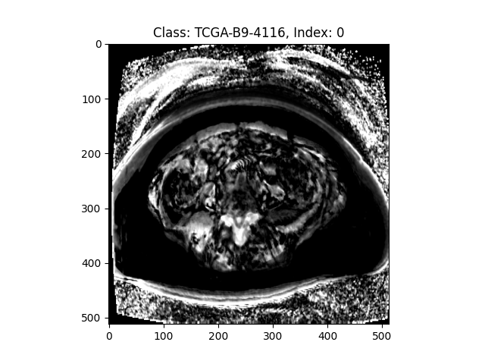
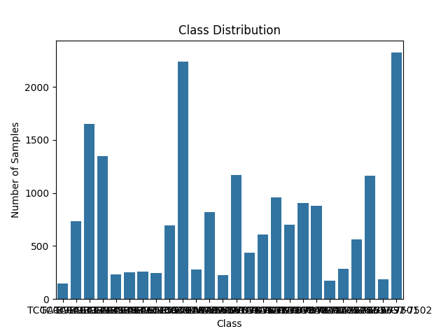
Output
Metadata file
Pre-processed Data
Class distribution of the data

Slide 5
Methods used to handle Unbalanced Data
Class weighting
Focal Loss
GAN
Oversampling and Augmentation
Dataset Taken:
3000+ images
20 classes
Minority class number: 2

Slide 6
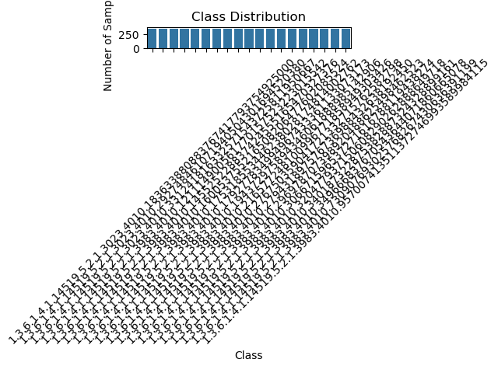
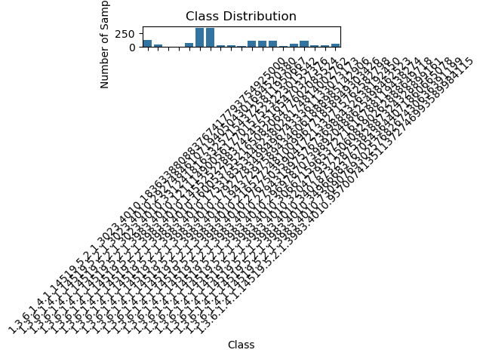
Update

Slide 7
Classification model
Easy Few Shot Learning: Prototypical Network
Simple CNN model for classification
Train: 70%
Test: 30%

Slide 8
CNN model Features
Conv2D (32 filters, kernel size 3x3): 1st layer (feature extraction)
MaxPooling2D (pool size 2x2): 2nd layer (spatial downsampling)
Conv2D (64 filters, kernel size 3x3): 3rd layer (deeper feature extraction)
MaxPooling2D (pool size 2x2): 4th layer (spatial downsampling)
Flatten: 5th layer (flattening the 2D feature maps into 1D)
Dense (128 neurons): 6th layer (fully connected layer)
Dropout (0.5 rate): 7th layer (dropout for regularization)
Dense (num_classes, softmax activation): 8th layer (output layer for classification)

Slide 9
GAN Model
Generator Network Layers:
Dense: 1st layer (fully connected, input layer)
Reshape: 2nd layer (reshaping the output from Dense layer)
Conv2DTranspose (128 filters): 3rd layer (transposed convolution for upscaling)
BatchNormalization: 4th layer (normalization)
LeakyReLU: 5th layer (activation function)
Conv2DTranspose (64 filters): 6th layer (transposed convolution for upscaling)
BatchNormalization: 7th layer (normalization)
LeakyReLU: 8th layer (activation function)
Conv2D (1 filter, tanh activation): 9th layer (output layer, producing the image)

Slide 10
Discriminator Network Layers:
Conv2D (64 filters): 1st layer (convolution for feature extraction)
LeakyReLU: 2nd layer (activation function)
Flatten: 3rd layer (flattening the feature map)
Dense (1 neuron, sigmoid activation): 4th layer (output layer, real/fake classification)

Slide 11
Results for CNN Classification Model
Oversampling Method Accuracy: 23.66%
Class_weighted Method Accuracy: 66.53%
Focal_loss Method Accuracy: 83.33%
Gan Method Accuracy: 85.43%

