Slide 1
Internship: Computational Pathology
Keerthan Ugrani
Heidelberg University

Slide 2
Internship Computational Pathology
End Goal: Image Classification on Pathology (Histology) images
For classification “FewShotLearning” is used which allows to classify with very little amount of data per class
Data sets are highly unbalanced

Slide 3
First Working Task
Objective: Creating a general data structure for classification of datasets.
Solution: The DatasetManager class for handling and streamline data management for DICOM medical images.
Recursive loading of DICOM files from specified directories.
Organized storage of data based on class labels derived from directory structure.
Automatic computation of class distributions and data statistics.
Extraction of essential metadata for analysis and reporting.
Supports standardization and normalization techniques.
Flexible methods to accommodate various preprocessing needs.
Easy partitioning into training and testing sets with customizable ratios.
Maintains class balance across splits.
Efficient storage of processed data in HDF5 format for quick access.

Slide 4
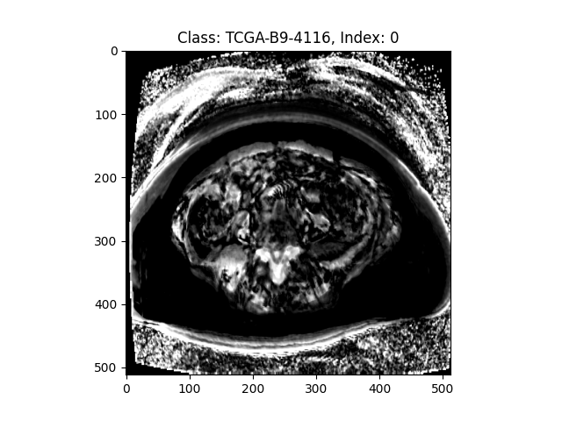
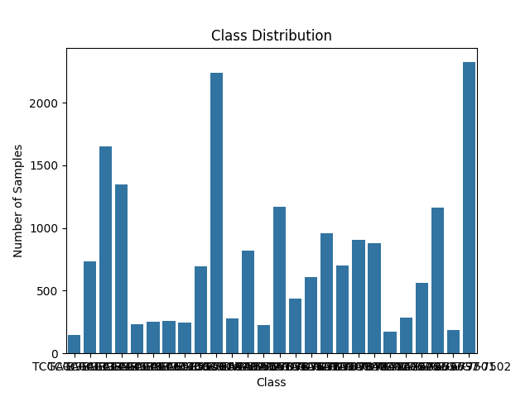
Output
Metadata file
Pre-processed Data
Class distribution of the data

