Slide 1
Handling Imbalanced Medical Datasets for Pathology Image Classification
Advanced Masters Internship
Keerthan Ugrani
keerthan.ugrani@stud.uni-heidelberg.de
Advanced Praktikum (8 LP)
15.11.2024

Slide 2
Table of Contents
Motivation and Objectives
Use Case
Requirements
Materials and Methods
Basic Approach
Main Implementation
Extracted Metadata
Class Imbalance Handling Methods
Results
Conclusion
Notes:
Our presentation today will cover the following key areas:
The presentation will last approximately 30 minutes. We will have a Q&A session at the end of this presentation, but feel free to jot down your questions as we go along.

Slide 3
Motivation and Objective
Motivation:
Medical Image datasets are often highly imbalanced, with rare pathologies underrepresented
Accurate classification is crucial for diagnosis but challenging due to data imbalance.
Objective:
Implement multiple techniques to handle dataset imbalance.
Exploring novel loss functions and architectures specifically designed for imbalanced datasets.
Developing innovative synthetic data generation methods for rare pathologies.
evaluate each method’s performance on a pathology image dataset.
identify the best approach for achieving balanced performance.
Notes:
Challenges Posed by Imbalanced Datasets in Medical Imaging
Algorithmic Bias:
Machine learning models are typically optimized to minimize overall error, leading them to favor majority classes at the expense of minority classes.
For instance, a model trained on a dataset where 90% of images are normal and 10% show a rare pathology might simply predict "normal" most of the time and still achieve high accuracy.
Poor Sensitivity for Rare Pathologies:
While models may achieve high accuracy overall, their sensitivity (true positive rate) for minority classes (rare diseases) is often very low.
This can result in misdiagnoses or missed diagnoses for patients with rare but critical conditions.
Evaluation Challenges:
Standard metrics like accuracy can be misleading for imbalanced datasets. Metrics such as precision, recall, F1-score, and the area under the precision-recall curve (PR-AUC) become more relevant but are less commonly used.
Annotation Challenges:
Rare pathology cases often require expert annotation, which can introduce variability and error due to differences in expertise or interpretation.

Slide 4
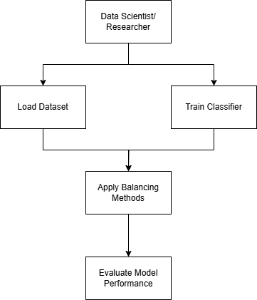
Use Case
Problem: Medical datasets in pathology often suffer from class imbalance, leading to biased classifiers.
Solution: This project explores four methods to improve classification accuracy by balancing classes effectively:
Oversampling and Data Augmentation
Class-weighted Loss
Focal Loss
Generative Adversarial Networks (GANs)
Application: This method enables more accurate diagnosis of underrepresented conditions in medical imaging.
Notes:
Data Scientist/Researcher:
The process starts with a data scientist or researcher who initiates the workflow. This person is responsible for designing and implementing the methods for handling the imbalanced dataset in medical imaging.
Load Dataset:
The first step in the workflow is to load the medical image dataset. This dataset is likely to be imbalanced, meaning there are fewer images representing rare pathologies compared to more common conditions.
Train Classifier:
Once the dataset is loaded, a machine learning or deep learning classifier is trained on this data. However, because of the imbalance, training a model at this stage might lead to biased predictions that favor the majority class (e.g., normal cases over rare diseases).
Apply Balancing Methods:
To address the class imbalance, various balancing methods are applied. These could include techniques like oversampling (increasing the number of minority class samples), undersampling (reducing the majority class samples), data augmentation, or specialized loss functions to improve model sensitivity to rare cases.
Evaluate Model Performance:
After applying the balancing methods, the model’s performance is evaluated. Here, the focus is on ensuring that the model performs well across all classes, including the minority (rare pathology) classes. Metrics like precision, recall, F1-score, or AUC-PR might be used instead of overall accuracy to get a more balanced view of performance.
This workflow provides a systematic approach to addressing class imbalance in medical image classification, which is essential for building models that can accurately identify both common and rare pathologies.

Slide 5
Requirements
Software & Libraries:
Python, Pytorch, Tensorflow, Keras
Data Processing: pandas, numpy
Image Processing: pydicom (DICOM image handling), matplotlib (for visualization)
Additional Libraries: sklearn for evaluation metrics, yaml for configuration

Slide 6
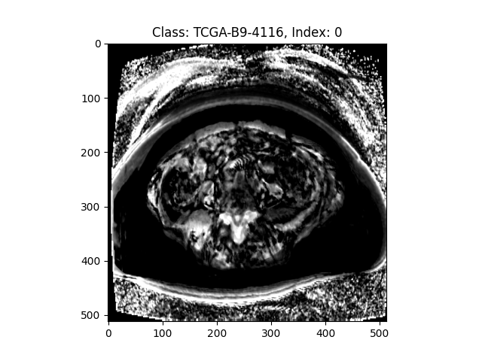
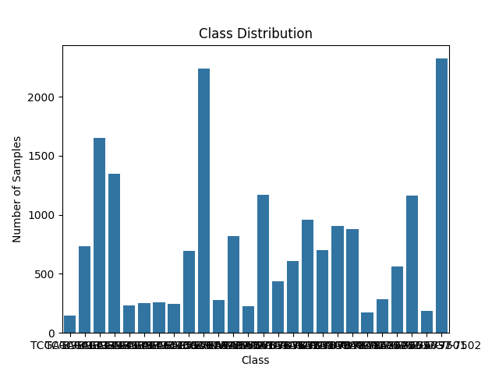
Material and Methods
Dataset: Pathology image dataset (DICOM format)
Methods:
Oversampling and augmentation: Balances classes by duplicating and augmenting images in minority classes
Class-Weighted Loss: Modifies the loss function to penalize misclassifications of minority classes more heavily.
Focal Loss: Focuses on hard-to-classify examples, reducing the impact of easy examples on training
GAN-based Augmentation: Generates synthetic images to increase the representation of minority classes.

Slide 7
Basic Approach
Load and Pre-Process Data:
Convert DICOM images, standardize sizes, and split the data into training and test sets.
Implement Dataset Balancing Techniques:
Apply each balancing method individually and store the modified datasets.
Train Classifier (CNN):
Use a CNN to classify images and evaluate using F1 Score
Evaluate Performance:
Compare results across methods to identify the most effective balancing approach

Slide 8
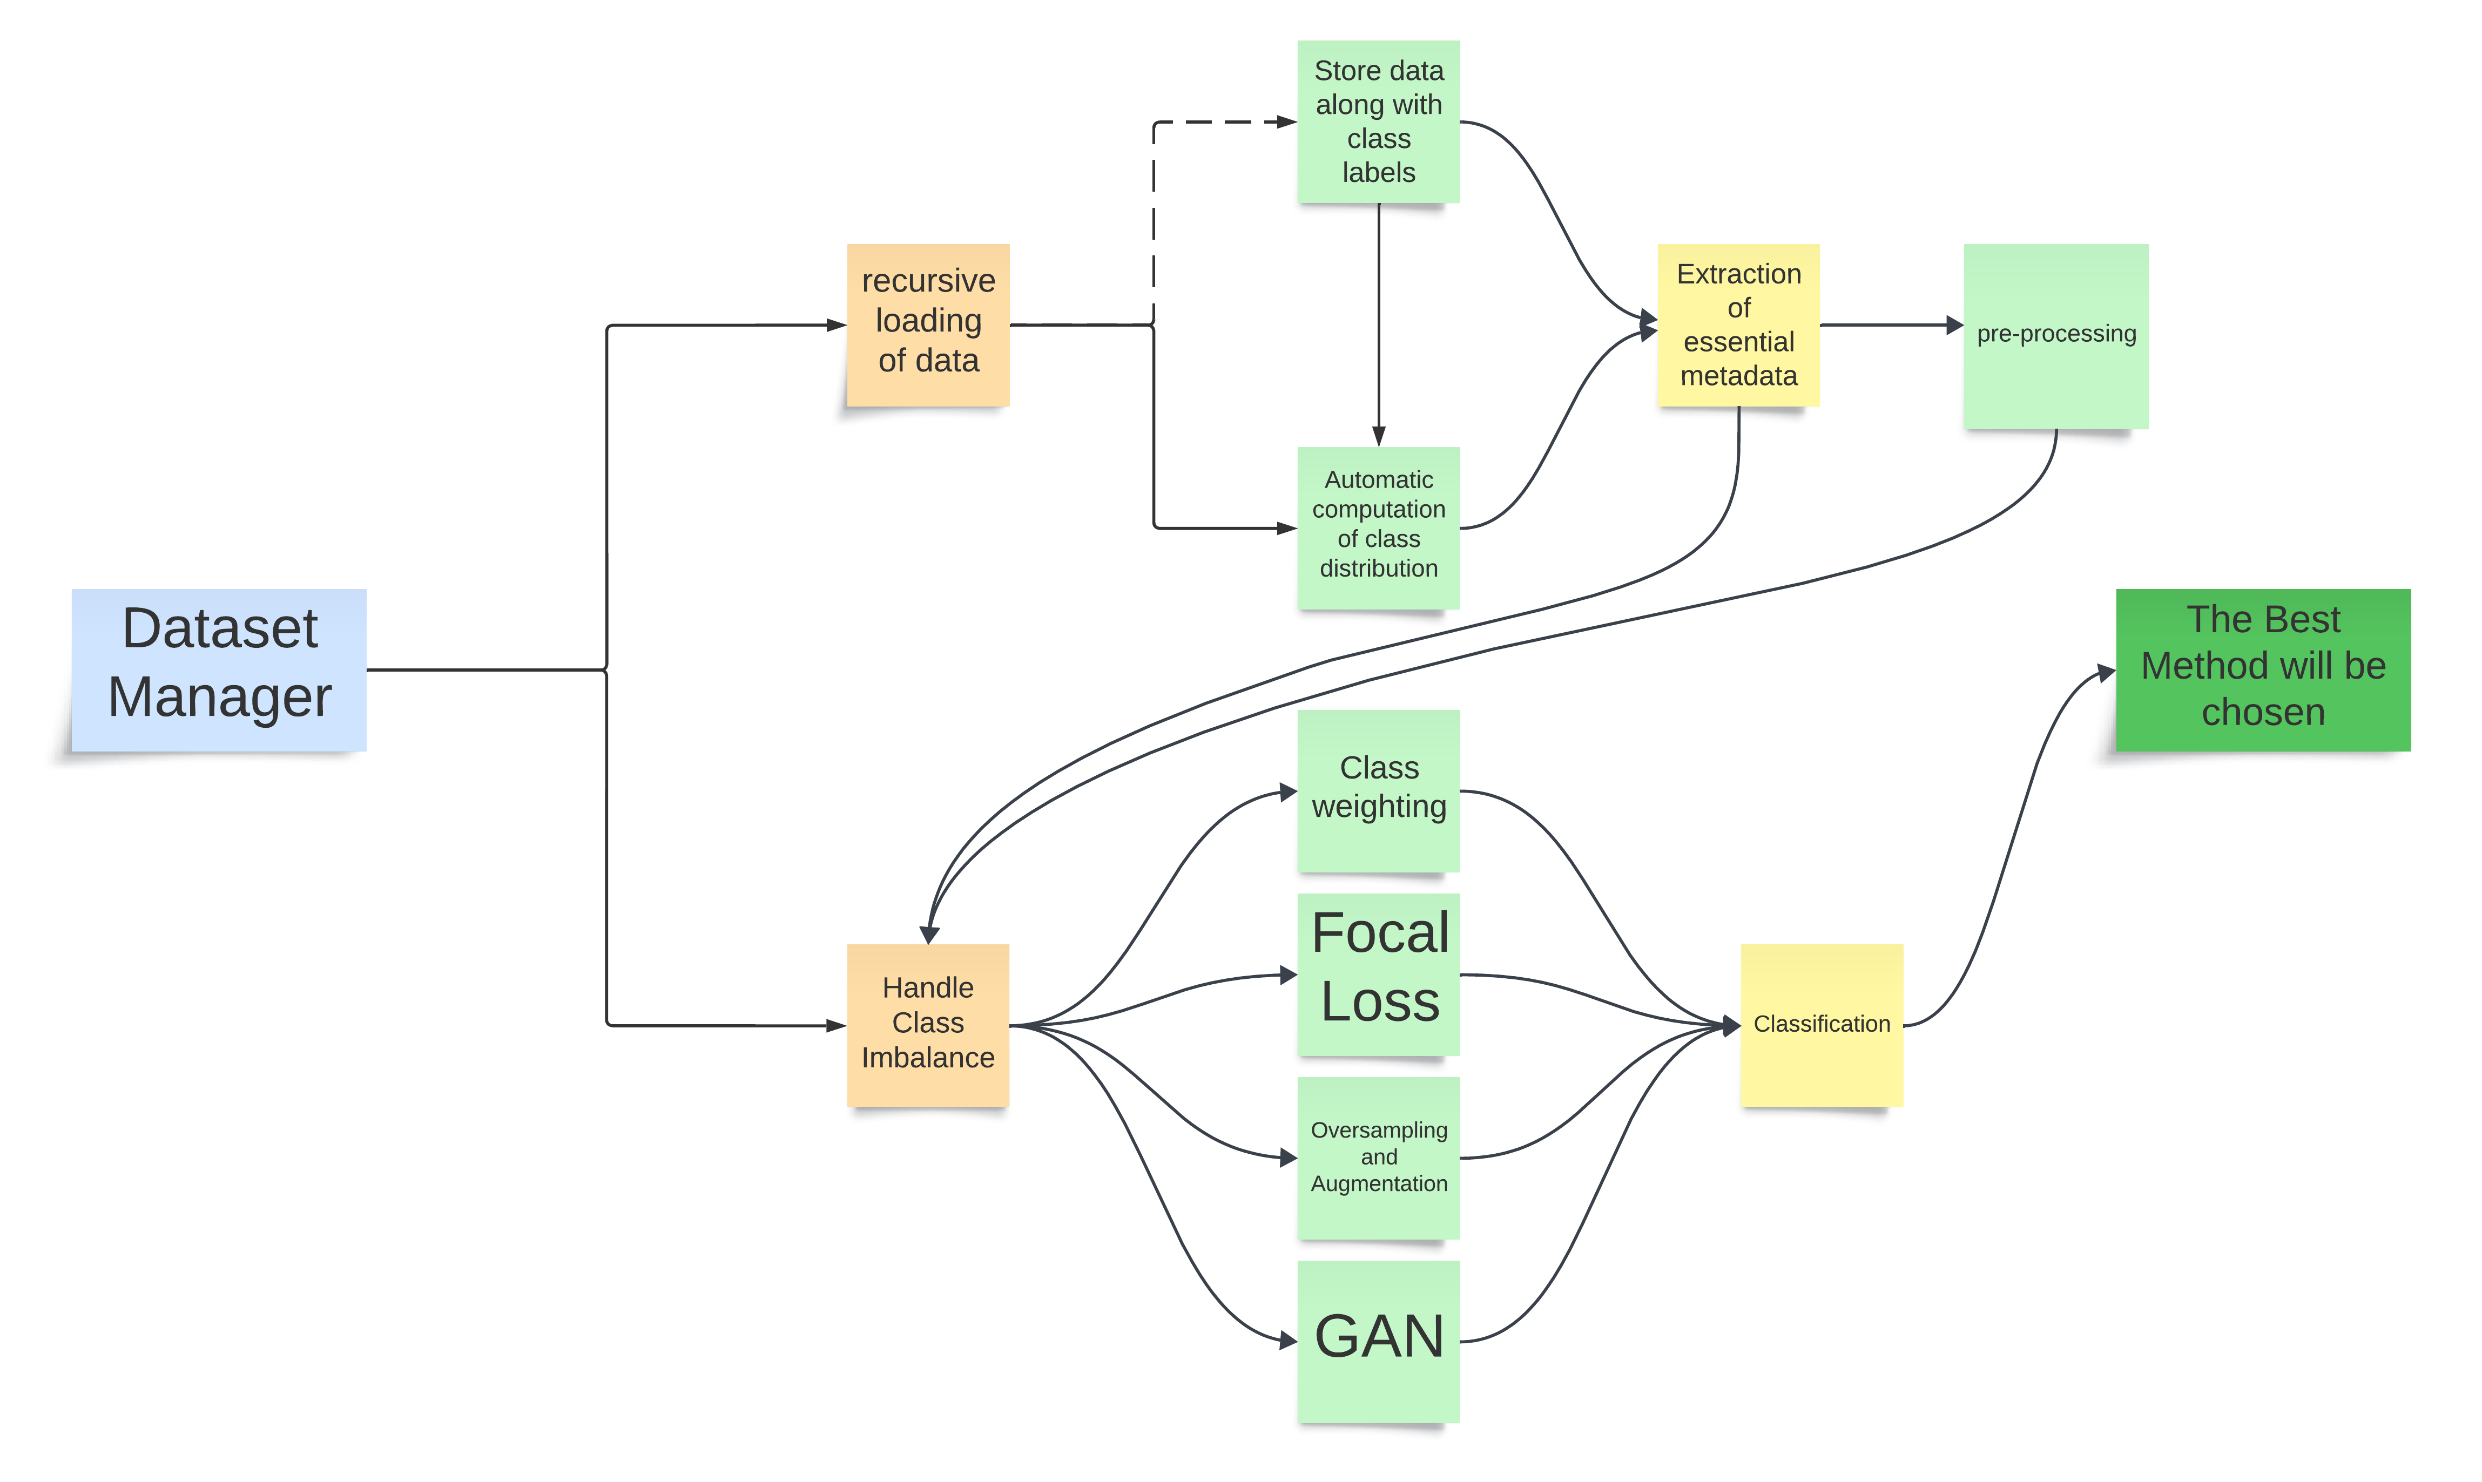
Main Implementation

Slide 9
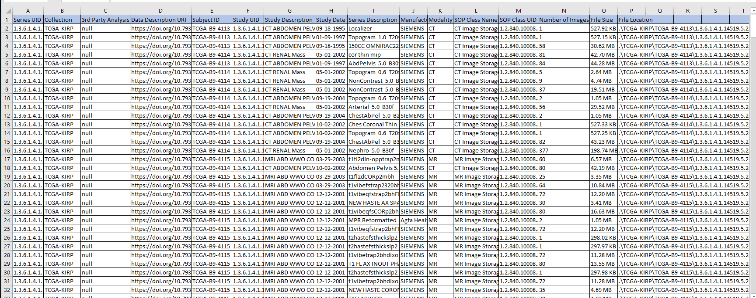
Extracted Metadata

Slide 10
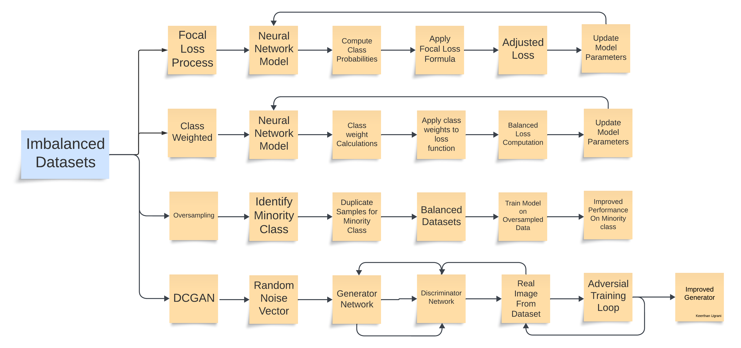
Class Imbalance Handling Methods
Notes:
Detailed Explanation of Focal Loss:
Imbalanced Dataset:
Start with a dataset that has class imbalance (e.g., a majority class significantly outnumbers the minority class).
Input data into the neural network.
Neural Network Model:
The model processes the data through layers to predict probabilities for each class.
Compute Class Probabilities:
For each sample, the model outputs predicted probabilities (ptp_tpt​) for the true class.
Apply Focal Loss Formula:
Use the formula: FL(pt)=−α(1−pt)γlog⁡(pt)\text{FL}(p_t) = -\alpha (1 - p_t)^\gamma \log(p_t)FL(pt​)=−α(1−pt​)γlog(pt​)
α (alpha) balances the importance of each class.
γ (gamma) adjusts focus on hard-to-classify examples:
Hard examples (low ptp_tpt​) get more weight.
Easy examples (high ptp_tpt​) are down-weighted.
Adjusted Loss for Hard Examples:
After applying Focal Loss, the loss emphasizes hard examples (e.g., samples with low confidence or from minority classes).
Update Model Parameters:
Use the adjusted loss values to update the model's weights during backpropagation.
class weighting:
Imbalanced Dataset (🗂️):
Visualize a dataset where one class (e.g., cats) has far more samples than another class (e.g., dogs).
The imbalance can lead the model to predict "cats" more often, ignoring "dogs."
Neural Network Model (🧠):
The model takes inputs and begins learning by predicting class probabilities and computing loss values.
Class Weight Calculation (📊):
The frequency of each class is counted.
Formula for Class Weight: Weighti=Total SamplesNumber of Samples in Classi\text{Weight}_i = \frac{\text{Total Samples}}{\text{Number of Samples in Class}_i}Weighti​=Number of Samples in Classi​Total Samples​
Example:
Total samples = 100
Cats = 90 → Weight for Cats = 10090=1.11\frac{100}{90} = 1.1190100​=1.11
Dogs = 10 → Weight for Dogs = 10010=10.0\frac{100}{10} = 10.010100​=10.0
Apply Class Weights to Loss Function (⚖️):
Modify the loss function (e.g., Cross-Entropy Loss): Weighted Loss=Class Weight×Loss\text{Weighted Loss} = \text{Class Weight} \times \text{Loss}Weighted Loss=Class Weight×Loss
Errors in minority classes (dogs) are scaled up, while errors in majority classes (cats) are scaled down.
Balanced Loss Computation (🎯):
The loss is now balanced, ensuring that both majority and minority classes influence the model equally during training.
Model Optimization (🔄):
Backpropagation uses the balanced loss values to update weights, improving predictions for all classes.
Oversampling:
Imbalanced Dataset (🗂️):
Visualize a dataset with a majority class (e.g., 90% "cats") and a minority class (e.g., 10% "dogs").
This imbalance makes the model biased toward predicting the majority class.
Identify Minority Class (📈):
Analyze the dataset to find underrepresented classes (e.g., "dogs").
Oversampling Process (🌀):
Duplication: Directly copy existing samples of the minority class multiple times.
Example: If there are 10 "dogs," duplicate them 9 times to match 90 "cats."
Synthetic Data Generation:
Use methods like SMOTE (Synthetic Minority Oversampling Technique):
Generate synthetic samples by interpolating between existing samples of the minority class.
Example: If two "dog" samples are nearby in feature space, a new synthetic sample is created between them.
Balanced Dataset (🆕):
After oversampling, the dataset now has equal representation of both classes (e.g., 90 "cats" and 90 "dogs").
This eliminates the imbalance that could skew the model during training.
Train Model on Oversampled Dataset (🧠):
The model trains on the newly balanced dataset, allowing it to learn features of both majority and minority classes equally.
Improved Performance on Minority Class (🎯):
The model is less biased and performs better on predicting the minority class ("dogs").
This leads to improved recall, precision, and F1-score for the minority class.
DCGAN(Deep Convolutional Generative Adversarial Network):
Input Random Noise (🗂️):
A random latent vector (e.g., a 100-dimensional vector of random numbers) is fed into the generator.
This vector represents the seed for generating images.
Generator Network (🎨):
The generator is a neural network designed to produce data (e.g., images) that mimic the real dataset.
Key features of the DCGAN generator:
Transposed Convolutions: Layers that gradually upscale the input noise into an image.
Batch Normalization: Stabilizes the training and speeds up convergence.
ReLU Activation: Helps the generator create more complex patterns.
Generated Fake Data (🖼️):
The generator outputs an image (e.g., a "fake cat").
Initially, these images may look like random noise but improve over time.
Discriminator Network (🕵️):
The discriminator is a convolutional neural network (CNN) that evaluates whether an input image is "real" (from the actual dataset) or "fake" (from the generator).
Key features of the DCGAN discriminator:
Convolutions: Extract spatial features from the input images.
Leaky ReLU Activation: Prevents the problem of dead neurons during training.
Adversarial Training Process (🔄):
Two Networks Compete:
The discriminator improves its ability to distinguish real images from fake ones.
The generator learns to create images that can fool the discriminator.
Loss Functions:
Discriminator minimizes classification error.
Generator maximizes the discriminator’s error (i.e., fools it).
Output Realistic Images (🎯):
After many iterations (epochs), the generator becomes skilled at creating realistic images, and the discriminator is less able to distinguish between real and fake images.

Slide 11
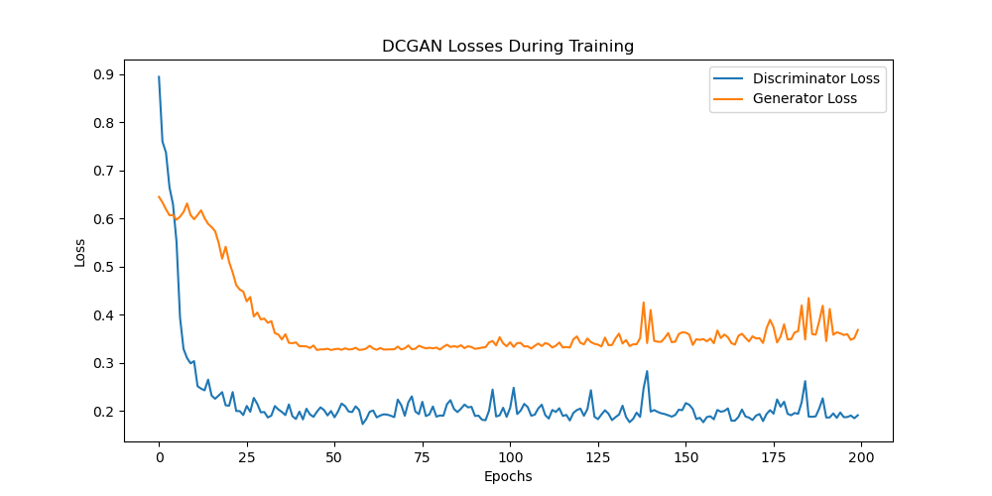
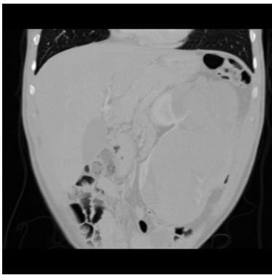
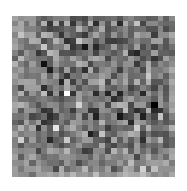
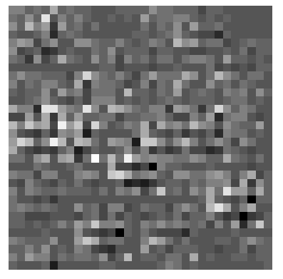
Results
Methods | Accuracy | F1 Score
Oversampling | 23.66
Class Weighted | 66.53 | -
Focal Loss Method | 83.33 | 0.4531
GAN method | 85.43 | 0.5847
Notes:
The table lists various balancing methods, their accuracy, and F1 scores:
Oversampling and Augmentation:
Accuracy: 23.66%
F1 Score: Not available
This approach involves duplicating minority class samples and/or applying transformations (such as rotation, flipping, etc.) to create more diverse samples. The low accuracy here indicates that simply augmenting and oversampling the minority class did not significantly improve model performance.
Class Weighted:
Accuracy: 66.53%
F1 Score: Not available
This method assigns higher weights to minority class samples to reduce bias toward the majority class. The accuracy has improved compared to oversampling and augmentation but still lacks a corresponding F1 score, which would provide insights into the model's balance between precision and recall.
Focal Loss Method:
Accuracy: 83.33%
F1 Score: 0.4531
Focal loss is a loss function that focuses on difficult-to-classify samples, often from minority classes. The accuracy here is significantly improved, and the F1 score, while modest, indicates that this method helps the model handle imbalanced classes better than oversampling and class weighting alone.
GAN (Generative Adversarial Network) Method:
Accuracy: 85.43%
F1 Score: 0.5847
GANs, specifically DCGANs in this case, are used to generate synthetic images of the minority class, increasing diversity in the dataset. This approach has the highest accuracy and F1 score among the methods listed, indicating that GANs help improve the model's ability to classify minority class samples effectively.
Synthetic Images Generated by DCGAN
The images at the bottom are examples of synthetic images generated by a DCGAN model. DCGANs are a type of GAN that use convolutional layers to generate more realistic images, which are particularly useful for medical images where specific textures and patterns (e.g., lesions or abnormalities) are important.
In this case, these synthetic images represent samples of the minority pathology class, created to balance the dataset. By adding these synthetic samples, the model has more examples to learn from, improving its ability to recognize rare conditions. As the table shows, the GAN method provided the best accuracy and F1 score, highlighting that the generated images are effective in mitigating the class imbalance issue.
Summary
The GAN method (using DCGANs for synthetic image generation) outperformed other balancing techniques in terms of accuracy and F1 score.
Focal Loss also performed relatively well, indicating its usefulness in handling class imbalance without synthetic data generation.
Oversampling and simple augmentation were less effective, suggesting that more sophisticated methods like GANs or focal loss are needed for highly imbalanced medical datasets.
The synthetic images generated by DCGANs proved to be useful in augmenting the dataset, helping the model to achieve better balanced performance.

Slide 12
Conclusion
Insights:
GAN-based data augmentation offers a viable way to balance minority classes with synthetic images.
Focal loss effectively handles imbalanced data by focusing on harder examples
Future Improvements:
Explore advanced GANs like Few-Shot GANs for smaller datasets.
Investigate transfer learning for even higher classification in medical application.
Implementation of easy few shot learning for the classification.
Using both Focal-loss and GAN based methods to handle imbalance in the classes.
Most Effective Method:
The Best-Performing method for the basic CNN classification is GAN based Augmentation for imbalanced classes.
The method can changes based on the usage of the classification techniques.
This method might be best suitable for other classification techniques as well because the GAN generates synthetic data of .dcm format with all the duplicate information of original images.
Notes:
These four methods—Oversampling and Augmentation, Class Weighting, Focal Loss, and GANs—are widely regarded as effective for handling imbalanced datasets, particularly in challenging domains like medical imaging, for several key reasons:
1. Oversampling and Augmentation
Why It Works: Oversampling and augmentation directly increase the representation of minority classes in the dataset, which helps the model see more examples of rare pathologies. Data augmentation (such as rotating, flipping, or adding noise) diversifies the dataset, making the model more robust to variations and helping prevent overfitting on limited minority samples.
Benefits: Easy to implement, cost-effective, and can be applied to any dataset without modifying the algorithm.
Limitations: Oversampling alone may lead to overfitting, as the model could simply memorize repeated examples. Augmentation may not always create realistic enough examples for medical images, especially when subtle features differentiate classes.
2. Class Weighting
Why It Works: Class weighting adjusts the importance of each class in the loss function, assigning higher weights to minority classes. This approach tells the model to pay more attention to rare classes during training, even if their sample count is lower.
Benefits: Straightforward to implement and does not require adding synthetic data, making it useful when generating synthetic samples is challenging or undesirable.
Limitations: Class weighting can be limited when there’s a high imbalance, as it might not be enough to fully overcome the bias toward the majority class. Also, it can be sensitive to the magnitude of the weights chosen, and finding the right balance can require fine-tuning.
3. Focal Loss
Why It Works: Focal Loss is a modified loss function that focuses on hard-to-classify examples, which are often from the minority class. By reducing the weight for correctly classified examples and increasing it for misclassified ones, Focal Loss emphasizes the harder (and often rarer) cases.
Benefits: Improves the model’s ability to learn from difficult or underrepresented samples, making it especially valuable in highly imbalanced settings. It’s particularly useful for datasets where class imbalance is severe.
Limitations: Can require more hyperparameter tuning (e.g., adjusting the gamma parameter) to work effectively. It is a more complex loss function, which might not be ideal for all types of models or tasks.
4. Generative Adversarial Networks (GANs)
Why It Works: GANs can generate new, realistic samples of the minority class by learning the underlying distribution of the dataset. This is particularly useful for medical imaging, where simple transformations may not be sufficient, and synthetic examples with realistic textures and patterns are needed to help the model generalize.
Benefits: Allows the creation of entirely new, diverse samples for the minority class, helping balance the dataset without duplicating existing images. GANs can produce high-quality images that resemble actual medical data, making them especially valuable in fields like radiology, pathology, and dermatology.
Limitations: GANs are complex to train, requiring careful tuning and significant computational resources. Poorly trained GANs can generate unrealistic or low-quality images, which could harm model performance. Also, GAN-generated images may not perfectly capture the diversity of real-world pathology.
Why These Four Are Considered Some of the Best for Handling Imbalance in Medical Imaging
Proven Effectiveness: Each of these methods has shown success in various domains, including medical imaging, where imbalanced data is common and minor classes are often more clinically significant.
Flexibility and Applicability: These techniques can be adapted to different datasets and models, offering solutions that range from data-level (oversampling, GANs) to algorithm-level (class weighting, focal loss) interventions.
Complementary Strengths: These methods address imbalance in different ways. For example:
Oversampling and augmentation provide straightforward data balancing.
Class weighting alters model training to reduce bias.
Focal Loss prioritizes hard-to-classify samples.
GANs generate entirely new examples to enrich minority class diversity.
This diversity makes them versatile across a range of datasets and imbalance scenarios.
Focus on Rare Classes: In medical imaging, identifying rare pathologies is crucial, as missing a rare condition can have serious consequences. These methods ensure that models pay sufficient attention to these minority classes, improving sensitivity for rare but critical conditions.
Reduced Risk of Overfitting: Methods like Focal Loss and GANs mitigate the risk of overfitting associated with naive oversampling by focusing on hard examples or by generating new, realistic samples rather than duplicating data. This quality is essential for achieving robust generalization, especially with small datasets.

Slide 13
THANK YOU !!

