Slide 1
Advance Java Script
Copied from Edureka

Slide 2
Java Script
JavaScript is a high level, interpreted, programming language used to make web pages more interactive.
Features of JavaScript
Scripting language and not Java: In fact, JavaScript has nothing to do with Java. Then why is it called “Java” Script? When JavaScript was first released it was called Mocha, it was later renamed to LiveScript and then to JavaScript when Netscape (founded JavaScript) and Sun did a license agreement.

Slide 3
Java Script
Object-based scripting language which supports polymorphism, encapsulation and to some extent inheritance as well.
Interpreted language: It doesn’t have to be compiled like Java and C which require a compiler.
JavaScript runs in a browser: You can run it on Google Chrome, Internet Explorer, Safari, etc. JavaScript can execute not only in the browser but also on the server and any device which has a JavaScript Engine.

Slide 4
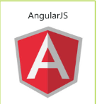
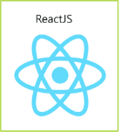


JavaScript Frameworks
Angular
React
MeteroJS
JQuery

Slide 5
JavaScript Fundamentals
we’ll cover the following basic fundamentals of JavaScript
Variables
Constants
Data Types
Objects
Arrays
Functions
Conditional statements
Loops
Switch case

Slide 6
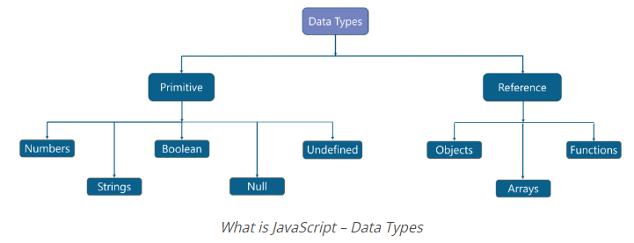
Data Types:

Slide 7
Class & Object:
→Objects are variables too, but they contain many values, so instead of declaring different variables for each property, you can declare an object which stores all these properties.
Example:
let contact = {
firstName=‘Nick’,
lastName=‘Watkins’,
mobile=‘999999’,
email=‘nick.Watkins@mail.com’,
}
Arrays:
An array is a data structure that contains a list of elements which store multiple values in a single variable.
Example:
let shopping=[];
shopping=['paintBrush','sprayPaint','waterColours','canvas'];

Slide 8
Jquery:
JQuery is developed by Google. To create the first jQuery example, you need to use JavaScript file for jQuery. You can download the jQuery file from jquery.com or use the absolute URL of jQuery file.
<!DOCTYPE html>
<html>
<head>
<title>Second jQuery Example</title>
<script type="text/javascript" src="https://ajax.googleapis.com/ajax/libs/jquery/2.1.3/jquery.min.js">
</script>
<script type="text/javascript" language="javascript">
$(function() {
$("p").css("color", "red");
});
</script>
</head>
<body>
<p>The first paragraph is selected.</p>
<p>The second paragraph is selected.</p>
<p>The third paragraph is selected.</p>
</body>
</html>
https://www.javatpoint.com/jquery-selectors

Slide 9
Advanced Javascript:
Recursion
Closure
Arrow Functions
Rest Parameters & Spread Operator
Global Object
Function Object
Function Binding
Prototype

Slide 10
Recursion:
Recursion is a programming pattern that helps in situations where a task can be naturally split into several tasks of the same kind, but simpler.
function pow(x, n) {
if (n == 1) {
return x;
} else {
return x * pow(x, n - 1);
}
}
alert( pow(2, 3) ); // 8

Slide 11
Closure:
JavaScript is a function-oriented language. You can create a function dynamically, copy to another variable or pass as an argument to another function and call from a totally different place later.
A closure is a function that remembers its outer variables and can access them. In some languages, it is not possible, or a function should be written in a special way to make it happen. But in JavaScript, all functions are naturally closures.
https://www.freecodecamp.org/news/lets-learn-javascript-closures-66feb44f6a44/
https://www.geeksforgeeks.org/closure-in-javascript/

Slide 12
Arrow Functions:
Arrow functions are anonymous and change the way this binds in functions. It makes our code more concise and simplifies function scoping and this keyword.
Example:
let myFunction = (a, b) => a * b;
https://www.w3schools.com/js/js_arrow_function.asp

Slide 13
Rest Parameters & Spread Operator:
Rest parameter is an improved way of handling function parameter, allowing us to more easily handle various input as parameters in a function. The rest parameter syntax allows us to represent an indefinite number of arguments as an array.
// es6 rest parameter
function fun(...data){
let sum = 0;
for(let i of data){
sum+=i;
}
return sum;
}
console.log(fun(1,2)); //3
console.log(fun(1,2,4)); //4
console.log(fun(1,2,4,6)); //13

Slide 14
Spread Operator:
Spread operator allows an iteretable to expand in places where 0+ arguments are expected. It is mostly used in variable array where there is more than 1 values are expected. It allows us the privilege to obtain a list of parameters from an array.
// spread operator doing the concat job
let arr = [1,2,3];
let arr2 = [4,5,6];
arr = [...arr,...arr2];
console.log(arr); // [ 1, 2, 3, 4, 5,6 ]
https://www.w3schools.com/react/react_es6_spread.asp
https://www.simplilearn.com/ecmascript-vs-javascript-article#:~:text=JavaScript%20implements%20with%20environment%2Dspecific,compatibility%20across%20implementations%20and%20settings.

Slide 15
Function Object:
In JavaScript, functions are objects. The different properties include:
name – the function name. Usually taken from the function definition, but if there’s none, JavaScript tries to guess it from the context (e.g. an assignment).
length – the number of arguments in the function definition. Rest parameters are not counted.
If the function is declared as a Function Expression, and it carries the name, then it is called a Named Function Expression. The name can be used inside to reference itself, for recursive calls or such.
function sayHi() {
alert("Hi");
}
alert(sayHi.name); // sayHi
function f2(a, b) {}
function many(a, b, ...more) {}
alert(f2.length); // 2
alert(many.length); // 2

Slide 16
Prototype in Javascript:
JavaScript is a prototype-based, automatically adds a prototype property to functions upon creation. This prototype object allows attaching methods and properties, facilitating inheritance for all objects created from the function.
// function constructor
function Person(name, job, yearOfBirth){
this.name= name;
this.job= job;
this.yearOfBirth= yearOfBirth;
}
// this will show Person's prototype property.
console.log(Person.prototype);
Person.prototype.mobile = 00999;
https://www.w3schools.com/js/js_object_prototypes.asp

Slide 17
Thank you

