Slide 1
React18

Slide 2

React18

Slide 3

React18

Slide 4


React18

Slide 5
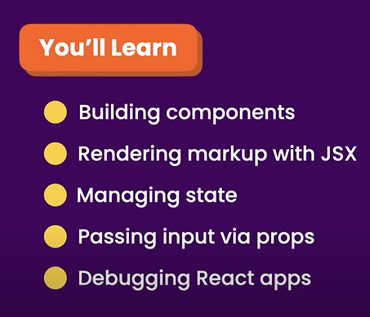
React18

Slide 6
Thank You

