Slide 1


K.RAMAKRISHNAN COLLEGE OF TECHNOLOGY
(AUTONOMOUS), TRICHY
ATM SIMULATION SYSTEM
PRESENTED BY SUPERVISOR
KEERTHANA R Mrs.K.Valli Priyadharshini M.E., (PhD),
2303811710422077 AP/CSE.

Slide 2
PRESENTATION OVERVIEW
Objective
Project Introduction
Problem Statement
Methodologies (Programming concepts relevant to problem statement)
Architecture of the proposed system
List of Modules
7. Merits
8. Results and Discussion
9. Queries

Slide 3
OBJECTIVE
This program simulates an ATM system with a user-friendly GUI for secure banking transactions like login, withdrawal, deposit, and balance inquiry. It ensures security by validating credentials, handles errors gracefully, and provides feedback via a display area, offering a simple yet effective simulation of ATM functionalities.

Slide 4
INTRODUCTION
The ATM Simulation program is a Java application developed to emulate the core operations of an Automated Teller Machine (ATM).
It leverages the AWT library to create a graphical interface that facilitates user interaction with features like secure login, fund withdrawal, deposits, and balance checking.
This application ensures user authentication, provides clear feedback, and handles errors efficiently to deliver a secure and practical experience.
The simulation serves as an excellent example for understanding and implementing essential ATM functions in a simplified yet effective manner.

Slide 5
PROBLEM STATEMENT
Create a robust ATM simulation system that can handle multiple customer requests and transactions. The ATM Simulation program addresses the need for a secure, user-friendly system to replicate core ATM functionalities for learning and development. It solves the challenge of demonstrating real-world banking processes like authentication, transactions, and error handling in a modular and scalable manner, serving as both an educational tool and a foundation for future enhancements.

Slide 6
METHODOLOGIES
Encapsulation: The program encapsulates data like balance, accountNumber, and pin within the class, ensuring these attributes are not directly accessible and can only be manipulated through methods like validateLogin(), withdraw(), deposit(), and checkBalance().
Abstraction: The program abstracts the implementation details of banking operations, such as login validation and balance updates, providing only the essential interfaces (methods) for interaction with the user.
Inheritance: The program uses inheritance as the ATMSimulation class extends the Frame class from AWT, inheriting its properties and methods to create a graphical user interface.
Polymorphism: Polymorphism is evident in the use of event handling through the ActionListener interface, where different actions (e.g., deposit, withdraw, login) are implemented uniquely for specific buttons.
Classes and Objects: The program is designed around the ATMSimulation class, and an object of this class (atm) is created in the main method to initiate the application.

Slide 7
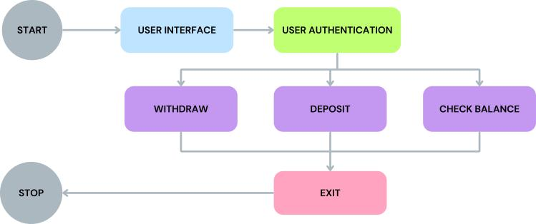
ARCHITECTURE OF THE PROPOSED SYSTEM

Slide 8
LIST OF MODULES
User Authentication Module:
Validates the account number and PIN entered by the user. Enables access to other functionalities upon successful login.
2. Withdrawal Module:
Allows users to withdraw money, checks for sufficient balance, and updates the account balance. Ensures the entered amount is valid and non-negative.
3. Deposit Module:
Facilitates depositing money into the account. Validates the input amount and updates the balance accordingly.

Slide 9
LIST OF MODULES
4. Balance Inquiry Module:
Displays the current account balance to the user. Provides feedback in the display area after successful login.
5. Graphical User Interface (GUI) Module:
Manages the graphical user interface using AWT components like buttons, text fields, labels, and text areas. Handles user interaction and provides feedback for each operation.
6. Error Handling Module:
Handles invalid inputs such as non-numeric values for account number, PIN, or transaction amounts. Displays appropriate error messages to guide the user.

Slide 10
LIST OF MODULES
7. Exit Module:
Allows users to exit the application gracefully by clicking the "Exit" button. Also ensures the application closes when the window is closed

Slide 11
MERITS
1. User-Friendly Interface: The program provides an intuitive GUI using AWT, making it easy for users to perform banking operations like login, withdrawal, deposit, and balance inquiry.
2. Customizable and Scalable: The design can be easily extended to include more features, such as fund transfers or transaction history.
3. Secure Transactions: Features login authentication to ensure only authorized users can access the system.
4. Lightweight Design: AWT ensures the application is lightweight and does not require external libraries, keeping the resource usage minimal.
5. Real-Time Feedback:Provides instant feedback on user actions, such as successful deposits or errors, enhancing the interactive experience.

Slide 12
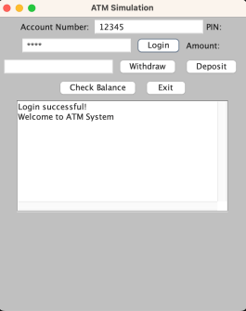
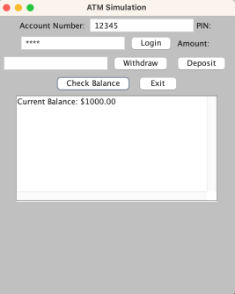
RESULT AND DISCUSSION
LOGIN
CHECK BALANCE

Slide 13
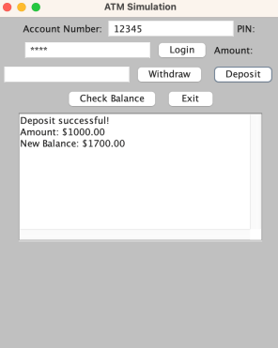
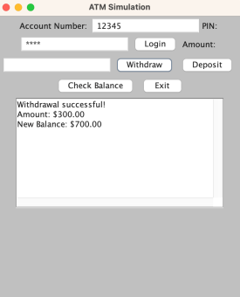
RESULT AND DISCUSSION
WITHDRAW
DEPOSIT

Slide 14

QUERIES

