Slide 1



TEAM 017
RURALKART
“NAVIGATING THE FUTURE OF ONLINE SHOPPING”
TEAM MEMBERS:
KEERTHANA K
INBARASI D
KAVIYA R
KARPAGAM S
JAINANDHINI S

Slide 2





Rimberio
Problem statement
Rural Artisans E-commerce Platform
Rural Artisans struggle to sell their handmade products to a broader audience

Slide 3


Existing Solutions
Existing platform link
Meesho
Amazon
https://www.amazon.in
https://www.meesho.com
Flipkart
Snapdeal
https://www.flipkart.com
https://www.snapdeal.com

Slide 4


Slide 5


Slide 6
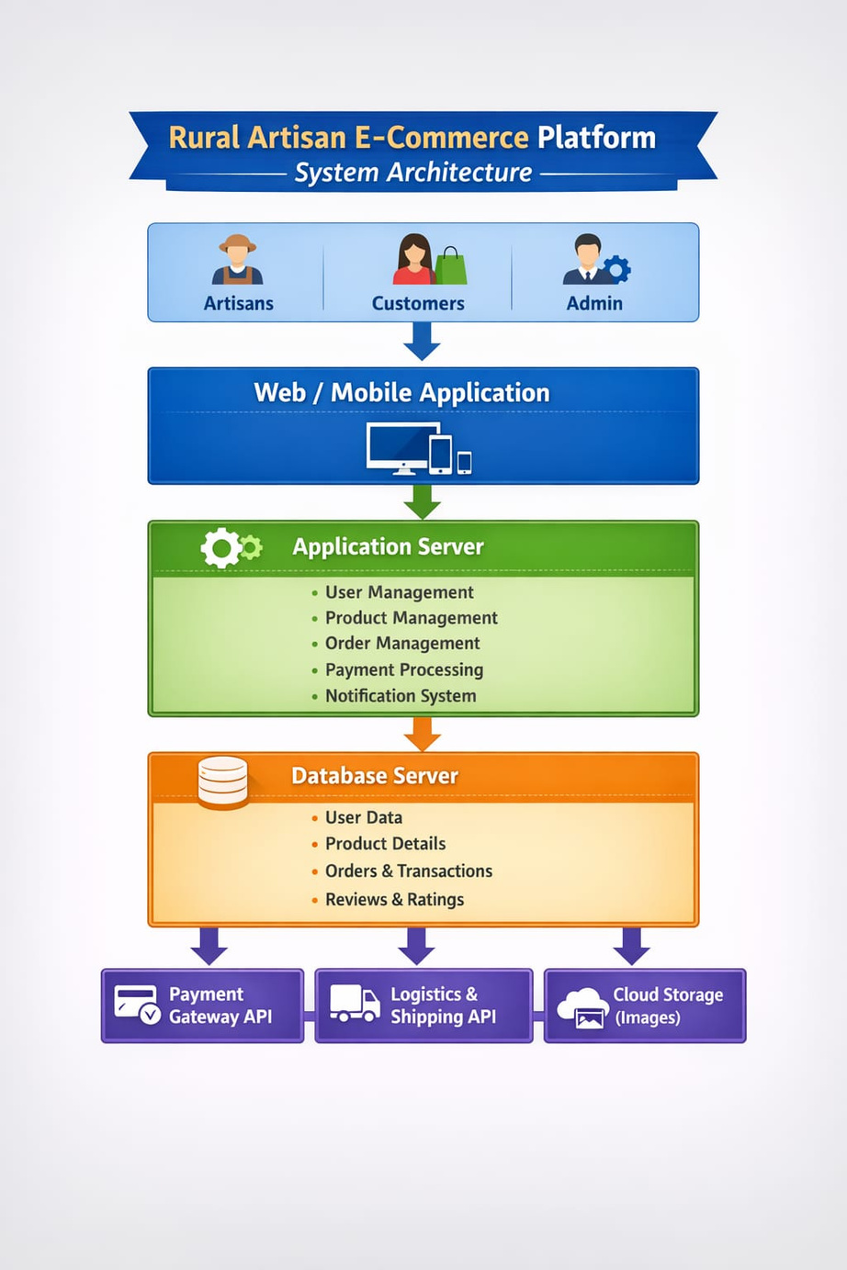
Architecture
:

Slide 7
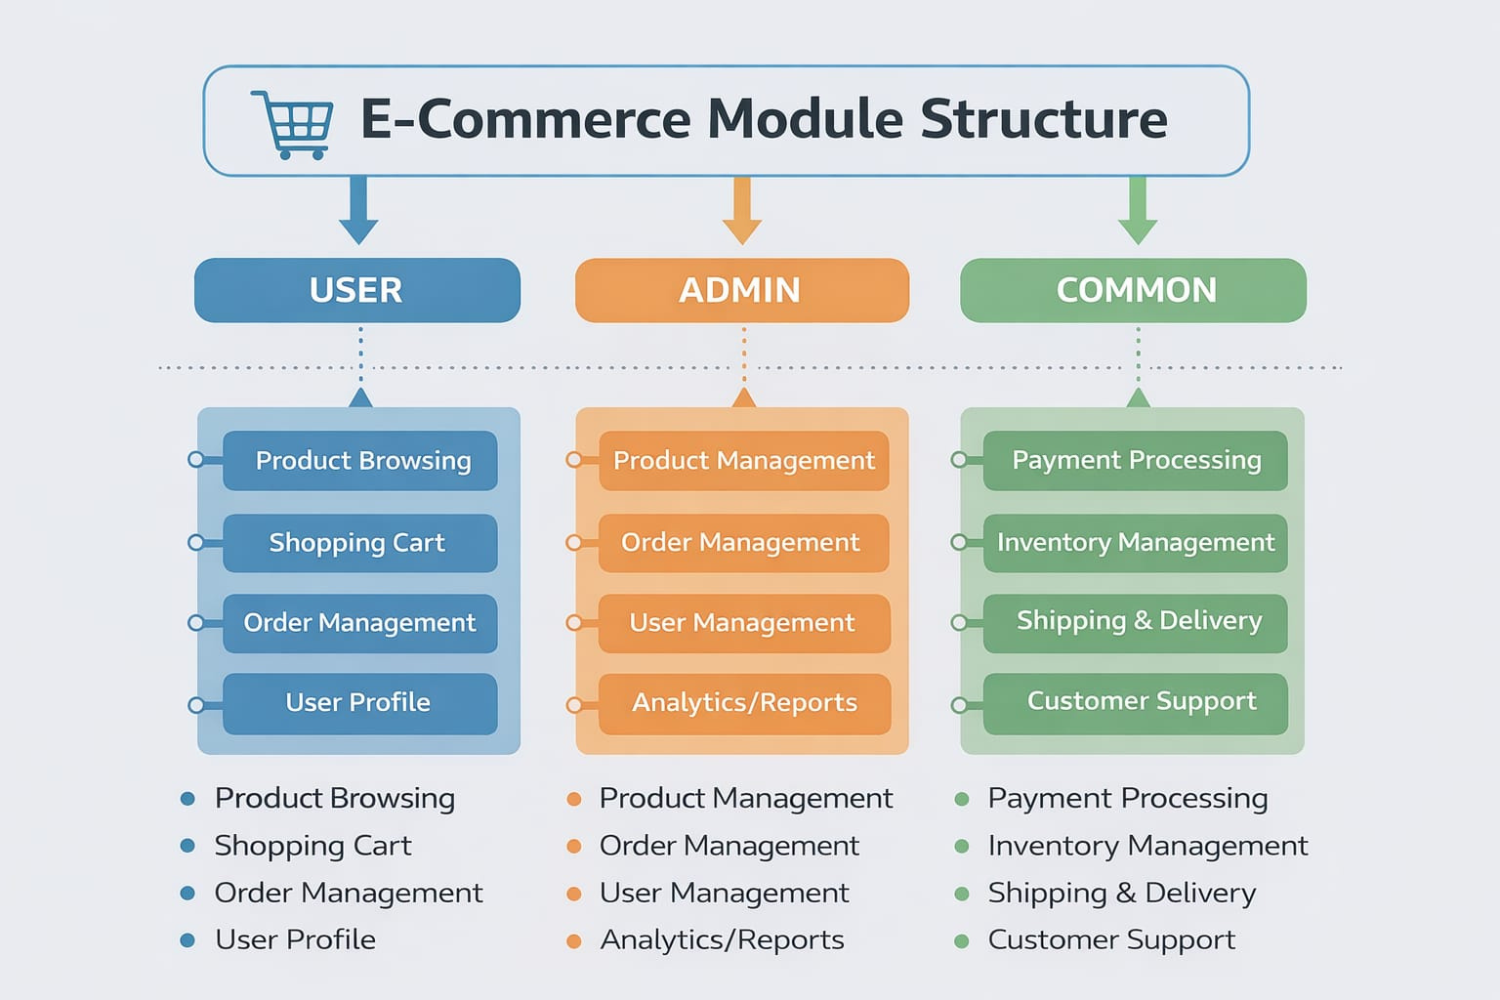
Module
structure

Slide 8


