Slide 1

Introduction to Linux
Notes:
Tux source: http://upload.wikimedia.org/wikipedia/commons/thumb/a/af/Tux.png/220px-Tux.png

Slide 2
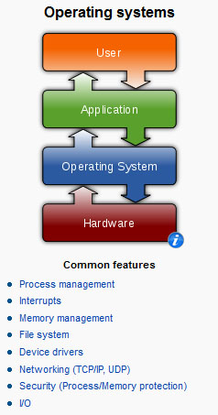
What is Linux?
It’s an Operating System
Notes:
Operating systems graphic source: http://en.wikipedia.org/wiki/Operating_system

Slide 3
What is Linux?
Linux is a Unix clone written from scratch by Linus Torvalds with assistance from a loosely-knit team of hackers across the Net.
Unix is a multitasking, multi-user computer operating system originally developed in 1969 by a group of AT&T employees at Bell Labs.
64% of the world’s servers run some variant of Unix or Linux. The Android phone and the Kindle run Linux.
Notes:
What is Linux? source: http://www.kernel.org/pub/linux/kernel/README and http://en.wikipedia.org/wiki/Linux and http://en.wikipedia.org/wiki/Unix
POSIX an acronym for "Portable Operating System Interface", is a family of standards specified by the IEEE for maintaining compatibility between operating systems. POSIX defines the application programming interface (API), along with command line shells and utility interfaces, for software compatibility with variants of Unix and other operating systems (source: http://en.wikipedia.org/wiki/POSIX).

Slide 4
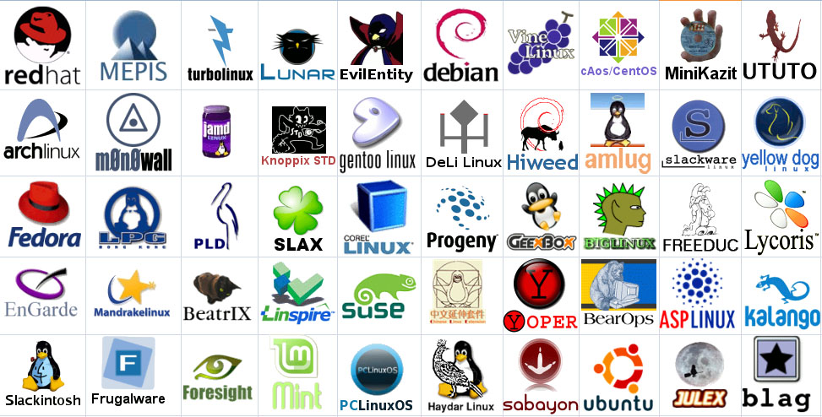
Linux Has Many Distributions
Notes:
Logos source: http://www.muylinux.com/wp-content/uploads/2009/04/logos-distros.jpg

Slide 5
What is Linux? “Small programs that do one thing well” (see unix-reference.pdf)
Network: ssh, scp, ping, telnet, nslookup, wget
Shells: BASH, TCSH, alias, watch, clear, history, chsh, echo, set, setenv, xargs
System Information: w, whoami, man, info, which, free, echo, date, cal, df, free, man, info
Command Information: man, info
Symbols: |, >, >>, <, &, >&, 2>&1, ;, ~, ., .., $!, !:<n>, !<n>
Filters: grep, egrep, more, less, head, tail
Hotkeys: <ctrl><c>, <ctrl><d>
File System: ls, mkdir, cd, pwd, mv, ln, touch, cat, file, find, diff, cmp, /net/<hostname>/<path>, mount, du, df, chmod, find
Line Editors: awk, sed
File Editors: vim, gvim, emacs –nw, emacs

Slide 6
The Role and Function of Linux
Application Platform
Hardware Moderator
Data Storage
Security
Connectivity

Slide 7
The Role and Function of Linux..
Application Platform: An operating system provides applications with a platform where they can run, managing their access to the CPU and system memory.
Hardware Moderator: The operating system also serves as a mediator between running applications and the system hardware. Most applications are not written to directly address a computer’s hardware.

Slide 8
The Role and Function of Linux..
Security: The operating system is responsible for providing a degree of security for the data it hosts.
Connectivity: The operating system manages connectivity between computer systems using a variety of network media and interfaces, including infrared, Ethernet, and wireless.

Slide 9
The Historical Development of Linux
In the early 1990s, Torvalds became interested in a freeware product called Minix were written by Andrew S. Tanenbaum. Developed by Andrew S.Tanenbaum, Minix was a clone of the commercial UNIX operating system.
Linux version 0.02, released on October 5, 1991, consisted of only the Linux kernel and three utilities:
■ bash : a command-line interface
■ update : a utility for flushing file system buffers
■ gcc : a C++ compiler

Slide 10
In 1991, Linus Benedict Torvalds was a second year student of Computer Science at the University of Helsinki and a self-taught hacker.

Slide 11
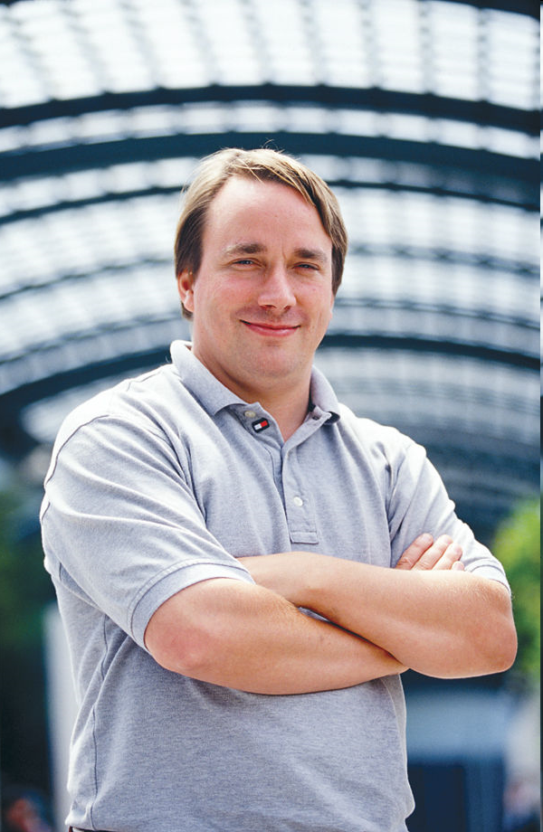

Slide 12
What is GNU?
GNU Project: Richard Stallman on September 27th 1983.
The GNU Project was launched in 1984 to develop a complete Unix-like operating system which is free software: the GNU system.
GNU's kernel isn't finished, so GNU is used with the kernel Linux. The combination of GNU and Linux is the GNU/Linux operating system, now used by millions.
www.gnu.org

Slide 13
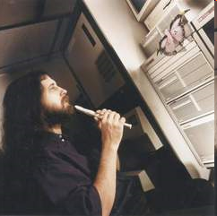
Richard Stallman, father of the GNU Project

Slide 14
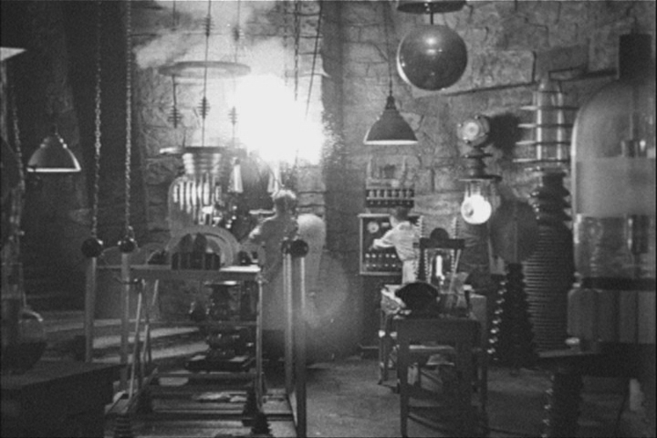
Let the Linux Lab Begin!
The Ideal Lab Facility
Notes:
Lab image source: http://www.sidekickcomicsuk.com/blogs/media/blogs/sidekick//frankenstein_lab.jpg
Frankenstein image source: http://4.bp.blogspot.com/_OcNNOGpvVSI/RyZDUhUpE2I/AAAAAAAAAEU/e-i67sz7_8U/s1600/2007_7young-frankenstein.jpg

