Slide 1


K. RAMAKRISHNAN COLLEGE OF TECHNOLOGY (AUTONOMOUS), TIRUCHIRAPALLI
AGI1242 - Machine Learning Techniques
AI-Based Email Spam Detection System Using Naive Bayes and NLP
PRESENTED BY
KAVIYA S | 2503811724322041
KEERTHANA D | 2503811724322042
MOHAMED AFSAR M | 2503811724321054
MOHAMED ARSHAD M | 2503811724321055
GUIDED BY
Mrs. M.A. Reetha Jeyarani
6/5/24

Slide 2
OBJECTIVE
3
Classify emails as Spam or Legitimate using NLP/ML.
Detect phishing, malware, and fraud.
Reduce false positives and protect genuine emails.
Adapt to new spam tactics through continuous learning.
Enable real-time filtering with confidence scores for review.

Slide 3
PROBLEM IDENTIFICATION
4
Manual spam sorting is time-consuming.
Rule-based filters are static and easy to bypass.
Spammers constantly change their tactics.
Genuine emails may be wrongly marked as spam.
Phishing and malware emails can threaten security.
Existing systems often cannot adapt to new spam patterns.

Slide 4
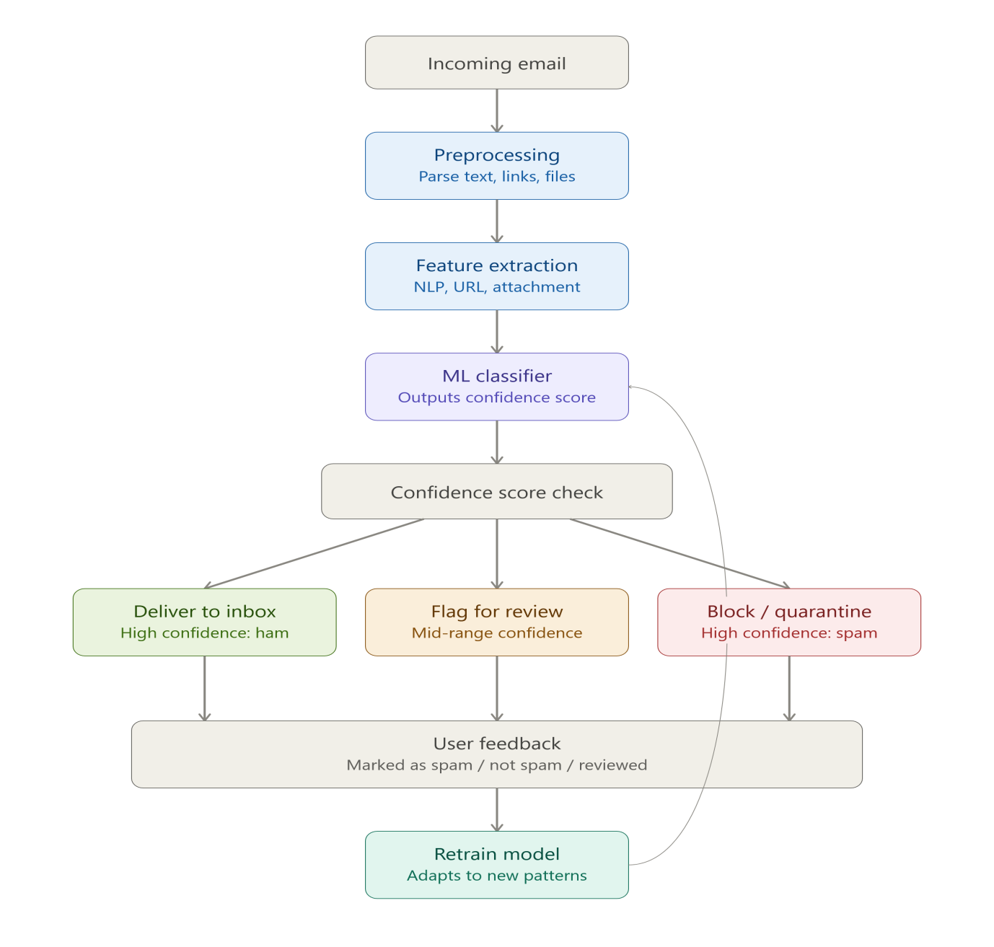
FLOW DIAGRAM
6

Slide 5
LITERATURE SURVEY
Literature Survey – Google sheets

Slide 6
RESEARCH METHODOLOGY
Naive Bayes uses probability-based classification to quickly identify emails as spam or legitimate.
TF-IDF converts email text into numerical features based on the importance of words.
NLP preprocessing cleans and prepares email content by removing unnecessary words and noise.

Slide 7
COMPARE ALGORITHM
9
ALGORITHM 1: NAÏVE BAYES
Principle:
Naive Bayes uses probability to classify emails as Spam or Ham.
Advantages:
Fast and simple.
Effective for text data.
Works well with TF-IDF features.

Slide 8
COMPARE ALGORITHM
ALGORITHM 2: TF-IDF
Principle:
Converts email text into numerical values based on word importance.
Advantages:
Simple and fast.
Effective for text classification.
Reduces the impact of common words.

Slide 9
COMPARE ALGORITHM
ALGORITHM 3: NLP Preprocessing
Principle:
Cleans and prepares email text by removing unnecessary words and noise.
Advantages:
Improves classification accuracy.
Reduces unnecessary data.
Makes text easier to process.

Slide 10
IMPLEMENTATION IDEA
Collect a labeled email dataset containing Spam and Ham emails.
Preprocess the email text using NLP techniques such as tokenization and stop-word removal.
Convert the processed text into numerical features using TF-IDF.
Train a Naive Bayes classifier using the prepared dataset.
Test the trained model with new and unseen emails.
Classify emails as Spam or Not Spam (Ham).
Evaluate the system using Accuracy, Precision, Recall, F1-Score, and Confusion Matrix.

Slide 11
MODULES
Data collection: Gathers labeled spam/ham and phishing/malware samples.
Preprocessing: Cleans and tokenizes email text.
Feature extraction: Converts text/metadata into numerical features.
Classification: Predicts spam/ham using Naive Bayes.
Link & attachment analysis: Detects malicious URLs and unsafe files.
Confidence scoring: Assigns probability score to predictions.

Slide 12
CONCLUSION
The system successfully classifies emails as spam or ham using Naive Bayes and NLP.
Detects phishing links and malicious attachments for added security.
Confidence scoring reduces false positives by flagging uncertain cases for review.
Feedback-based retraining helps adapt to evolving spam patterns.
Provides a scalable, real-time solution that reduces manual effort and improves email security.
Future scope: explore deep learning (LSTM/BERT) for higher accuracy.

Slide 13
THANK YOU
14

