Slide 1
Amazon Inspector
Vulnerability Scanning for EC2 & ECR
Cloud Security Project
DETECT • FIX • VERIFY
PROJECT TEAM
2400031870 – K. Thanu Sree
2400031880 – Nanduri Vaibhavi
2400031895 – Bikkina Keerthana
2400031898 – Karthik Katuri

Slide 2
What is the Project?
Automated vulnerability detection for AWS workloads
01 DETECT
02 REMEDIATE
03 VERIFY
Find known security vulnerabilities
in AWS resources.
Identify the affected package and
apply the recommended fix.
Run another scan and compare the
result after the fix.

Slide 3
EC2 & ECR
Two resource types covered by the project
EC2 | Elastic Compute Cloud
ECR | Elastic Container Registry
A virtual computer / server running in AWS.
The server contains an operating system, applications and
software packages that may become outdated or vulnerable.
An AWS service used to store Docker container images.
The image can contain operating-system packages and
application dependencies that may have known
vulnerabilities.
EC2 → SOFTWARE / PACKAGES
ECR → DOCKER IMAGES

Slide 4
What is Amazon Inspector?
AWS security service used to identify known software vulnerabilities
SCAN
PRIORITIZE
AMAZON
INSPECTOR
Automatically assess supported resources.
Show severity such as Critical, High,
Medium and Low.
FIND
REMEDIATE
Generate vulnerability findings and CVE
information.
Provide information that helps identify
the recommended fix.

Slide 5
Why is Vulnerability Scanning Needed?
The security problem addressed by the project
• Outdated software may contain known security weaknesses.
• Manually checking every package is difficult and time-consuming.
• Early detection helps reduce security risks and protect cloud applications.
RISK
Known weaknesses can remain unnoticed.
CHALLENGE
Large environments contain many
packages and images.
GOAL
Automate detection and support
remediation.

Slide 6
Project Objectives
What the project is designed to achieve
01 Scan EC2
02 Scan ECR
03 Analyze
Detect vulnerabilities in EC2 instances.
Scan Docker images stored in ECR.
Identify CVEs and understand severity.
04 Remediate
05 Verify
Fix vulnerable software and images.
Rescan and compare results after fixing.

Slide 7
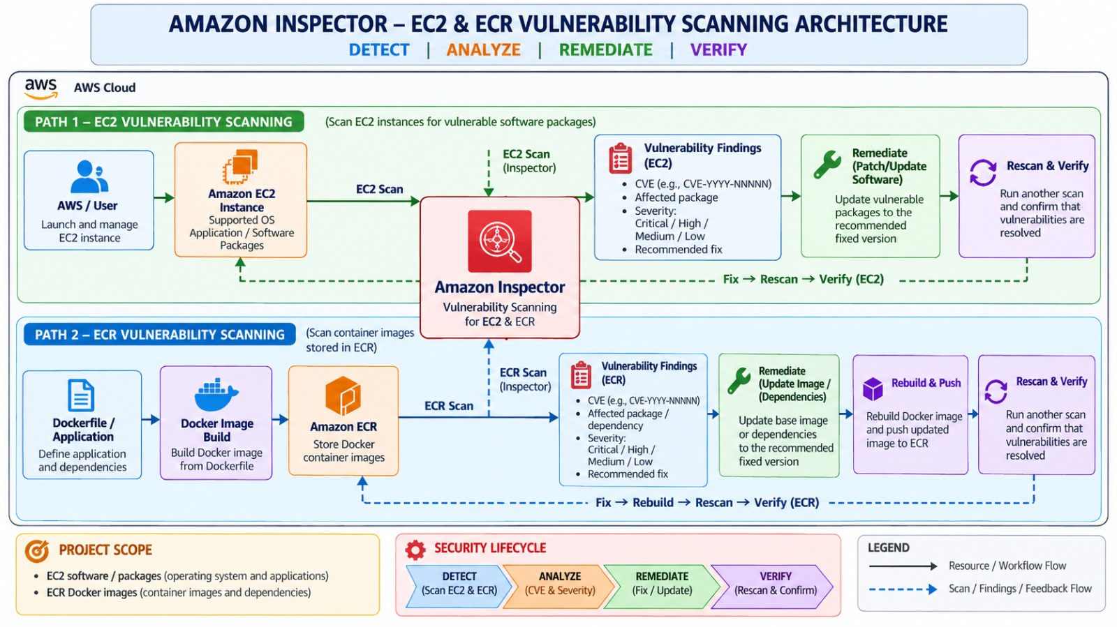
Project Architecture:

Slide 8
EC2 Scanning — Implementation
From instance creation to verification
01
Launch EC2
Use a supported operating system.
02
Run Software
Install or run the required application/software.
03
Enable Inspector
Enable Amazon Inspector for EC2 scanning.
04
Review Findings
Check vulnerable packages, CVEs, severity and recommended fixes.
05
Update & Verify
Update vulnerable packages and perform another scan.

Slide 9
ECR Scanning — Implementation
Container image lifecycle
Dockerfile
Docker Image
ECR
Inspector
Findings
Update
Rescan
Build
Package
Push / Store
Scan
Analyze
Rebuild / Push
Verify
Key output:
A vulnerability finding associated with the container image, including affected package/dependency, CVE and severity.

Slide 10
Understanding CVE & Severity
How vulnerability findings are described
CVE | Common Vulnerabilities and
Exposures
CRITICAL
A CVE is an identifier for a publicly known security
vulnerability.
Example format:
CVE-YYYY-NNNNN
The identifier helps teams refer to the same known
vulnerability consistently.
Highest severity category
HIGH
High priority
MEDIUM
Moderate severity
LOW
Lower severity

Slide 11
Vulnerability Remediation
Turning a finding into a verified fix
1
2
3
4
5
Find
Check
Update
Rebuild
Verify
Identify affected package
or dependency.
Review the recommended
fixed version.
Patch EC2 software or
update Docker base
image/dependencies.
For ECR, rebuild and push
the updated image.
Run another scan and
confirm the improvement.
BEFORE → FIX → AFTER

Slide 12
Expected Results
What the completed project should demonstrate
EC2 FINDINGS
ECR FINDINGS
SEVERITY
Identify vulnerabilities in EC2 and
understand which packages are affected.
Identify vulnerabilities in container
images and their dependencies.
View CVE information and severity
categories for findings.
REMEDIATION
VERIFICATION
Update affected software or images.
Demonstrate security improvement using
before-and-after scans.

Slide 13
Future Scope
How the project can be extended
ALERTS
DASHBOARD
CI/CD
AUTOMATION
Automatic alerts for Critical
or High findings.
Security dashboard for
vulnerability trends.
Integrate scanning into
CI/CD pipelines.
Automate parts of
remediation and reporting.

Slide 14
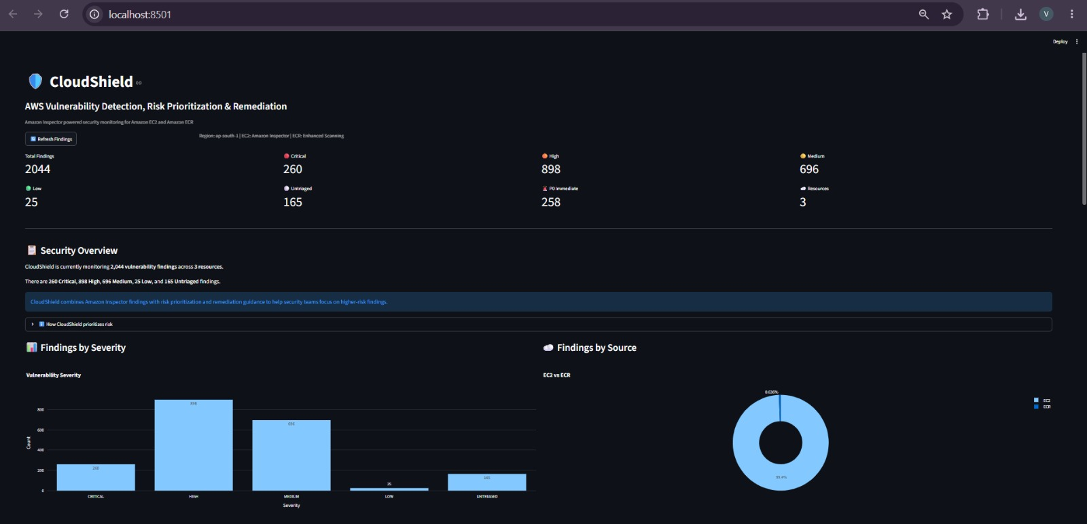
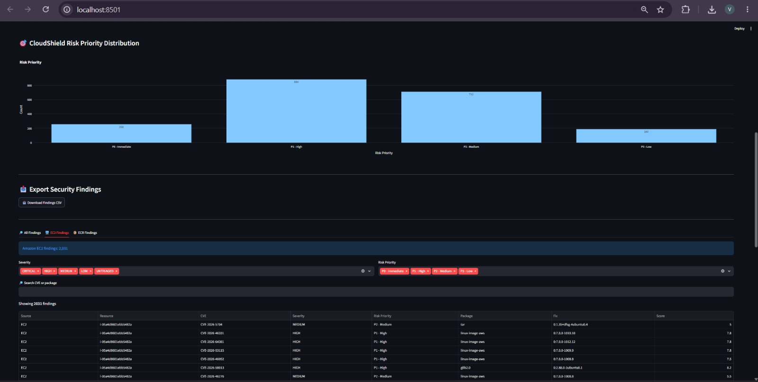
Outputs :

Slide 15
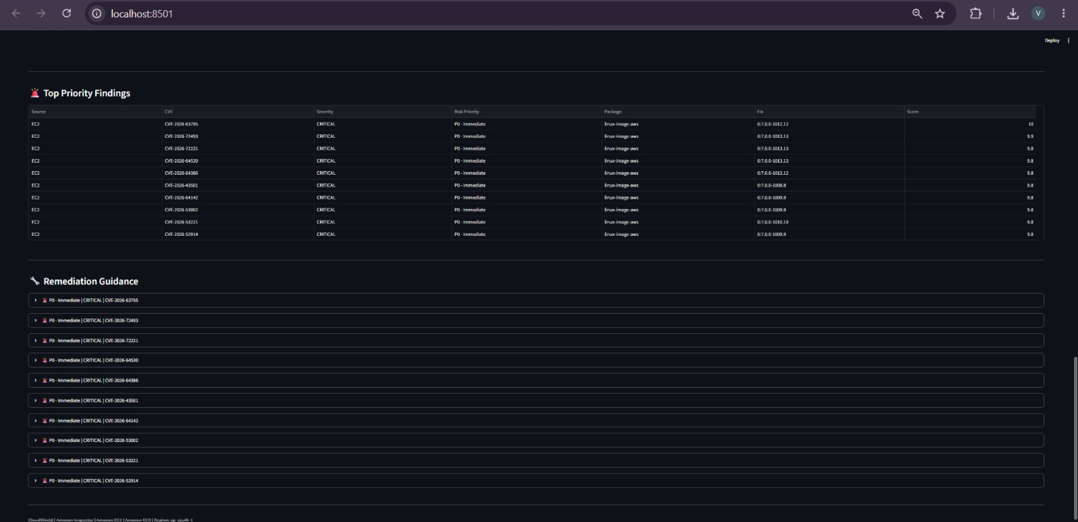
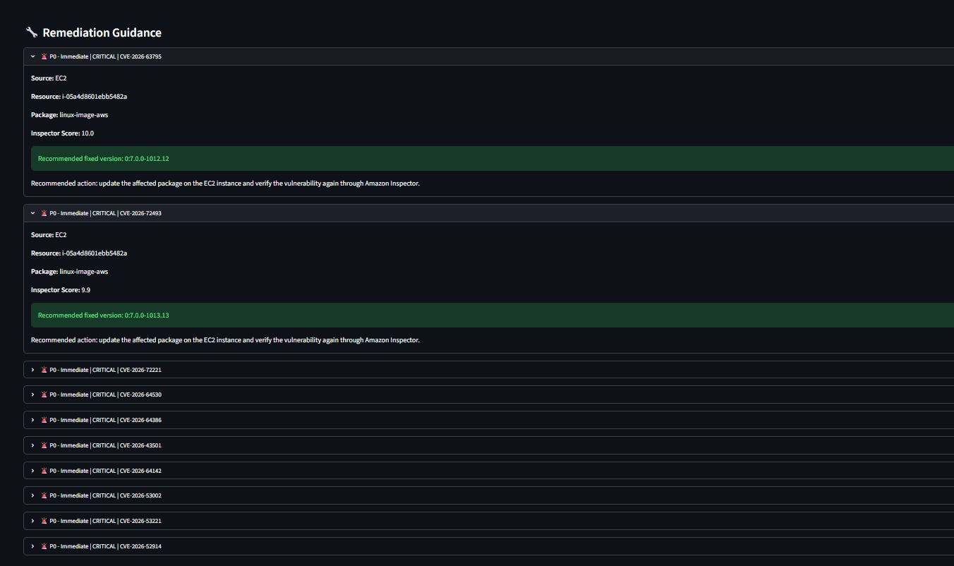

Slide 16
Conclusion
A continuous security workflow for cloud workloads
DETECT
ANALYZE
FIX
RESCAN
• Amazon Inspector helps identify known vulnerabilities in cloud workloads.
• Our project demonstrates scanning of EC2 instances and ECR container images.
• The complete approach is Detect → Analyze → Fix → Rescan.
• This helps maintain a safer and more secure AWS environment.

