Slide 1

LingoSense
AI for Translating Colloquial Languages
JUNIOR SCHOLOR’S :
Keerthana Bollepally - 22WU0104028
Alaka Asritha Ghantasala - 22WU0104129
Kamal Sai Cherukuri - 22WU0104030
SUPERVISOR :
DR.UDAY CHANDRA

Slide 2
INTRODUCTION :
Language is the backbone of human communication.
Current AI translation systems struggle with informal, colloquial, and culturally
nuanced expressions.
In India, hundreds of dialects and code-mixed conversations exist across
regions.
People often use slang, idioms, and transliterations on social media
and casual chats.
Bridging this communication gap is essential for building inclusive
AI-powered platforms.
This project aims to create a multilingual colloquial AI system that:
- Translates informal and colloquial conversations.
- Understands cultural context and sentiment.
- Preserves the essence of everyday communication.

Slide 3
PROJECT OBJECTIVES:
To develop an AI system capable of understanding and translating
colloquial, informal conversations across Indian languages (Hindi,
Bengali, Marathi, Telugu, Malayalam, Tamil).
To detect slang, idioms, and code-mixed text while preserving cultural
and contextual nuances.
To implement sentiment analysis for informal text and optionally
integrate speech-based input/output for natural interactions.

Slide 4
PROBLEM STATEMENT:
Existing translation tools such as Google Translate and Microsoft Translator primarily focus on formal and structured text, often failing in the context of casual, colloquial, or code-mixed Indian language usage.
Challenges include:
Handling slang, idioms, and informal phrases.
Transliteration issues (e.g., Hindi in Roman script).
Code-mixed text (English + regional language).
This creates a significant gap in making AI truly conversational for real-world, informal communication.

Slide 5
NOVELTY :
Creation of a colloquial, slang-annotated dataset for Indian languages.
Fine-tuning transformer models (Facebook M2M-100,RudraHsha)
specifically on informal and code-mixed text.
Integration of sentiment analysis + speech features into translation,
making the system conversational and more natural.

Slide 6
LITERATURE REVIEW / EXISTINGWORK
Existing Work:
Widely used translation systems such as Google Translate and DeepL perform well for formal text (e.g., news articles, Wikipedia, parliamentary text). Prior NLP research in Indian languages has also mainly concentrated on these structured datasets.
Gap Identified:
However, informal and colloquial communication—such as social media posts, chats, or forum discussions—remains less explored. These often include slang, idioms, transliterated words, and code-mixed text, which existing tools do not fully capture.

Slide 7
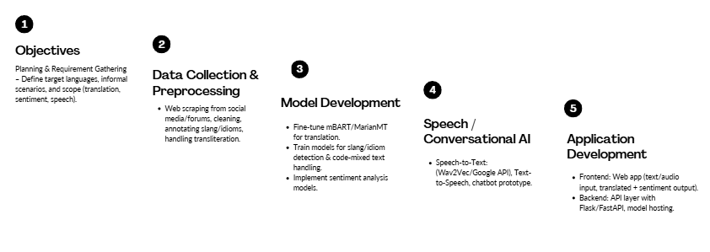
PROPOSED METHODOLOGY

Slide 8
TOOLS / TECHNOLOGIES USED:
Programming & Frameworks: Python, Flask/FastAPI
Machine Learning / NLP: PyTorch, TensorFlow, HuggingFace
Transformers (mBART, MarianMT)
Data Collection: BeautifulSoup, Scrapy (for web scraping)
Experimentation: Google Colab, Jupyter Notebooks.
Frontend: HTML, CSS, JavaScript
Deployment: Heroku, AWS, GCP

Slide 9
INITIAL STAGE :
Data Collection:
Scraped formal text from multiple websites for six Indian languages: Hindi, Telugu, Tamil, Marathi, Bengali, Malayalam.
Focused on structured, high-quality content (news, articles, Wikipedia).
Data Preparation:
Cleaned and preprocessed the scraped text.
Created language-specific corpora for training.
Model Training:
Used Helsinki NLP models for multilingual translation.
Trained and fine-tuned on formal multilingual data for all six languages.
Outcome:
Developed a baseline multilingual translation system capable of accurately translating formal text.

Slide 10
PROGRESS
Collected datasets:
Code-Mixed, ComiLingua, and Hinglish datasets.
Scraped additional data from multiple online sources for informal and formal text.
Merged and preprocessed datasets to create a comprehensive multilingual corpus.
Models used for training:
Facebook M2M-100 ,facebook/nllb-200-distilled-600Mfor multilingual translation.
RudraHsha model for code-mixed translation tasks.
Current progress:
Successfully trained and fine-tuned models for Hindi translation.

Slide 11
CURRENT WORK
Developed LingoSense, a hybrid transliteration–translation system for code-mixed and informal Indian text.
Implemented a modular pipeline: Input Processing → Transliteration → Code-mix Detection → Normalization → Contextual Translation → Multilingual Output.
Integrated Transformer-based models: IndicTrans2, NLLB-200, FLAN-T5.
Achieved accurate transliteration and contextually coherent translations across six Indian languages: Hindi, Bengali, Marathi, Telugu, Malayalam, Tamil .
Built a web-based interface for real-time translation and interactive visualization using Streamlit.
Users can input Romanized/code-mixed text, select target languages, and view native script, English, and multilingual translations instantly.
Supports interactive comparisons across languages, enhancing accessibility and usability for end-users.

Slide 12
FUTURE SCOPE
Feature Expansion: Complete web interface and handle irregular transliterations.
Performance Optimization: Fine-tune models to reduce semantic errors and enable faster inference with GPU acceleration.
Extended Functionality: Incorporate regional language patterns and enhance context-aware translation using advanced data augmentation.
User Experience: Improve interactive feedback, interface design, and side-by-side output visualization.
Research Focus: Explore hybrid pipelines for new multilingual contexts and extend applications to social media, e-learning, and governance.

Slide 13
Thank you !

