Slide 1
Brain Tumour Detection Using CNN
A Deep Learning Approach for MRI Classification
Final Year Project Presentation
Name: __________ USN: __________ Guide: __________
Brain Tumour Detection Using CNN | 1

Slide 2
Introduction
Brain tumours are abnormal growths of cells in the brain.
MRI scans provide detailed images of brain structures.
Manual MRI interpretation requires specialist expertise.
CNN can learn image patterns and support an automated research prototype.
Brain Tumour Detection Using CNN | 2

Slide 3
Problem Statement
MRI image classification can be time-consuming.
A computer-assisted model can classify images into tumour and no-tumour classes.
The project explores CNN-based image classification; it does not replace a radiologist.
Brain Tumour Detection Using CNN | 3

Slide 4
Objectives
Prepare and organize labelled MRI images.
Preprocess images into a consistent size and scale.
Build and train a CNN model.
Evaluate the model using test data and classification metrics.
Provide a simple interface to upload and classify an MRI image.
Brain Tumour Detection Using CNN | 4

Slide 5
Existing and Proposed System
Existing: MRI scans are interpreted by trained medical professionals.
Proposed: a CNN-based academic prototype predicts one of two image classes.
Output: tumour class or no-tumour class, with a model score.
Clinical interpretation remains the responsibility of qualified professionals.
Brain Tumour Detection Using CNN | 5

Slide 6
Technologies Used
Python – programming language
TensorFlow / Keras – deep learning model
OpenCV / Pillow – image handling
NumPy and Matplotlib – numerical work and plots
Streamlit – simple user interface
Brain Tumour Detection Using CNN | 6

Slide 7
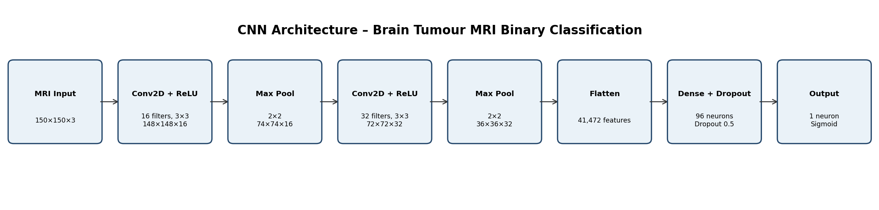
System Architecture
Input MRI image
Image resizing and normalization
CNN feature extraction using convolution and pooling
Flatten and dense classification layers
Sigmoid output: tumour / no tumour
Evaluation and display of model output
Brain Tumour Detection Using CNN | 7

Slide 8
CNN Model Architecture
Input: 150 × 150 × 3
Conv2D: 16 filters (3×3) + ReLU → MaxPool (2×2)
Conv2D: 32 filters (3×3) + ReLU → MaxPool (2×2)
Flatten → Dense (96, ReLU) → Dropout (0.5)
Output: Dense (1, Sigmoid)
Brain Tumour Detection Using CNN | 8

Slide 9
Dataset and Preprocessing
Use labelled brain MRI images in two classes: tumor and no_tumor.
Arrange images into train and test folders.
Resize each image to 150 × 150 pixels.
Normalize pixel values from 0–255 to 0–1.
Keep patient-level separation between training and test data.
Brain Tumour Detection Using CNN | 9

Slide 10
Methodology
1. Collect a permitted labelled MRI dataset.
2. Organize and preprocess images.
3. Train the CNN using Adam and binary cross-entropy.
4. Monitor training and validation loss/accuracy.
5. Evaluate on held-out test images.
6. Run predictions through the Streamlit application.
Brain Tumour Detection Using CNN | 10

Slide 11
Evaluation Metrics
Accuracy: overall fraction classified correctly.
Precision: among predicted positives, fraction truly positive.
Recall: among actual positives, fraction detected.
F1-score: harmonic mean of precision and recall.
Confusion matrix: counts of correct and incorrect predictions.
Brain Tumour Detection Using CNN | 11

Slide 12
Expected Output / Demonstration
Upload an MRI image through the web interface.
The model preprocesses the image and predicts a class.
The interface displays the model class and score.
Actual performance must be measured after training on the selected dataset.
Brain Tumour Detection Using CNN | 12

Slide 13
Advantages and Limitations
Advantages: automated feature learning; repeatable inference; simple interface.
Limitations: performance depends on dataset quality and diversity.
Small or biased datasets can cause poor generalization.
This prototype is not clinically validated and is not for diagnosis.
Brain Tumour Detection Using CNN | 13

Slide 14
Conclusion and Future Scope
A CNN-based pipeline for binary MRI image classification is implemented.
Future work: larger multi-centre datasets and patient-level validation.
Explore multi-class tumour types, explainability and external validation.
Clinical use would require rigorous medical and regulatory evaluation.
Brain Tumour Detection Using CNN | 14

Slide 15
References
Supplied reference paper: Brain Tumor Detection Using CNN: A Deep Learning Approach for MRI Classification (2025).
TensorFlow/Keras documentation: https://www.tensorflow.org/
Streamlit documentation: https://docs.streamlit.io/
Dataset source and licence should be added by the project team.
Brain Tumour Detection Using CNN | 15

