Slide 1
HealthAI
HEALTHCARE
AI
Intelligent Healthcare AI Platform
End-to-end healthcare AI for clinical decision support
and evidence-grounded health information
ML • DL • NLP • RAG • AGENTS
Portfolio / Educational Demonstration
September 2026

Slide 2
The Healthcare AI Challenge
PROBLEM
Why HealthAI uses a modular, multi-model platform
Heterogeneous Data
Different AI Tasks
User Experience
Structured patient measurements, medical text, imaging, patient feedback and operational information must coexist in one workflow.
Classification, regression, clustering, association mining, deep learning, medical NLP and evidence retrieval each need different methods.
The application should feel like one hospital platform even though the underlying models are specialized services.
Design objective
Build one modular application that routes each request to the appropriate AI capability while keeping evidence grounding, API contracts and safety boundaries visible.
Core idea: specialization + orchestration + evidence grounding

Slide 3
End-to-End System Architecture
ARCHITECTURE
Presentation, API, orchestration and AI components are separated
Streamlit
Virtual Hospital
FastAPI
REST Layer
Agent Router
+ Executor
Specialized
AI Adapters
USER
Classical ML
Deep Learning
Medical NLP
RAG
Translation
Structured Result
+ Sources / Safety Metadata
Response normalization keeps the UI independent of individual model output structures.

Slide 4
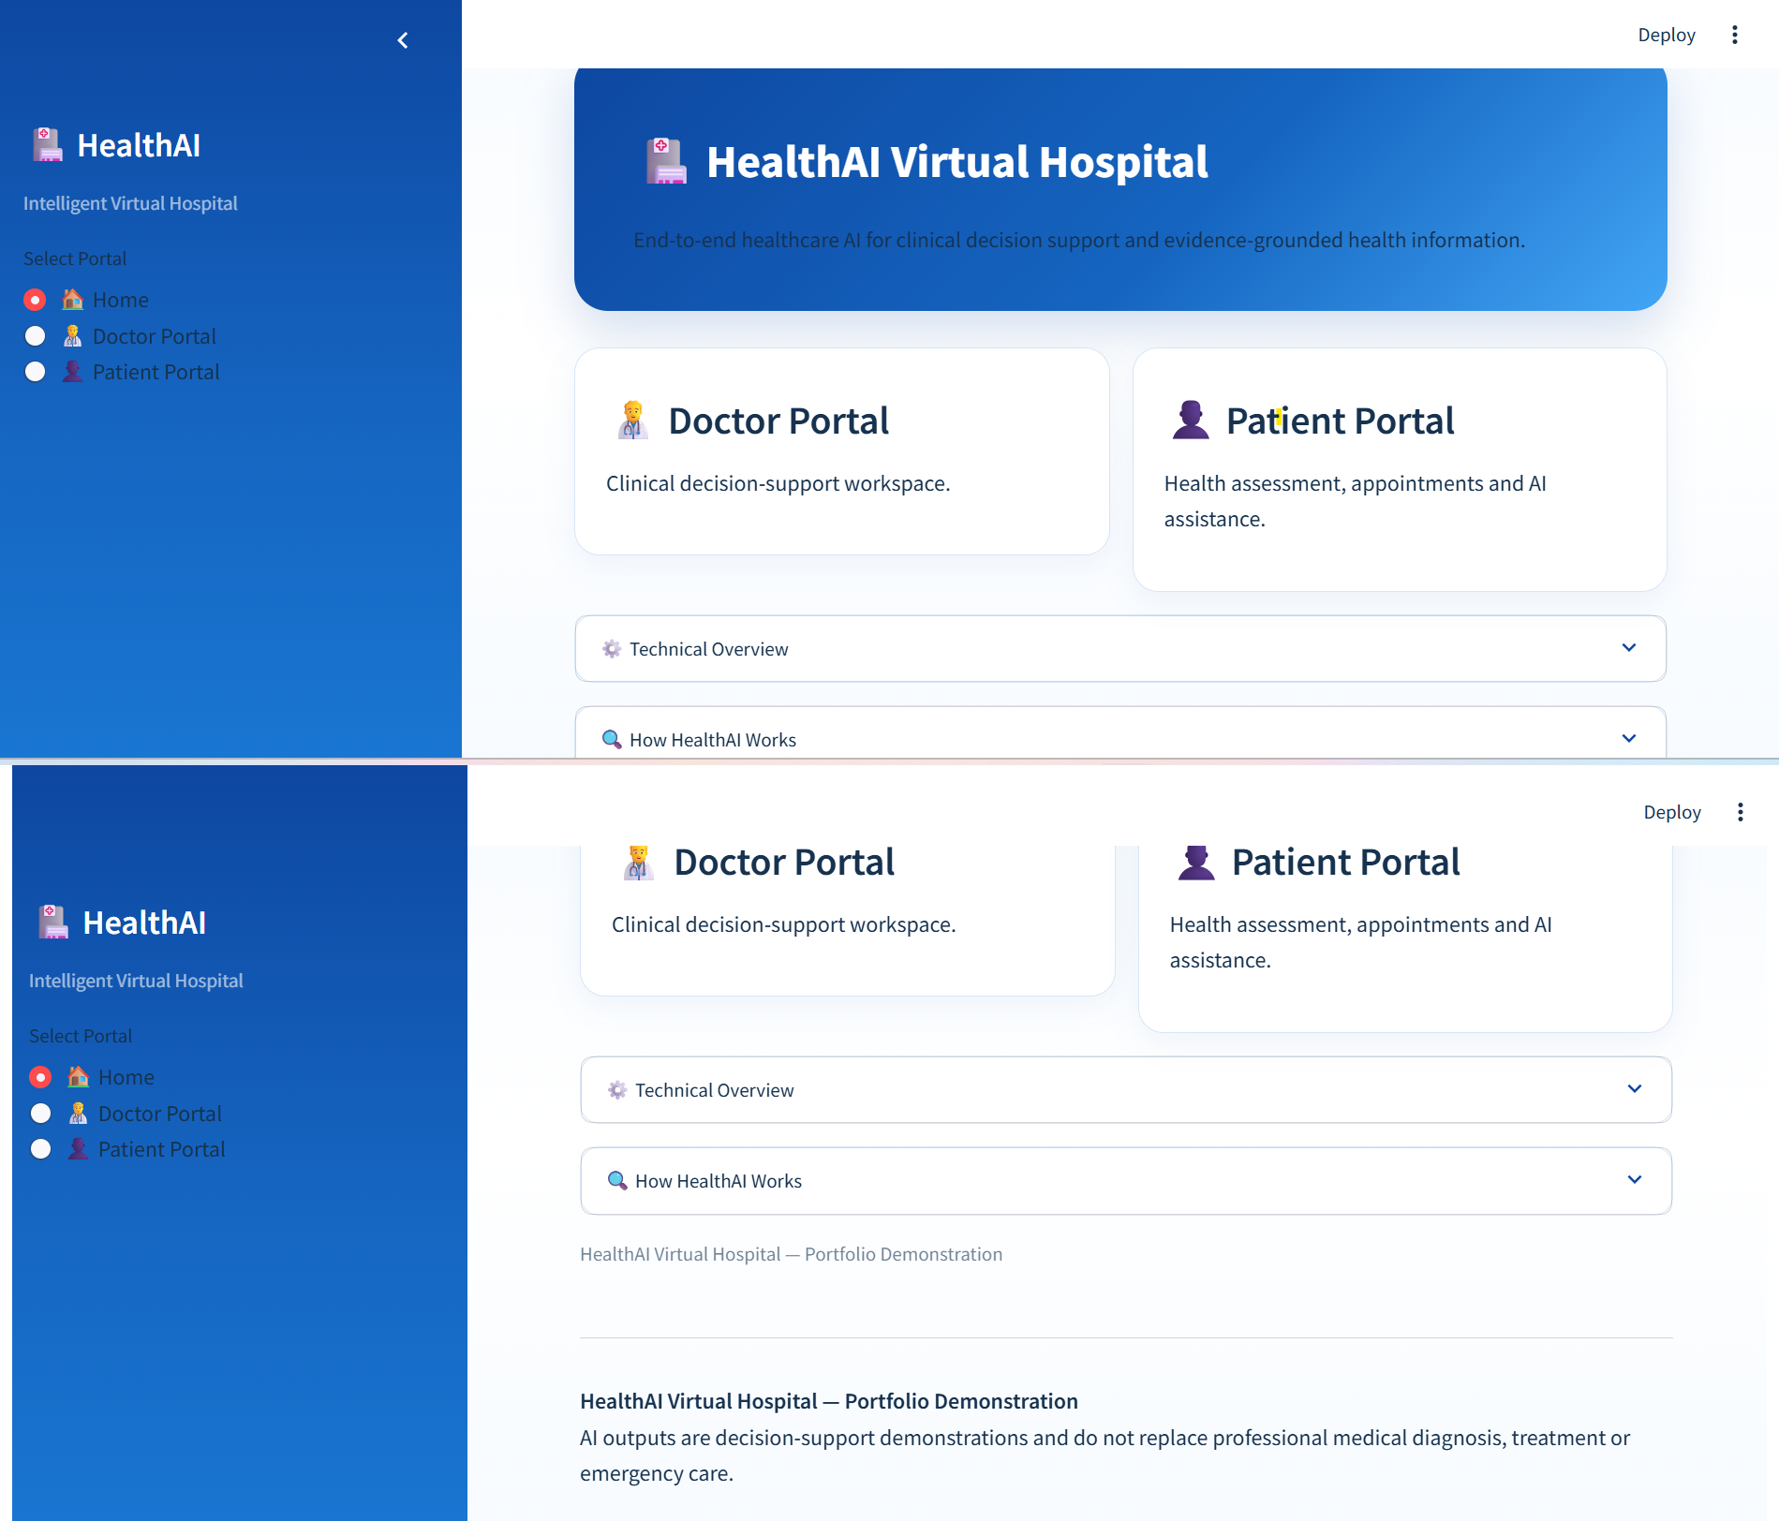
One Platform, Two User Experiences
APPLICATION
A unified virtual-hospital interface for clinical support and patient interaction
Doctor Portal
Clinical decision-support workspace with imaging, prediction and medical text tools.
Patient Portal
Health dashboard, risk assessment, AI assistant, appointments and hospital services.
Design Boundary
The application presents AI outputs as portfolio / decision-support demonstrations and keeps medical safety language visible.

Slide 5
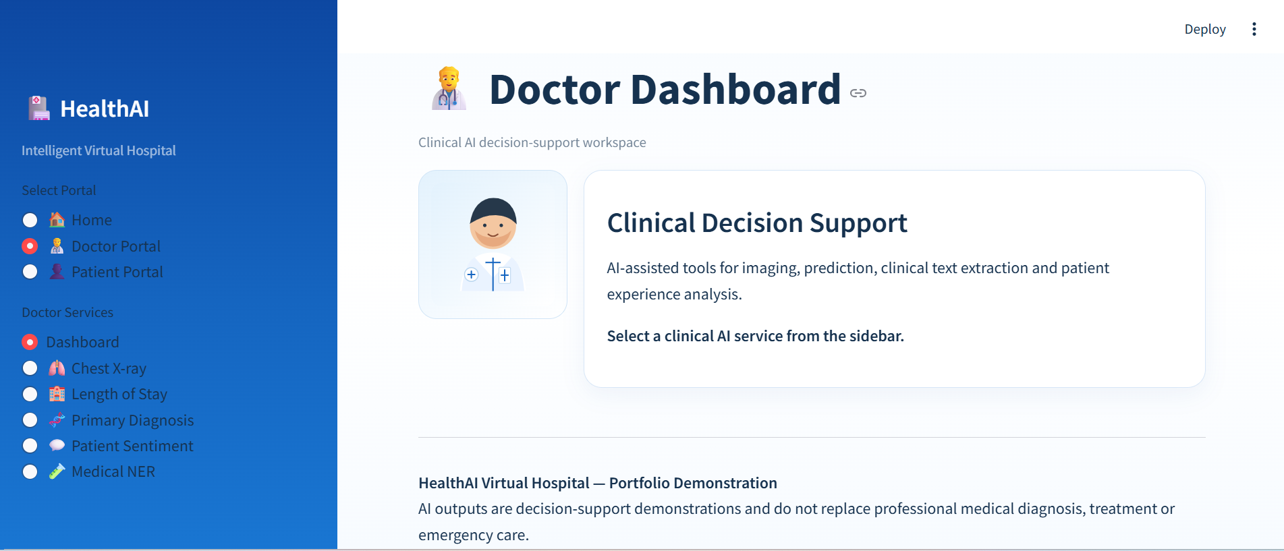
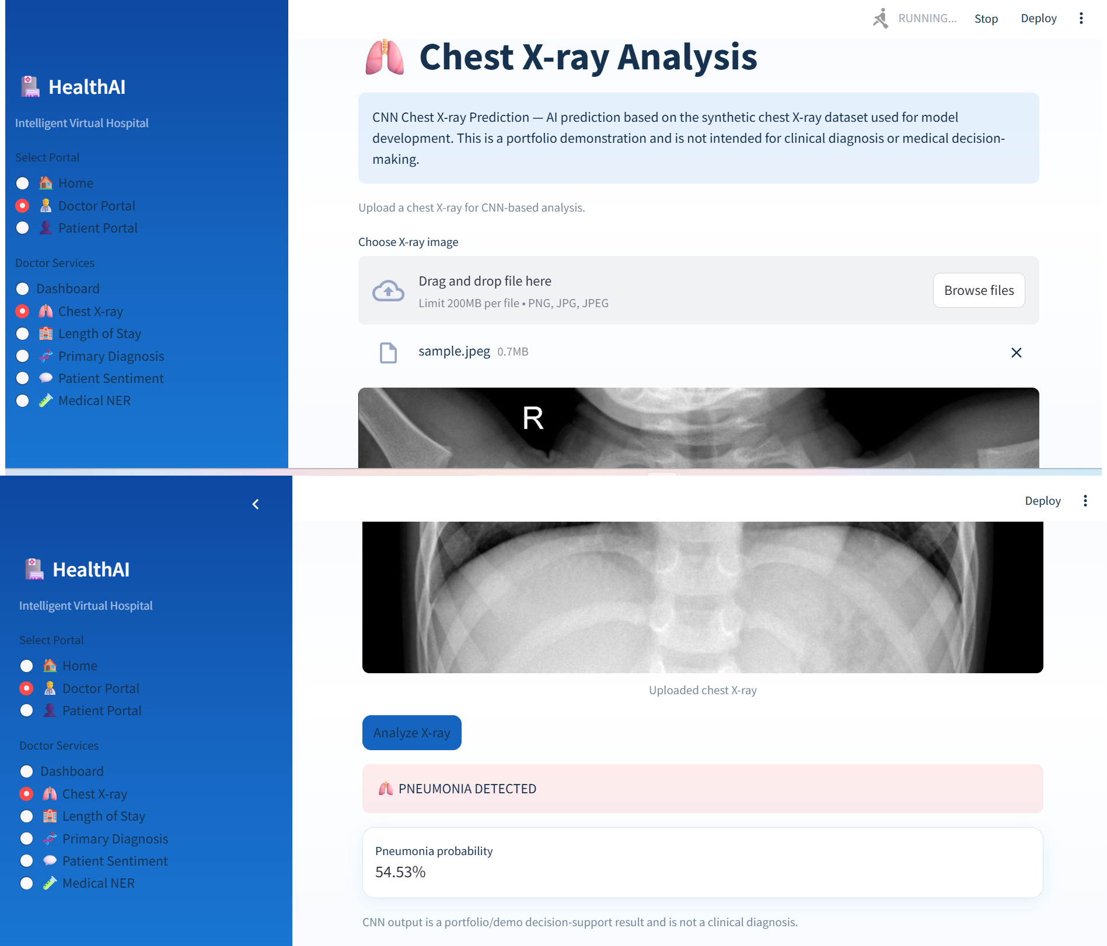
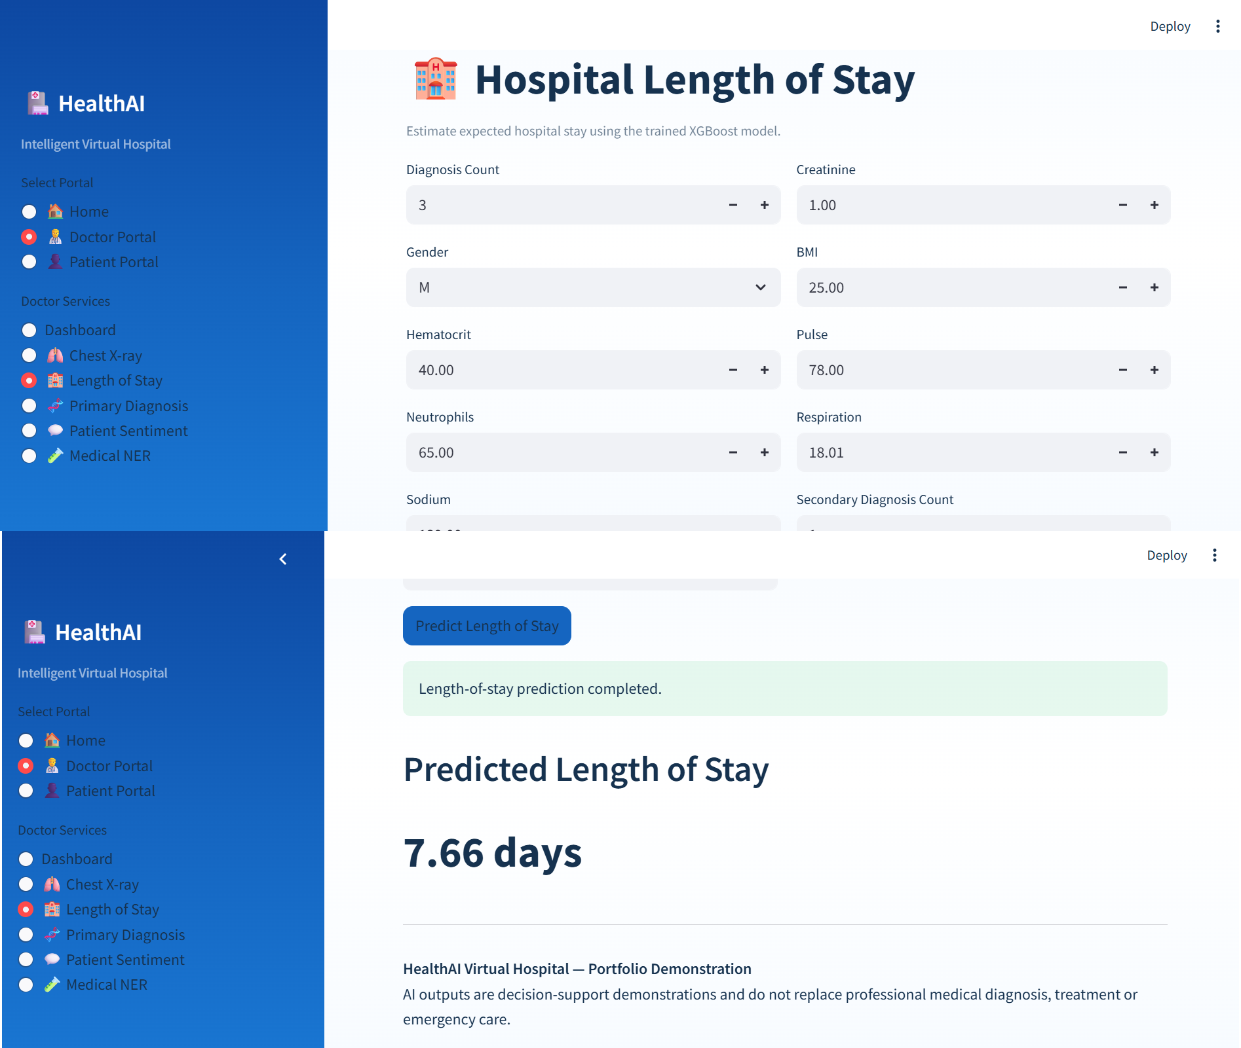
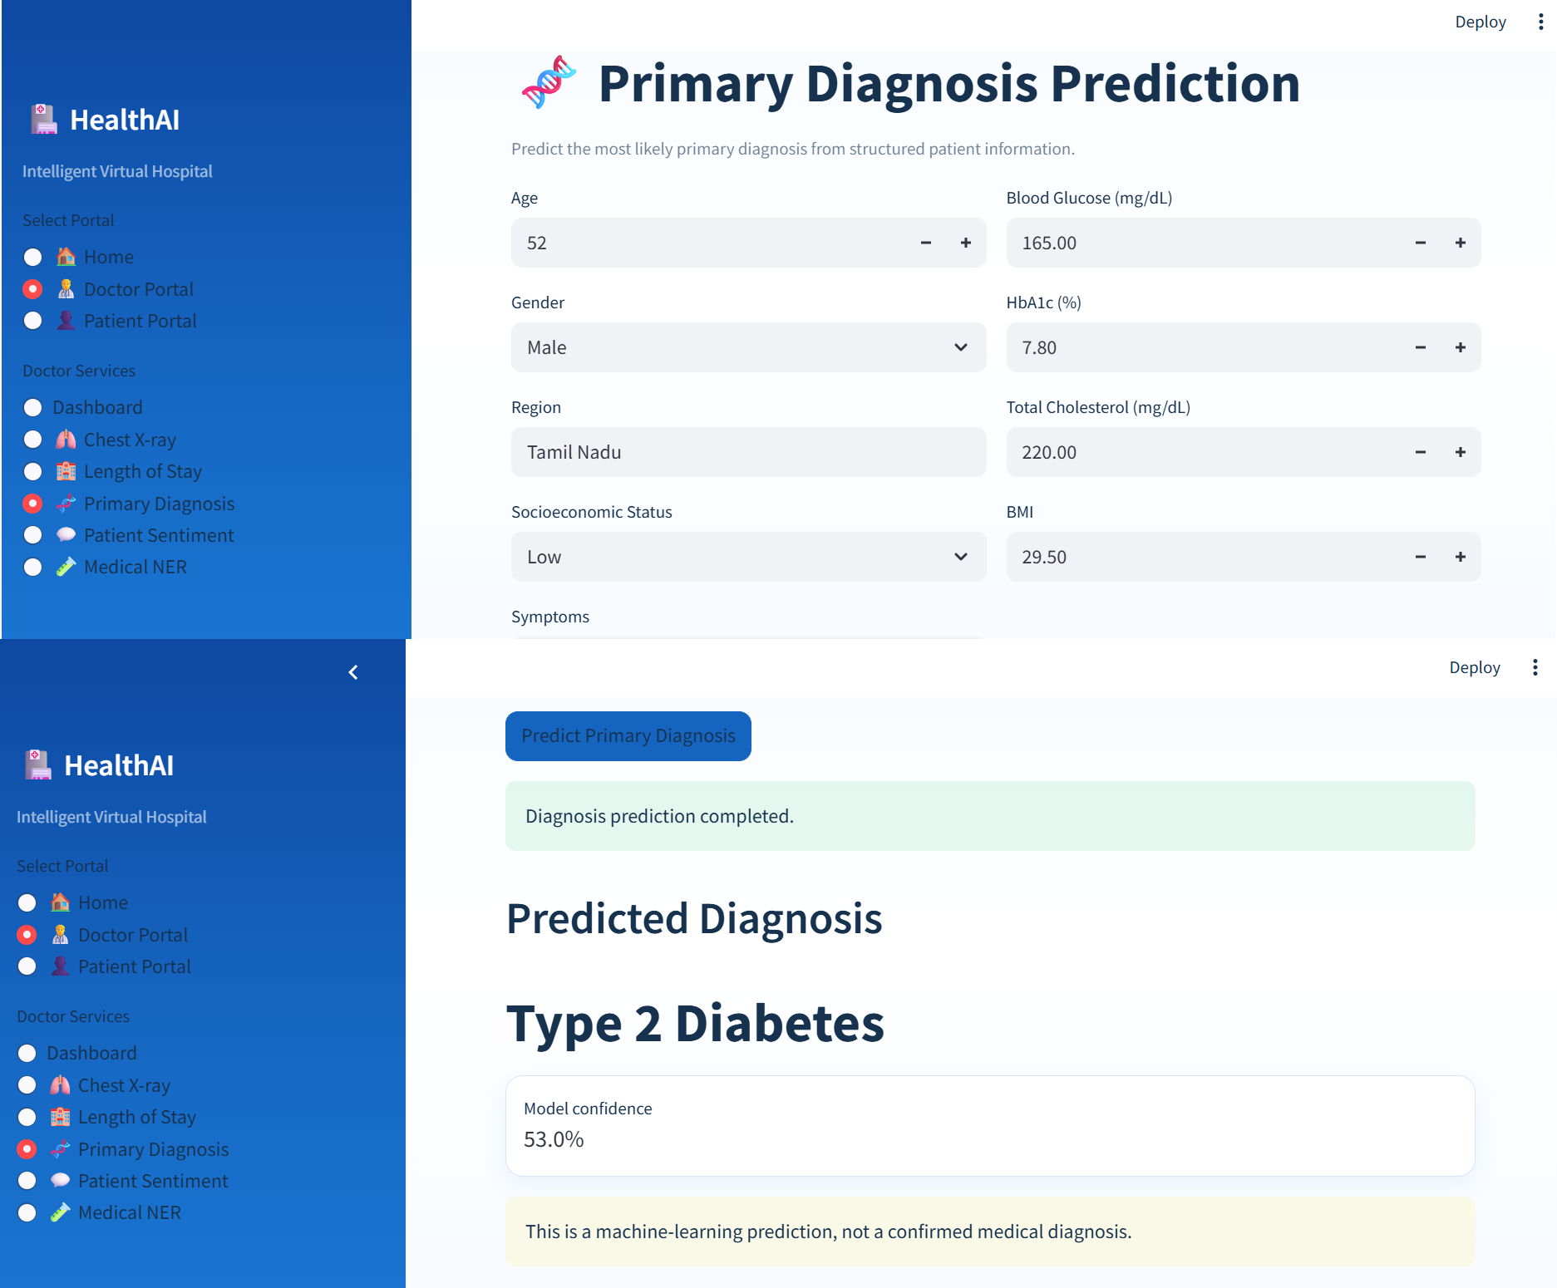
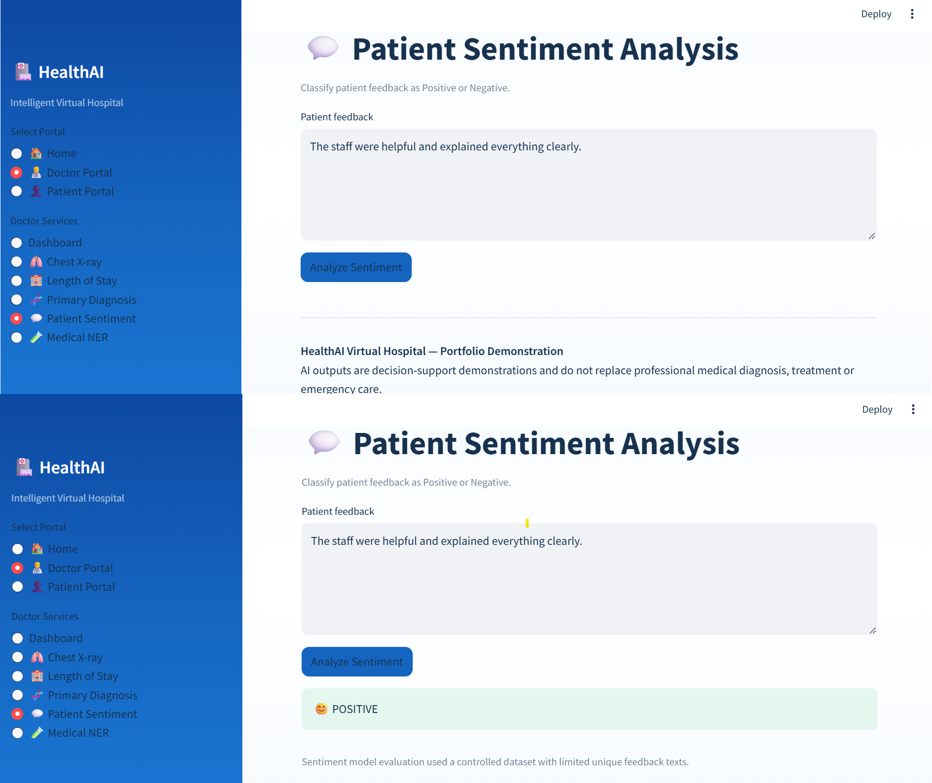
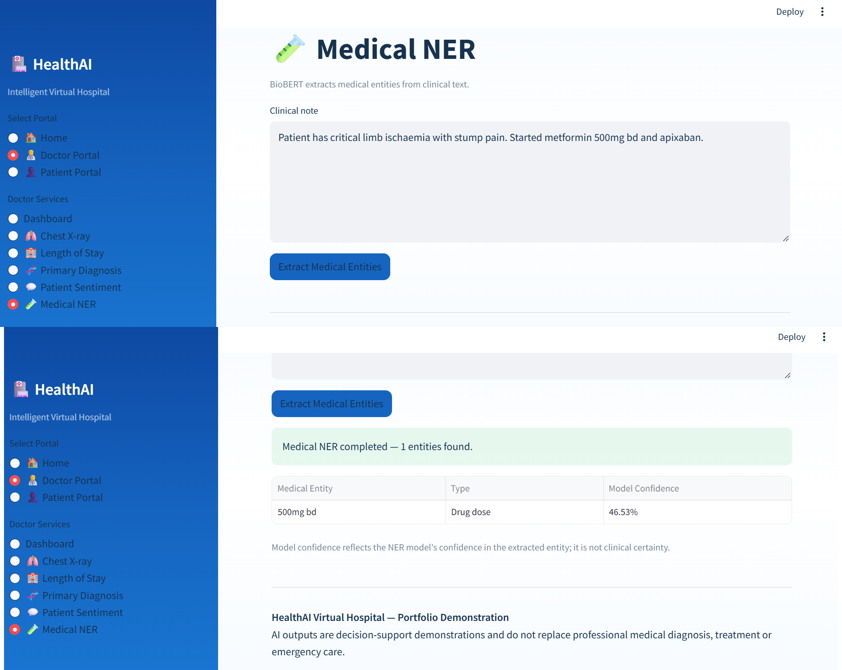
Doctor Portal — Clinical AI Services
DOCTOR
The Doctor workspace exposes specialized capabilities through one navigation layer
Chest X-ray
LOS

Slide 6
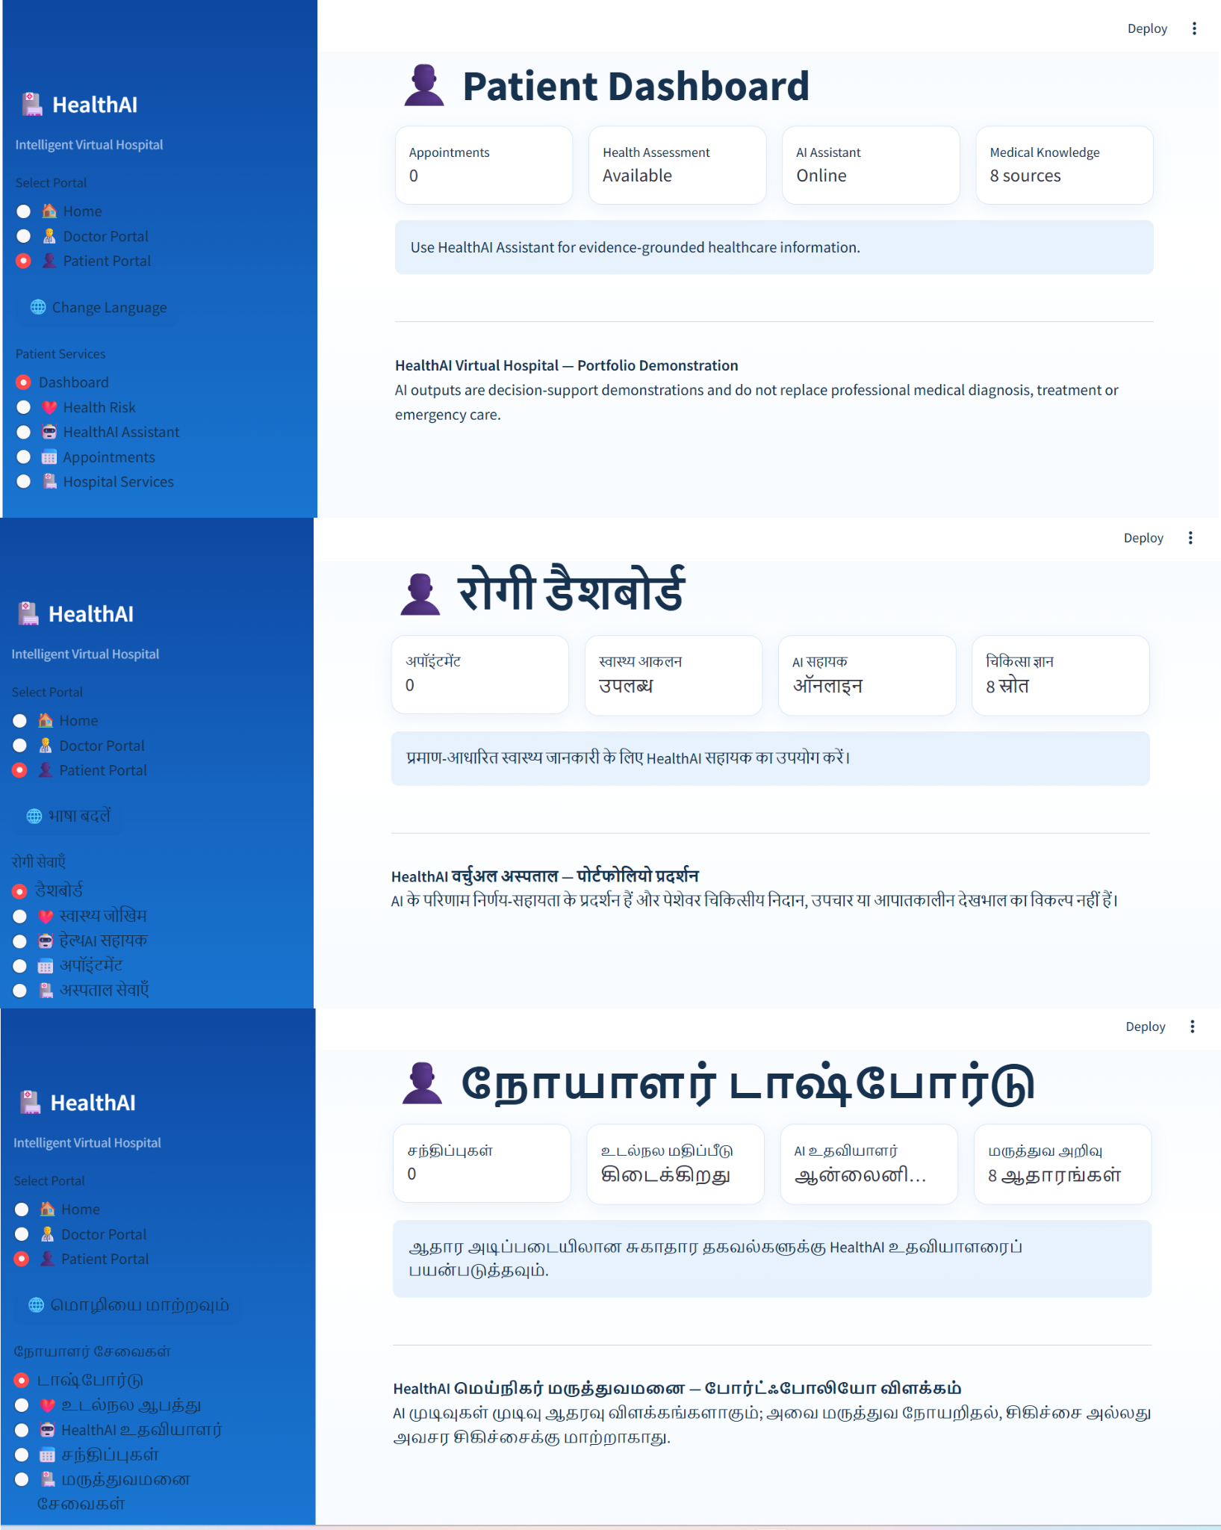
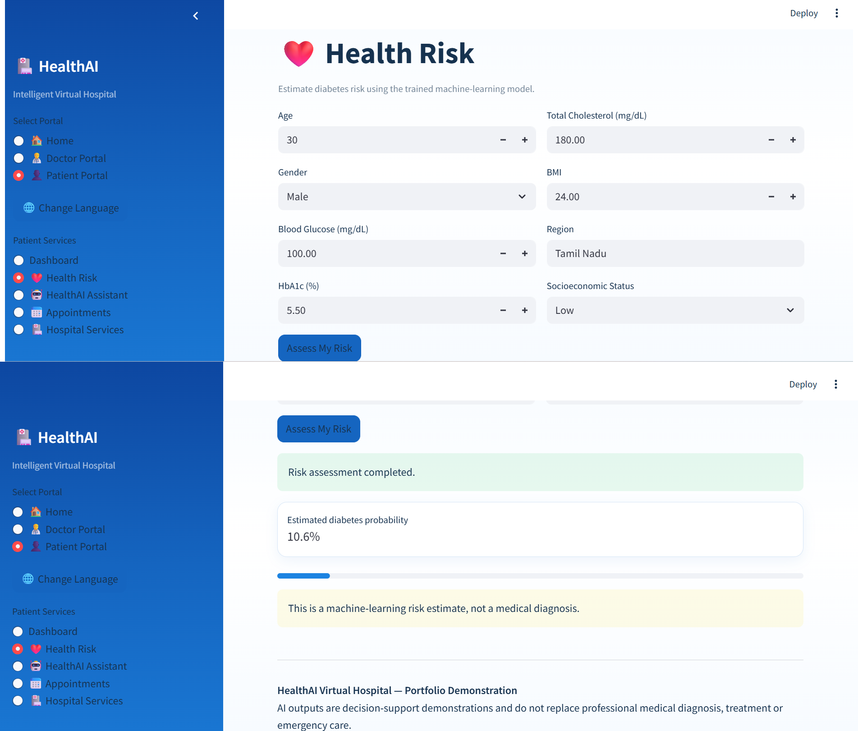
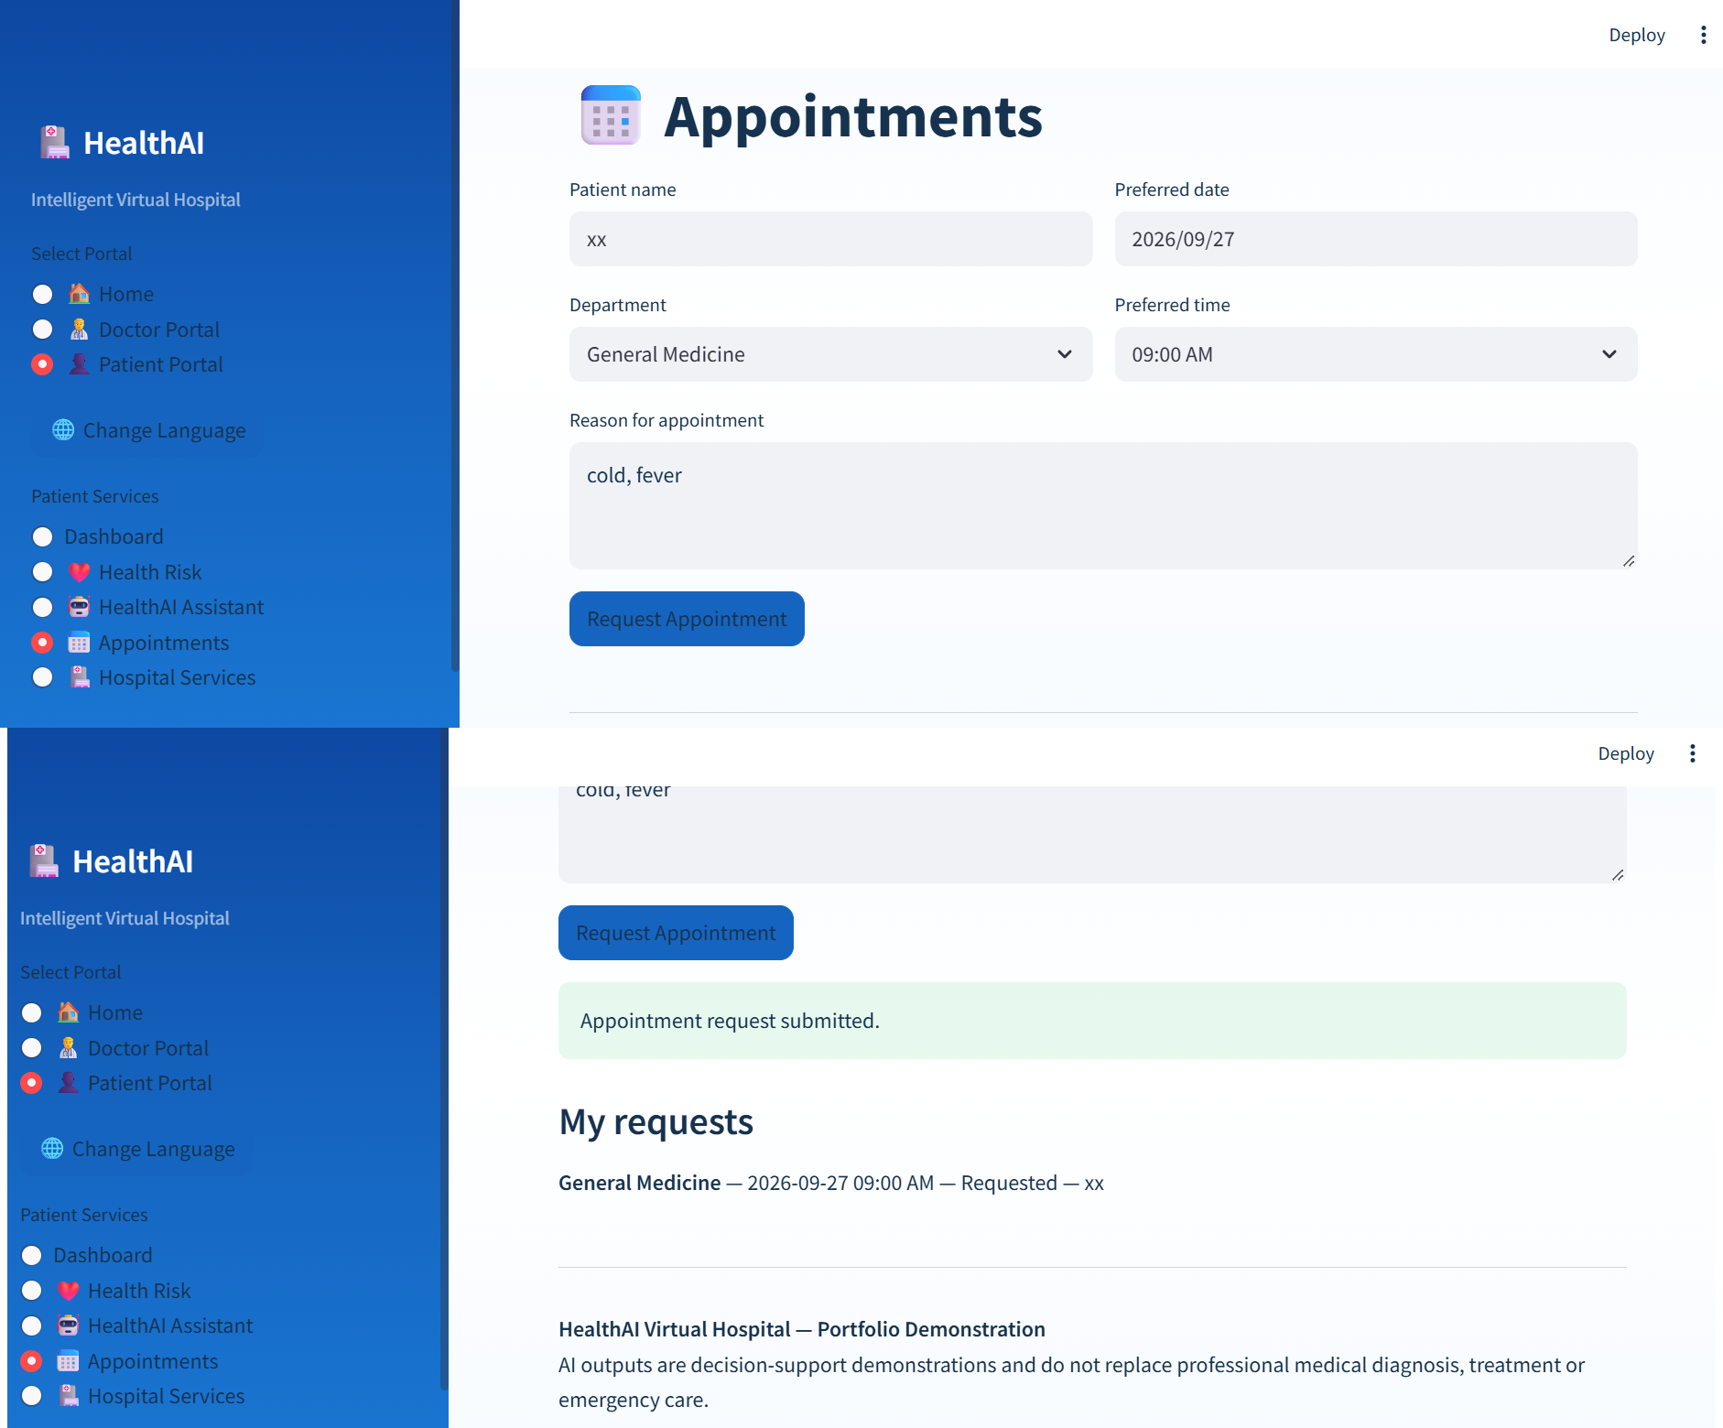
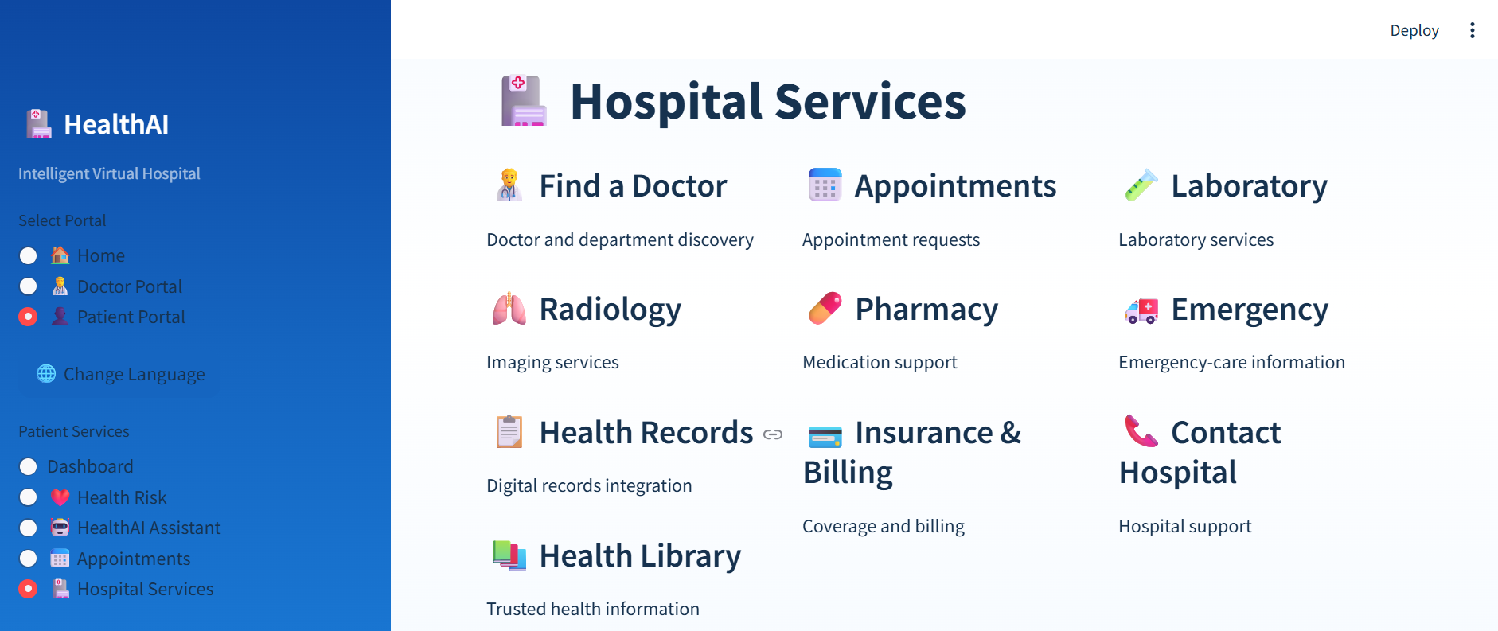
Patient Portal — Experience & Services
PATIENT
Patient-facing workflows include localized UI, health assessment and service navigation

Slide 7
Classical Machine Learning — Evaluation Snapshot
ML
Finalized application models and their recorded evaluation metrics
Diabetes Risk — Random Forest
Primary Diagnosis — Random Forest + SMOTE + Feature Engineering
Accuracy
F1
ROC-AUC
Accuracy
Macro F1
Weighted F1
92.76%
87.28%
96.62%
43.46%
0.2255
0.4181
Hospital Length of Stay — XGBoost
Selection note
MAE
RMSE
R²
For primary diagnosis, Macro F1 is the primary metric because the task is multiclass and imbalanced. An earlier XGBoost configuration recorded Macro F1 0.2315, but the finalized application artifact identifies Random Forest + SMOTE + feature engineering as the integrated model.
0.3201
0.4329
0.9659
Interpretation boundary
These metrics describe the project’s recorded development / evaluation datasets. They do not establish clinical effectiveness, safety or real-world hospital performance.

Slide 8
Deep Learning & Medical NLP
DL / NLP
Recorded final evaluations across ANN/MLP, CNN, RNN/LSTM and biomedical NER
ANN / MLP
RNN
BioBERT NER
ClinicalBERT
MAE 0.4424
RMSE 0.6371
R² 0.9260
Accuracy 84.53%
Precision 32.70%
Recall 61.50%
F1 42.70%
ROC-AUC 81.99%
Token accuracy 78.16%
Entity F1 43.37%
Token accuracy 77.14%
Entity F1 40.16%
CNN Chest X-ray
LSTM
Sentiment
Accuracy 99.17%
Precision 99.17%
Recall 99.17%
F1 99.17%
Accuracy 84.75%
Precision 31.72%
Recall 54.47%
F1 40.09%
ROC-AUC 79.36%
TF-IDF + Logistic Regression evaluation: Accuracy 50.00%, Precision 50.00%, Recall 100.00%, F1 66.67%. A DistilBERT workflow also exists, but the recorded artifacts do not provide a directly comparable final metric record.
Comparative interpretation
RNN and LSTM show different strengths across metrics; the project does not claim a universal winner. BioBERT has higher recorded entity-level metrics than ClinicalBERT in the evaluated NER results.

Slide 9
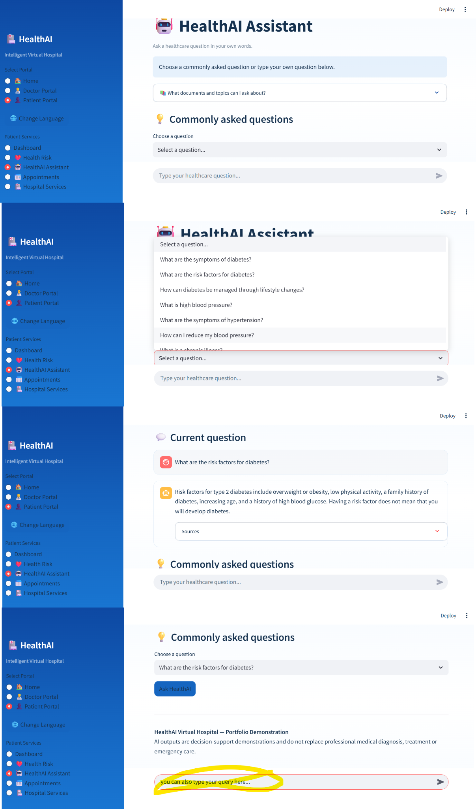
Medical RAG — Evidence-Grounded Answers
RAG
Retrieval quality, source grounding and safety behaviour are evaluated explicitly
Question
Embedding
55-vector index
Rerank
Safety gate
Grounded answer + sources
Abstain
Top-1 Topic Accuracy
Top-3 Topic Hit Rate
Safety Score
1.0000
1.0000
0.9333
Topic Consistency
In-domain Acceptance
OOD Rejection
0.8333
1.0000
1.0000
Knowledge base
8 curated WHO / WHO India / MedlinePlus sources • 384-dimensional embedding space

Slide 10
Agentic AI — Routing + Execution
AGENTS
Natural-language requests are mapped to specialized healthcare tools
User request
Agent router
Selected tool
Adapter / executor
Structured result
Router evaluation
Final integration
Observed issue
14 test cases
14 correct routes
Routing accuracy: 100%
Covered diabetes, LOS, clustering, association analysis, X-ray, deterioration, NER, sentiment, RAG and safe fallback.
10 scenarios
10 correct routes
9 valid executions
Execution success rate: 90%
Overall pass rate: 90%
One chest X-ray scenario was routed to the expected tool but produced an execution error. The recorded evidence therefore separates routing correctness from execution success.
Extensible pattern
Natural language → router → registered capability → normalized response. This keeps the UI stable while new tools or models are added.

Slide 11
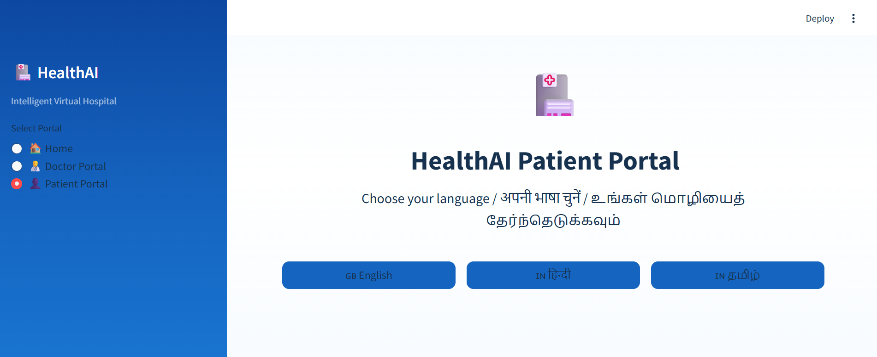
Multilingual Patient Experience
MULTILINGUAL
English, Hindi and Tamil patient-facing workflows
English UI
Hindi UI
Tamil UI
Default patient-facing experience with localized navigation and service labels.
Patient-facing interface localized into Hindi. Free-form translation uses a pretrained English-to-Hindi Transformer/NMT workflow.
Tamil patient-facing UI is implemented through application-level translations.
Model boundary
Helsinki-NLP/opus-mt-en-hi is a pretrained neural machine-translation model; it is not presented as a general-purpose LLM.

Slide 12
Data Provenance, Safety & Responsible AI
GOVERNANCE
Public and synthetic healthcare resources are documented separately from model claims
Indian Healthcare Patient Records
Hospital Deterioration
RAG knowledge sources
Kaggle — Arun's Workspace
Hugging Face — tarekmasryo • CC BY 4.0
8 curated public medical-information sources from WHO, WHO India and MedlinePlus. These are knowledge sources, not project-owned datasets.
LengthOfStay.csv
Synthetic Chest X-ray
Microsoft R Server — Hospital Length of Stay • MIT
Hugging Face — chimbiwide • CC BY 4.0
Responsible-use boundaries
• Public / synthetic data
• No claim of clinical validation
• Exact licenses should never be guessed
• Model outputs are decision-support demonstrations
• Real-world deployment would require validation, governance, security and human oversight
Patient Feedback / Sentiment
Synthetic Medical Notes for NER
Kaggle — SANAK.2000 • MIT
Hugging Face — E3-JSI • MIT

Slide 13
Engineering Implementation & Deployment
ENGINEERING
Turning model experiments into a reusable application stack
Streamlit UI
FastAPI
Agent / Adapters
Models / RAG
Docker
GitHub Actions
API layer
Testing / CI
Deployment
Stable REST contracts connect the Streamlit interface to healthcare AI services. Representative routes cover diabetes, X-ray, LOS, diagnosis, NER, sentiment and RAG.
API tests live under test/test_api.py and are executed through the GitHub Actions CI workflow with required FastAPI dependencies.
Docker deployment is provided under deployment/.
Streamlit: http://localhost:8501
FastAPI: http://localhost:8000
Reproducibility
Large datasets and model artifacts stay outside Git history. The project keeps source references, model evaluation artifacts and deployment configuration separate from the UI code.

Slide 14
Limitations & Future Development
LIMITATIONS
What the current project demonstrates — and what it does not
Current limitations
Responsible-use boundary
• Public / synthetic datasets do not represent all real clinical populations
• Primary diagnosis remains affected by multiclass imbalance
• RNN/LSTM deterioration modelling requires further validation
• Sentiment evaluation uses a controlled dataset with limited unique feedback texts
• RAG quality depends on curated source coverage
• Translation scope is currently limited
The platform is not clinically validated. The X-ray module and predictive outputs are portfolio / decision-support demonstrations and should not be presented as medical diagnosis or treatment.
Future development
Engineering next steps
• Broader validation datasets
• Expanded multilingual translation
• Model cards and failure-mode analysis
• Stronger auditability and governance
• Human oversight for real-world deployment
• Continue hardening execution paths
• Expand API and integration coverage
• Deepen reproducibility across environments
• Add further monitoring and evaluation for deployed workflows

Slide 15
Demo Flow & Final Takeaways
CLOSING
A concise walkthrough of the application and its engineering story
Home
Doctor Portal
X-ray
LOS
Diagnosis
Sentiment
Medical NER
Patient Portal
Health Risk
RAG + Sources
Hindi / Tamil
SPECIALIZATION
ORCHESTRATION
EVIDENCE + SAFETY
Use the appropriate model or retrieval workflow for the healthcare task.
Connect models through adapters, FastAPI and agentic routing.
Ground medical information in curated sources and support abstention when evidence is insufficient.
HealthAI demonstrates end-to-end AI engineering across healthcare data, machine learning, deep learning, medical NLP, RAG, agentic orchestration, APIs, deployment and user experience.
Portfolio / Educational Demonstration • Not a clinically validated medical device

