Slide 1

Grocery Store Management
Girkati Keerthana
Batch:484

Slide 2
About me
I am B.Tech Graduate.
I want to learn data analysis to uncover meaningful insights from raw information and make smarter decisions.
Github: keerthanagirkati27-rgb
LinkedIn: www.linkedin.com/in/girkati-keerthana-7a1b39353

Slide 3
Agenda
Buissness Problem
Problem Statement
Objective
ER Diagram
Queries
Challenges
Conclusion
Recommendations

Slide 4
Buissness Problem
Grocery stores face challenges in managing inventory, suppliers, employees, and customer orders efficiently. Without proper analysis, they struggle to identify top customers, best‑selling products, revenue trends, and employee performance, which limits their ability to optimize operations and improve profitability.
Problem Statement
The grocery store lacks a structured system to analyze customer behavior, product performance, supplier contributions, and employee efficiency. This makes it difficult to track sales trends, understand purchasing patterns, and ensure data consistency across multiple tables with complex relationships.

Slide 5
Objective
To design and implement a relational SQL database that enables accurate tracking of customers, products, suppliers, employees, and orders.
The project aims to generate business insights such as top customers, revenue trends, product performance, and supplier contributions while overcoming challenges like complex joins, aggregation, and time‑based analysis.

Slide 6
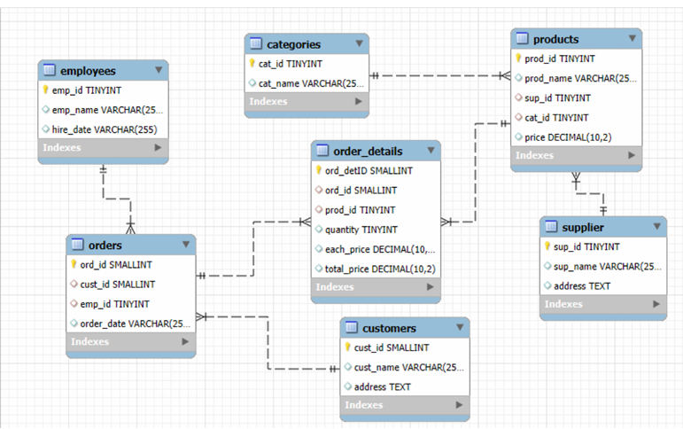
ER Diagram

Slide 7
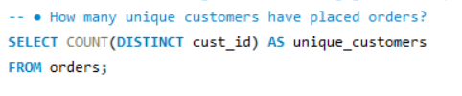

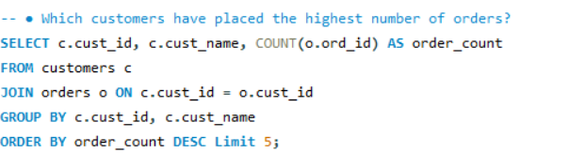
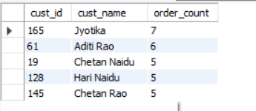
Queries Customer Insights

Slide 8
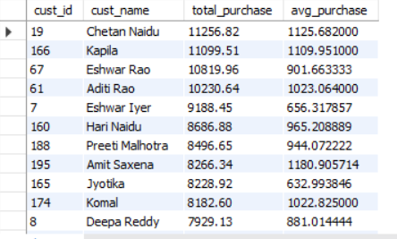
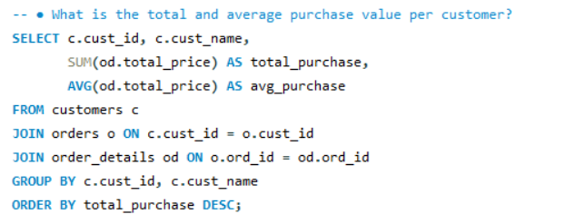
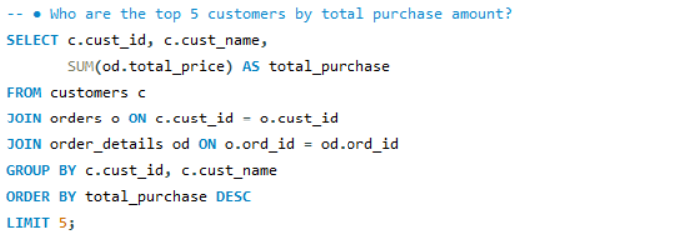
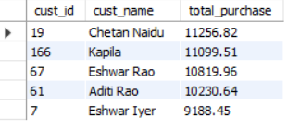

Slide 9
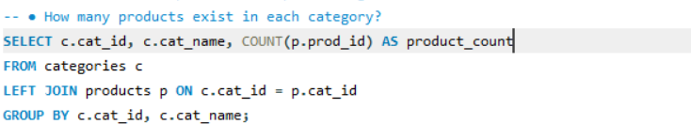
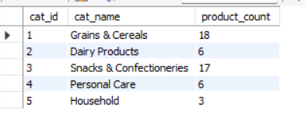
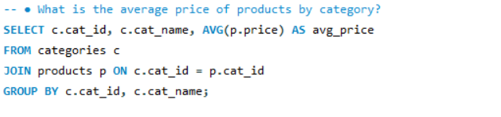
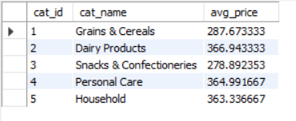
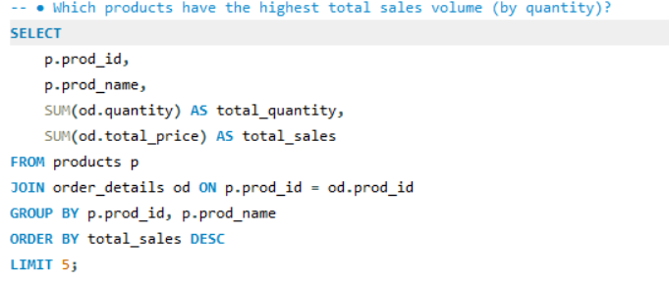
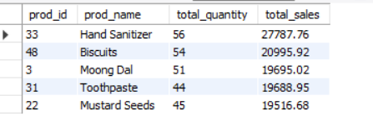
Product Performance

Slide 10
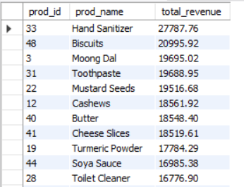
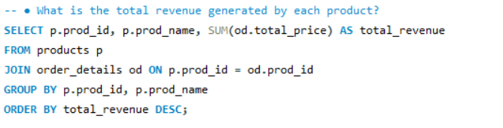
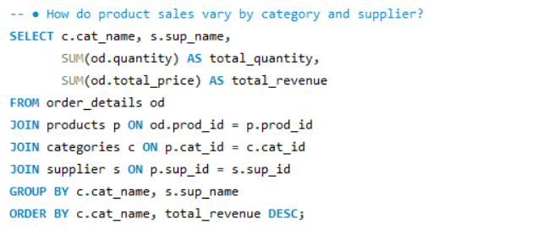
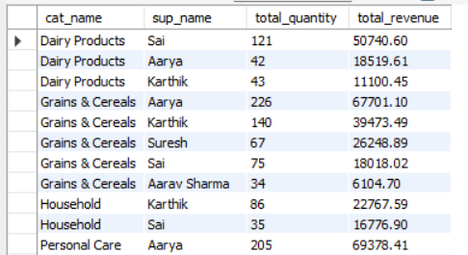

Slide 11


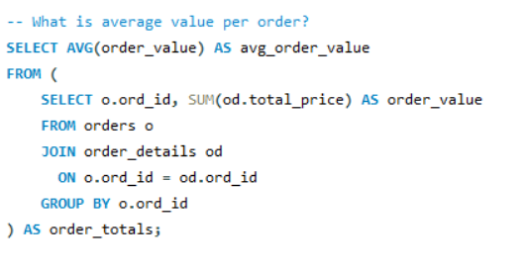

Sales and Order Trends

Slide 12
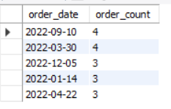
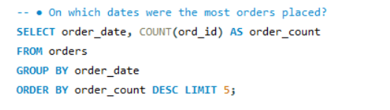
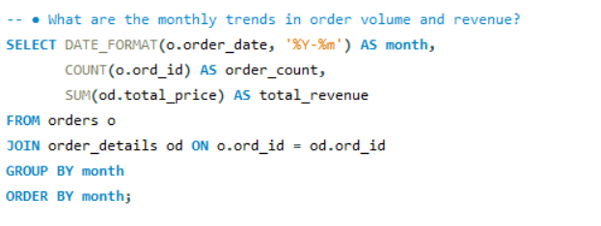
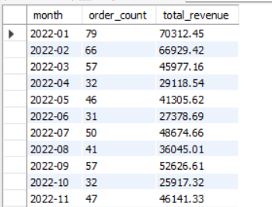

Slide 13
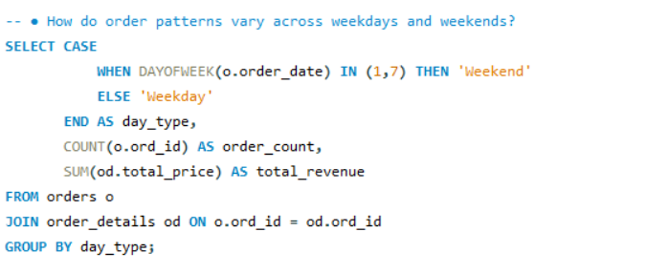

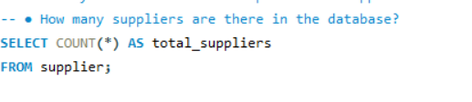

Supplier Contribution

Slide 14
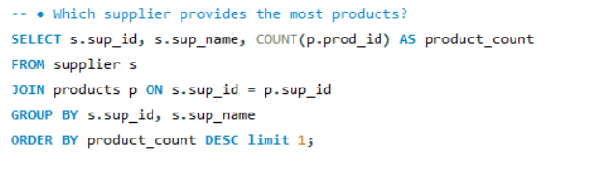

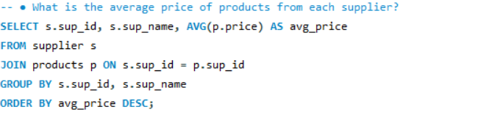
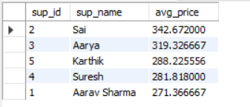
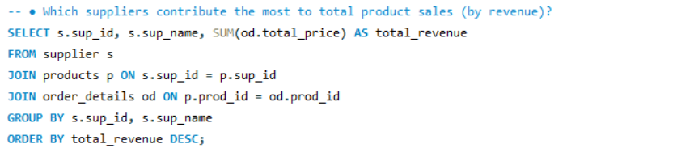
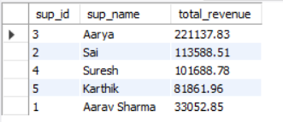

Slide 15
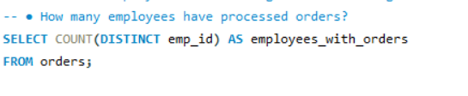

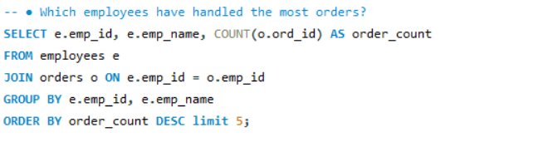
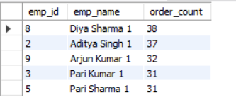
Employee Performance

Slide 16
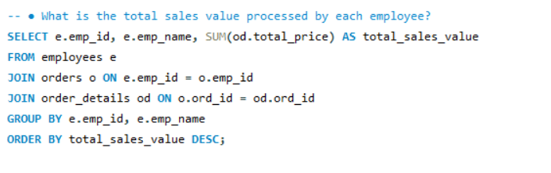
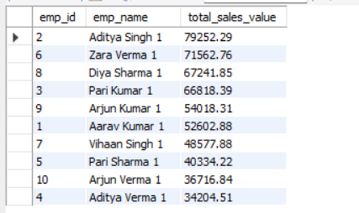
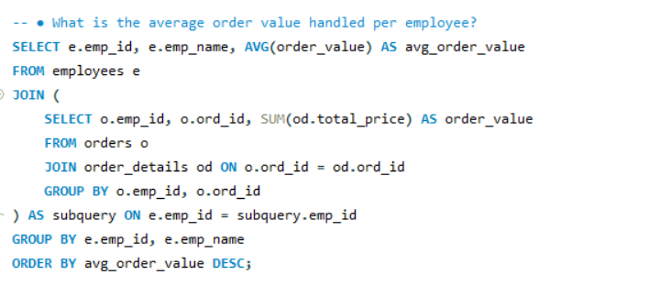
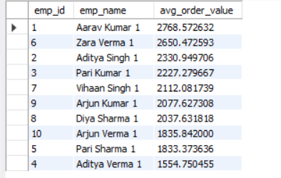

Slide 17
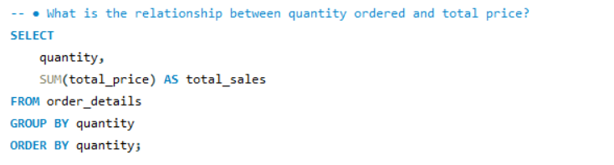
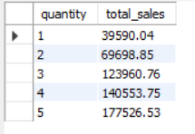
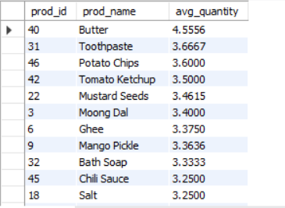
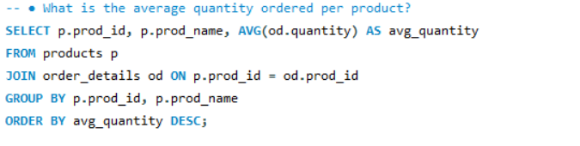
Order Details Deep Dive

Slide 18
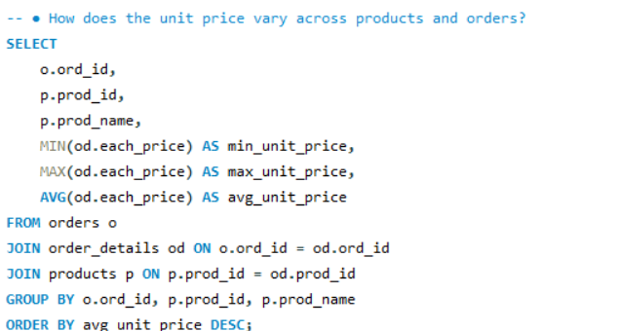
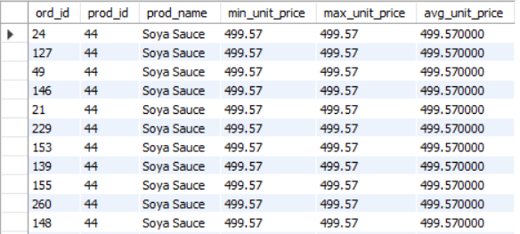

Slide 19
Challenges
Understanding table relationships and applying correct joins.
Ensuring data consistency with foreign key constraints.
Handling complex aggregations across multiple joined tables.
Extracting time-based trends when date data is stored as VARCHAR.

Slide 20
CONCLUSIONS
The Grocery Store Management database successfully integrates suppliers, products, customers, employees, and orders into a relational structure.
Through SQL queries and analysis, it provides clear insights into customer behavior, product performance, supplier contributions, employee efficiency, and overall sales trends.
Despite challenges like complex joins and time-based analysis, the system enables reliable decision-making and operational efficiency.

Slide 21
RECOMMENDATIONS
Implement data validation and cleaning to ensure consistency across tables.
Use indexes on frequently joined columns (cust_id, prod_id, ord_id) to improve query performance.
Convert date fields to proper DATE/TIMESTAMP types for accurate time-based analysis.
Regularly monitor top customers and best-selling products to design loyalty programs and targeted promotions.
Track supplier performance to negotiate better pricing and ensure product availability.
Evaluate employee order handling to identify training needs and reward high performers.

Slide 22


Slide 23

THANK YOU

