Slide 1
DAA HACKATHON |
School Bus Route Planner
Smart pickup routes that respect road distance, bus capacity and student priority.
Team Members: R. Shravya Sri (25MVCSMR0710), E. Gangothri (25MVCSMR0642)
K. Keerthana (25MVCSMR0648), T. Sai Hansika (25MVCSMR0703)
Problem Domain: Transportation & Logistics / Smart Education
Core Algorithms: Dijkstra • BFS • Greedy

Slide 2
The Challenge
2 / 7
Real-World Problem
Why It Matters
Key Challenges
Schools plan bus routes by hand or guesswork
Many stops, uneven roads, limited seats
Each bus must still reach school on time
Shorter rides: safer, less tiring for children
Lower fuel cost and fewer buses needed
Fair pickup for students with higher priority
Find true shortest road distance between stops
Never exceed bus capacity
Balance distance against pickup priority
Detect unreachable stops early

Slide 3
Our Innovation
3 / 7
Core Idea: Use real shortest-path distances (Dijkstra) as the cost, then let a priority-aware Greedy rule build capacity-safe routes – and explain every decision.
Priority-aware
Capacity-safe
Explainable
Reachability check
Stops scored by distance and pickup priority
Bus is never overloaded
Shows why each stop was chosen
BFS flags isolated stops first
Unique approach: combines three DAA techniques in one pipeline instead of a single shortest-path run.

Slide 4
How It Works
4 / 7
INPUT
PROCESSING
ALGORITHM
OUTPUT
Stops, road map, distances, bus capacity, priorities
Build weighted graph; BFS checks reachability
Dijkstra distances + Greedy stop selection
Route per bus, total distance, load, reasons
User Journey
1. Select school & students
2. Set capacity & priority
3. Click Optimize Route
4. View routes, export CSV

Slide 5
Technology & Algorithm
5 / 7
Tech Stack
JavaScript
Algorithms in browser
Algorithm | Role | Why chosen | Complexity
Dijkstra | Shortest road distance between stops | Road weights are non-negative | O((V+E) log V)
BFS | Reachability & minimum-hop check | Fast, flags unreachable stops | O(V+E)
Greedy | Pick next stop by distance + priority within capacity | Quick, explainable choices | O(n log n)
HTML / CSS
Responsive UI
SVG
Route canvas
Hatchable
Hosting + optional AI

Slide 6
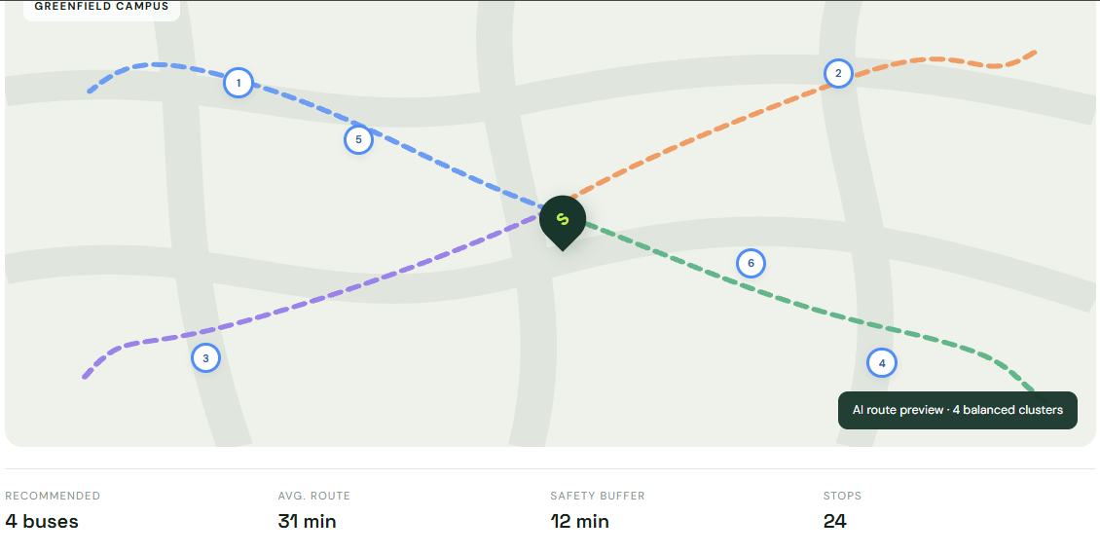
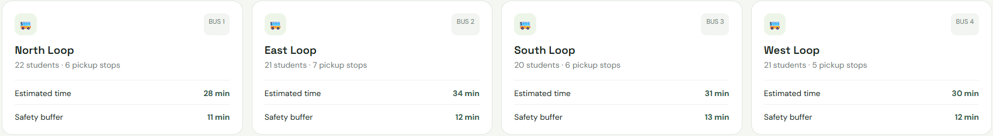
Demo & Impact
6 / 7
Sample Output
North Loop: 22 students, 6 stops
28 min, safety buffer 11 min
East Loop: 21 students, 7 stops
34 min, safety buffer 12 min
Results & Benefits
4 buses for 84 students
Avg route 31 min, buffer 12 min
No bus over capacity
Export plan as CSV

Slide 7

Future Vision
7 / 7
Achieved
Future Work
Scalability
Dijkstra + BFS + Greedy pipeline
Interactive route canvas
Explainable insight + CSV export
Real maps & live traffic
GPS + parent alerts
Driver dashboard
Heap-based Dijkstra
Cached distance matrix
Hosted web app
Takeaway: Safer, shorter, fairer school commutes through smart algorithms.
Thank You | Q & A

