Slide 1
Agentic AI Hackathon: Building Intelligent Agents with IBM Granite and LangFlow
AI-Based Crop Health Monitoring and Advisory System

Slide 2
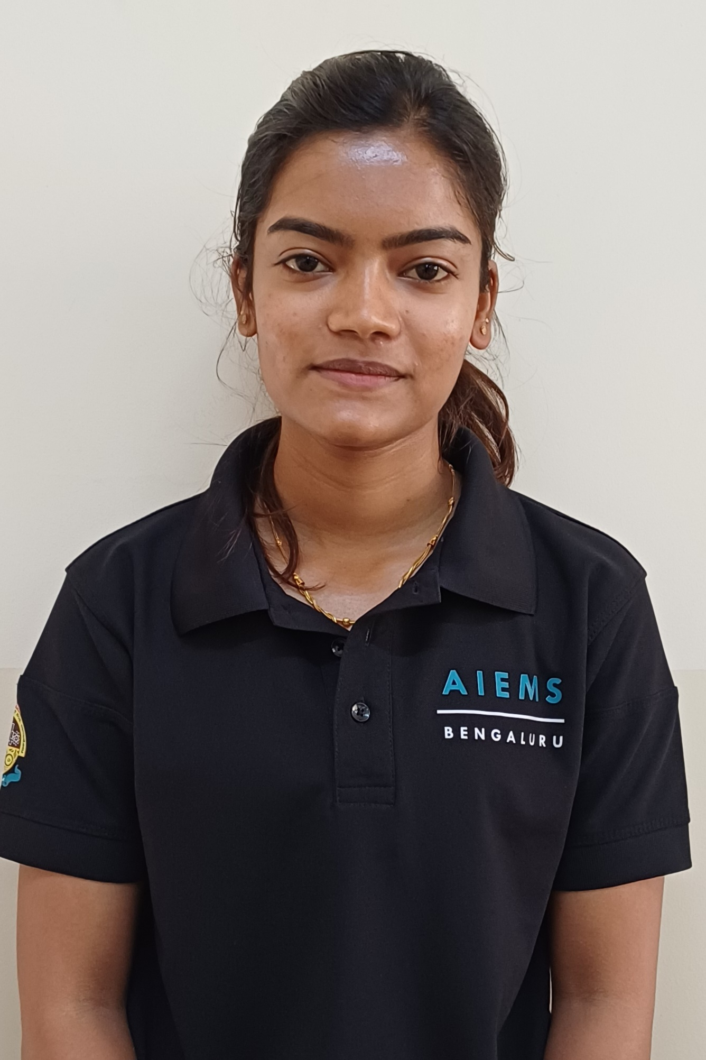
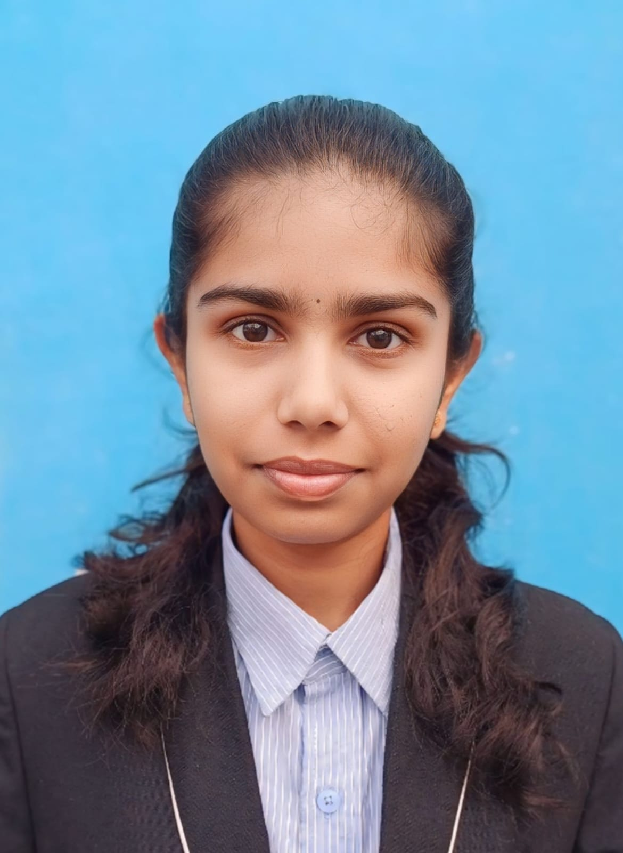
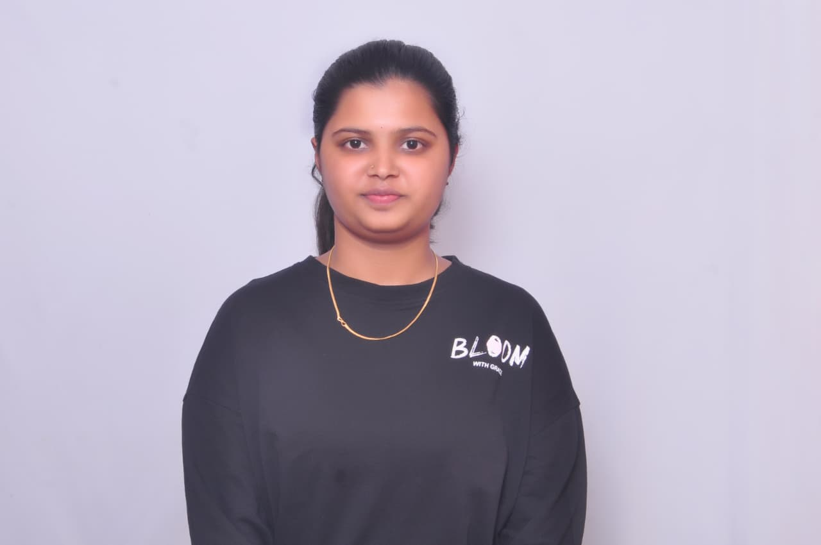
Name of the team: FarmTech
Details of Team members
TEAM MEMBER NAME | Recent Passport Photo | Email ID | Phone number [WhatsApp]
Gagana K |  | brunogagana@gmail.con | 7760859880
Keerthana B P |  | keerthanagowda1505@gmail.com | 6360558071
Keerthana N |  | keerthanajayanthi54@gmail.com | 9606667816

Slide 3
Problem statement
Crop health depends on soil conditions, weather, pests, and irrigation. Farmers often rely on manual field checks, which can delay the detection of early crop stress. An AI-based system is needed to continuously monitor agricultural data, identify risks early, and provide timely advisories to improve yield and farm decision-making.

Slide 4
Proposed solution
Develop an AI-based crop health monitoring system
Continuously collect data from soil, weather, and crop growth conditions
Analyze data using AI models to detect early crop stress and risks
Identify potential pest attacks and adverse environmental conditions
Generate real-time alerts for emerging crop health issues
Provide agronomy-aligned advisories for better farm decisions
Help improve crop yield, resource efficiency, and sustainability

Slide 5
Need of project
Farmers often detect crop problems too late, leading to yield loss
Manual field monitoring is time-consuming and not always accurate
Crop health depends on multiple factors that are hard to track together
Lack of real-time insights affects timely decision-making
Overuse of water, fertilizers, and pesticides increases costs and environmental impact
Farmers need data-driven guidance instead of only experience-based decisions
An AI-based system can provide early warnings and smart advisories

Slide 6
End user of project
Farmers – To monitor crop health and receive timely advisories
Agricultural Consultants / Agronomists – To support farmers with data-driven insights
Agri-Tech Companies – To integrate smart monitoring into their solutions
Government Agriculture Departments – For large-scale crop monitoring and planning
Farmer Producer Organizations (FPOs) – To guide member farmers effectively
Research Institutions – For studying crop patterns and improving advisory models

Slide 7
Technology Used
Langflow platform
Langflow component name – Agent , Chat input , Chat output
IBM Grainte model – ibm-granite-3-2-8b
IBM Cloud
Watson studio
Watson Machine Learning
Watson Governance
Cloud Object Storage
IBM Watsonx.ai
Watsonx

Slide 8
Novelty and Uniqueness
Integrates AI with real-time farm data (soil, weather, crop stage, etc.)
Provides continuous crop health monitoring, not just one-time inspection
Detects early stress signals and disease risks before visible damage spreads
Combines data analysis + predictive models for proactive decision-making
Delivers instant, personalized advisories to farmers
Reduces dependence on manual field scouting
Accessible through simple digital/mobile platforms
Helps improve yield, input efficiency, and sustainable farming

Slide 9
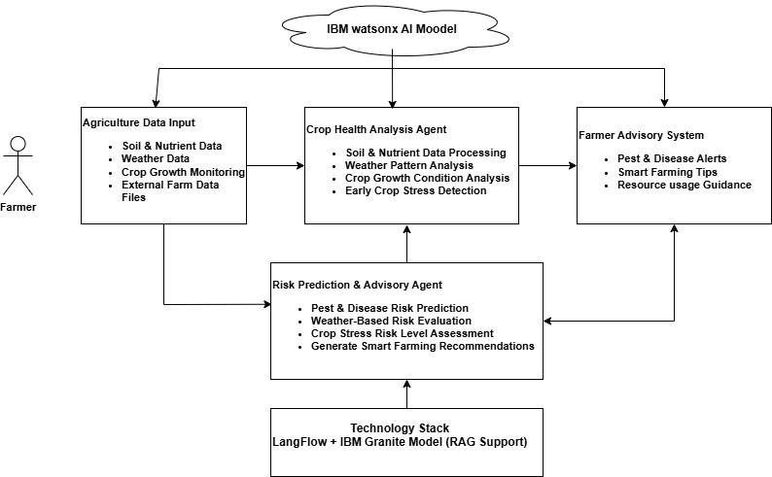
Technical flow diagram - Architecture blueprint

Slide 10
Langflow component Used
Langflow Components Used in the Project
1) Chat Input
Acts as the user interaction point
Farmers or users enter crop symptoms, questions, or farm details
Sends the user’s query to the AI system for analysis
2) IBM watsonx AI Agent
Serves as the core intelligence of the system
Processes user input along with agricultural data
Uses AI models to analyze crop conditions, detect risks, and generate advisories
Provides data-driven recommendations for crop health management

Slide 11
3) Chat Output
Displays the AI-generated response to the user
Shows crop health insights, risk alerts, and advisory suggestions
Acts as the final communication layer between the system and the farmer

Slide 12
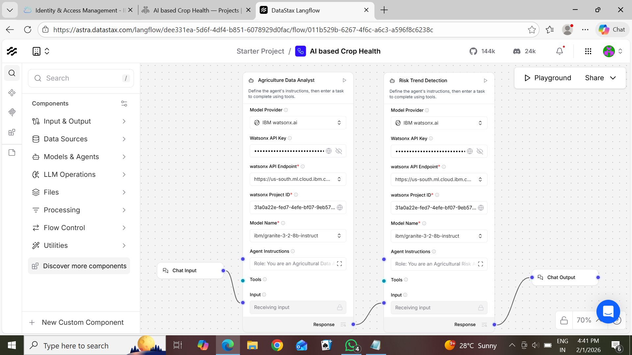
Input Screenshot 1

Slide 13
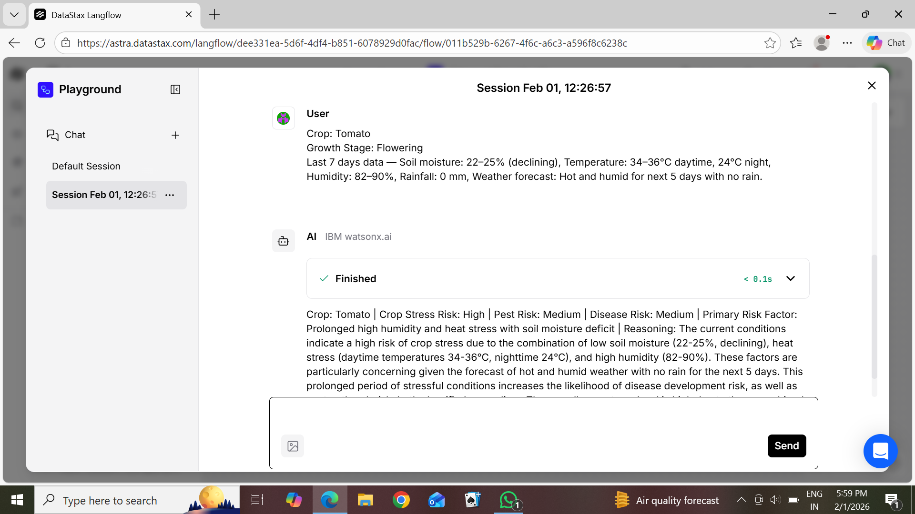
Output Screenshot 1

Slide 14
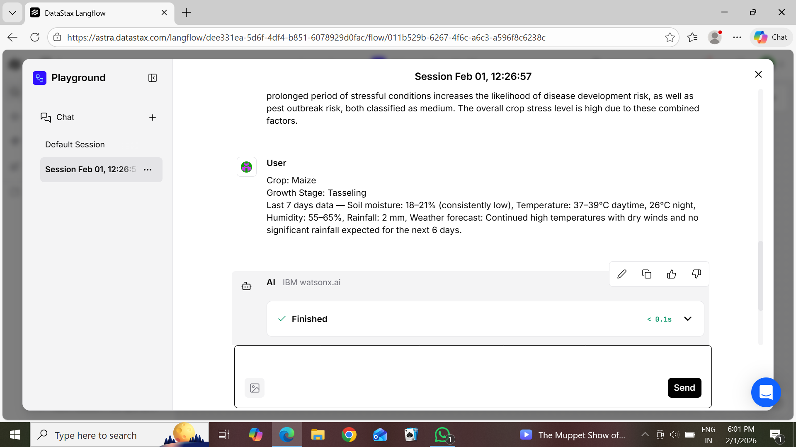
Output Screenshot 2

Slide 15
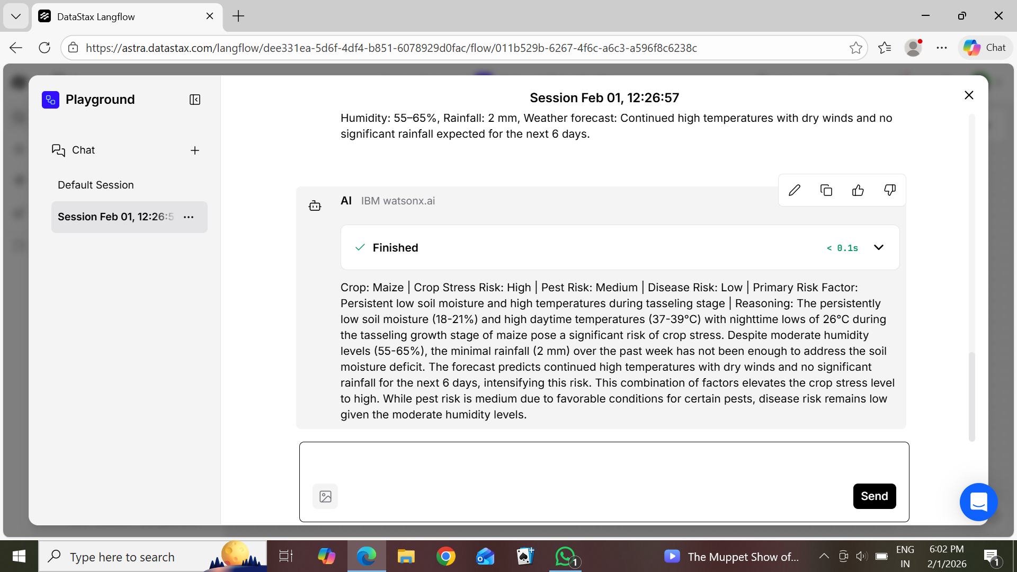
Output Screenshot 3

Slide 16
Future Scope
Integration with IoT sensors for real-time field monitoring
Use of satellite and drone imagery for large-scale crop analysis
Advanced AI models for yield prediction and risk forecasting
Expansion to support multiple crops and different regions
Personalized advisories based on soil, weather, and crop stage
Multilingual, mobile-based advisory system for better farmer access

Slide 17
Git Hub Link
https://github.com/keerthanagowda1505-blip/First-Project

Slide 18
References
1. AI-powered crop health monitoring research (drone + machine learning) https://journal.ijprse.com/index.php/ijprse/article/view/1224
2. Review on AI, Machine Learning & IoT integration in precision agriculture
https://doi.org/10.25081/jsa.2025.v9.9497
3. Precision Agriculture 4.0: AI + IoT for data-driven crop monitoring
https://doi.org/10.17051/NJSARI/01.01.07
4. Integrating AI and IoT for crop monitoring & management
https://doi.org/10.1016/j.sintl.2024.100292
·

Slide 19


