Slide 1
AIR QUALITY
ANALYSIS AND
PREDICTION IN
TAMILNADU

Slide 2
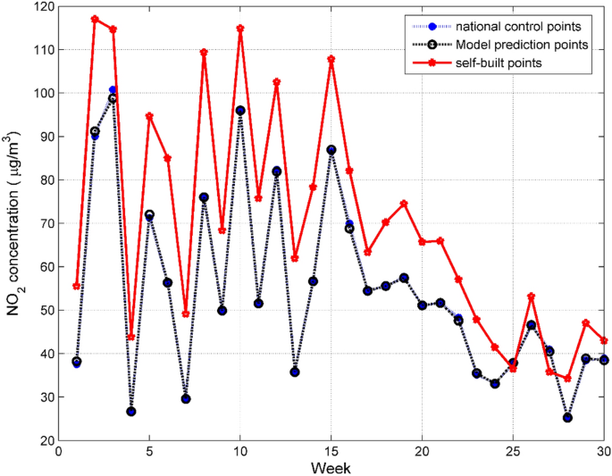
PROBLEM DEFINITION:-
The project aims to analyze and visualize air quality data from monitoring stations in Tamil Nadu.

Slide 3
SUBTITLE:-
Project Objectives
Analysis Apporach
Visualization Techiques

Slide 4
DATA PREPROCESSING:-
The preprocessing phase includes the handling of missing data, handling of the outliers,data de-trending and data smoothing.

Slide 5
ANALYSIS OF DATA FOR AIR POLLUTION:-
The pollution mix across india with virtually all sites in northern india(north of 23.5⁰ ⁾

Slide 6
PROJECT OBJECTIVES:-
Analysis air quality trends
Identifying pollution hotspots
Predictive models for RSPM/PM10 Levels

Slide 7
VISUALIZATION TECHNIQUES:-
Line charts
HeatMap

Slide 8
EVALUTION:-
Evaluate this models performance using appropriate time series forcasting metrics

