Slide 1
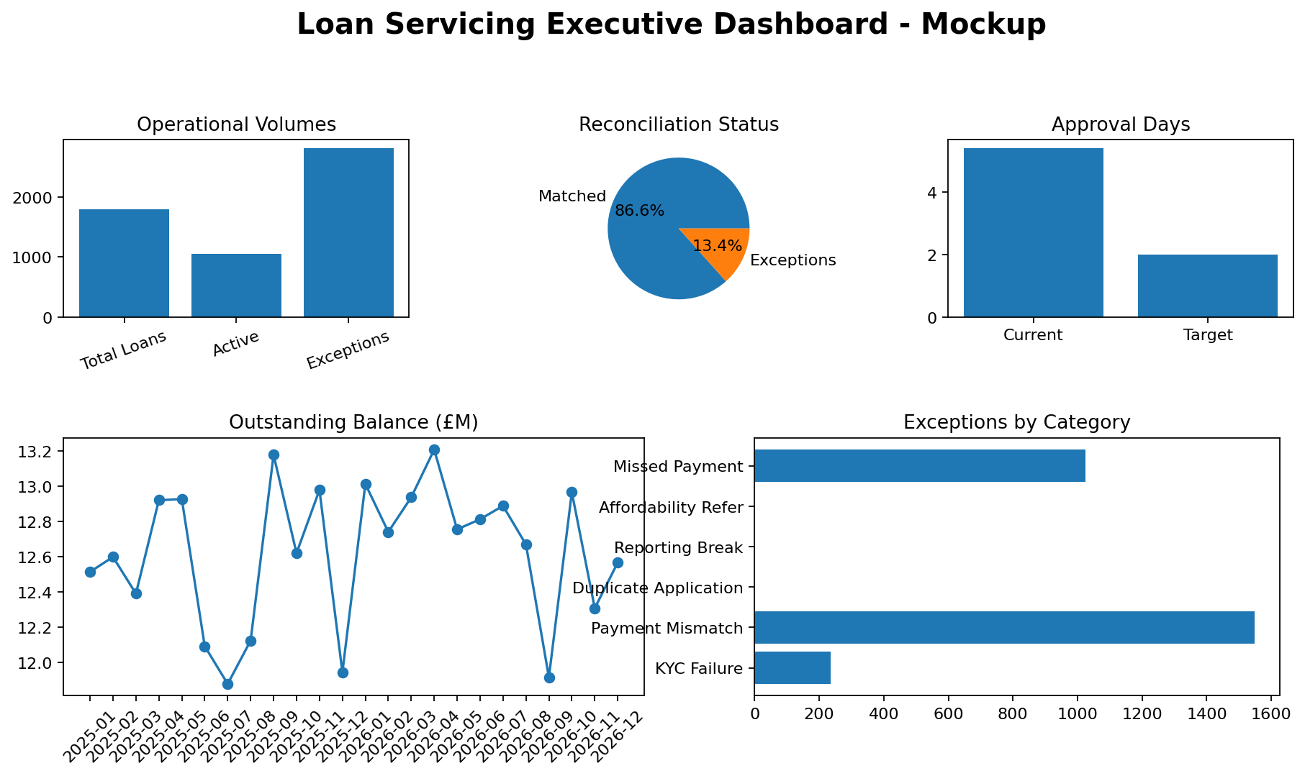
Loan Servicing Process Improvement
Business Analyst portfolio project | LendWise Finance UK
AS-IS / TO-BE process redesign
BRD, FRD, RTM, UAT and defect governance
SQL analysis and Power BI reporting design

Slide 2
Business Problem
Manual verification delays approval
Duplicate data entry creates rework
Reconciliation breaks impact reporting confidence
Email-based exception handling gives poor ownership
KPI | Current | Target
Approval Days | 5.4 | 2.0
Recon Accuracy | 93% | 99.5%
Reporting Delay | 2 days | 0

Slide 3
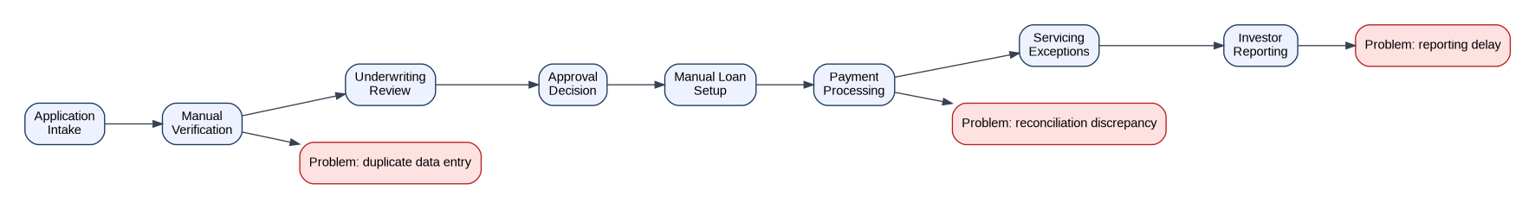
AS-IS Process
Application to investor reporting is linear and manual
Verification, setup and reporting rely on spreadsheets
UAT defects are not fully linked to requirements

Slide 4
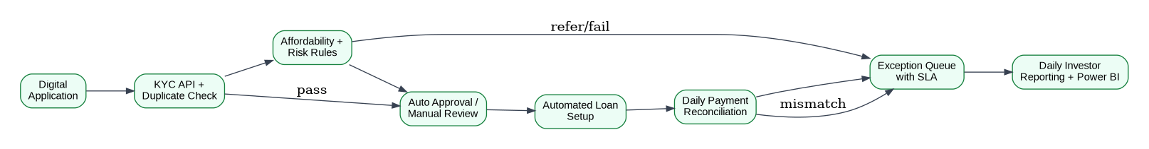
TO-BE Process
Digital KYC and duplicate checks
Automated loan setup and repayment schedule
Daily payment reconciliation
SLA-based exception queue
Daily investor reporting Power BI dataset

Slide 5
Stakeholders
Loan Operations owns process outcomes
Credit/Risk owns underwriting rules
Finance owns reconciliation controls
Compliance owns KYC and audit controls
BI owns dashboard delivery
Deliverable | Status
BRD / FRD | Complete
RTM / UAT | Complete
SQL / Data | Complete
Dashboard Guide | Complete

Slide 6
Requirements Scope
25 business requirements documented
Functional modules include KYC, underwriting, payments and reporting
Business rules define validation, exception and audit behaviour
Deliverable | Status
BRD / FRD | Complete
RTM / UAT | Complete
SQL / Data | Complete
Dashboard Guide | Complete

Slide 7
Gap Analysis
Current-state pain points converted into future-state capabilities
Prioritisation based on operational impact and control risk
Gaps become user stories and UAT coverage
Deliverable | Status
BRD / FRD | Complete
RTM / UAT | Complete
SQL / Data | Complete
Dashboard Guide | Complete

Slide 8
UAT and Defect Governance
RTM links requirements to user stories and test cases
30 UAT scenarios cover core business flows
Defect log records severity, owner, status and retest result
Deliverable | Status
BRD / FRD | Complete
RTM / UAT | Complete
SQL / Data | Complete
Dashboard Guide | Complete

Slide 9
SQL and Data Quality
PostgreSQL schema for customer, loan, verification, payments, exceptions and reporting
Queries calculate approval days, reconciliation accuracy and exception backlog
Data quality checks identify control breaks
Deliverable | Status
BRD / FRD | Complete
RTM / UAT | Complete
SQL / Data | Complete
Dashboard Guide | Complete

Slide 10
Power BI Dashboard
Executive overview
Loan operations funnel
Payment and reconciliation performance
Exception ageing and ownership
Investor reporting trend

Slide 11
Business Impact
Approval time reduced from 5.4 to 2 days
Manual verification reduced through API and exception review
Reconciliation accuracy target of 99.5%
Daily reporting improves leadership visibility
Deliverable | Status
BRD / FRD | Complete
RTM / UAT | Complete
SQL / Data | Complete
Dashboard Guide | Complete

