Slide 1
HKBK College of Engineering Department of Computer Science and Engineering PROJECT TITLE: Fake Social Media Account Detection using Machine Learning
^{zeroth} Review
Presented by Guided by
1. Keerthana k h-1HK23CS062 Prof.Sarumathi.S
2.Anil-1HK23CS017 Assistate Professor
3.Govindraj-1HK23CS049 Dept. of CSE,HKBKCE
4.Chinthan g k-1HK23CS034
Date:18-09-2025

Slide 2
Abstract
Social media plays a major role in communication, business, and learning.
However, fake accounts spread misinformation and spam.
This project focuses on detecting fake social media accounts using Machine Learning (ML) algorithms like
Decision Tree, Random Forest, and Support Vector Machines along with NLP techniques.
The aim is to build a model that can classify real vs fake accounts with high accuracy.

Slide 3
Introduction
Social media platforms like Facebook, Twitter, Instagram, and YouTube are widely used.
Fake accounts spread misinformation, fake news, and spam.
These affect society negatively. Detecting fake accounts is important to ensure security, trust, and prevention of misinformation.

Slide 4
Literature Survey – Limitations
Sl. No | Title of Paper | Algorithm(s) Used | Parameters Considered | Efficiency / Limitation
1 | Fake News Detection on Social Media: A Data Mining Perspective (Shu et al., 2017) | Data Mining + Content/User Behavior Models | Content features, user behavior, social context | Good accuracy for fake news; not suitable for fake account detection.
2 | Early Detection of Fake News (Liu & Wu, 2018) | RNN + CNN (Deep Learning) | Propagation paths, user interactions | High accuracy in early detection; computationally expensive, not account-specific.
3 | Towards Automatic Fake News Classification (Ghosh & Shah, 2018) | Deep Learning + NLP | Textual features, claim verification | Strong for text classification; ignores profile/behavioral features.
4 | COVID-19 Fake News Classification on Twitter (Qureshi et al., 2021) | Complex Network + User Profile Features | Network links, profile metadata | Effective for pandemic-related misinformation; dataset-specific, limited generalization.
5 | Fake Social Media Accounts Detection using ML (Bhargavi et al., 2025 – Base Paper) | Decision Tree, Random Forest, SVM + NLP | Profile features (followers, bio), behavioral features (posting rate), textual features (spam, sentiment) | Achieved ~97% accuracy; still faces scalability, evolving bots, and privacy challenges.

Slide 5
Existing System – Problem Statement
Existing fake account detection techniques rely on simple heuristics
such as account activity or follower counts. These are insufficient against advanced bots.
Problem Statement: To design a reliable machine learning-based solution for detecting fake accounts across platforms.

Slide 6
Objectives
1. To detect fake accounts on social media platforms using ML.
2. To improve accuracy by combining classification models (Decision Tree, Random Forest, SVM).
3. To ensure real-time detection and minimize false positives.

Slide 7
Proposed System
The system collects social media data (followers, following, posts, comments, bio, account age).
Data preprocessing removes irrelevant/noisy features.
Machine learning algorithms (Decision Tree, Random Forest, SVM) are trained on labeled datasets
To classify accounts as real or fake.
NLP techniques are used to analyze user-generated content for patterns of spam/automation.

Slide 8
Proposed Algorithm Used
Decision Tree Classifier: For structured feature-based classification.
Random Forest: For improving classification accuracy via ensemble learning.
SVM: For separating data with maximum margin.
NLP (sentiment/spam detection): For analyzing user text content.

Slide 9
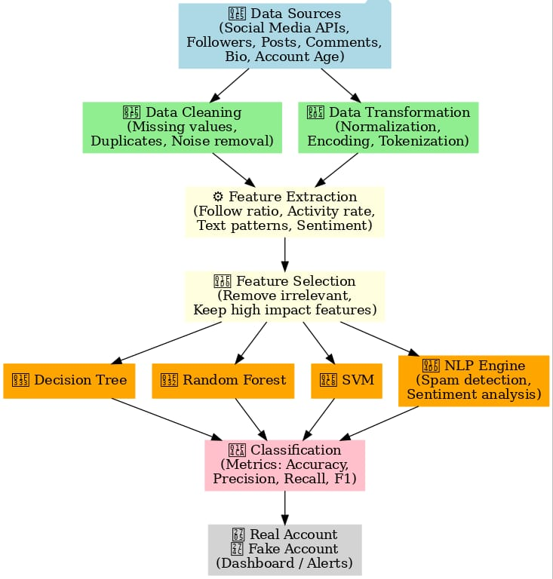
Proposed System – Functional architectural Diagram

Slide 10
Project Specification(Hardware/Software)
Hardware:
• 8GB RAM, i5 Processor
Software:
• Python 3.10, scikit-learn, pandas, NumPy
Dataset:
• Social media datasets (Twitter, Instagram, Facebook).

Slide 11
Expected Outcomes
1. A machine learning model capable of detecting fake accounts with accuracy >95%.
2. Performance metrics (precision, recall, F1-score) for Decision Tree and Random Forest.
3. A web-based tool for real-time detection of fake accounts.
4. Contribution to cybersecurity in social media.

Slide 12
REFERENCES
[1] Shu et al., Fake News Detection on Social Media: A Data Mining Perspective, 2017.
[2] Qureshi et al., COVID-19 Fake News Classification on Twitter, IEEE Access, 2021.
[3] Ghosh & Shah, Towards Automatic Fake News Classification, 2018.
[4] Liu & Wu, Early Detection of Fake News, AAAI, 2018.
[5] K.Bhargavi et al., Fake Social Media Accounts Detection using Machine Learning, IEEE ICPCSN 2025.

Slide 13
Queries

Slide 14
THANK YOU

