Slide 1

Problem Statement : Digital safety problem
Students increasingly encounter digital threats such as:
Phishing messages asking for passwords, OTPs or account verification
Online scams involving prizes, money or fake offers
Cyberbullying and harmful messages
Online harassment and threats
Privacy risks involving phone numbers, addresses, Aadhaar, date of birth and other personal information
Team Name:
ShieldX
Team Members:
Keerthana R(1DB24CS051)
Geetha R(1DB24CS035)

Slide 2
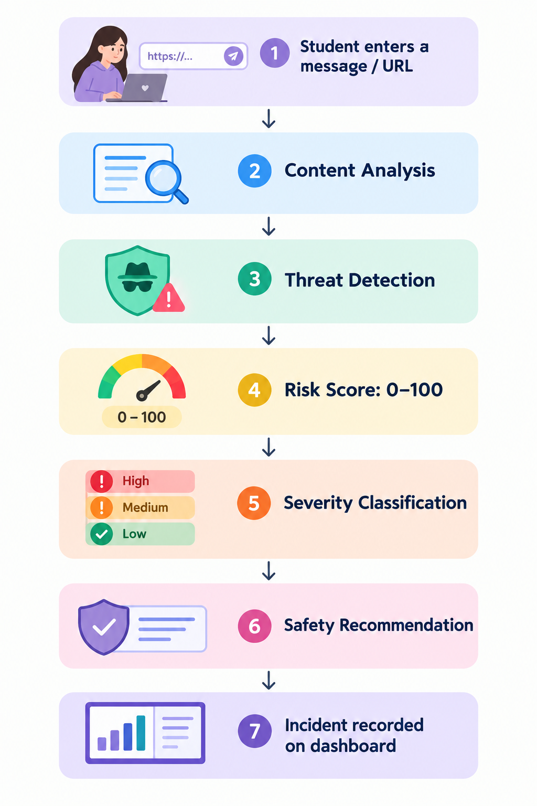
Introduction : Student Safety — Intelligent Digital Safety MVP
Problem Statement : Digital Safety problem
Proposed Solution:
Student Safety is a prototype designed to provide students with a simple way to identify potentially unsafe digital content. It is a digital safety platform that analyzes messages and URLs, detects potential threats, assigns a 0–100 risk score, and provides an appropriate safety recommendation.
How it works:
Threat Categories
🔴 Phishing
🟠 Scam
🟡 Cyberbullying
🔴 Harassment
🟠 Privacy Risk

Slide 3
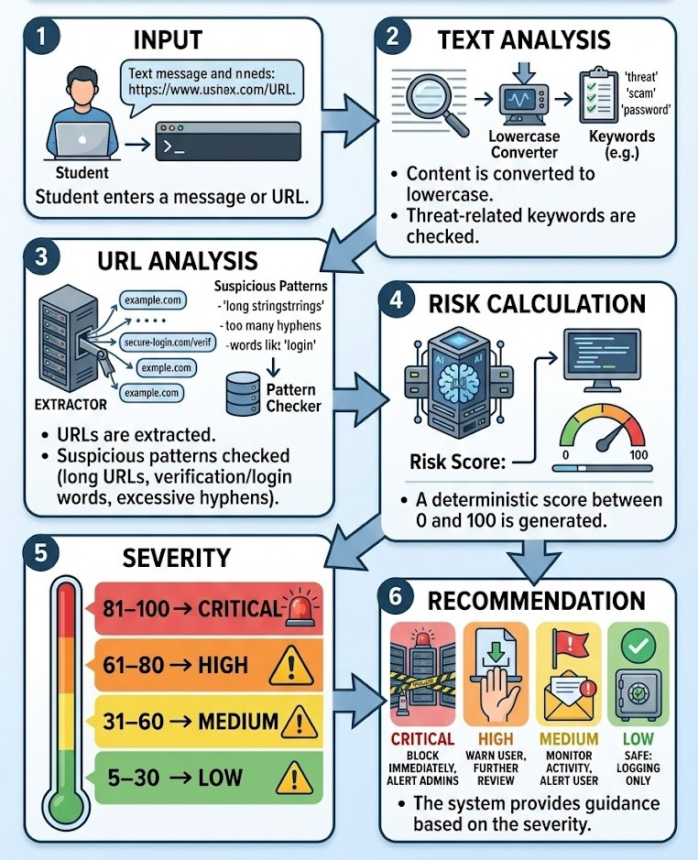
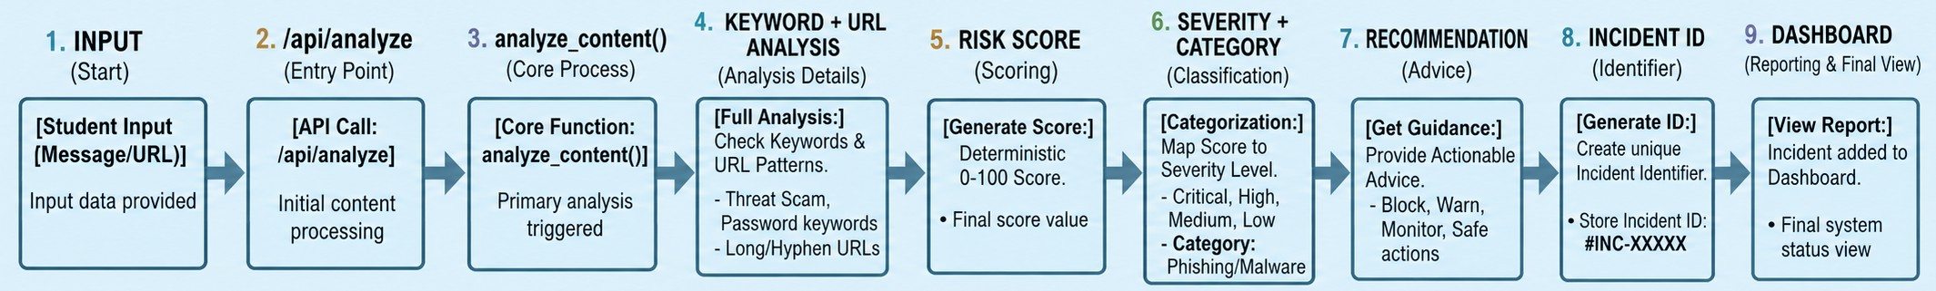
Methodology or Technical approach
Detection Process:
Technology Stack
Frontend
HTML/CSS/JavaScript interface
Backend
Python
Flask 3.1.2
Detection Engine
Rule-based keyword analysis
URL heuristic analysis
Deterministic risk scoring
Backend flow:

Slide 4
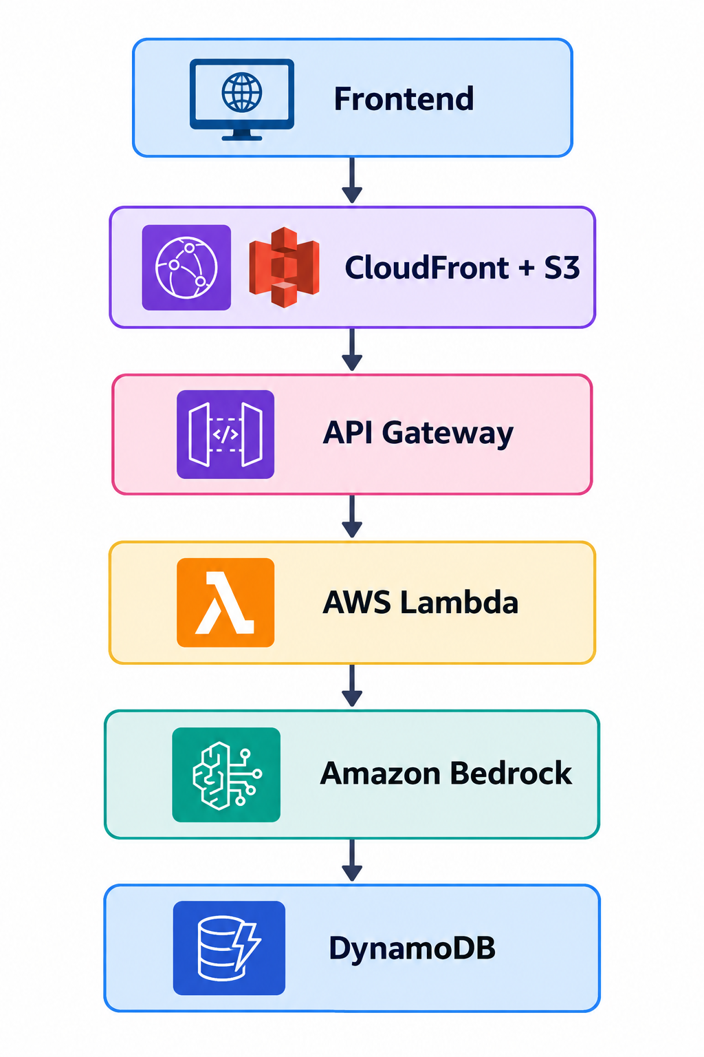
Feasibility and Viability
Technical Feasibility
✅ Built using Python + Flask
✅ Lightweight and easy to deploy
✅ REST API based architecture
✅ Rule-based detection works without requiring a trained ML model
✅ Prototype can run locally
Scalability / Future Cloud Architecture
Operational Feasibility
The platform can support:
Student-side threat checking
Incident recording
Admin monitoring
Incident status tracking
Safety recommendations

Slide 5
Benefits And Impact
Benefits for Students
🛡️ Early Threat Detection
Helps students recognize suspicious digital content.
📊 Risk Awareness
Provides a simple 0–100 risk score.
🚨 Severity Classification
Clearly identifies LOW, MEDIUM, HIGH and CRITICAL risks.
💡 Actionable Guidance
Provides recommendations instead of only identifying a threat.
🔐 Privacy Awareness
Detects indicators related to sensitive personal information.
Benefits for Institutes
Centralized incident monitoring
Incident tracking
High-risk incident identification
Resolution status tracking
Potential for future automated notifications
Expected Impact
Student → Safer Digital Decisions
School → Better Incident Visibility
Platform → Scalable Digital Safety Infrastructure

Slide 6
References
Flask Documentation
Python web framework used for the backend.
Python Documentation
Programming language used to implement the prototype.
AWS Documentation
Reference for the proposed cloud architecture including Lambda, API Gateway, DynamoDB, Cognito, S3/CloudFront, Bedrock and SNS.
Project README
SafeStudent — Intelligent Digital Safety MVP.
Project Source Code
app.py — detection logic, risk scoring, incident management and API endpoints.

