Slide 1

Smart LPG gas level monitoring system using load cell sensor
Team Member:
Keerthana.T
Mentor Name :
B.Maheshwari

Slide 2

Objective
The objective of the project is focused on the automation of LPG gas detection
To design and implement a robust system capable of accurately measuring the quantity of LPG gas within the tanks or containers.
Through the utilization of advanced technologies such as a load cell sensors and data processing algorithms.
The project aims to ensure precise monitoring of gas levels
The project to optimize the efficiency and reliability of Lpg gas level both residental and catering to both residental and industrial applications with a focus on enhancing safety and convenience.

Slide 3
Problem Statement
The problem statement : Develop a system to measure the LPG( liquefied petroleum gas) usage accurately , the system should provide real-time data on gas consumption , enabling users to monitor usage patterns and manage refills efficiently.

Slide 4
Proposed Solution
First , we can use a load cell sensor to measuring the amount of LPG gas level.
The LPG gas level can be detected to using the load cell sensor and HX 711 ,LCD display with 12c.
First we set the loadcell on LPG gas cylinder bottom and then the load cell sensor will be connected to the HX 711 arduino board and we have to do the coding for arduino board and they the HX 711 will be connect to LCD display with 12c and finally display the amount of gas level.
This is one of the best solution of detect the Gas level.

Slide 5
Literature Survey 1
Abstract:
The automation of Liquefied Petroleum Gas (LPG) gas level detection in home appliances presents a significant advancement in ensuring safety and efficiency in residential environments. This abstract outlines the key aspects and benefits of integrating smart technology for monitoring LPG gas levels within household appliances.Traditional methods of LPG gas level monitoring often rely on manual checks or rudimentary gauges, which can be cumbersome and prone to human error. Moreover, inaccurate readings or oversight in monitoring can lead to potentially hazardous situations such as gas leaks or depleted fuel supply, posing serious risks to inhabitants and property.The proposed solution leverages automation technology to streamline the process of monitoring LPG gas levels in home appliances. By integrating sensors and Microcontroller Aurdino connectivity, these appliances can continuously monitor gas levels in real-time. The data obtained from these sensors can be transmitted to a centralized control system or directly to users' smartphones, providing timely alerts and notifications regarding gas levels. This abstract underscores the significance of automation in LPG gas level detection within home appliances, emphasizing its role in enhancing safety, efficiency, and user experience in residential settings.

Slide 6
Literature Survey 2
Abstract:
Gas level measurement using a load cell sensor involves mounting the load cell beneath the gas container or integrating it into the support structure. The load cell detects the weight changes caused by variations in gas levels. After calibrating the load cell to ensure accuracy, baseline measurements are taken when the gas container is full. As the gas level changes, the load cell measures the corresponding weight difference, allowing for inference of the gas level. Data processing techniques are then applied to convert these weight measurements into meaningful gas level readings, which can be presented through various output methods for monitoring and control purposes.

Slide 7
Literature Survey 3
Measurements for components:
HEIGHTS IN MM | WEIGHT
LPG-CYLINDER - 648mm | 14.8kg to 29kg
LOADCELL SENSOR – 25mm | 30kg
HX 711 ARDUINO | 0.250mg
LCD DISPLAY WITH 12C – 74.2*25.2mm | 1.42 g

Slide 8
Summary of Literature Survey
Using load cell sensor to find the level of LPG gas is very easy way to identify the level:
Sensor Selection: Evaluate various sensor options suitable for measuring LPG gas levels, considering factors such as accuracy, reliability, and compatibility with the system.
System Design: Design the architecture of the automated gas level detection system, including sensor placement, data processing algorithms, and user interface layout.
Prototype Development: Develop a working prototype of the automated system, integrating selected sensors, implementing data processing algorithms, and creating a basic user interface for testing.
Testing and Optimization: Conduct rigorous testing of the prototype to ensure accuracy and reliability under various conditions. Optimize the system performance based on test results and user feedback.
Interface Development: Design and develop a user-friendly interface for monitoring and managing gas levels, incorporating features such as real-time data display, alerts for low levels, and historical data analysis.
Integration and Deployment: Integrate all components of the system into a cohesive unit and deploy it for field testing in real-world environments, gathering further feedback for refinement.

Slide 9
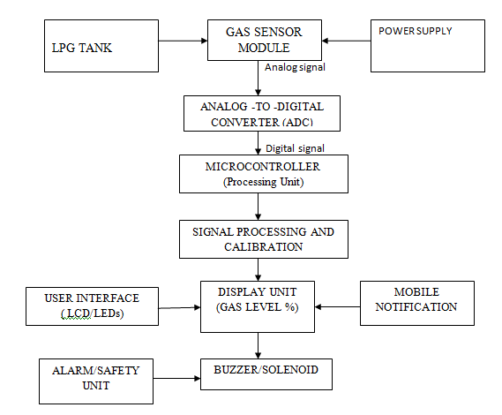
Block Diagram

Slide 10
Components requirement
Components:
1) load cell sensor
2) HX 711 arduino board
3) LCD display with 12 c ,display board

Slide 11
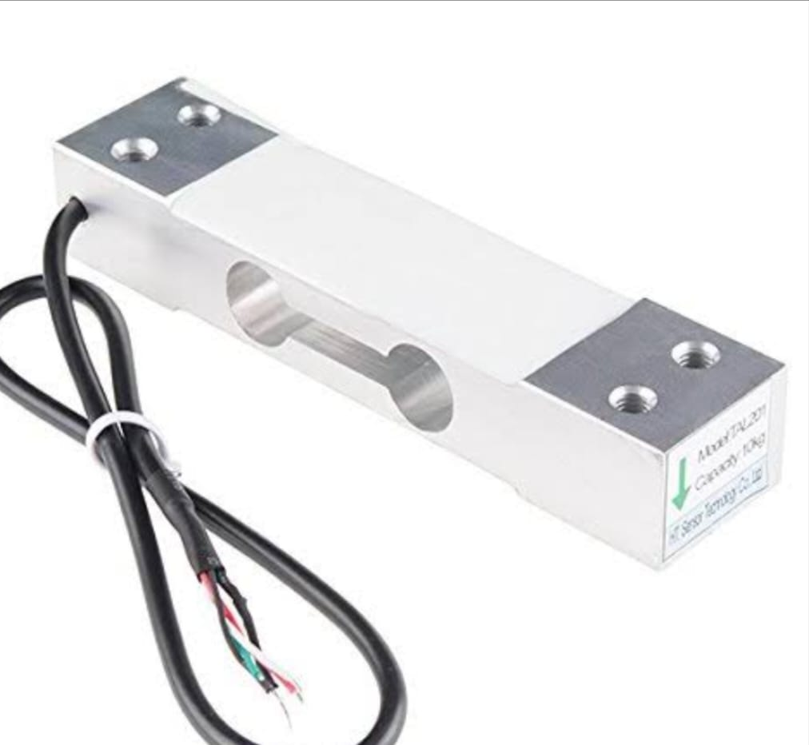
Components image & operation
Load cell sensor and it’s operation:
A load cell sensor is an electro-mechanical sensor used to measure the force (or) weight.it has a simple yet effective design which relies upon the well-known transference between an applied force , material deformation and the flow of electricity.

Slide 12
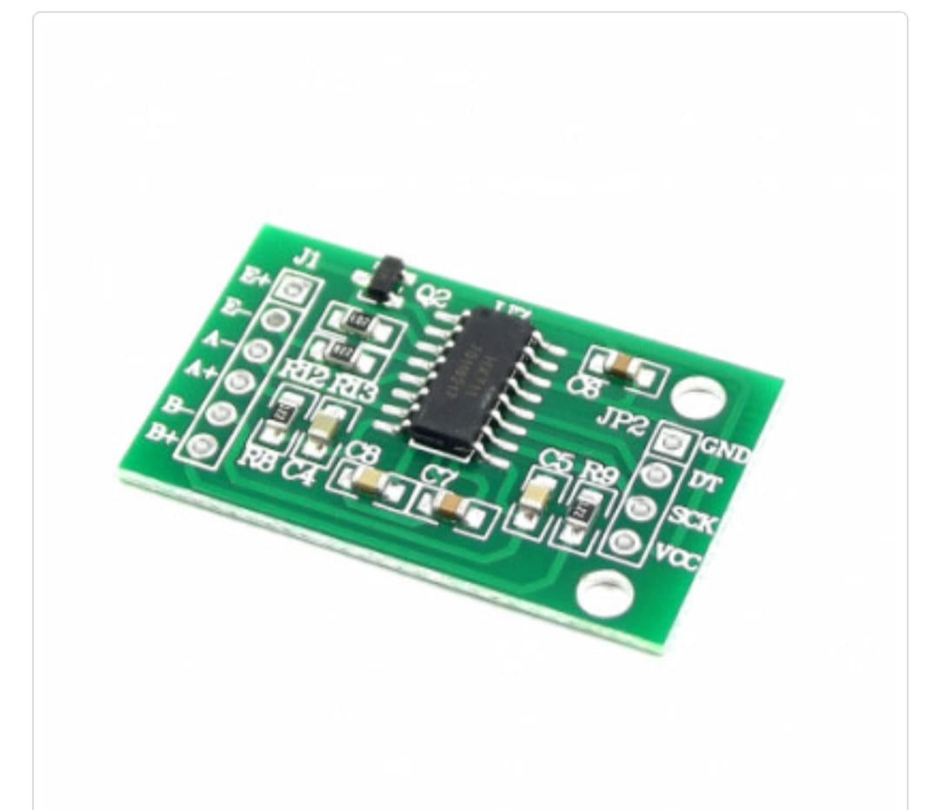
Components image & opertaion
HX 711 Arduino board:
Load cell which is an amplifier senses the weight and supplies an electrical analog voltage to HX 711 load amplifier module.then this amplified value is fed to the arduino where the output of HX 711 is converted into the weight values in grams.the output result is displayed on 16*2 LCD.

Slide 13
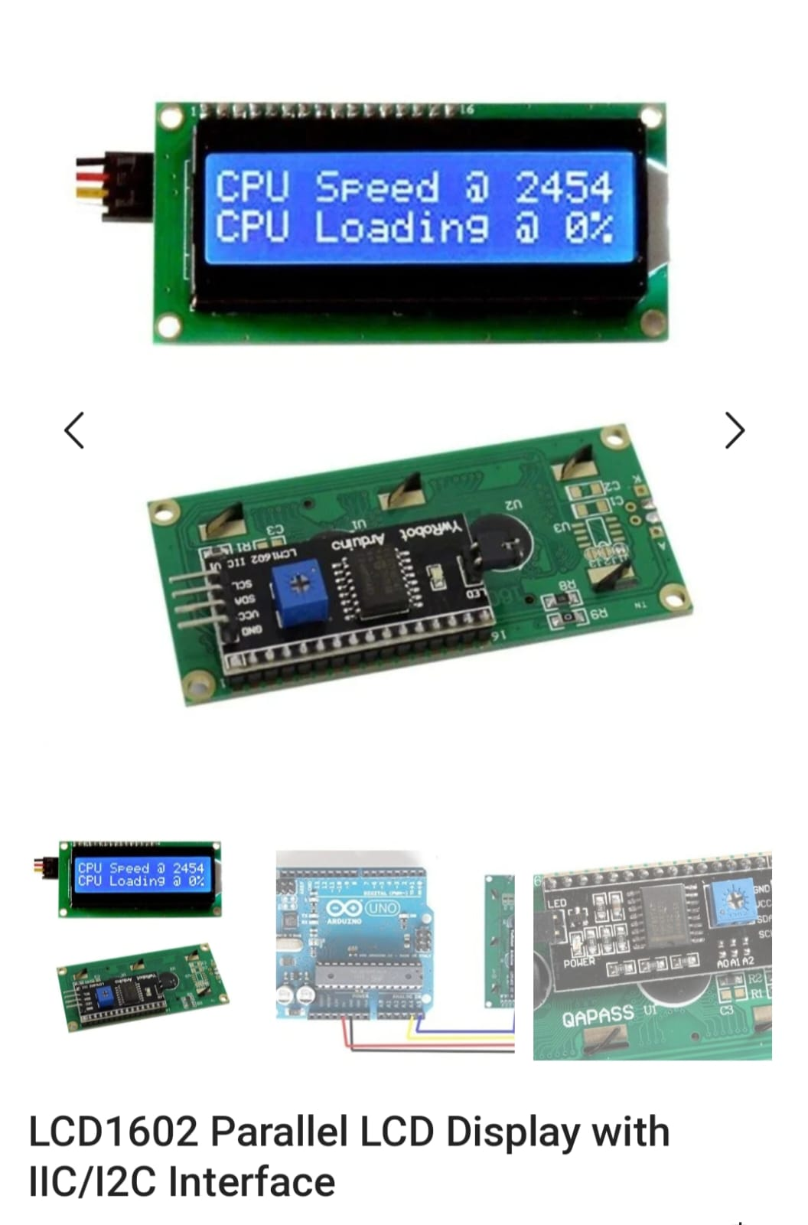
Components image & operation
LCD display with 12c :
The 12c LCD component drives an 12c interfaced 2 line by 16 character LCD.the 12c master component and makes use of an existing 12c master component.if a

Slide 14
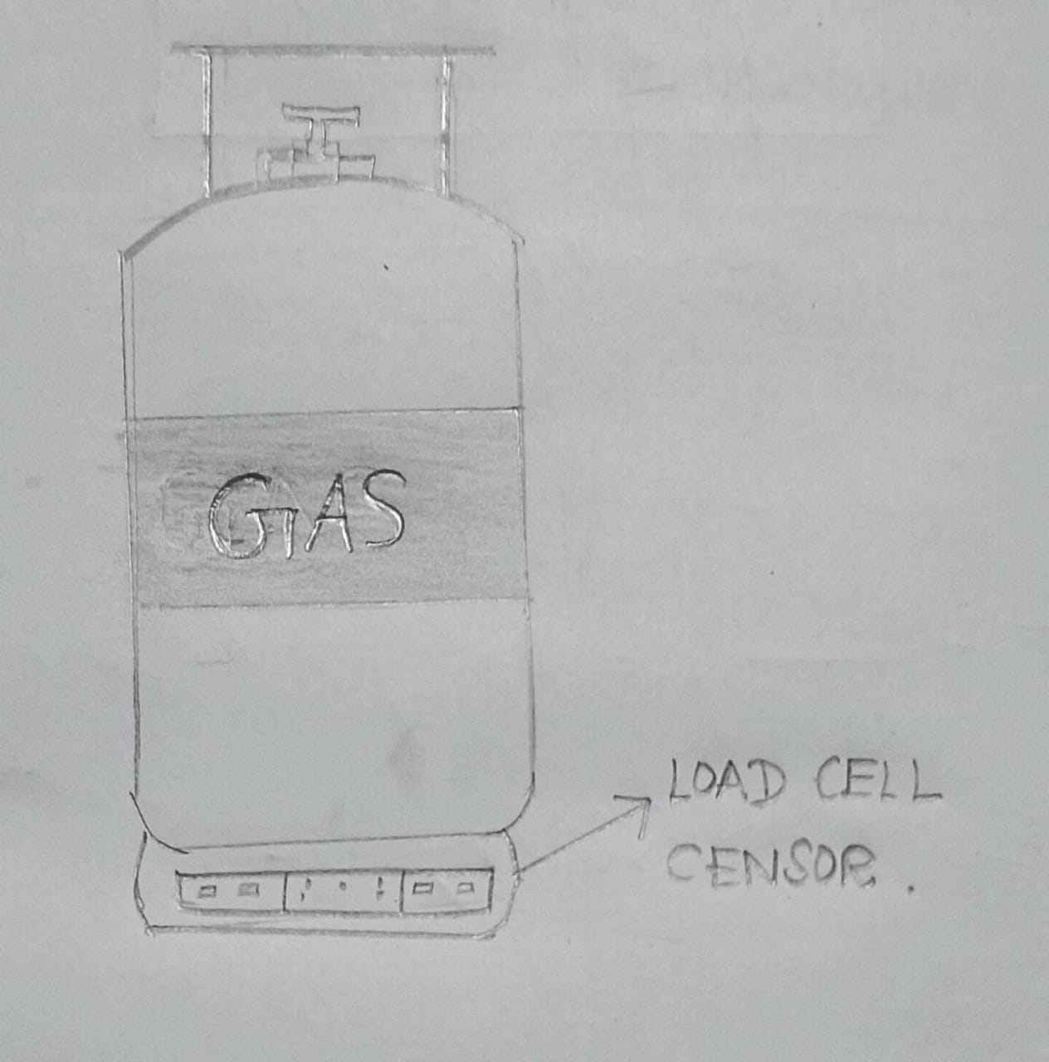
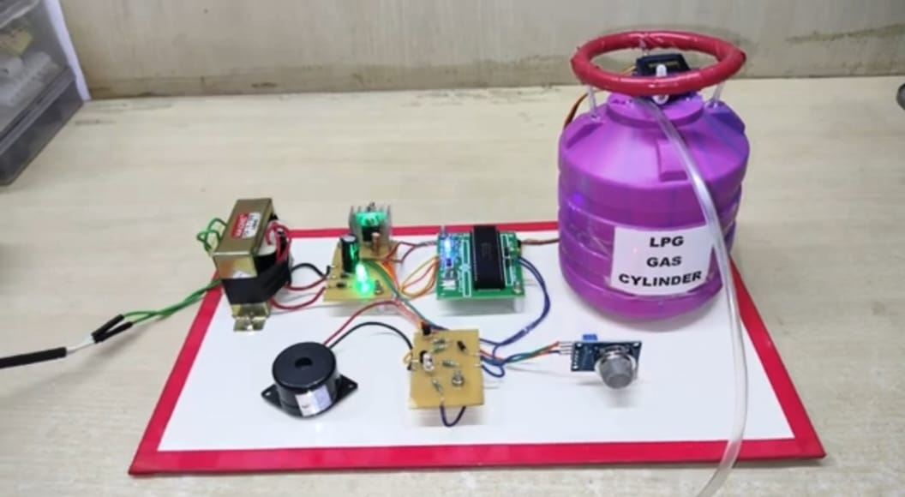
Product design / 3D view /Sketch

Slide 15
Reference
https://youtu.be/pWiS-oW3Snc?si=_B_m3IR897jLreXL

Slide 16
Thank You

