Slide 1
Sensors

Slide 2
Gamma Radiation Sensor
Exposure to nuclear radiations is extremely harmful to human and animal life. Three main types of nuclear radiations are alpha, beta, and gamma. Gamma radiation is dangerous to human life causing cellular destruction and subsequently leading to DNA damage, cancer, and radiation sickness if exposed in excess. Gamma radiation detector forms the heart of a radiation monitoring system and hence, deployment of such detectors in the vicinity of nuclear power plants is vital.

Slide 3


Slide 4
Body temperature sensor
The MAX30205 temperature sensor accurately measures temperature and provide an overtemperature alarm/ interrupt/shutdown output. This device converts the temperature measurements to digital form using a highresolution, sigma-delta, analog-to-digital converter (ADC). Accuracy meets clinical thermometry specification of the ASTM E1112 when soldered on the final PCB. Communication is through an I2C-compatible, 2-wire serial interface.

Slide 5
Benefits and Features
High Accuracy and Low-Voltage Operation Aids Designers in Meeting Error and Power Budgets
• 0.1°C Accuracy (37°C to 39°C)
• 16-Bit (0.00390625°C) Temperature Resolution
• 2.7V to 3.3V Supply Voltage Range
● One-Shot and Shutdown Modes Help Reduce Power Usage
● 600μA (typ) Operating Supply Current
● Digital Functions Make Integration Easier into Any System • Selectable Timeout Prevents Bus Lockup • Separate Open-Drain OS Output Operates as Interrupt or Comparator/Thermostat Output

Slide 6
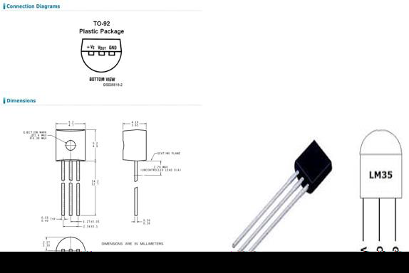
Technical Specifications
Calibrated directly in Celsius (Centigrade)
Linear + 10-mV/°C scale factor
0.5°C ensured accuracy (at 25°C)
Rated for full −55°C to 150°C range
Suitable for remote applications

Slide 7
Pulse Rate Sensor
The heartbeat sensor is based on the principle of photoplethysmography. It measures the change in volume of blood through any organ of the body which causes a change in the light intensity through that organ (avascular region). In the case of applications where the heart pulse rate is to be monitored, the timing of the pulses is more important. The flow of blood volume is decided by the rate of heart pulses and since light is absorbed by the blood, the signal pulses are equivalent to the heartbeat pulses.
There are two types of photoplethysmography:
Transmission: Light emitted from the light-emitting device is transmitted through any vascular region of the body like earlobe and received by the detector.
Reflection: Light emitted from the light-emitting device is reflected by the regions.

Slide 8
Working of a Pulse rate sensor
The basic heartbeat sensor consists of a light-emitting diode and a detector like a light detecting resistor or a photodiode. The heartbeat pulses cause a variation in the flow of blood to different regions of the body. When tissue is illuminated with the light source, i.e. light emitted by the led, it either reflects (a finger tissue) or transmits the light (earlobe). Some of the light is absorbed by the blood and the transmitted or the reflected light is received by the light detector. The amount of light absorbed depends on the blood volume in that tissue. The detector output is in the form of the electrical signal and is proportional to the heartbeat rate.
This signal is a DC signal relating to the tissues and the blood volume and the AC component synchronous with the heartbeat and caused by pulsatile changes in arterial blood volume is superimposed on the DC signal. Thus the major requirement is to isolate that AC component as it is of prime importance.

Slide 9
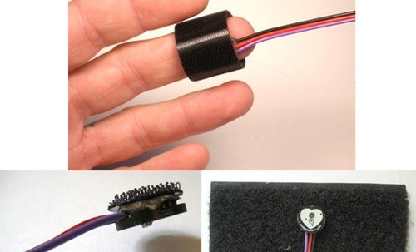
Pulse rate sensor

Slide 10
GSR Sensor
GSR stands for galvanic skin response, is a method of measuring the electrical conductance of the skin. Strong emotion can cause stimulus to your sympathetic nervous system, resulting more sweat being secreted by the sweat glands. Grove - GSR allows you to spot such strong emotions by simple attaching two electrodes to two fingers on one hand. It is an interesting to create emotion related projects like sleep quality monitor.

Slide 11
