Slide 1
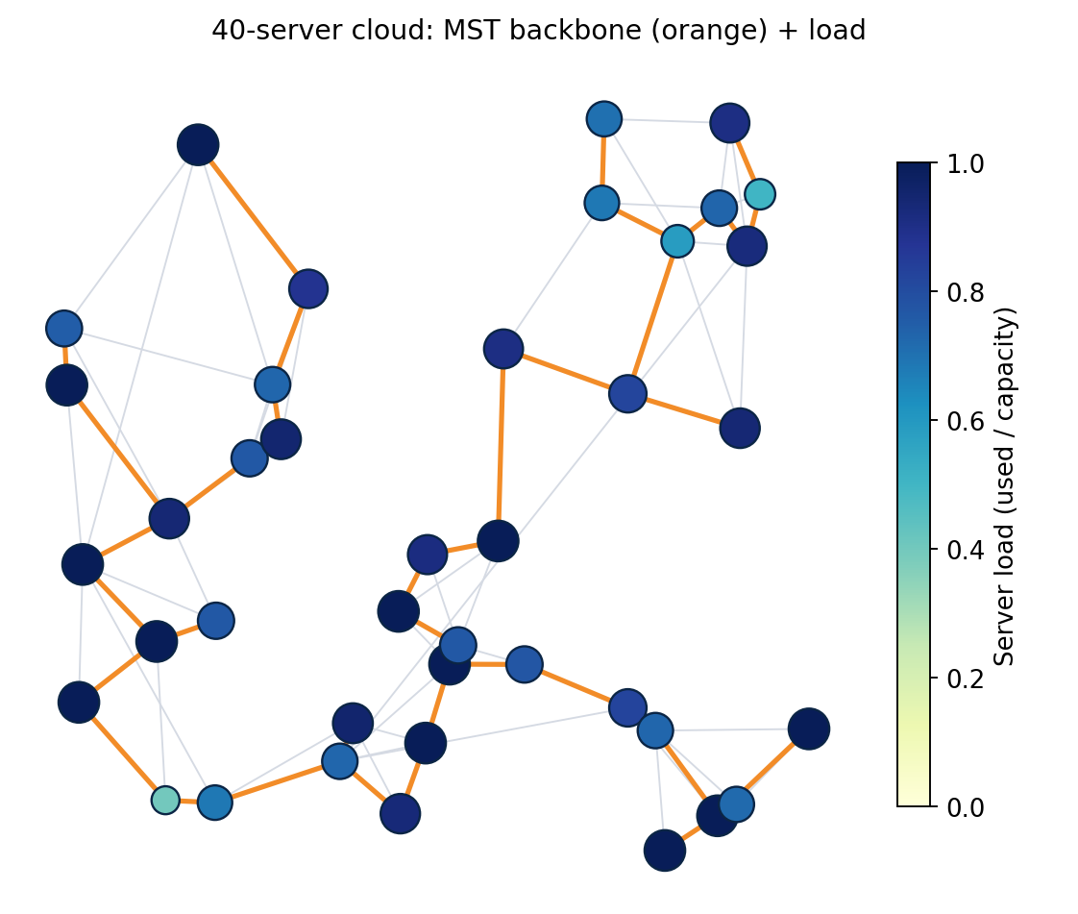
Cloud Task Placement
Latency-aware VM placement using graphs, greedy algorithms and dynamic programming
Design and Analysis of Algorithms | Internal Project
Team
1. Andrew Devasani | 25WU0102067
2. Sathyanarayana Varma | 25WU0102088
3. G. Daiwik Reddy | 25WU0102340
4. G. Keerthan Chowdary | 25WU0102076
B.Tech CSE (2025-2029), Woxsen University
40 servers: MST backbone in orange, darker = fuller
Notes:
Introduce the project: place tasks/VMs on servers so that high-value tasks get low latency without exceeding capacity. Picture shows the synthetic 40-server network used in the demo.

Slide 2
Problem statement
The problem
A cloud has servers connected by links with latencies. Each task needs some capacity, earns a value, and has users at a particular node. Decide which tasks to run and where, so total value minus latency cost is maximised and no server is overloaded.
Why it matters
Poor placement means slow responses and wasted servers. Exact solutions do not scale (the problem is NP-hard), so good heuristics matter.
Match algorithms to subproblems
1
MST for the backbone, shortest paths for latency, greedy and DP for placement
Respect real constraints
2
Server capacities and a latency penalty shape every placement
Measure the trade-offs
3
Time bounds, measured runtime and quality against the exact optimum
Notes:
Frame the problem in one sentence: choose which tasks run where so valuable tasks get low latency within capacity. It is a generalised assignment problem, so NP-hard; we use structure-aware heuristics.

Slide 3
Background: algorithms used
Source | Contribution | Used for
Kruskal (1956) | Greedy MST by sorted edges + union-find | Backbone network
Prim (1957) | Grow an MST from one node | Cross-check of Kruskal
Dijkstra (1959) | Shortest paths, non-negative weights | Server-to-server latency
Floyd (1962), Warshall (1962) | All-pairs shortest paths by DP, O(V^3) | Dense-network latency matrix
Johnson (1977) | APSP for sparse graphs via reweighting | Sparse-network latency matrix
Martello and Toth (1990) | Knapsack problems: DP and bounds | Per-server task selection
Cormen et al., CLRS | Textbook proofs and complexity | Correctness arguments
Gap addressed: the textbook algorithms are usually taught separately; this project combines them in one placement pipeline and measures the trade-offs.
Notes:
These are the foundational algorithm papers and textbooks the project builds on. Add two or three cloud-placement papers you have actually read before presenting.

Slide 4
Software requirements (SRS)
Functional requirements
Non-functional requirements
FR1 Generate or load a server network and workload
FR2 Build an MST backbone (Kruskal, Prim)
FR3 Compute latency matrix (Dijkstra, Floyd-Warshall, Johnson)
FR4 Place tasks within capacity (Greedy + DP)
FR5 Compare with baselines and the exact optimum
Correct: tests cross-check every algorithm
Fast: placement of 600 tasks on 80 servers in well under a second
Reproducible: seeded synthetic data
Modular: one file per algorithm family
Python only, matplotlib for charts
Input: Topology (nodes, link latencies), server capacities, task demand, value and origin
Output: Task-to-server plan, utility, average latency, charts and policy tables
Notes:
Functional requirements say what the system does; non-functional say how well. Input and output boxes show the data flow.

Slide 5
Dataset and model
Network (synthetic)
Workload
Servers get random positions on a plane
Latency = 1 ms + distance x 40 ms + 0-2 ms jitter
Each server links to its nearest earlier server, so the network is connected
Extra nearest-neighbour links set the density
Task demand: 1 to 10 capacity units
Task value: 5 to 60
Users of each task sit at a random server
Server capacity varies 0.6x to 1.4x of the average
Load = total demand / total capacity
utility(t, s) = value(t) - lambda * latency(origin(t), s)
Notes:
All data is synthetic and seeded, so every result can be reproduced exactly.

Slide 6
System design
1
2
3
4
5
Topology and workload
MST backbone
Latency matrix
Placement
Policy and charts
Synthetic graph, adjacency lists
Kruskal / Prim
Dijkstra, Floyd-Warshall or Johnson
Greedy proposals + knapsack DP
Plans, cost tables, plots
Utility of placing task t on server s
utility(t, s) = value(t) - lambda * latency(origin(t), s)
lambda = 1; a task is placed only if its utility is positive
Notes:
Five stages. The MST is for the cheap backbone; shortest paths give the latency matrix; the placement stage uses the matrix plus capacities.

Slide 7
Backbone design with an MST
Kruskal
Prim
74%
fewer links than the full network, with only V-1 links kept
Sort all links by latency
Add a link if it joins two separate groups (union-find)
Time O(E log E)
Grow the tree from one server
Always add the cheapest link leaving the tree (binary heap)
Time O(E log V)
Use: a cheap backbone for replication and control traffic. It is not used for user latency, because routes on a tree are longer (see policy).
Notes:
Kruskal and Prim always returned the same total weight in the tests, which is a built-in correctness check.

Slide 8
Algorithm choices and complexity
Subproblem | Algorithm | Time | Why
Backbone | Kruskal / Prim | O(E log E) / O(E log V) | Two methods agree: built-in check
Latency, one source | Dijkstra | O((V+E) log V) | Latencies are non-negative
Credits / penalties | Bellman-Ford | O(VE) | Negative edges, detects cycles
All pairs, dense | Floyd-Warshall | O(V^3) | Simple, wins near complete graphs
All pairs, sparse | Johnson | O(VE + V^2 log V) | Reweighting, then Dijkstra
Value upper bound | Fractional knapsack | O(n log n) | Greedy is optimal when divisible
Per-server selection | 0-1 knapsack DP | O(nC) | Exact, items are indivisible
Deadline batch jobs | Job sequencing | O(n^2) | Greedy by profit, exchange argument
Notes:
Every subproblem has a named algorithm with a reason. n is the number of items, C the capacity, V servers, E links.

Slide 9
Placement algorithm and correctness
Proposal rounds
Why it is correct
1
Each pending task proposes to its best server (highest positive utility, not banned)
Feasible: a server accepts only a knapsack subset that fits its remaining capacity, so capacity is never exceeded (checked in code)
Terminates: every rejection bans one server for that task, so at most V rounds
Locally optimal: DP is exact for each server's proposals
Not globally optimal: the problem is a generalised assignment problem (NP-hard), so we compare with an exact solver
2
Each server runs 0-1 knapsack DP over its proposals, with its remaining capacity
3
Chosen tasks are placed; the rest ban that server
4
Repeat until nothing is pending
Notes:
Walk through one round. Stress that the whole problem is NP-hard so we measured against the exact MILP optimum rather than claiming optimality.

Slide 10
Implementation and prototype
✓
graph.py
Adjacency-list graph, topology and workload generators
✓
mst.py
Kruskal with union-find, Prim with binary heap
✓
shortest.py
Dijkstra, Bellman-Ford, Floyd-Warshall, Johnson
✓
greedy.py / dp.py
Fractional knapsack, job sequencing, 0-1 knapsack
✓
placement.py
Greedy+DP, baselines, exact MILP, metrics
406 lines of source 7/7 tests pass
Demo: 120 tasks on 40 servers, 87.5% placed, 1.72 ms average latency
Notes:
Show the repo structure. All 7 tests pass; run_experiments.py regenerates every chart and number in this deck.

Slide 11
Experiment setup
Runtime vs size
25 to 200 servers, five graph algorithms timed
Sparse vs dense
120 servers, 191 to 3427 links, Floyd-Warshall vs Johnson
1
2
Quality vs optimum
10 servers, 16 tasks, 12 instances, exact MILP as yardstick
Behaviour under load
60 servers, 250 tasks, load 0.4 to 1.5, 4 seeds averaged
3
4
Metrics: total utility, % of tasks placed, average latency, capacity used, runtime. Baselines: nearest-first (by value) and random placement.
Notes:
Four experiments, each averaged over several seeds where noted. Baselines are nearest-first and random.

Slide 12
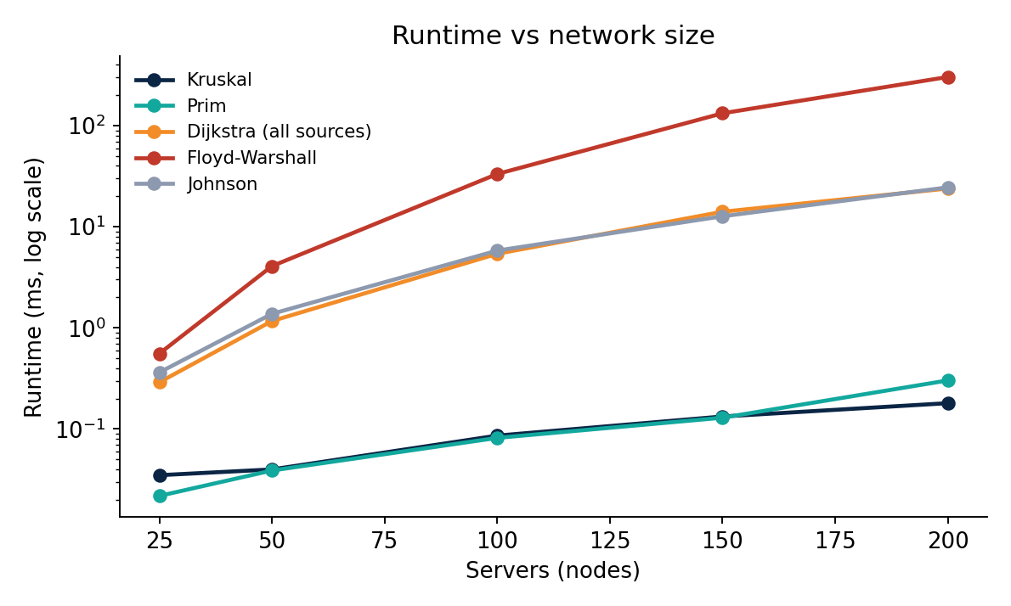
Results: algorithm runtime
12x
Johnson vs Floyd-Warshall at 200 servers (about 25 ms vs 303 ms)
< 0.4 ms
Kruskal and Prim at 200 servers
Single run per size on one machine, so treat small differences as noise.
Notes:
Johnson is about 12 times faster than Floyd-Warshall at 200 servers on this sparse topology. Kruskal and Prim stay under a millisecond.

Slide 13
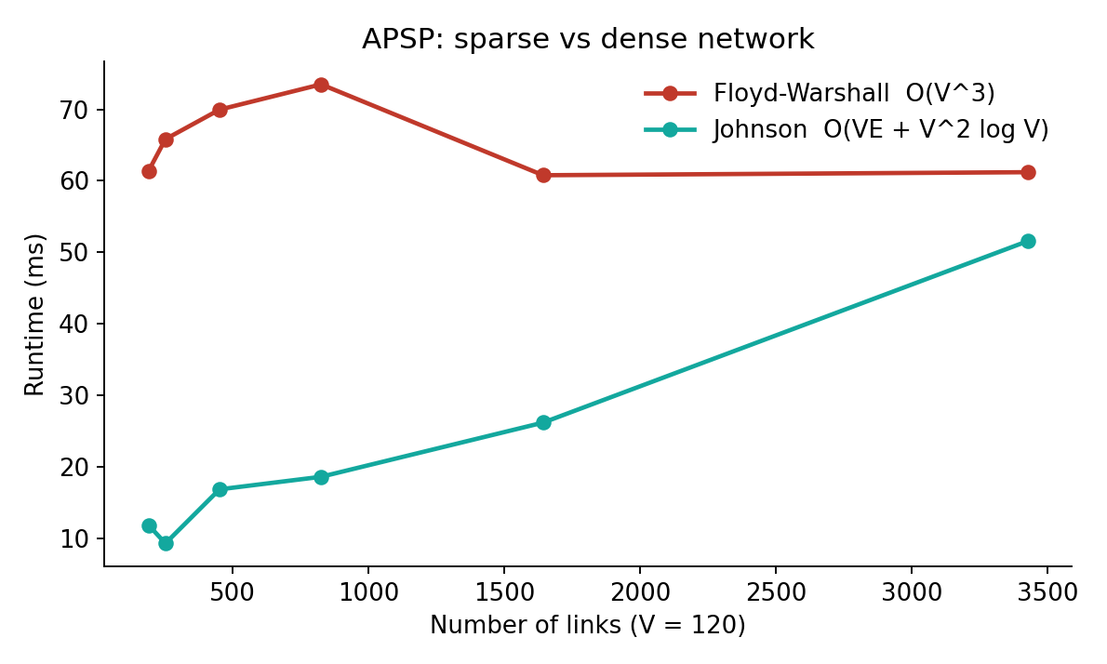
Results: sparse vs dense networks
What we saw
191 links: Johnson about 5x faster
3427 links: about 1.2x faster
Floyd-Warshall stays roughly constant, as O(V^3) predicts
Rule: sparse network, use Johnson
Notes:
At 120 servers Johnson stayed ahead everywhere we tested, but the lead shrank as links were added. Theory says Floyd-Warshall wins only near complete graphs, which we did not reach.

Slide 14
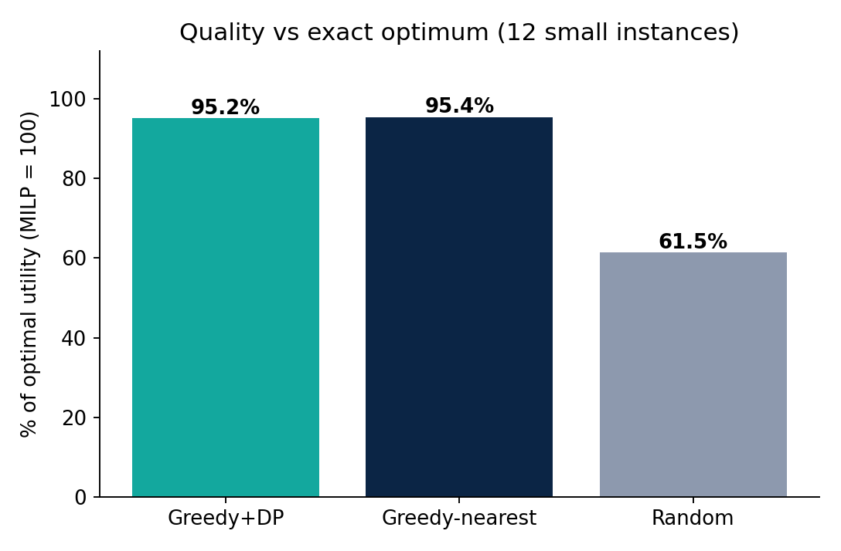
Results: solution quality
Reading the chart
Optimum from an exact MILP solver (10 servers, 16 tasks)
Greedy+DP: 95.2% (worst case 90.9%)
Nearest-first: 95.4% (worst case 88.0%)
Random: 61.5%
Notes:
On 12 small instances Greedy+DP and nearest-first both reach about 95 percent of optimal. We report that honestly: the DP advantage shows up under load, next slide.

Slide 15
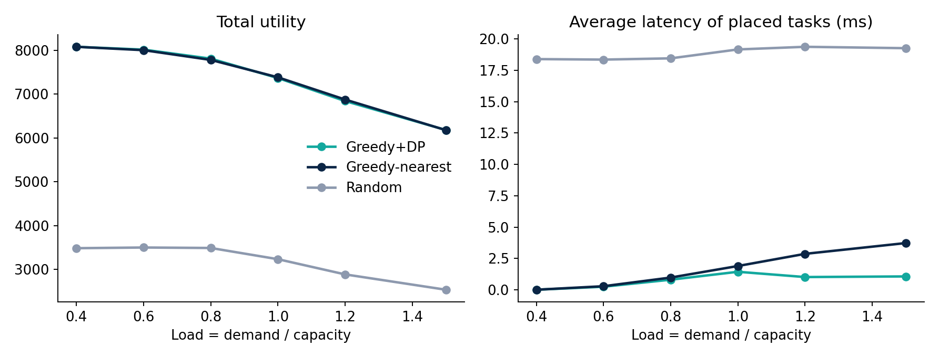
Results: behaviour under load
At load 1.5: Greedy+DP averages 1.07 ms vs 3.73 ms for nearest-first, placing 70.6% vs 67.9% of tasks, with the same utility (6182 vs 6179).
Notes:
Utility is almost identical, but Greedy+DP keeps latency about 3.5 times lower at load 1.5 and places slightly more tasks.

Slide 16
Policy recommendations
Servers | Links (full) | Links (MST) | Link cost cut | Latency stretch
30 | 109 | 29 | 83.6% | 1.76x
60 | 228 | 59 | 82.6% | 2.42x
100 | 371 | 99 | 81.9% | 2.68x
Backbone: Use the MST for replication and control traffic; route user traffic on shortest paths.
Latency matrix: Use Johnson on sparse networks, Floyd-Warshall only when links approach V^2.
Placement: Use Greedy+DP once load passes 1.0: same utility, far lower latency.
Capacity: Utility fell from 8080 to 6182 as load rose from 0.4 to 1.5: keep headroom.
Notes:
The MST saves about 74 percent of links and over 80 percent of link cost, but stretches latency 1.8 to 2.7 times, so it should carry background traffic, not latency-critical traffic.

Slide 17
Conclusion and future work
Findings
Limitations
Future work
Pipeline of MST, shortest paths, greedy and DP solves placement end to end
About 95% of optimal on small cases
Best at keeping latency low under load
Synthetic topology and workload
One resource type per task
Static workload, no arrivals
Heuristic, not provably optimal
Multi-resource (CPU, memory) demands
Real network traces
Online arrivals and migration
Replica placement
Bottom line: each textbook algorithm has a clear role, and measuring them showed where each one wins and where it does not.
Notes:
Be upfront about limitations: synthetic data, one resource type, static workload, heuristic.

