Slide 1
REVIEW 3 | FINAL DEMONSTRATION
Vehicle Service Centre
Management System
AutoCore VSC Website, Final Demonstration, Report & Viva-Voce (Project 10)
G. Keerthan Chowdary | 25WU0102076

Slide 2
Review 3 Deliverables
1
2
3
4
AutoCore VSC Website
Final Demonstration
Project Report
Viva-Voce
Web interface for the Vehicle Service Centre database: dashboard, customers, vehicles, bookings, job cards, inventory and billing.
Walkthrough of the website pages, from the dashboard to billing, on the project sample data.
Problem, ER and relational design, DDL, queries, implementation, results and conclusion.
Questions on normalization, constraints, triggers, SQL and the working website.

Slide 3
Project Journey: Review 1 to Review 3
1
2
3
Review 1
Review 2
Review 3
Design
Database + Terminal Prototype
Website
Problem statement, ER model, relational schema and 3NF mapping
3NF tables, DDL with constraints, sample data, SQL queries and a Python terminal prototype built in VS Code
AutoCore VSC web interface, final demonstration, report and viva-voce

Slide 4
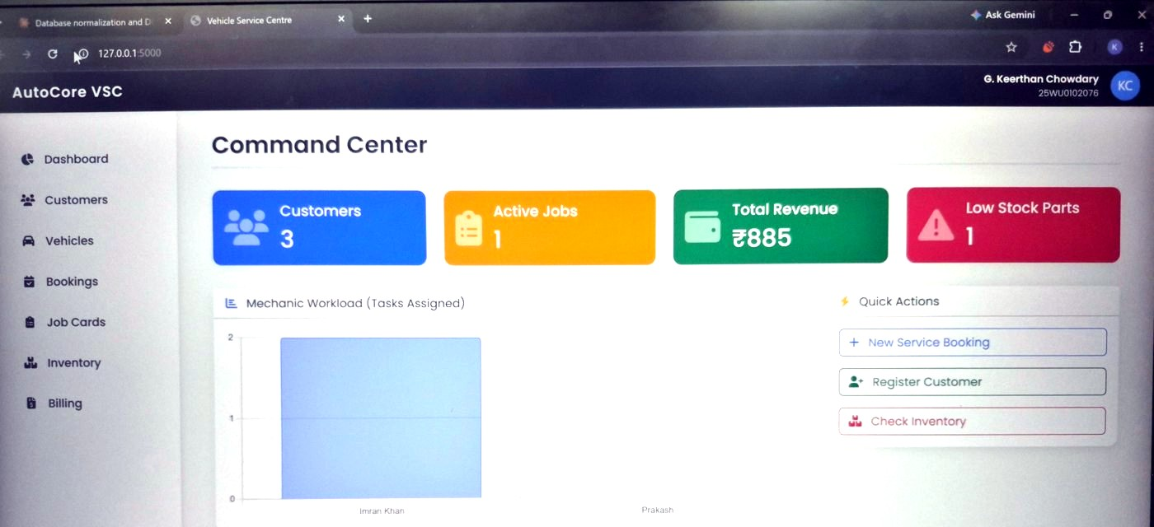
AutoCore VSC: The Website
AutoCore VSC
Web interface for the Vehicle Service Centre database, opened in a browser.
Where it runs
Locally at 127.0.0.1:5000 and shared online through the public link on the next line.
Seven pages
Dashboard, Customers, Vehicles, Bookings, Job Cards, Inventory, Billing.
https://89cfa03d00e924.lhr.life/

Slide 5
Dashboard: Command Center
Live summary
Four cards: Customers 3, Active Jobs 1, Total Revenue Rs. 885 and Low Stock Parts 1.
Mechanic workload
Bar chart of tasks assigned to each mechanic (Imran Khan, Prakash).
Quick actions
New Service Booking, Register Customer and Check Inventory in one click.
Screenshot of the AutoCore VSC website running at 127.0.0.1:5000

Slide 6
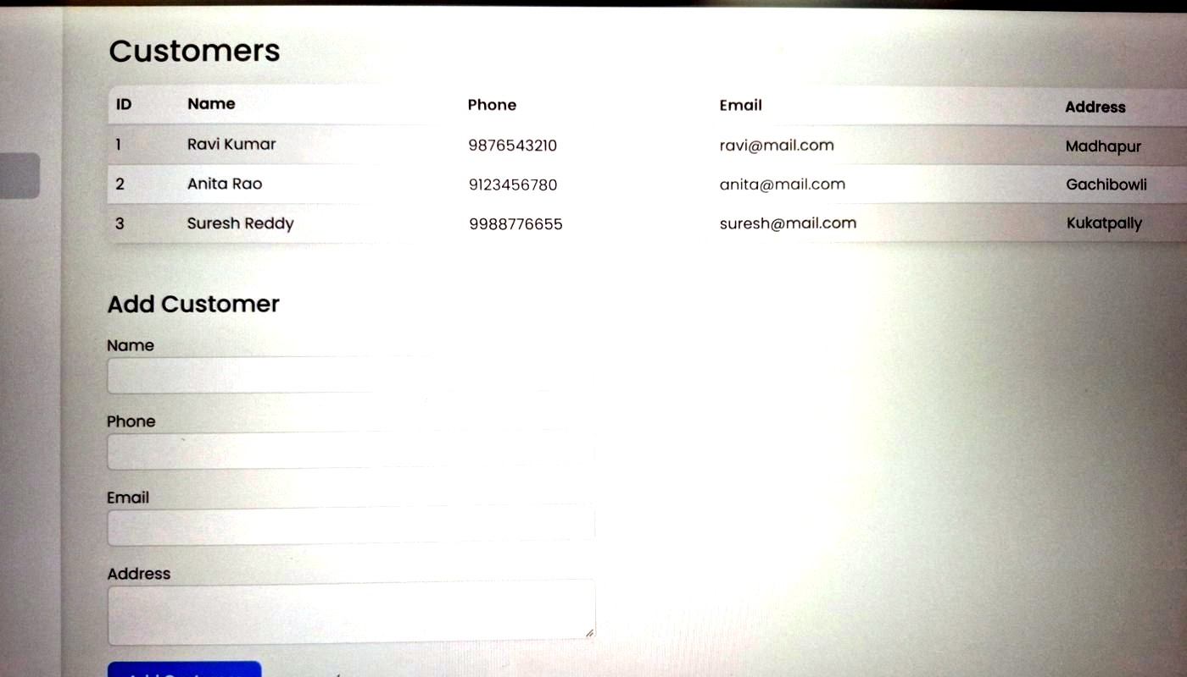
Customers Page
Customer list
ID, name, phone, email and address of every registered customer.
Add Customer form
Name, phone, email and address saved to the database with one button.
Screenshot of the AutoCore VSC website running at 127.0.0.1:5000

Slide 7
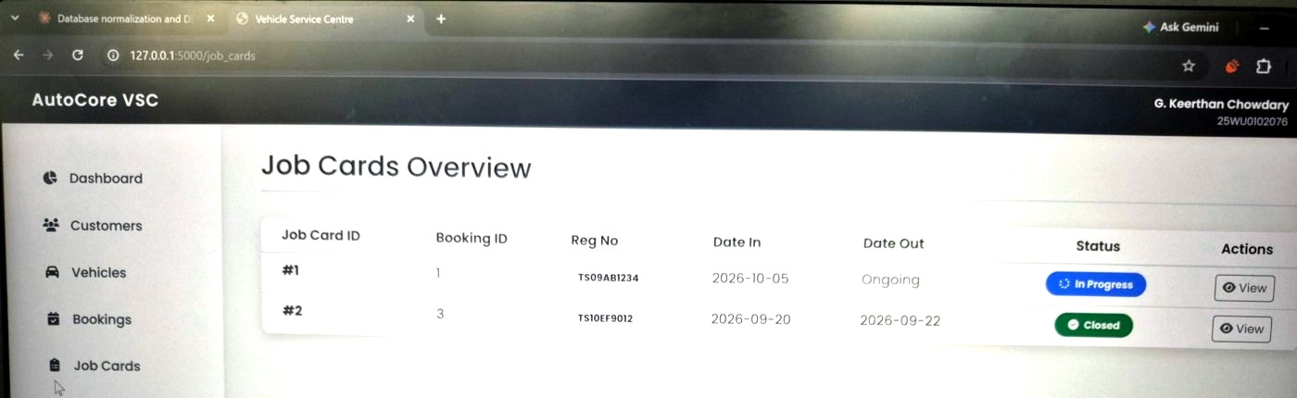
Job Cards Overview
Job card table
Job card ID, booking ID, registration number, date in and date out.
Status badges
In Progress for the open job (date out shows Ongoing) and Closed for the finished one.
View action
Each row has a View button to open the job card details.
Screenshot of the AutoCore VSC website running at 127.0.0.1:5000

Slide 8
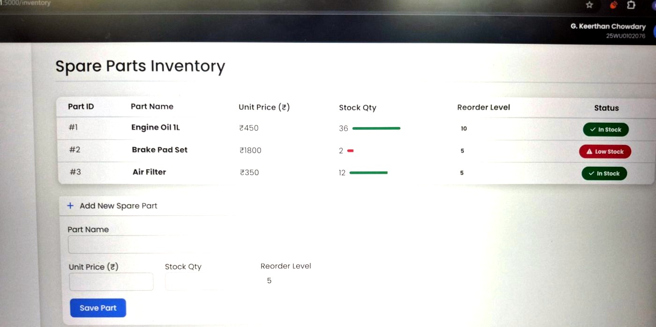
Spare Parts Inventory
Stock at a glance
Part, unit price in Rs., stock quantity with a level bar, and the reorder level.
Low-stock warning
Brake Pad Set shows Low Stock (2 left, reorder level 5); the others show In Stock.
Add New Spare Part
Form for part name, unit price, stock quantity and reorder level (default 5).
Screenshot of the AutoCore VSC website running at 127.0.0.1:5000

Slide 9
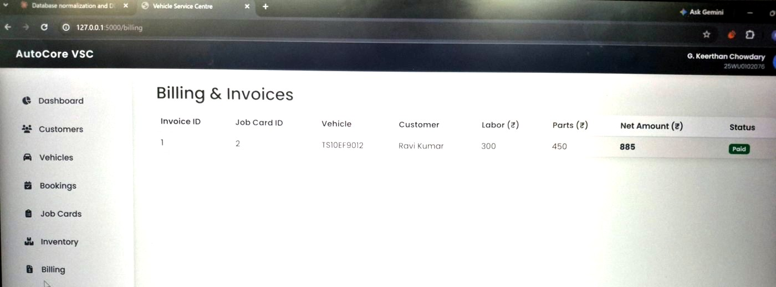
Billing & Invoices
Invoice details
Invoice, job card, vehicle, customer, labor, parts and net amount.
Sample invoice
Invoice 1 for job card 2: labor Rs. 300 + parts Rs. 450 + 18% GST = Rs. 885.
Payment status
Shown as a Paid badge; this amount feeds the dashboard revenue.
Screenshot of the AutoCore VSC website running at 127.0.0.1:5000

Slide 10
Using the Website: End-to-End Workflow
Customers
Vehicles
Bookings
Job Cards
Inventory
Billing
Dashboard
Register customer
Add vehicle
Book a slot
Open and track job
Check and issue parts
Invoice and payment
Revenue and workload
Sidebar navigation
Every step is one click away in the left sidebar, so a service advisor can follow a vehicle from booking to invoice.
Sample scenario
Customer Ravi Kumar, vehicles TS09AB1234 and TS10EF9012, job cards 1 and 2, invoice paid at Rs. 885.

Slide 11
Architecture: Website and Review 2 Prototype
Users
AutoCore VSC website
Database
Service Advisor
Service Mechanic
Inventory Controller
Workshop Manager
Review 3
Browser interface, 7 pages
10 tables in 3NF
Keys and CHECK constraints
3 triggers
Design from Review 2
Terminal prototype
Review 2 (VS Code)
Python menu application

Slide 12
Business Rules Enforced by the Database
10
Tables in 3NF
3
Triggers
4
Constraint types: PK/FK, UNIQUE, CHECK, NOT NULL
trg_no_overlap
Before an Assignment insert, rejects a mechanic booked in an overlapping time slot.
trg_check_stock
Before a Part_Usage insert, aborts with "Insufficient stock" if quantity exceeds stock.
trg_deduct_stock
After a Part_Usage insert, reduces Spare_Part.StockQty by the quantity issued.
Rules live in the database, so every route into the data obeys them.

Slide 13
Testing & Results
# | TEST CASE | EXPECTED BEHAVIOUR | RESULT
1 | Duplicate booking, same vehicle and slot | Rejected by UNIQUE constraint | PASS
2 | Overlapping task for the same mechanic | Blocked by trg_no_overlap | PASS
3 | Issue 5 brake pad sets (stock is 3) | Blocked by trg_check_stock | PASS
4 | Issue 1 brake pad set | Allowed, stock falls from 3 to 2 | PASS
5 | Invoice for job card 1 | (1100 + 3600) x 1.18 = 5546.00 | PASS
6 | Low-stock report after usage | Brake Pad Set (2 left, level 5) | PASS
Tests were run on the database and Review 2 terminal prototype using the sample scenario.

Slide 14
Conclusion & Future Scope
Achievements
Future Scope
Designed and normalized the database to 3NF (Reviews 1 and 2)
Built and tested a terminal prototype in VS Code (Review 2)
Built the AutoCore VSC website with dashboard, customers, vehicles, bookings, job cards, inventory and billing (Review 3)
Business rules enforced inside the database
Permanent hosting of the website
Role-based login for the four user roles
SMS or email service reminders
Online payment integration
Deployment on MySQL

Slide 15
Thank You
Questions & Viva-Voce
ER Modeling
3NF Normalization
Constraints & Triggers
SQL Queries
AutoCore VSC Website

