Slide 1
TestBrand
Weekly Social Media Performance Report
Mar 1 - Mar 28, 2026
Prepared by TNT | Powered by Ascnd

Slide 2
Executive Summary
35
Total Posts
641,600
Total Reach
8.83%
Avg Engagement Rate
Reel
Top Content Type

Slide 3
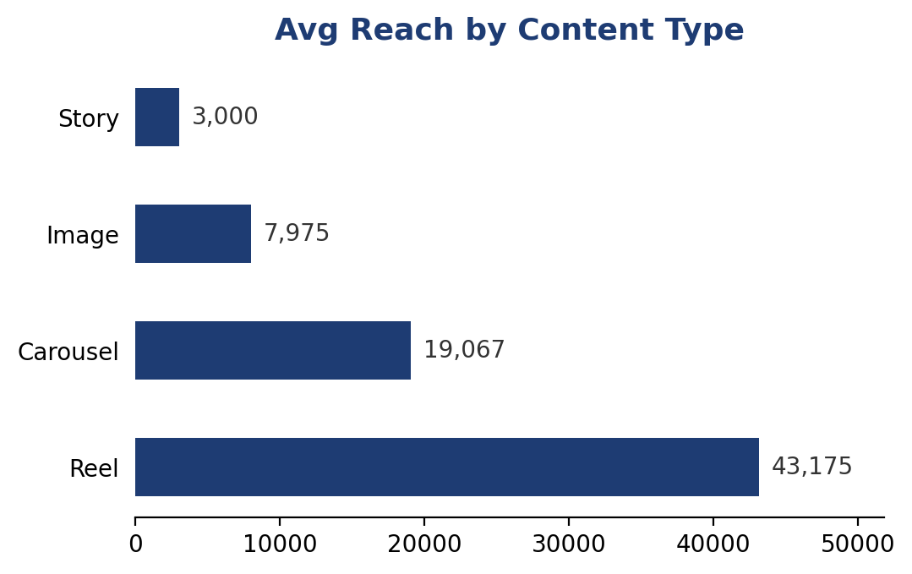
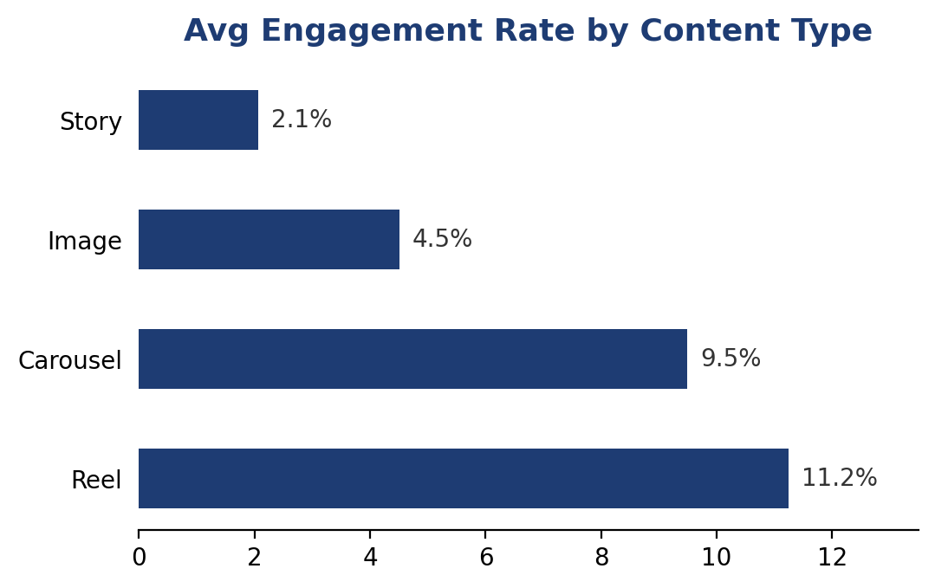
Instagram Performance
20
Posts
497,700
Total Reach
8.45%
Avg Engagement Rate

Slide 4
Top Performing Instagram Posts
Date | Type | Caption | Reach | Eng. Rate
2026-03-19 | Reel | Wait for the cheese pull at the end. You're welcome. | 50,000 | 12.7%
2026-03-15 | Reel | Three words: truffle. parmesan. fries. | 45,200 | 12.59%
2026-03-24 | Reel | The sound of our fresh pasta being made is pure ASMR | 41,000 | 11.39%
2026-03-28 | Reel | This reel took 6 hours to film and 30 seconds to eat. Story of our lives | 44,800 | 11.37%
2026-03-01 | Reel | New drop alert! Our spicy mango salsa is here and your taste buds aren't ready | 48,500 | 10.81%

Slide 5
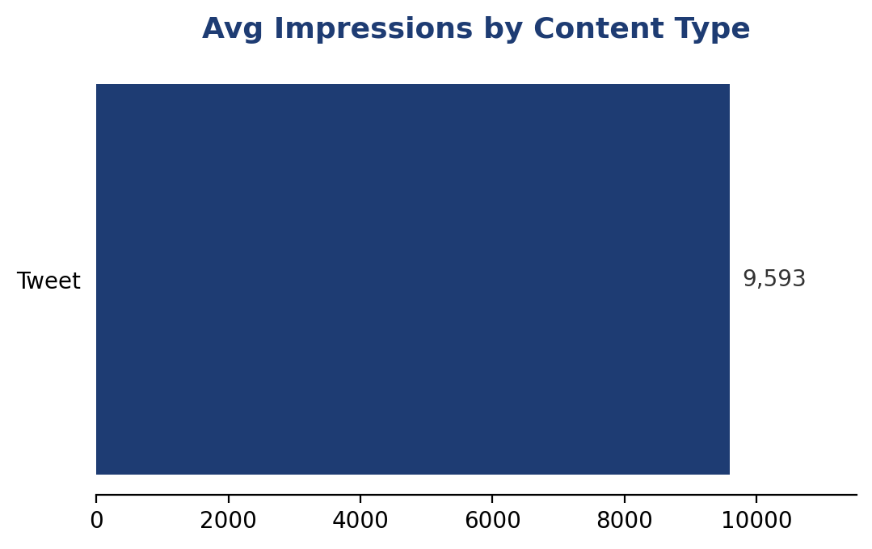
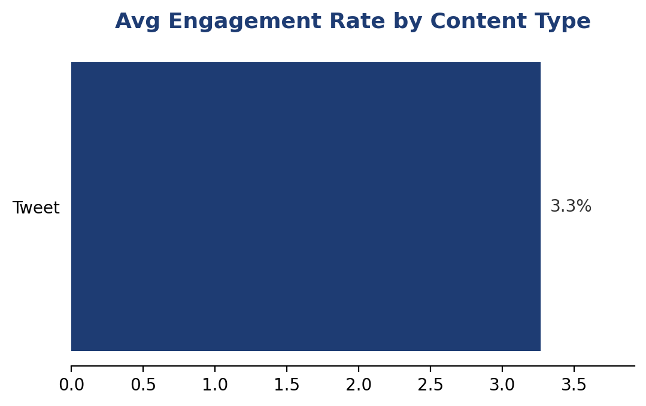
X (Twitter) Performance
15
Tweets
143,900
Total Impressions
3.27%
Avg Engagement Rate

Slide 6
Top Performing X Posts
Date | Tweet Preview | Impressions | Eng. Rate
2026-03-08 | Retweet if you've ever eaten an entire burrito bowl in under 5 minutes. No judgment. | 11,200 | 4.6%
2026-03-03 | Unpopular opinion: pineapple on pizza is elite and we will die on this hill | 15,000 | 4.5%
2026-03-10 | The truffle fries are back. This is not a drill. | 14,200 | 4.4%
2026-03-18 | Our new summer menu drops Monday. Here's a sneak peek. | 13,500 | 4.0%
2026-03-07 | Our secret menu is no longer a secret. Link in bio for the full list. | 9,800 | 4.0%

Slide 7
Key Insights
Reels drove the highest average engagement at 11.2%
Sunday was the strongest posting day with 34,950 average reach
The top post reached 50,000 people with 12.7% engagement
Instagram generated 497,700 total reach across 20 posts
X generated 143,900 impressions across 15 tweets
Space for additional notes

Slide 8
Thank You
Prepared by TNT
Report generated by Ascnd ReportEngine
Mar 1 - Mar 28, 2026

