Slide 1
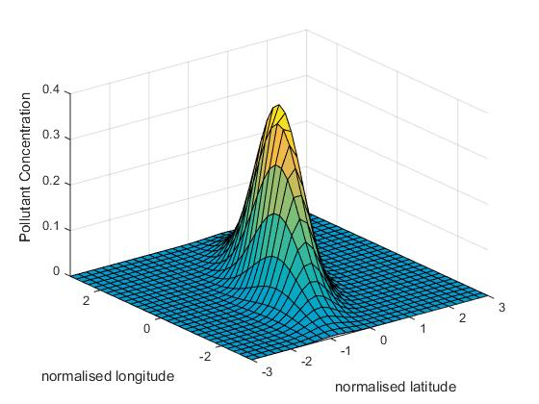

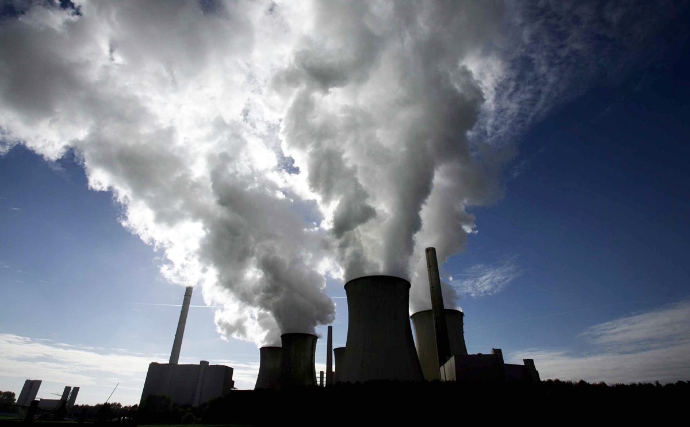
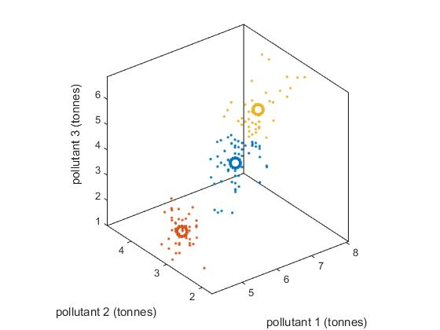
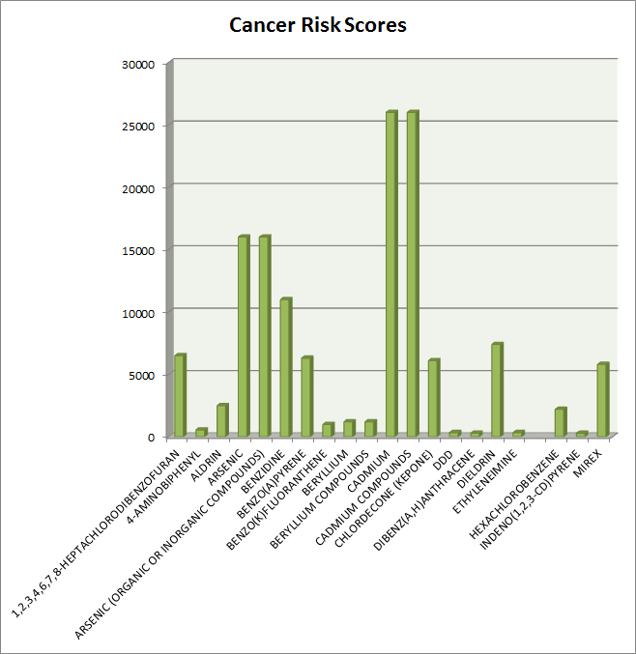
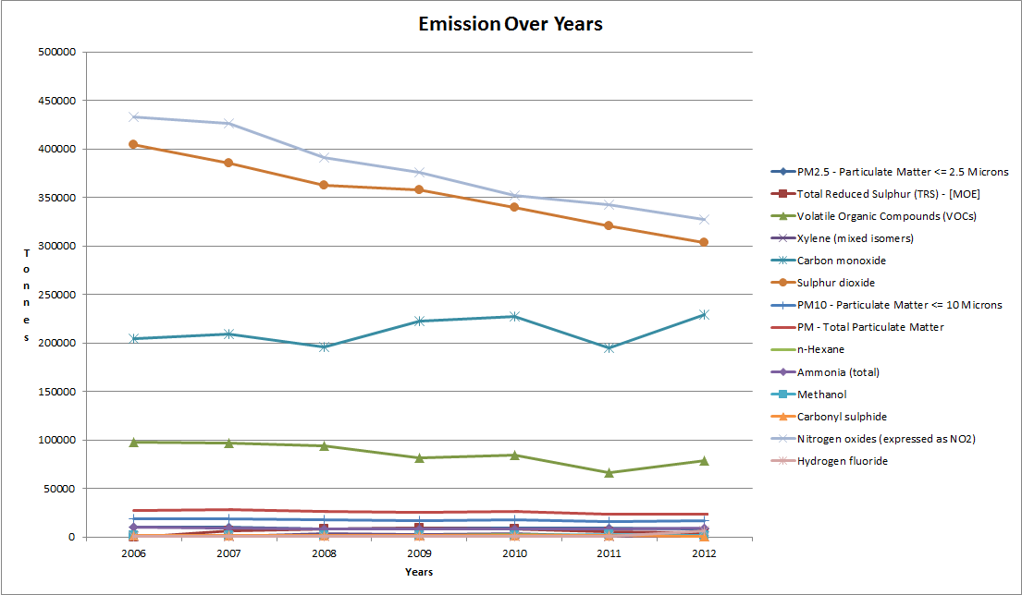
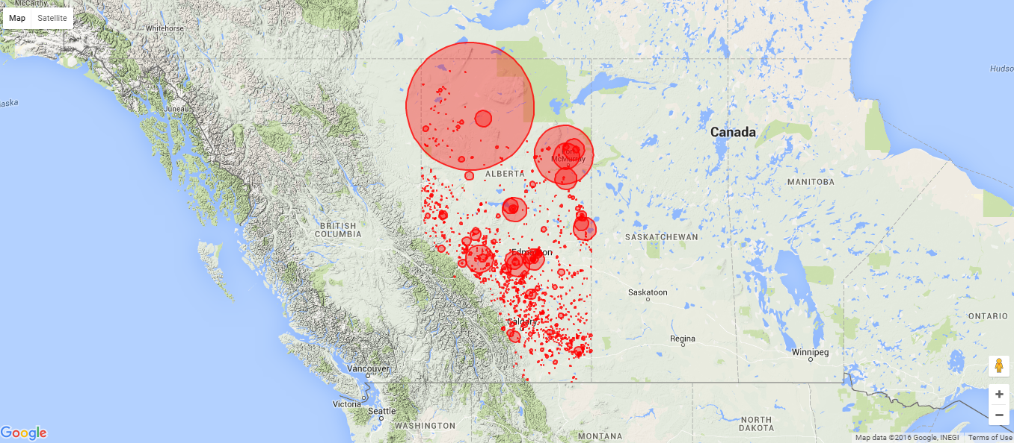

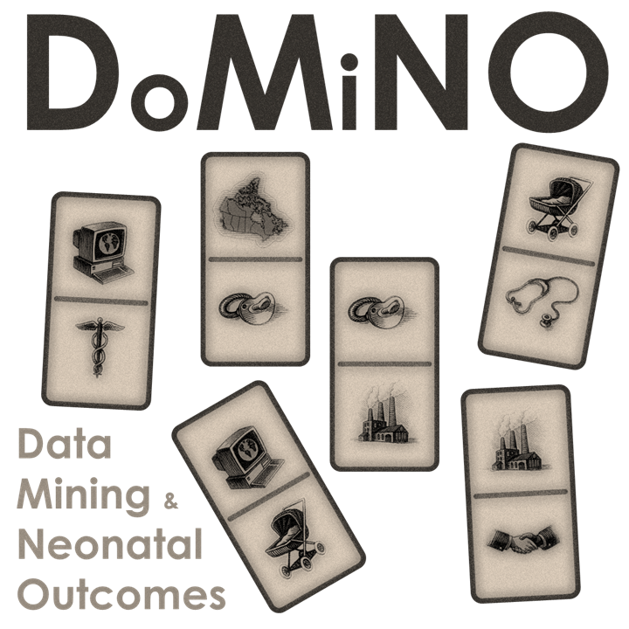
Mapping Cancer Incidence in Children to Carcinogenic Emissions in Canada
Keerthana P G¹, Jesus Serrano Lomelin², Alvaro A R Osornio²
¹Indian Institute of Technology, Kharagpur, India, ²University Of Alberta, Edmonton, Canada
INTRODUCTION
ESTIMATING POLLUTION
IDENTIFYING MIXTURES
Estimating pollution levels across the province requires us to accurately project reported emissions. A number of statistical distributions have been recommended in literature, more commonly lognormal[1] and gamma[2].
Identifying prominent mixtures in the emission data helps us reduce its dimensionality making way for easier understanding and computation. One approach to this end is to calculate high mutual correlations, or a PCA (Principal Component Analysis). However, this approach is limited by its inability to account for non-linear associations in the data. A second approach is to do cluster analysis in multidimensional space to observe the prominent mixtures emitted.
From 2006 to 2012, a total of 111 chemicals were emitted. So each facility has a emission vector of 111 values for each year. The emission vectors are then clustered in this 111-dimension space.
Air pollution is known to be associated with adverse birth outcomes (ABOs) and cancer in children.
ABOs are classified under three categories: Pre-term birth (PTM), Small for Gestational Age (SGA) and Low Birth Weight (LBW). They are assumed to be a consequence of maternal and environmental variables.
This study concerns with air pollution from industrial sources in the Alberta province and their associated health effects. Emission data is sourced from the National Pollution Register Inventory and the identified health effects of chemicals are sourced from Scorecard, P65 and International Agency for Research in Cancer (IARC) databases.
The project has four objectives:
Exploratory data characterization
Identifying major mixtures emitted by industrial facilities
Estimating pollutant concentration across the province
Developing data visualization tools to perceive trends in emission, pollution, cancer and ABO statistics
GRAPHIC
GRAPHIC
A schematic plot of skewed multivariate normal
For this study, we divided the province of Alberta into grids of 3 km by 3km. We estimated the toxic potential equivalent of emissions of each facility in each year. Using the coordinates of the emission source, we intend to use a multivariate normal distribution to estimate toxic equivalent concentration at each grid point. This would help us identify locations were pollutant concentration are beyond tolerable limit and take necessary steps to curb adverse health outcomes.
Image source: afreebirdorganization.tumblr.com
Image source: www.scmp.com
EXPLORATORY DATA ANALYSIS
DATA VISUALISATION TOOLS
The average emission of 83% facilities over the years could be simplified to a mixture of 340.12 tonnes of Carbon and 352.06 tonnes of Nitrogen oxides.
We intended to characterize the large amount of data sourced from emissions and related developmental health effects data bases from 2006 to 2012 and study the trends using exploratory data analytic methods.
Currently, there’s a lack of data visualization tools or iterative map generators for cancer incidence, adverse birth outcome statistics or emissions in Alberta. Under this task, we hope to build the Alberta Cancer and ABOs Atlas and Alberta Pollution and Emission Data Visualizer. These will be web application with interactive maps built using open source technologies such as D3.js.
Map showing CO emission in 2006
REFERENCES
[1]- Kan, H, -D, Chen, .B, -H, “Statistical distributions of ambient air pollutants in Shanghai, China”, Scopus Biomedical and Environmental Sciences, Volume 17, Issue 3, September 2004, Pages 366-372
[2]- P. E. Oguntunde, O. A. Odetunmibi, and A. O. Adejumo, “A Study of Probability Models in Monitoring Environmental Pollution in Nigeria,” Journal of Probability and Statistics, vol. 2014, Article ID 864965, 6 pages, 2014. doi:10.1155/2014/864965
Notes:
Under data visualization you talk about cancer but your introduction is about ABO. Clarify

