Slide 1

Analysis of GOT’s Twitter Dataset
By Akarsh Kancharla & Keerthan Vudutha
April 1^{st,} 2012

Slide 2

Introduction
Goal : To analyse the Game of Thrones Twitter dataset to see how the audience have received the final season of the show.
Datasets Used :
Game of thrones twitter dataset from Kaggle
Critic reviews dataset from Rotten Tomatoes site
Bag of positive and negative words as a text file
Tools:
MongoDB to store the datasets
Python to run the queries (PyMongo)

Slide 3
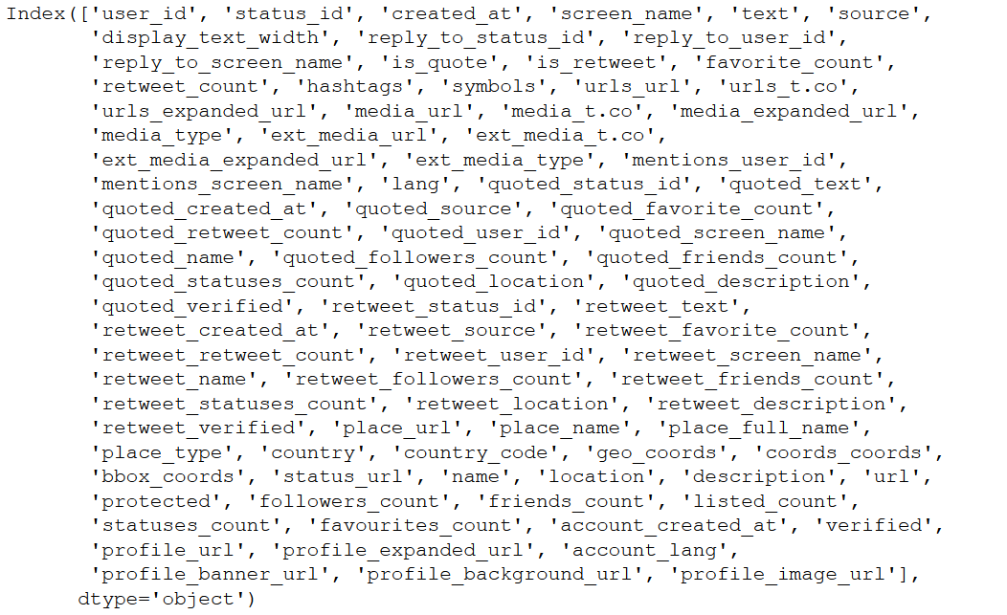

Collection 1
The first Collection has the fields shown in the figure

Slide 4
Collection 2
Scrapped from the RottenTomatoes website:
https://www.rottentomatoes.com/tv/game_of_thrones/s08

Slide 5
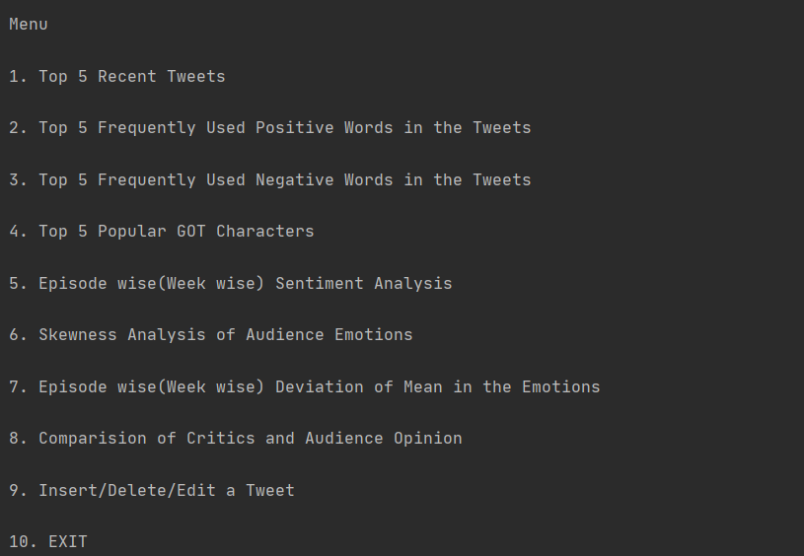
User Interface

Slide 6
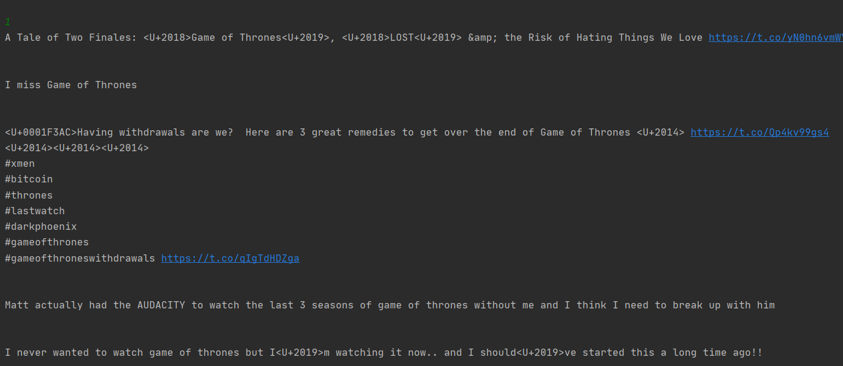
Top 5 Recent Tweets
Arrange the tweets in non-ascending order by using date and time
And return the text of only top 5 tweets from the collection

Slide 7
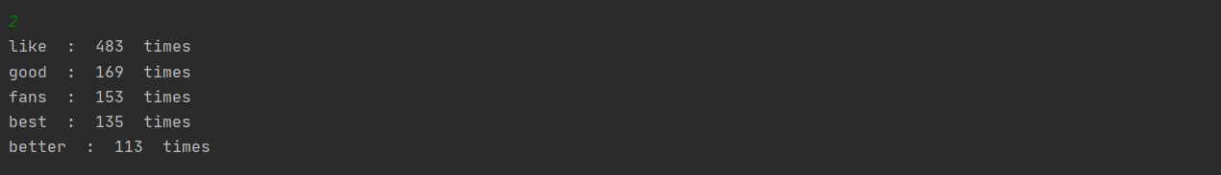
Top 5 Frequently Used Positive Words in the Tweets
Get a bag of positive words from a text file, put those words into a data structure
Compare all the tweets with the words in data structure and if matched increase the count for that word
Return the top 5 words with highest count

Slide 8
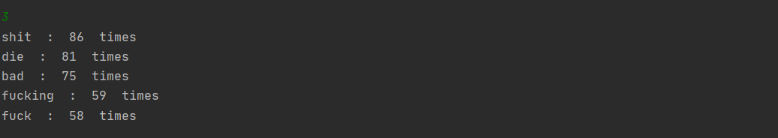
Top 5 Frequently Used Negative Words in the Tweets
Get a bag of negative words from a text file, put those words into a data structure
Compare all the tweets with the words in data structure and if matched increase the count for that word
Return the top 5 words with highest count

Slide 9
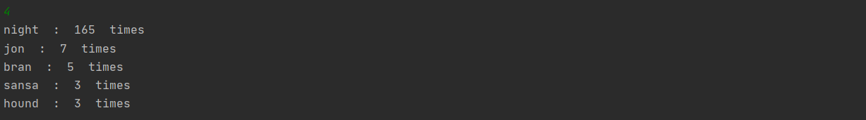
Top 5 Popular GOT Characters
Get a list of characters into a data structure
Compare all the tweets with the character in data structure and if matched increase the count for that word
Return the top 5 characters with highest count

Slide 10
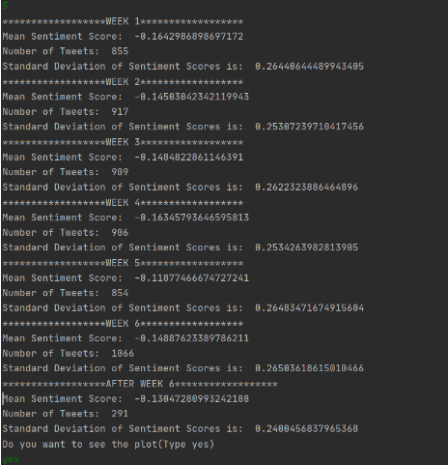
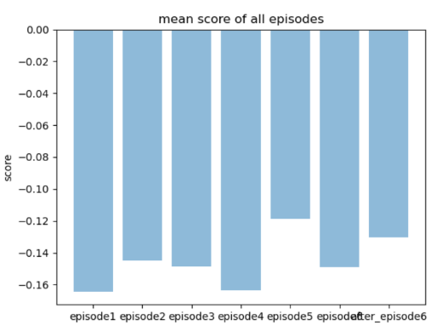
Episode wise(Week wise) Sentiment Analysis
Calculate sentiment score for all tweets
Group the tweets on episode basis and find the mean of sentiment scores for each episode
Return the mean values of each episode and plot them on bar graph

Slide 11
Skewness analysis of Audience Emotions
Calculate sentiment score for all tweets
Group them on episode basis
Calculate mean of sentiment scores for each episode
Calculate and return skewness of entire data by using the mean value for each episode.

Slide 12
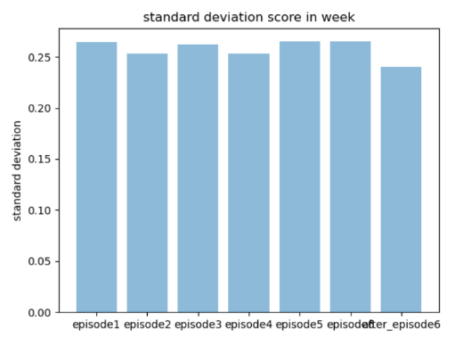
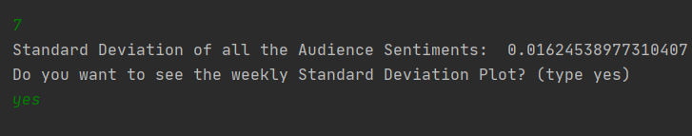
Episode wise(Week wise) Deviation of Mean in the Emotions
Calculate sentiment score for all tweets
Return standard deviation of all tweets
Group the sentiment value of all tweets on episode basis
Calculate standard deviation of each episode
And plot the deviation value for each episode values on bar graph

Slide 13
Comparison of Critics and Audience Opinion
Calculate sentiment score of audiences tweets for every episode from collection 1
Calculate sentiment score of critics reviews for every episode from collection 2
Find and return correlation between the calculated sentiment scores of audience tweets and calculated sentiment scores of critics reviews

Slide 14
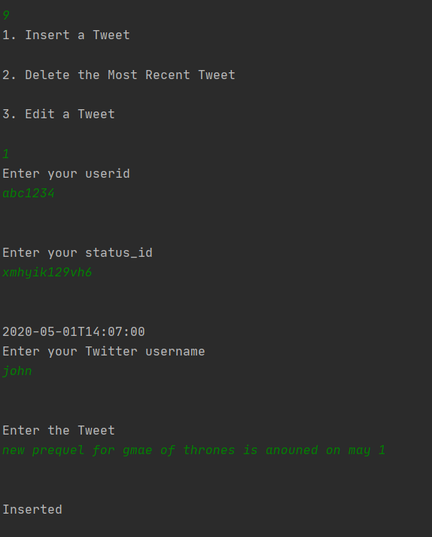
Insert a Tweet
Take user_id, status_id, username, text as inputs from user
Get current date from system and use it as input
Using above inputs inserting a tweet
insert a document into
collection 1

Slide 15
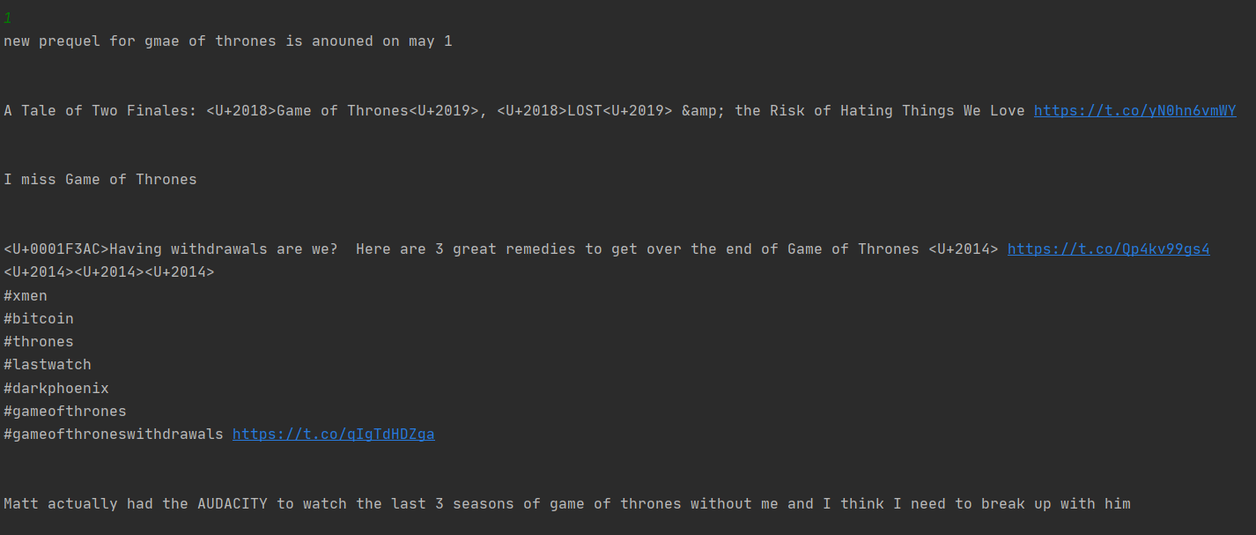
Recent tweets before insertion
Recent tweets after insertion

Slide 16
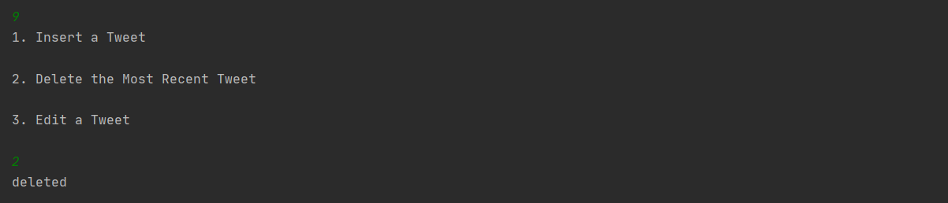
Delete Recent Tweet
Sort the tweets in non-ascending order
Find the most recent tweet in a collection
Delete that tweet from the collection
Deleting a tweet

Slide 17
Recent tweets before deletion:
Checking recent tweets: previously inserted tweet got deleted

Slide 18
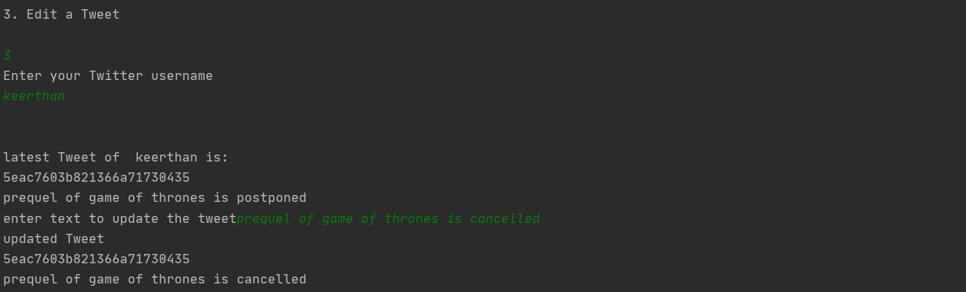
Edit Recent Tweet of a user
Take username as input
Sort tweets with that username in non-ascending order of date and time
Find the recent tweet and display the text
Take text as input, use the input to edit the text
Make the changes and save into databases
Editing:

Slide 19
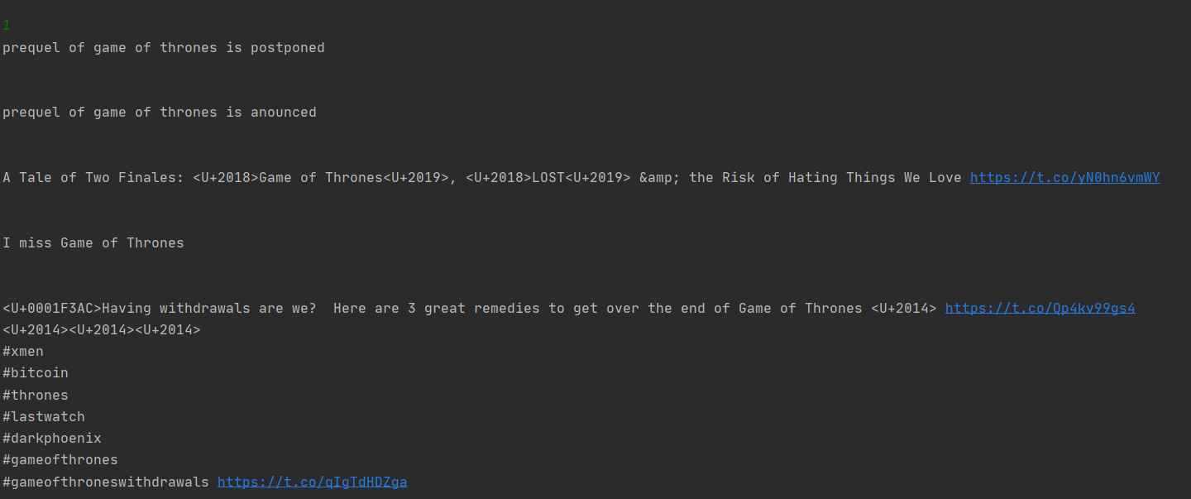
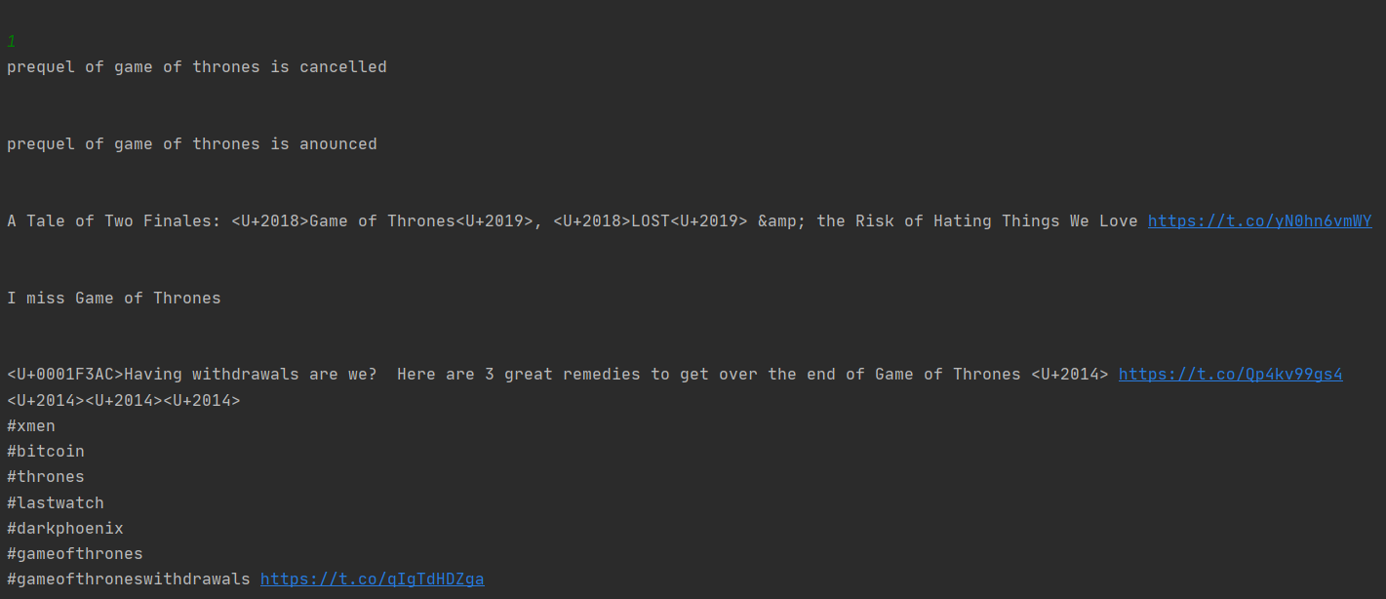
Recent tweets before Editing a tweet:
Recent tweets after editing: tweet got updated

Slide 20
References
[1] The Dataset is obtained from the following source on the internet https://www.kaggle.com/monogenea/game-of-thrones-twitter.
[2] Bag of positive, negative words are taken from https://github.com/jeffreybreen/twitter-sentiment-analysis-tutorial-201107/tree/master/data/opinion-lexicon-English
[3] Critics reviews for Game of Thrones final season are collected from
https://www.rottentomatoes.com/tv/game_of_thrones/s08
[4] https://api.mongodb.com/python/current/tutorial.html

Slide 21


