Slide 1

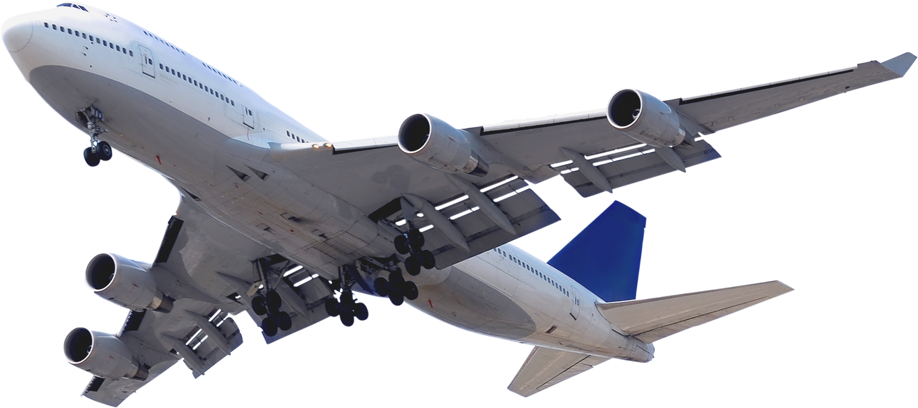

Flight
Delay
Analysis

Slide 2


INTRODUCTION
In our fast-paced world, air travel has become an indispensable part of modern life. However, flight delays can disrupt travel plans and create challenges for passengers, airlines, and airports alike. Understanding the causes and patterns of flight delays is key to enhancing the overall air travel experience and identifying areas for improvement.

Slide 3
this project is to perform a comprehensive Data Analysis using a vast dataset of flight information. Our primary focus is to gain insights into flight delay patterns, ultimately shedding light on the dynamics of air travel.
OBJECTIVE

Slide 4




PROCESS
DATA HANDLING
DATA PREPROCESSING
DATA ANALYSIS
PERFORMANCE OPTIMIZATION

Slide 5
DATA
HANDING
schema presentation
highlighting the number of null values and duplicates
ensuring data consistency

Slide 6
DATA PREPROCESSING
- Converting the "Flight_Date" from a string type to a date type.
- Creating a new column, "TotalDelay," to compute the total delay for each flight by summing "DepDelay" and "ArrDelay."
- Introducing a "Carrier Name" column to map the carrier shortcuts to their full names.
- Creating a new column, "TotalDelay," to compute the total delay for each flight by summing "DepDelay" and "ArrDelay."
- Introducing "Origin_City" and "Dest_City" columns to map airport city shortcuts to full city names.

Slide 7
DATA
ANALYSIS
What is the average delay time for each airline?
Which are the top 10 airlines with the most delay time?
What is the most common cause of delays?
How does distance relate to delay time?
Which airport experiences the highest flight volume?
What is the average delay time by day of the week?
What is the average delay time by month?

Slide 8


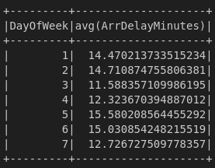
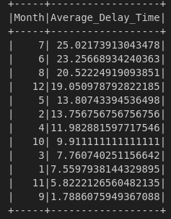
Busiest Airport
Most Delay Time
INSIGHTS
Average delay time by DayOfMonth
Most average delay time by month

Slide 9
PERFORMANCE OPTIMIZATION
Data Sampling:
Given resource constraints, we extract a sample of the dataset using a fraction ratio.
Data Partitioning:
To enhance parallel processing, the number of partitions is increased from 6 to 10.
Caching:
After numerous data transformations, the final DataFrame is cached to improve processing efficiency.
Memory Management:
Driver and executor memory are specified to optimize resource utilization.

Slide 10
This Presentation highlights my approach and methodologies for a comprehensive Flight Delay Analysis, providing valuable insights into the world of air travel.
CONCLUSION

