Slide 1



Lecture 8
Chapter 2. Basic Structures
  Sets
  Set Operations
8-<number>

Slide 2


2.1 Sets
 A set is a new type of structure, representing an unordered collection (group) of zero or more distinct (different) objects. The objects are called elements or members of the set.
 Notation: x ∈ S
 Set theory deals with operations between, relations among, and statements about sets.
 Sets are ubiquitous in computer software systems.
 (E.g. data types Set, HashSet in java.util)
7-<number>

Slide 3

Basic Notations for Sets
 For sets, we’ll use variables S, T, U,…
 We can denote a set S in writing by listing all of its elements in curly braces:
 {a,b,c} is the set whose elements are a, b, and c
 Set builder notation:
 For any statement P(x) over any domain,
{x | P(x)} is the set of all x such that P(x) is true
 Example: {1, 2, 3, 4}
= {x | x is an integer where x > 0 and x < 5 }
= {x∈Z | x > 0 and x < 5 }
7-<number>

Slide 4

Basic Properties of Sets
 Sets are inherently unordered:
 No matter what objects a, b, and c denote,
{a, b, c} = {a, c, b} = {b, a, c} =
{b, c, a} = {c, a, b} = {c, b, a}.
 All elements are distinct (unequal); multiple listings make no difference!
 If a = b, then {a, b, c} = {a, c} = {b, c} =
{a, a, b, a, b, c, c, c, c}.
 This set contains (at most) 2 elements!
7-<number>

Slide 5

Definition of Set Equality
 Two sets are declared to be equal if and only if they contain exactly the same elements.
 In particular, it does not matter how the set is defined or denoted.
 Example:
The set {1, 2, 3, 4}
= {x | x is an integer where x > 0 and x < 5}
= {x | x is a positive integer where x² < 20}
7-<number>

Slide 6

Infinite Sets
 Conceptually, sets may be infinite
(i.e., not finite, without end, unending).
 Symbols for some special infinite sets:
N = {0, 1, 2,…} the set of Natural numbers.
Z = {…, –2, –1, 0, 1, 2,…} the set of Zntegers. Z⁺ = {1, 2, 3,…} the set of positive integers.
Q = {p/q | p,q ∈ Z, and q ≠ 0}
the set of Rational numbers.
R = the set of “Real” numbers.
 “Blackboard Bold” or double-struck font is also often used for these special number sets.
7-<number>

Slide 7

Basic Set Relations
 x∈S (“x is in S”) is the proposition that object x
is an ∈lement or member of set S.
 e.g. 3 ∈ N,
a ∈ {x | x is a letter of the alphabet}
 Can define set equality in terms of ∈ relation:
∀S,T: S = T ↔ [∀x (x∈S ↔ x∈T)]
“Two sets are equal iff they have all the same members.”
 x∉S ≡ ¬(x∈S) “x is not in S”
8-<number>

Slide 8

The Empty Set
 ∅ (“null”, “the empty set”) is the unique set that contains no elements whatsoever.
 ∅ = { } = {x | False}
 No matter the domain of discourse, we have the axiom ¬∃x: x∈∅.
 { } ≠ {∅} = { { } }
 {∅} it isn’t empty because it has ∅ as a member!
8-<number>

Slide 9

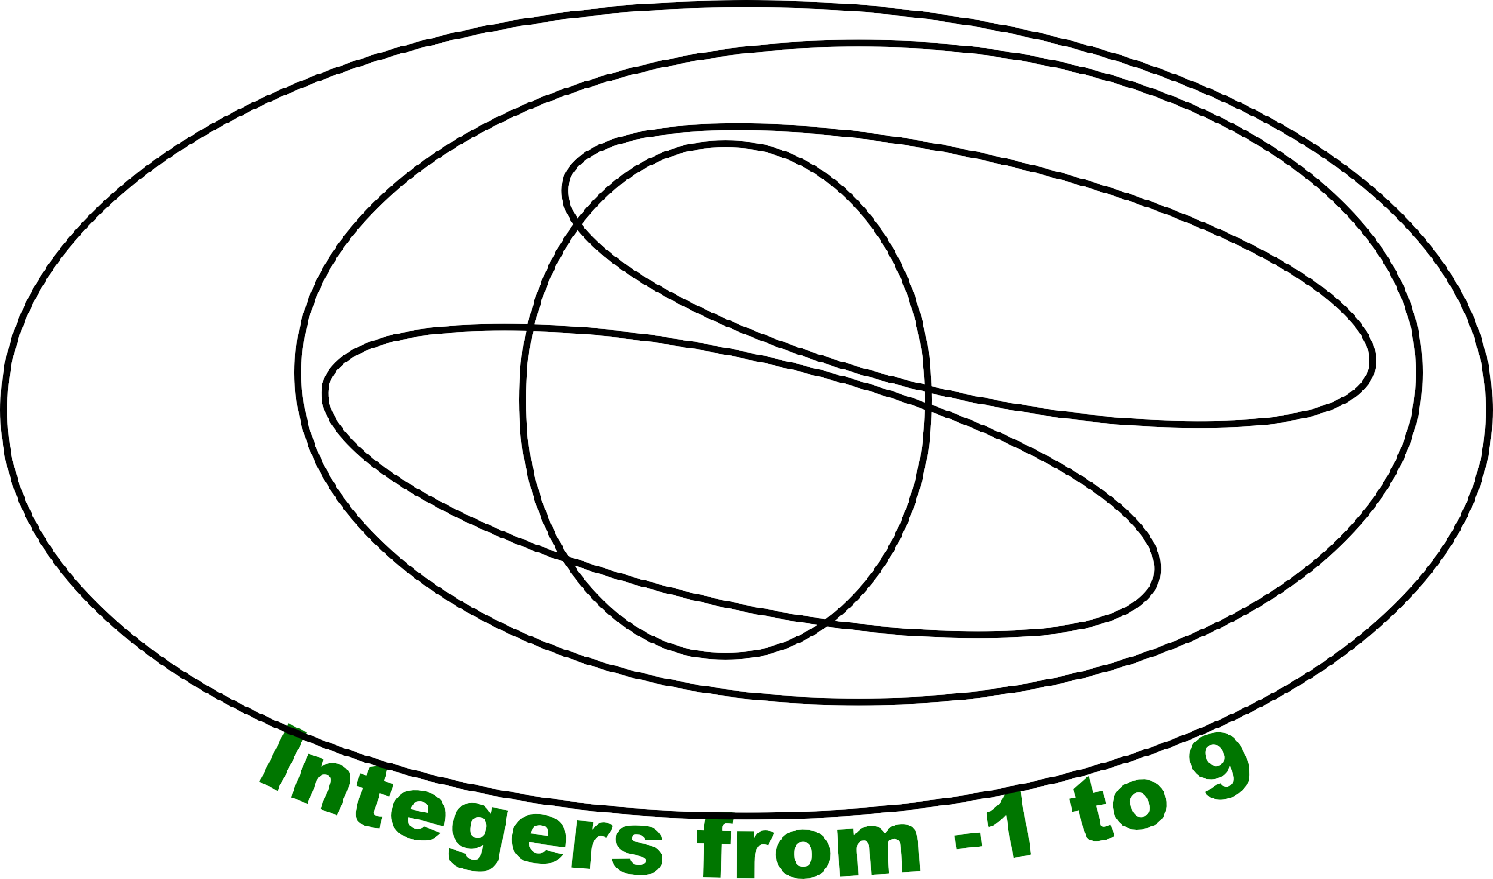



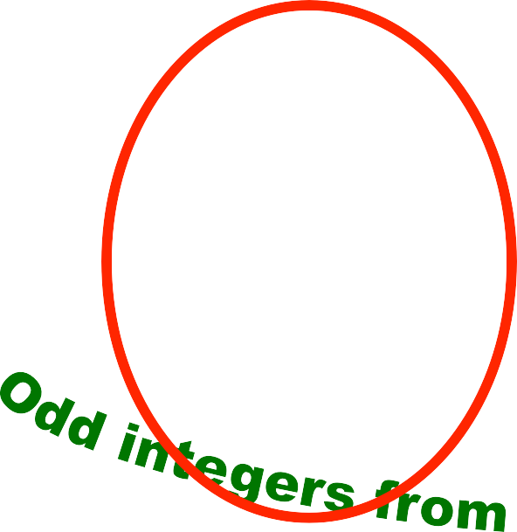































































































Venn Diagrams
U
8-<number>

Slide 10

Subset and Superset
 S⊆T (“S is a subset of T ”) means that every element of S is also an element of T.
 S⊆T ≡ ∀x (x∈S → x∈T)
 ∅⊆S, S⊆S
 S⊆T (“S is a superset of T ”) means T⊆S
 Note (S = T) ≡ (S⊆T ∧ S⊆T)
≡ ∀x(x∈S → x∈T) ∧ ∀x(x∈T → x∈S)
≡ ∀x(x∈S ↔ x∈T)
 S⊆T means ¬(S⊆T), i.e. ∃x(x∈S ∧ x∉T)
8-<number>

Slide 11
Proper (Strict) Subsets &
Supersets
 S⊂T (“S is a proper subset of T ”) means that
S⊆T but T⊆S. Similar for S ⊃T.
 Example:
{1, 2} ⊂ {1, 2, 3}
S
T
Venn Diagram of S⊂T
8-<number>

Slide 12


Sets Are Objects, Too!
 The objects that are elements of a set may
themselves be sets.
 Example:
Let S = {x | x ⊆ {1, 2, 3}} then S = { ∅,
{1}, {2}, {3},
{1, 2}, {1, 3}, {2, 3},
{1, 2, 3} }
 Note that 1 ≠ {1} ≠ {{1}} !!!!
8-<number>

Slide 13

Cardinality and Finiteness
 |S| (read “the cardinality of S”) is a measure of how many different elements S has.
 E.g., |∅| = 0, | {1, 2, 3} | = 3, | {a, b} | = 2,
| { {1, 2, 3}, {4, 5} } | =
 If |S| ∈ N, then we say S is finite.
Otherwise, we say S is infinite.
 What are some infinite sets we’ve seen?
N, Z, Q, R
8-<number>

Slide 14

The Power Set Operation
 The power set P(S) of a set S is the set of all subsets of S. P(S) = {x | x⊆S}.
 Examples
 P({a, b}) = { ∅, {a}, {b}, {a, b} }
 S = {0, 1, 2}
P(S) = {∅, {0}, {1}, {2}, {0, 1}, {0, 2}, {1, 2},
{0, 1, 2}}
 P(∅) = {∅}
 P({∅}) = {∅, {∅}}
 Note that for finite S, |P(S)| = 2^{|S|}.
 It turns out ∀S (|P(S)| > |S|), e.g. |P(N)| > |N|.
8-<number>

Slide 15

Ordered n-tuples
 These are like sets, except that duplicates matter, and the order makes a difference.
 For n∈N, an ordered n-tuple or a sequence or list of length n is written (a₁, a₂, …, a_{n}). Its first element is a₁, its second element is a₂, etc.
 Note that (1, 2) ≠ (2, 1) ≠ (2, 1, 1).
Contrast with sets’ {}
 Empty sequence, singlets, pairs, triples, quadruples, quintuples, …, n-tuples.
8-<number>

Slide 16

Cartesian Products of Sets
 For sets A and B, their Cartesian product denoted by A × B, is the set of all ordered pairs (a, b), where a∈A and b∈B. Hence,
A × B = { (a, b) | a∈A ∧ b∈B }.
 E.g. {a, b} × {1, 2}
= { (a, 1), (a, 2), (b, 1), (b, 2) }
 Note that for finite A, B, |A × B| = |A||B|.
 Note that the Cartesian product is not
commutative: i.e., ¬∀A,B (A × B = B × A).
 Extends to A₁ × A₂ × … × A_{n}
= {(a₁, a₂, …, a_{n}) | a_{i} ∈ A_{i} for i = 1, 2,…, n}
8-<number>

Slide 17

The Union Operator
 For sets A and B, their union A∪B is the set containing all elements that are either in A, or (“∨”) in B (or, of course, in both).
 Formally, ∀A,B: A∪B = {x | x∈A ∨ x∈B}.
 Note that A∪B is a superset of both A and B
(in fact, it is the smallest such superset):
∀A,B: (A∪B ⊆ A) ∧ (A∪B ⊆ B)
8-<number>

Slide 18










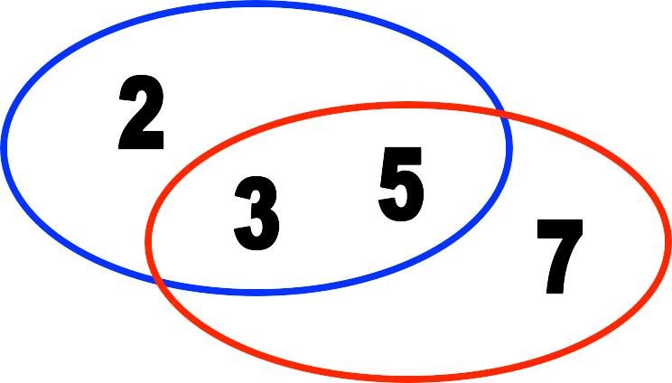
Union Examples
 {a, b, c} ∪ {2, 3} = {a, b, c, 2, 3}
 {2, 3, 5} ∪ {3, 5, 7} = {2, 3, 5, 3, 5, 7}
= {2, 3, 5, 7}
8-<number>

Slide 19

The Intersection Operator
 For sets A and B, their intersection A∩B is the set containing all elements that are simultaneously in A and (“∧”) in B.
 Formally, ∀A,B: A∩B = {x | x∈A ∧ x∈B}.
 Note that A∩B is a subset of both A and B (in fact it is the largest such subset):
∀A,B: (A∩B ⊆ A) ∧ (A∩B ⊆ B)
8-<number>

Slide 20
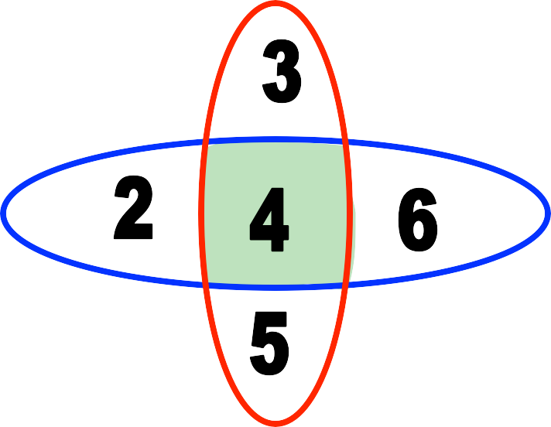
Intersection Examples
 {a, b, c} ∩ {2, 3} = ∅
 {2, 4, 6} ∩ {3, 4, 5} = {4}
Think “The intersection of University Ave. and Dole St. is just that part of the road surface that lies on both streets.”
8-<number>

Slide 21
Disjointedness
 Two sets A, B are called disjoint (i.e., unjoined) iff their intersection is empty. (A ∩ B = ∅)
Help, I’ve been disjointed!
 Example: the set of even integers is disjoint with the set of odd integers.
8-<number>

Slide 22

Inclusion-Exclusion Principle^{Un}
 How many elements are in A∪B?
|A∪B| = |A| + |B| - |A∩B|
 Example: How many students in the class major in Computer Science or Mathematics?
 Consider set E = C ∪ M,
C = {s | s is a Computer Science major}
M = {s | s is a Mathematics major}
 Some students are joint majors!
|E| = |C ∪ M| = |C| + |M| - |C ∩ M|
8-<number>

Slide 23

Inclusion-Exclusion Principle^{Uni}
 How many elements are in A∪B?
|A∪B| = |A| + |B| - |A∩B|
 Example: How many students in the class major in Computer Science or Mathematics?
 Consider set E = C ∪ M,
C = {s | s is a Computer Science major}
M = {s | s is a Mathematics major}
 Some students are joint majors!
|E| = |C ∪ M| = |C| + |M| - |C ∩ M|
8-<number>

Slide 24

Set Difference
 For sets A and B, the difference of A and B, written A - B, is the set of all elements that are in A but not B.
 Formally:
A - B = {x | x∈A ∧ x∉B}
= {x | ¬(x∈A → x∈B)}
 Also called:
The complement of B with respect to A.
8-<number>

Slide 25

Set Difference: Venn Diagram
 A − B
is what’s left after B “takes a bite out of A”
Chomp!
Set
A - B
Set A
Set B
8-<number>

Slide 26
Set Difference Examples
 {1, 2, 3, 4, 5, 6} - {2, 3, 5, 7, 9, 11} =
{1, 4, 6}
 Z - N = {… , −1, 0, 1, 2, … } - {0, 1, … }
= {x | x is an integer but not a natural #}
= {… , −3, −2, −1}
= {x | x is a negative integer}
8-<number>

Slide 27
Set Complements
 The universe of discourse (or the domain) can itself be considered a set, call it U.
 When the context clearly defines U, we say that for any set A ⊆ U, the complement of A, written as A, is the complement of A with respect to U, i.e., it is U - A.
 E.g., If U = N,
{3, 5} = {0,1, 2, 4, 6, 7,...}
8-<number>

Slide 28
More on Set Complements
 An equivalent definition, when U is obvious:
A ={x | x ∉ A}
A
A
A
U
8-<number>

Slide 29

Interval Notation
 a, b ∈ R, and a < b then
 (a, b) = {x ∈ R | a < x < b}
 [a, b] = {x ∈ R | a ≤ x ≤ b}
 (a, b] = {x ∈ R | a < x ≤ b}
 (–∞, b] = {x ∈ R | x ≤ b}
 [a, ∞) = {x ∈ R | a ≤ x}
 (a, ∞) = {x ∈ R | a < x}
8-<number>

